Slide 1
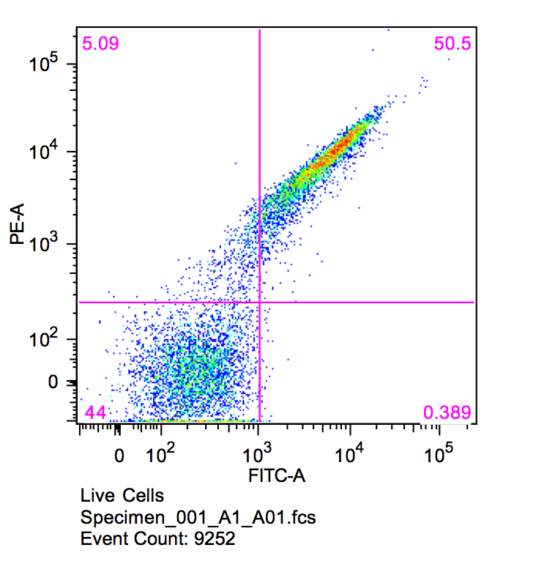
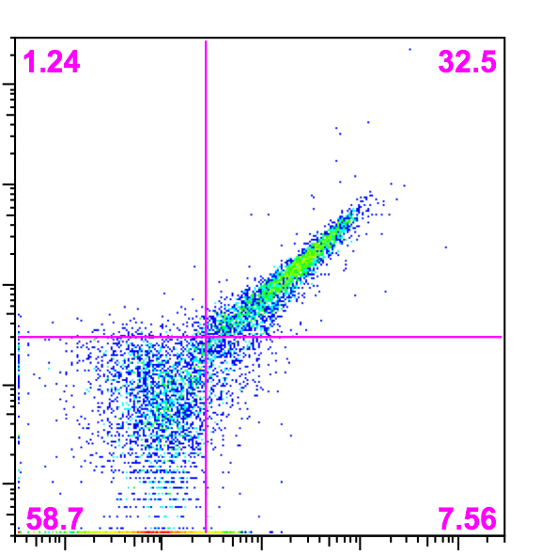
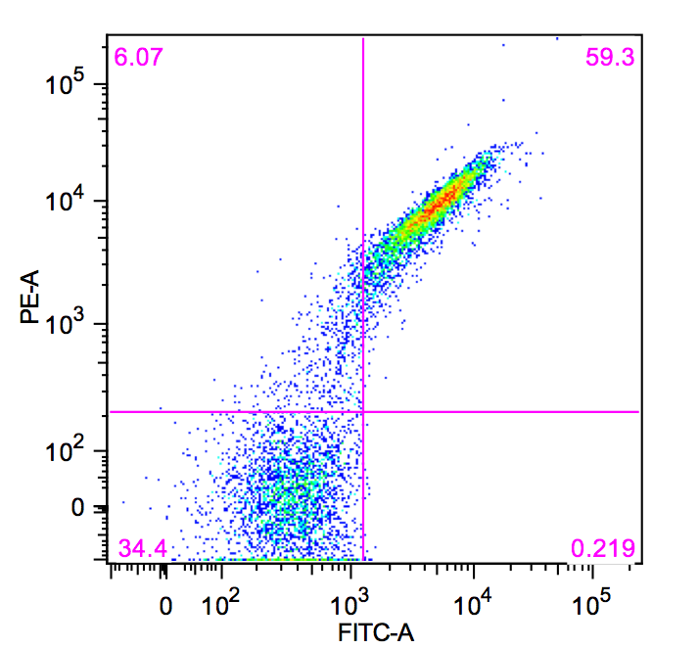
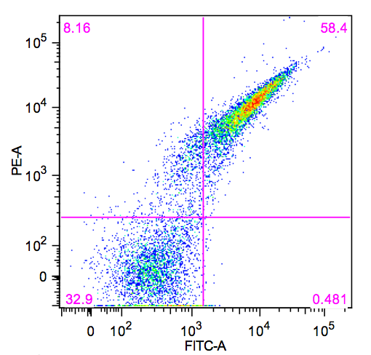
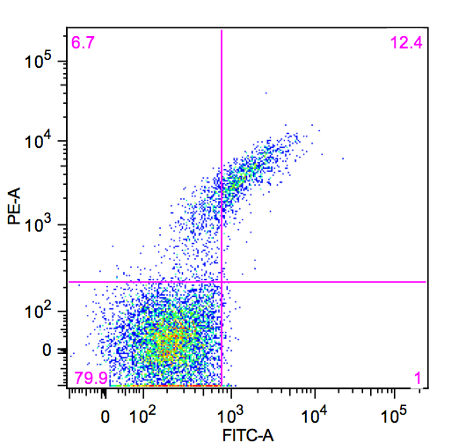
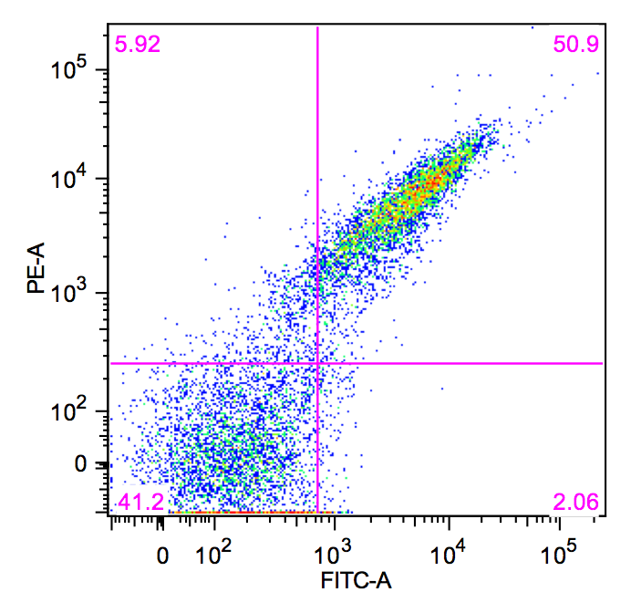
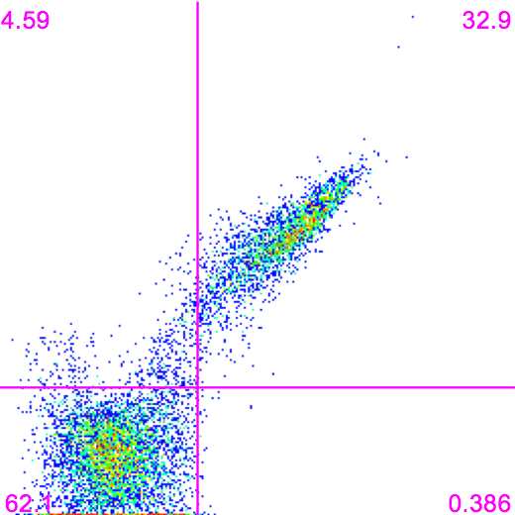
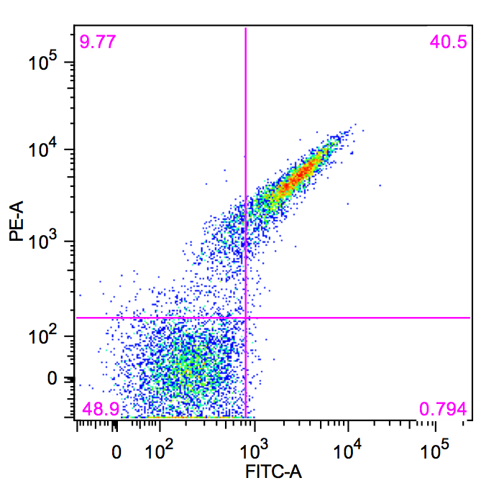
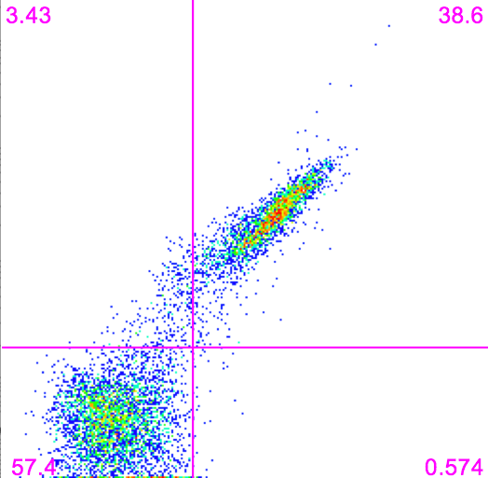
Supplemental Data
Surface Expression
1.24
32.5
I-AabMI
I-CpaMI
I-GpeMI
58.7
7.56
I-GzeII
I-LtrI
I-LtrWI
I-OnuI
I-PanMI
I-SmaMI
A plot of PE vs. FITC was examined for each wildtype enzyme to verify expression of full-length, stable protein on the surface of the yeast.

Slide 2
Notes regarding data for each enzyme on following pages:
The relative binding of each DNA target (WT and each mutated variant) is shown on the first page as raw flow cytometric data and on the 2nd page as bar graphs, with binding signal normalized relative to the WT DNA target for each enzyme. Target sites that are bound at 90+% of WT efficiency are indicated with arrows.
The extent of in vitro solution-based cleavage of purified DNA substrates (WT and each mutated variant) using recombinant or surface-released protein is illustrated on the next page as raw electrophoretic gels analyses, along with the percent of cleavage product formed for each substrate (also normalized relative to percent of cleavage of the WT DNA target for each enzyme).
The corresponding extent of cleavage of the same DNA substrates (WT and each mutated variant) using a tethered flow-based cytometric assay is tabulated below the corresponding in vitro-based cleavage percentages. The raw flow cytometric plots for each enzyme-substrate combination are shown on the final page.
The indication of cleavable DNA target site variants for each enzyme is provided in the same manner as in Figure 4. The WT DNA target is shown in blue bold font. DNA variants that are bound and cleaved at 90+% efficiency of the WT target are shown in black bold font with a black arrow. DNA variants that display deficiencies in DNA binding and in activity in in vitro cleavage assays, but are rescued by tethering, are indicated with grey arrows and one asterisk (“ * ”). DNA variants that are bound tightly, but appear to be cleaved less efficiently than WT, are indicated with grey arrows and two asterisks (“ ** ”).
Figure 4 in the main text summarizes the results of these experiments.

Slide 3
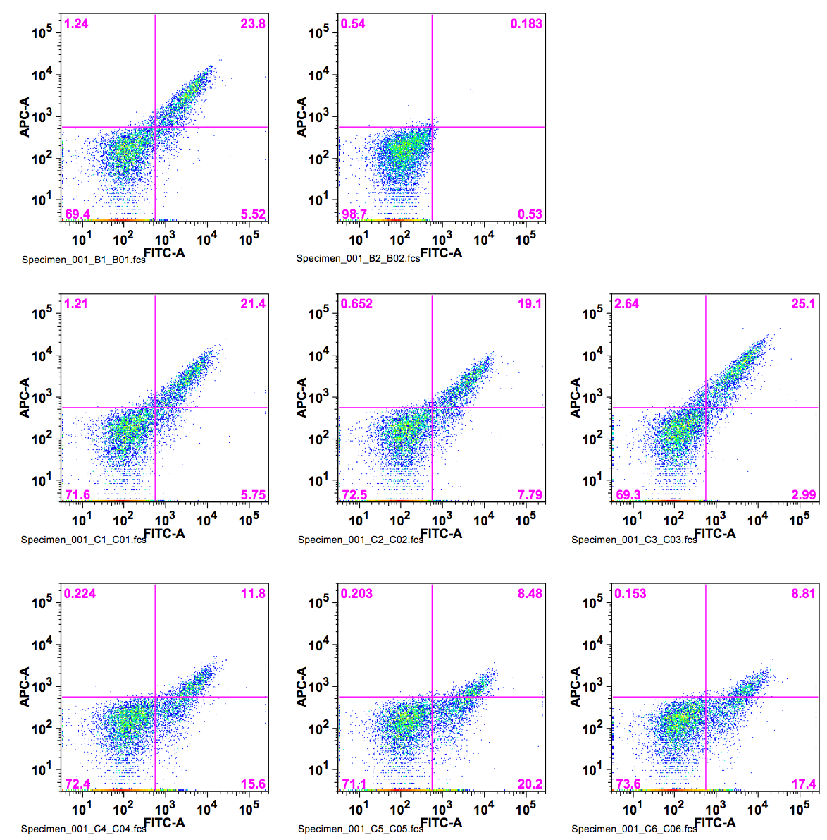
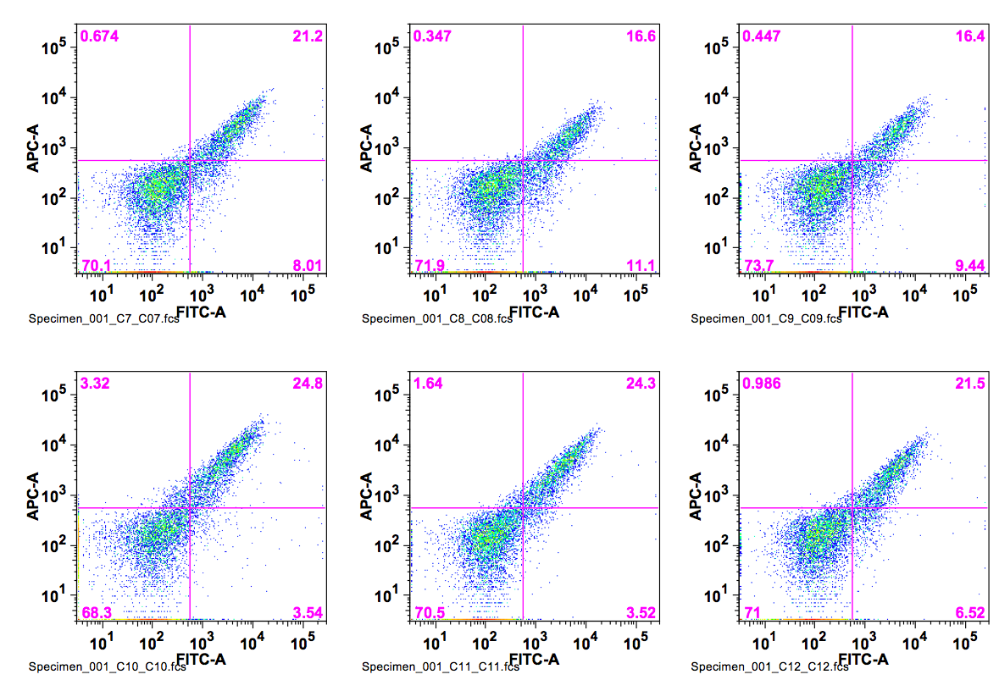
I-AabMI
wt TTAA
Binding
400pM DNA substrate
ATAA
CTAA
GTAA
TAAA
TCAA
TGAA
TTTA
TTCA
TTGA
TTAT
TTAC
TTAG

Slide 4
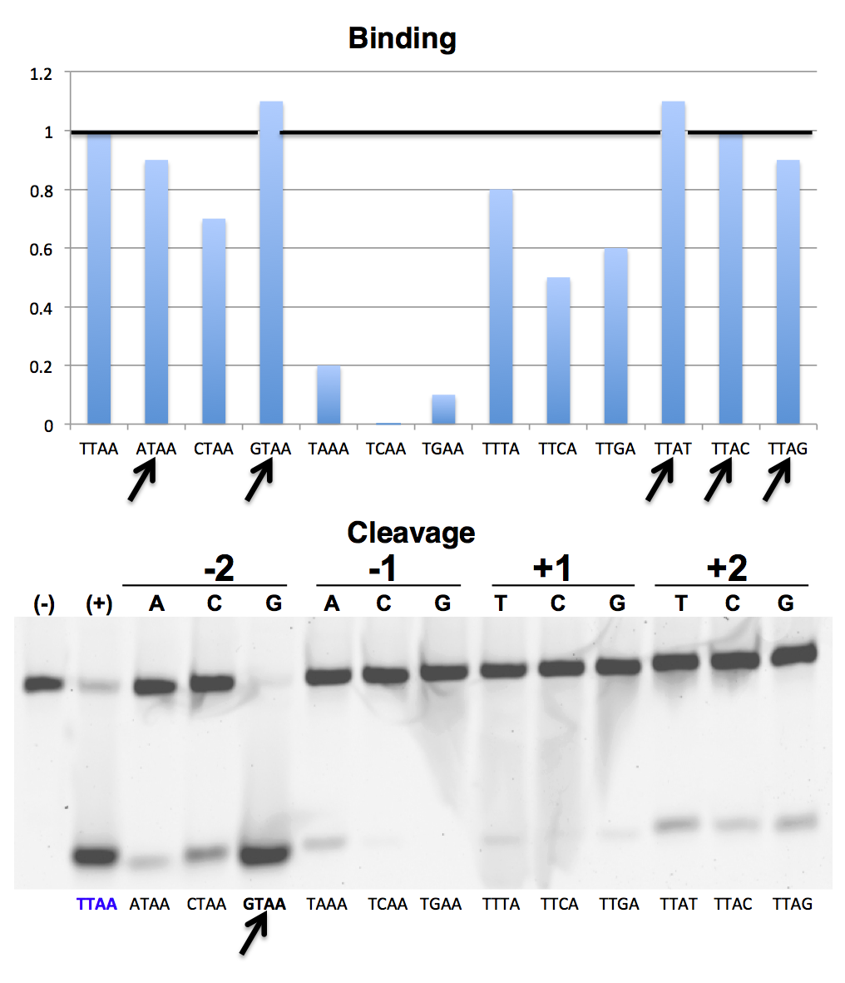
I-AabMI
TTAT | ATAA | CTAA | GTAA | TAAA | TCAA | TGAA | TTTA | TTCA | TTGA | TTAT | TTAC | TTAG
In-Vitro | 15% | 37% | 112% | 12% | 3% | 0% | 8% | 6% | 6% | 24% | 15% | 23%
Tethered-Flow | 6% | 20% | 106% | 26% | 3% | 0% | 6% | 3% | 3% | 11% | 3% | 3%

Slide 5
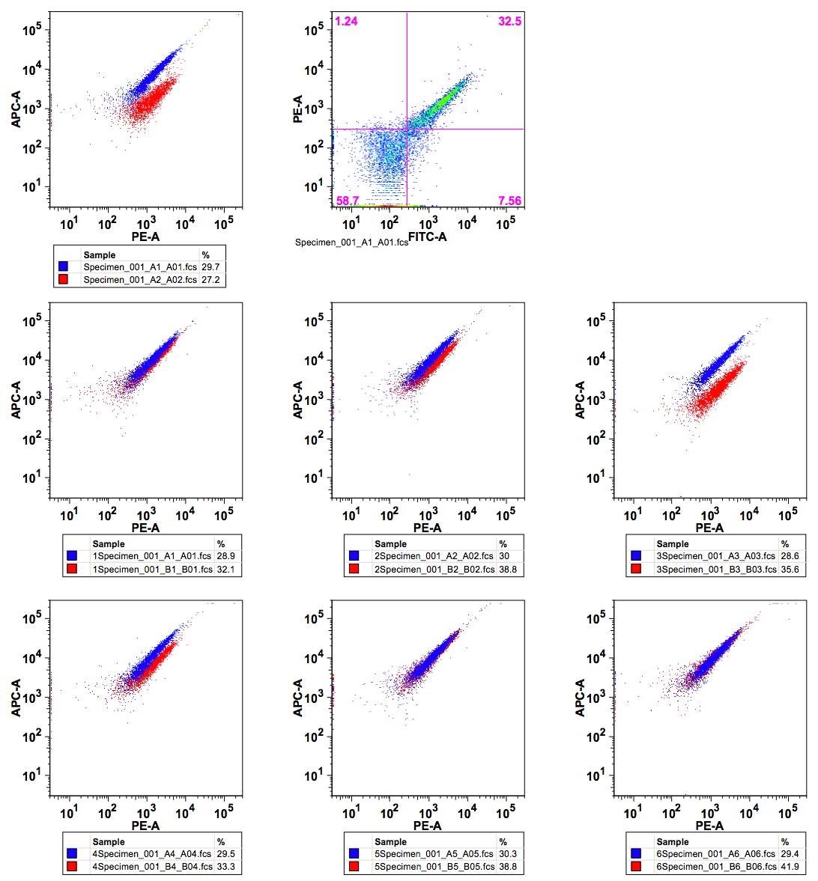
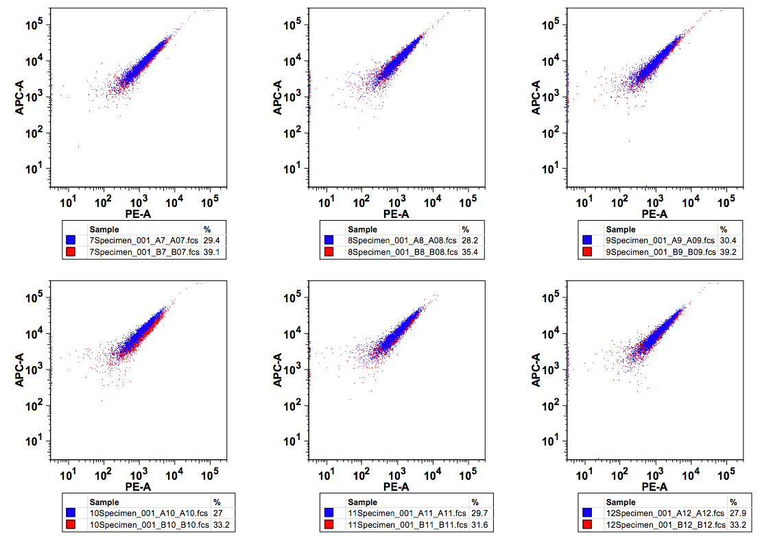
I-AabMI
Tethered Cleavage Activity
wt TTAA
ATAA
CTAA
GTAA
TAAA
TCAA
TGAA
TTTA
TTCA
TTGA
TTAT
TTAC
TTAG

Slide 6
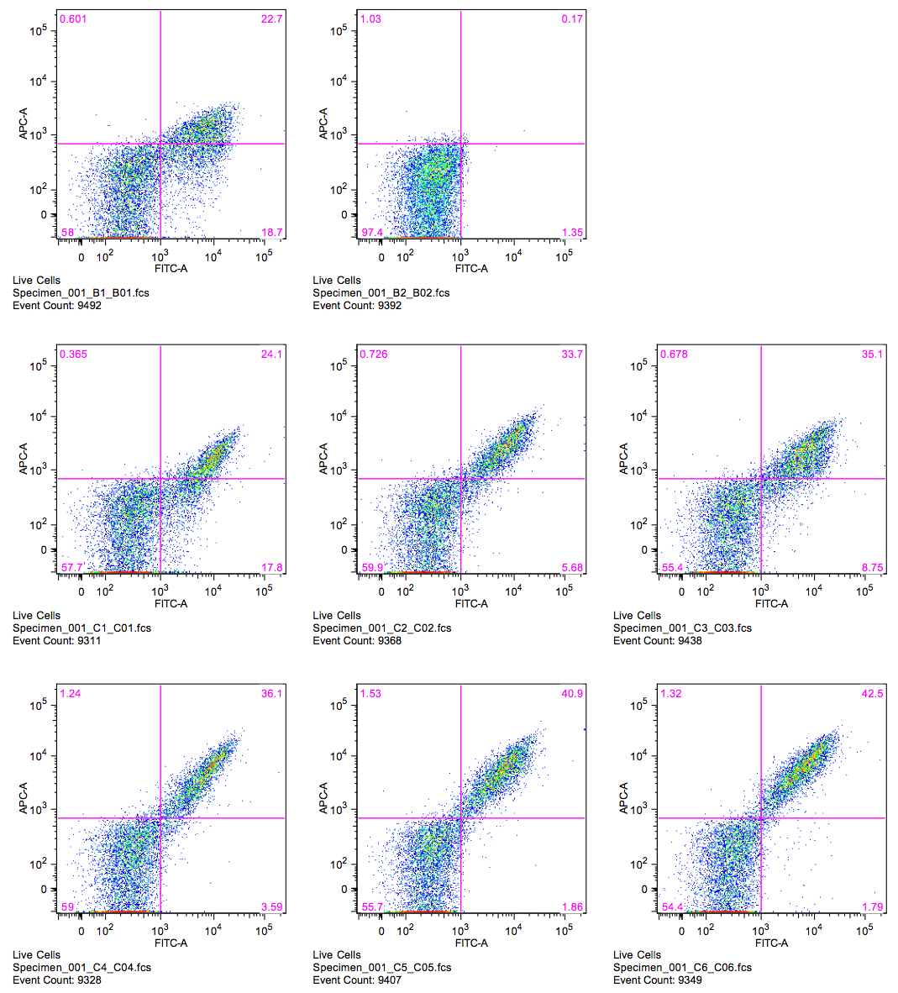
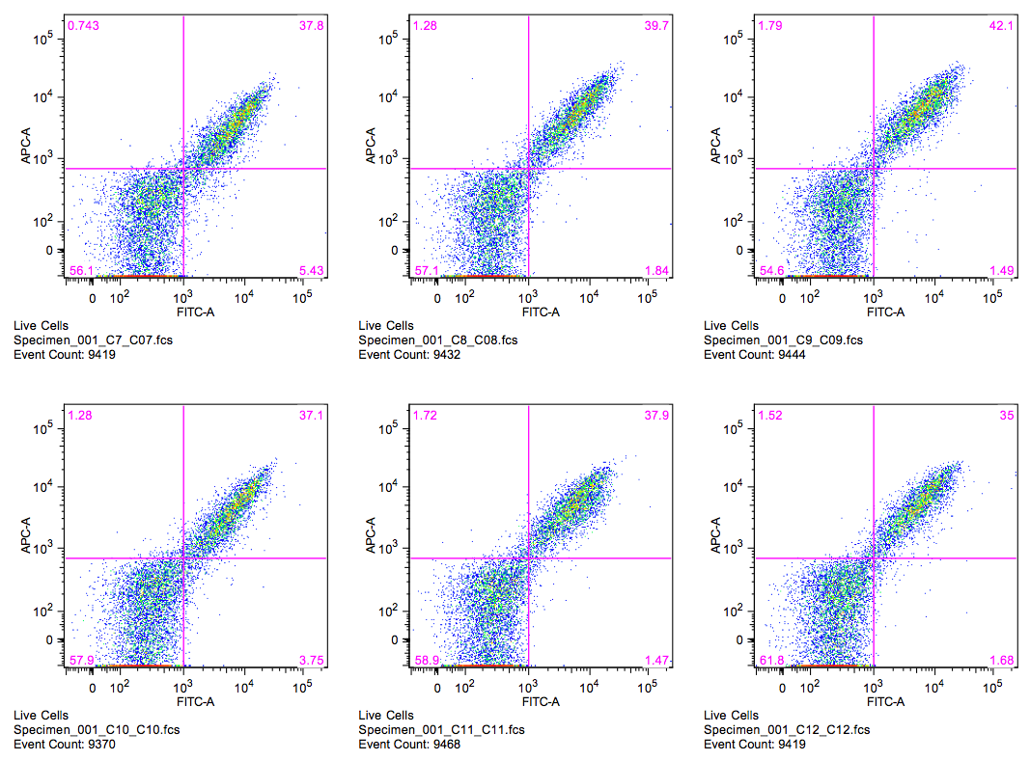
I-CpaMI
wt ATAT
Binding
100pM DNA substrate
TTAT
CTAT
GTAT
AAAT
ACAT
AGAT
ATTT
ATCT
ATGT
ATAA
ATAC
ATAG

Slide 7
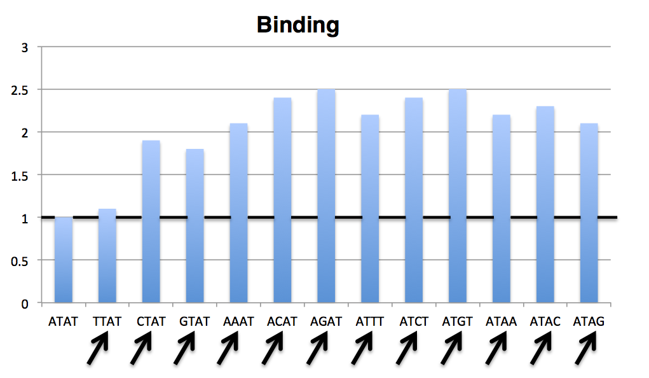

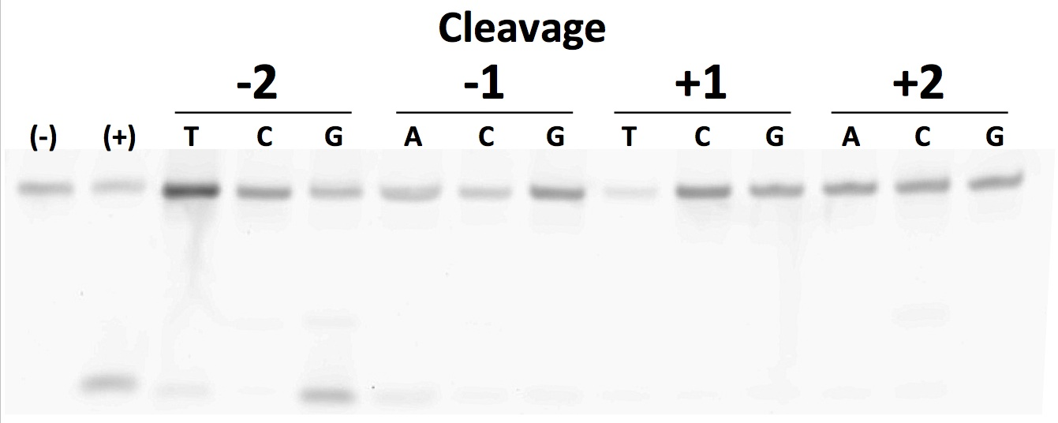
I-CpaMI
ATAT | TTAT | CTAT | GTAT | AAAT | ACAT | AGAT | ATTT | ATCT | ATGT | ATAA | ATAC | ATAG
In-Vitro | 0% | 2% | 81% | 35% | 17% | 11% | 7% | 1% | 0% | 0% | 0% | 0%
Tethered-Flow | 7% | 0% | 13% | 7% | 0% | 0% | 7% | 0% | 0% | 0% | 0% | 0%

Slide 8
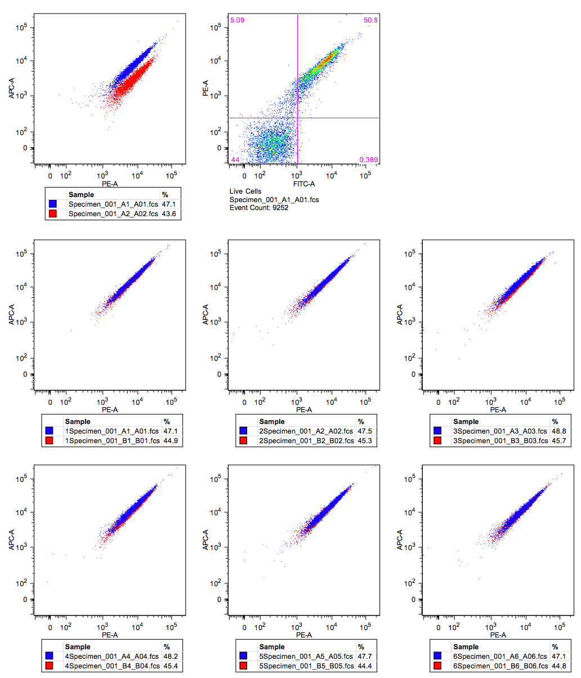
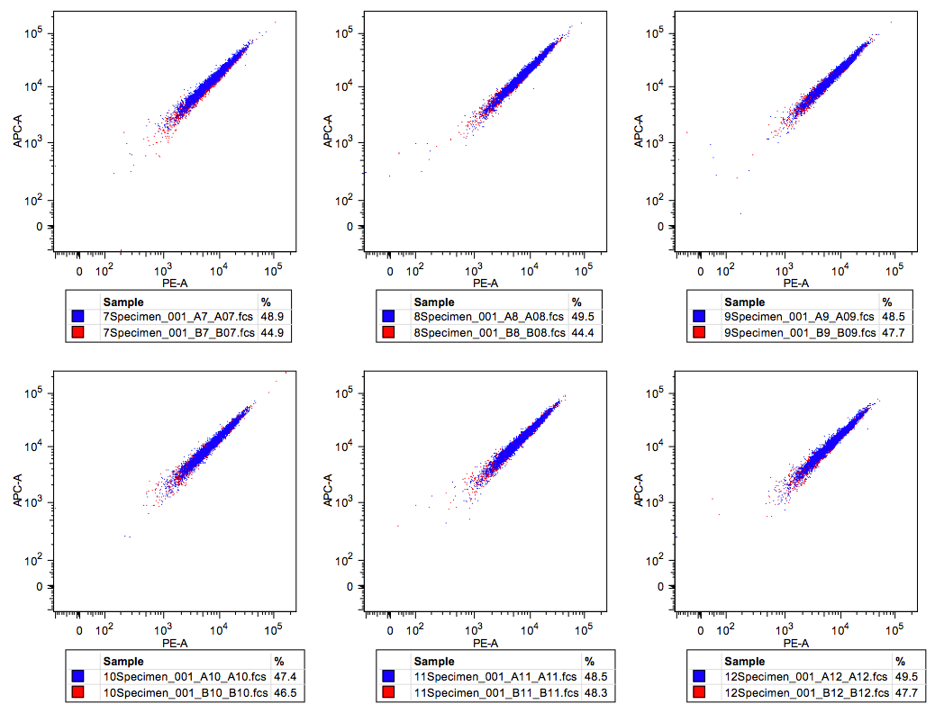
I-CpaMI
Tethered Cleavage Activity
wt ATAT
TTAT
CTAT
GTAT
AAAT
ACAT
AGAT
ATTT
ATCT
ATGT
ATAA
ATAC
ATAG

Slide 9
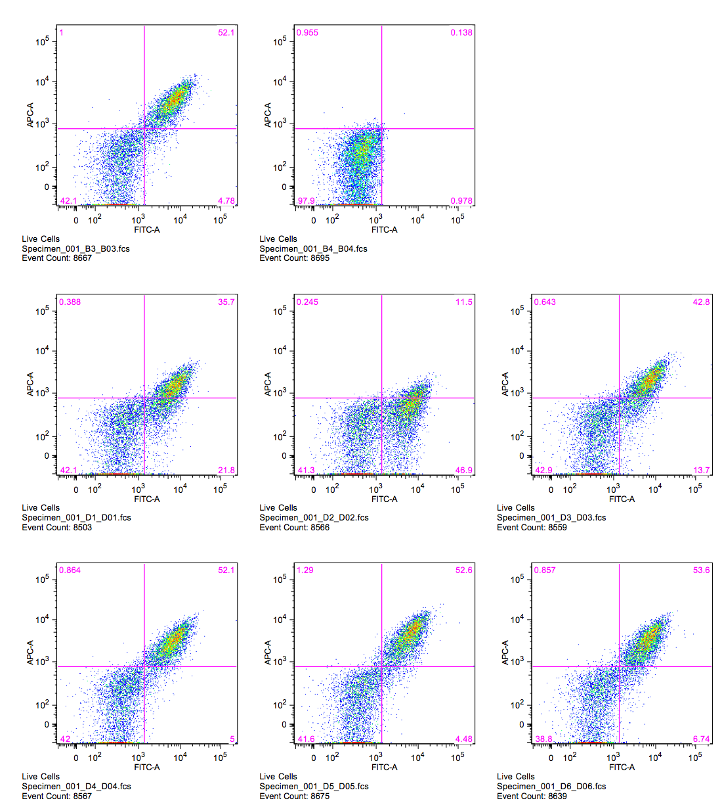
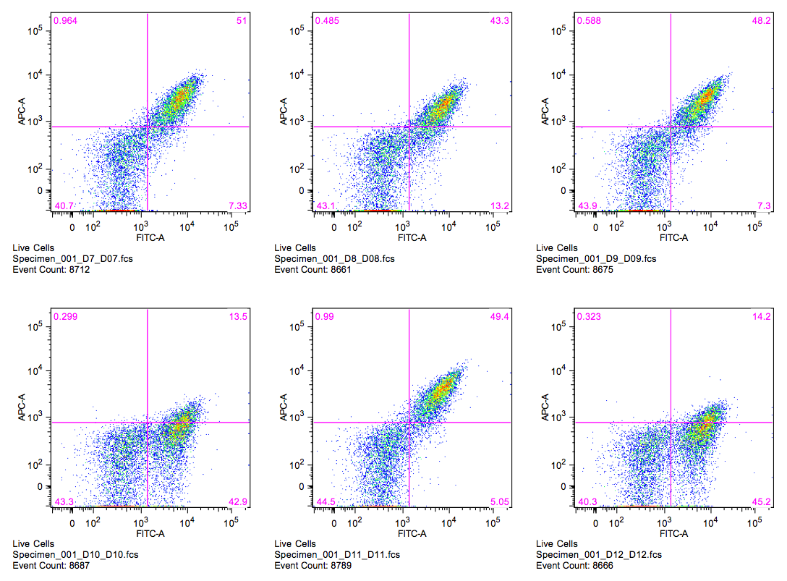
I-GpeMI
wt ATTC
Binding
100pM DNA substrate
TTTC
CTTC
GTTC
AATC
ACTC
AGTC
ATAC
ATCC
ATGC
ATTA
ATTT
ATTG

Slide 10
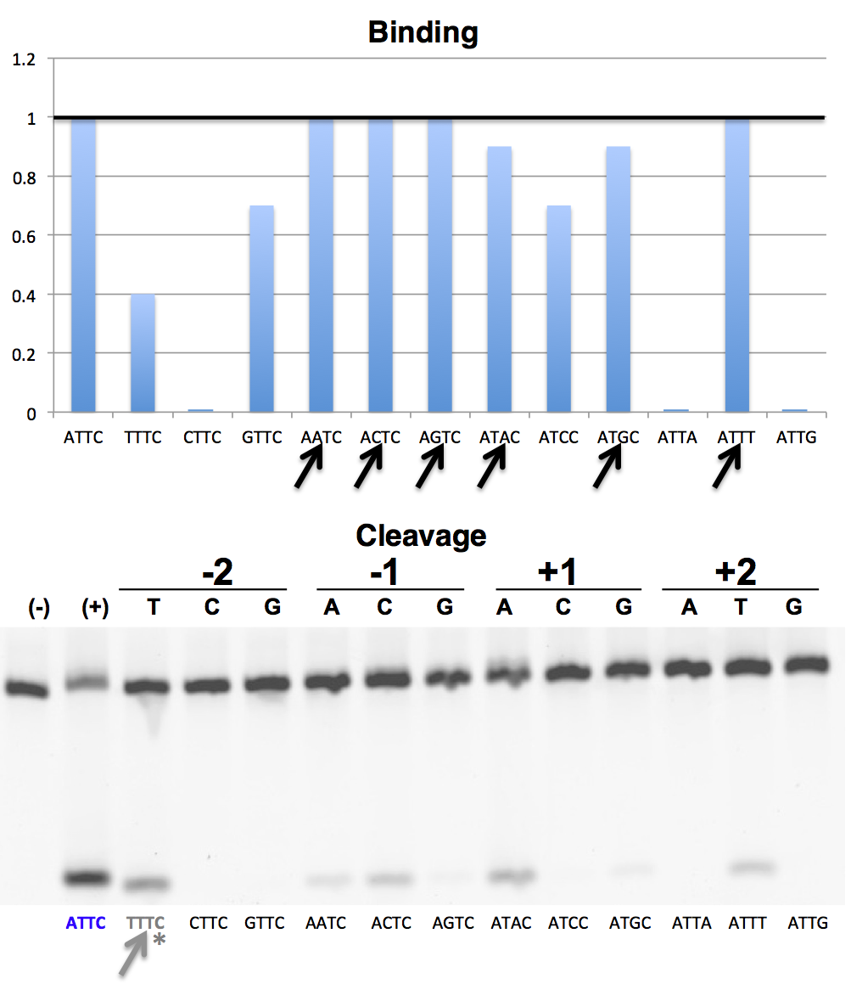

I-GpeMI
ATTC | TTTC | CTTC | GTTC | AATC | ACTC | AGTC | ATAC | ATCC | ATGC | ATTA | ATTT | ATTG
In-Vitro | 59% | 0% | 1% | 18% | 29% | 6% | 44% | 2% | 4% | 1% | 29% | 1%
Tethered-Flow | 175% | 0% | 6% | 50% | 50% | 19% | 75% | 13% | 13% | 6% | 19% | 6%

Slide 11
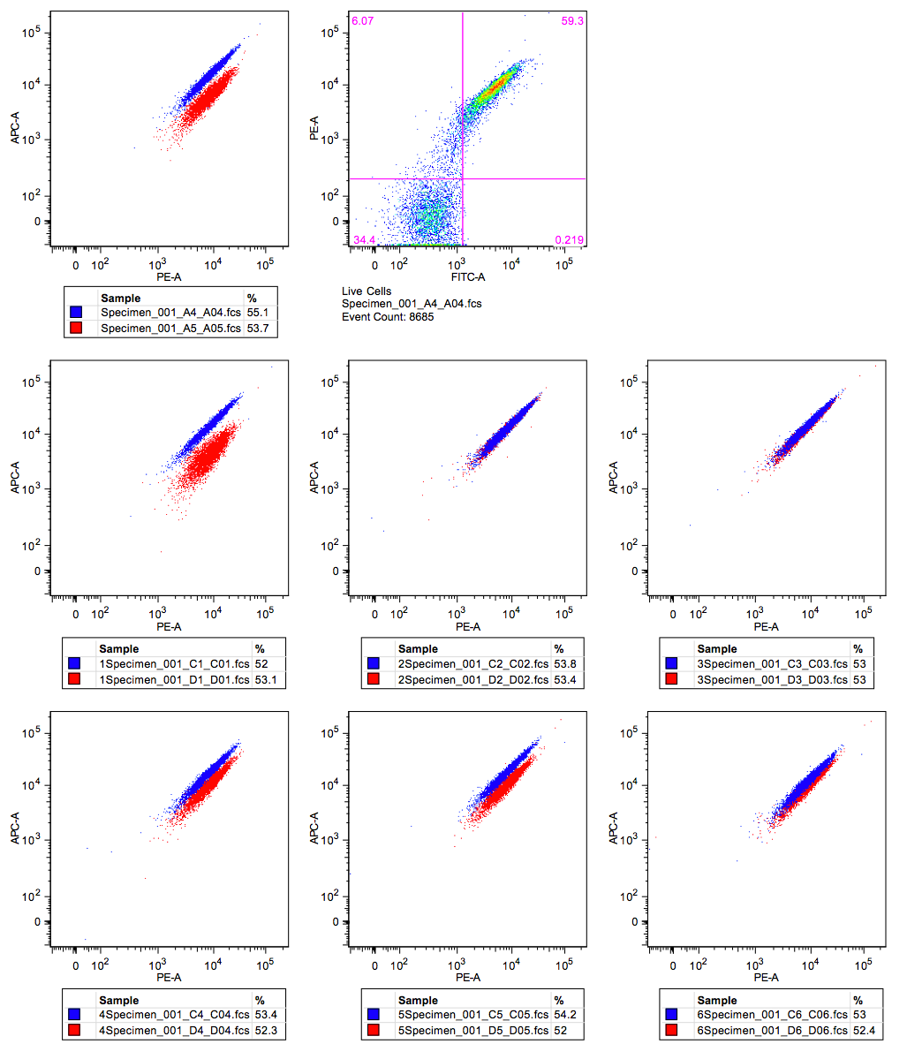
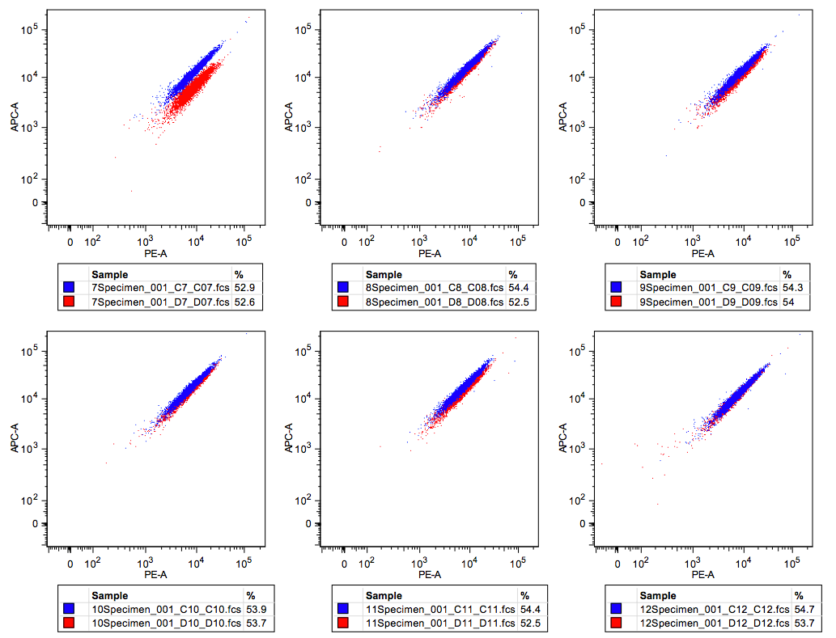
I-GpeMI
Tethered Cleavage Activity
wt ATTC
TTTC
CTTC
GTTC
AATC
ACTC
AGTC
ATAC
ATCC
ATGC
ATTA
ATTT
ATTG

Slide 12
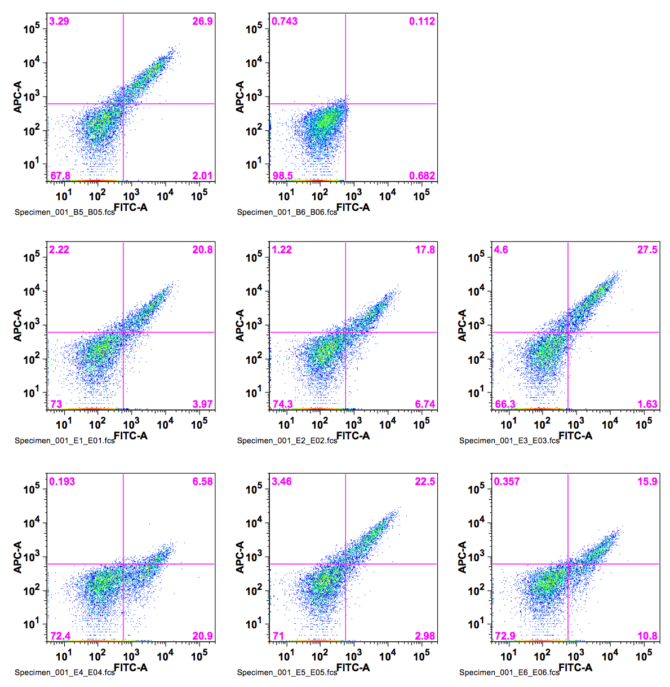
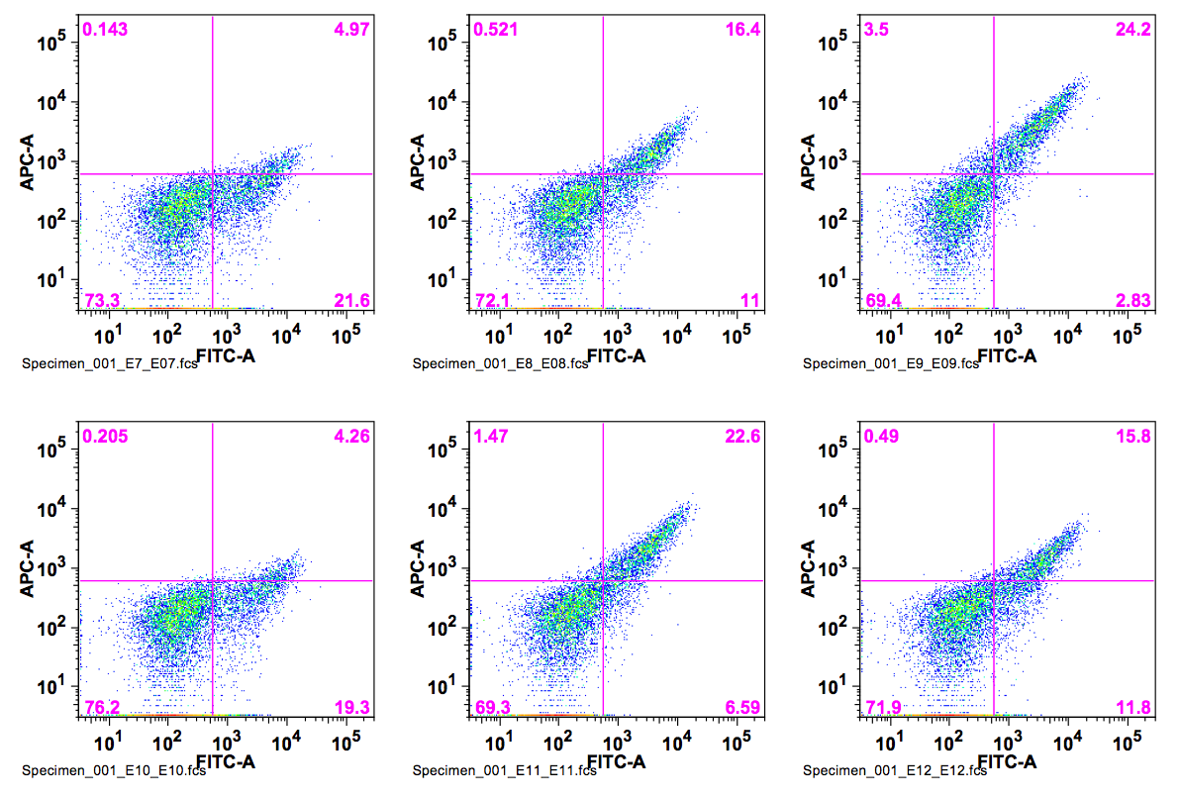
I-GzeII
wt ATAT
Binding
100pM DNA substrate
TTAT
CTAT
GTAT
AAAT
ACAT
AGAT
ATTT
ATCT
ATGT
ATAA
ATAC
ATAG

Slide 13
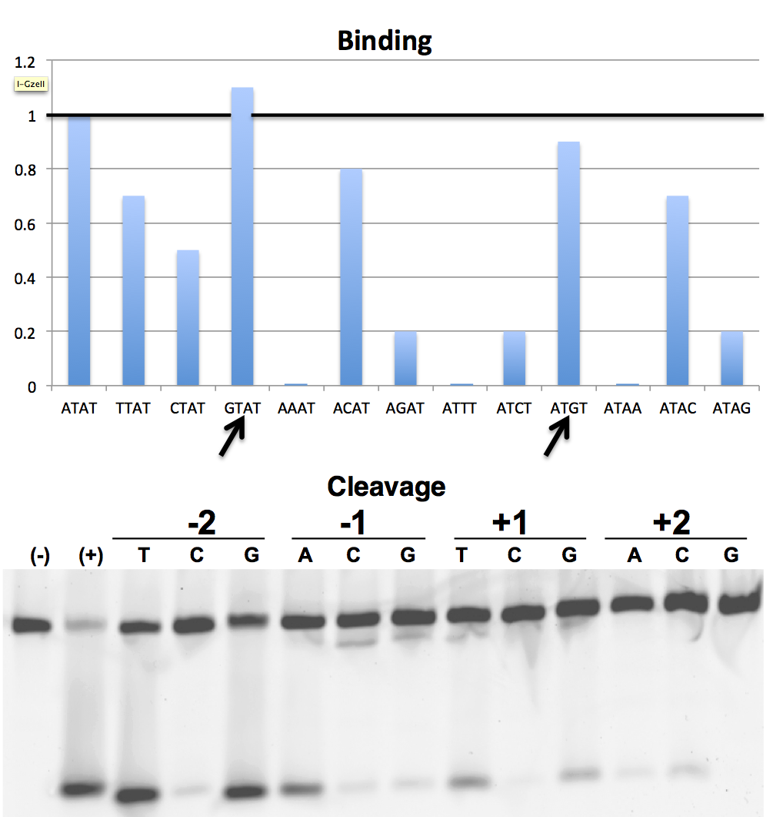

I-GzeII
ATAT | TTAT | CTAT | GTAT | AAAT | ACAT | AGAT | ATTT | ATCT | ATGT | ATAA | ATAC | ATAG
In-Vitro | 78% | 8% | 77% | 48% | 4% | 11% | 34% | 5% | 23% | 8% | 13% | 7%
Tethered-Flow | 83% | 8% | 61% | 49% | 6% | 10% | 46% | 11% | 7% | 6% | 3% | 0%

Slide 14
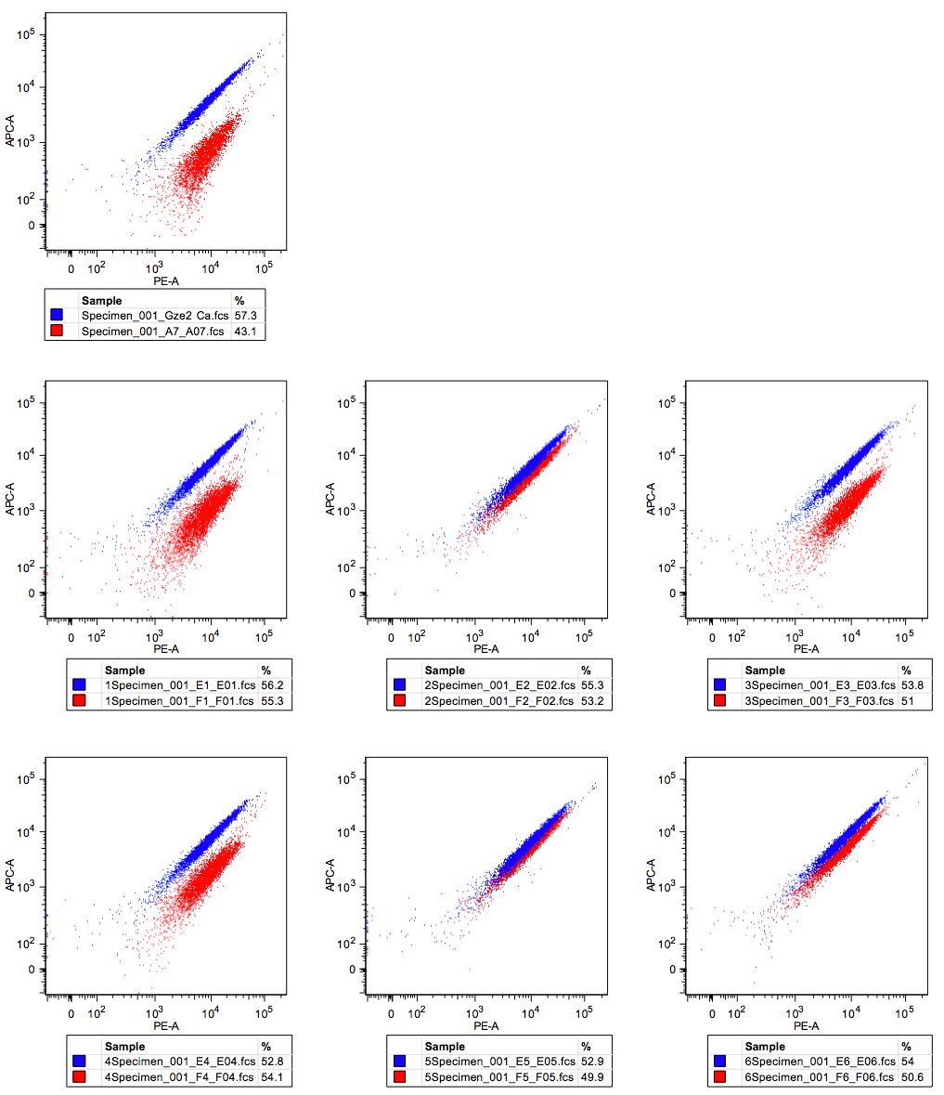
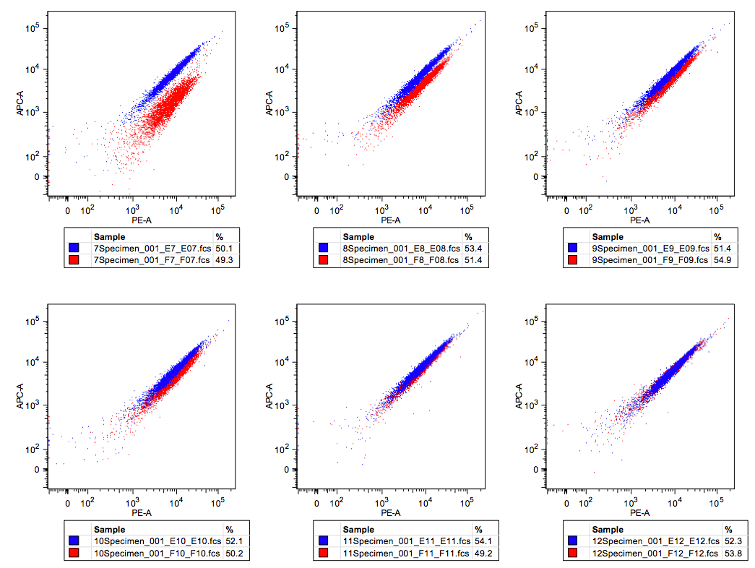
I-GzeII
wt ATAT
Tethered Cleavage Activity
TTAT
CTAT
GTAT
AAAT
ACAT
AGAT
ATTT
ATCT
ATGT
ATAA
ATAC
ATAG

Slide 15
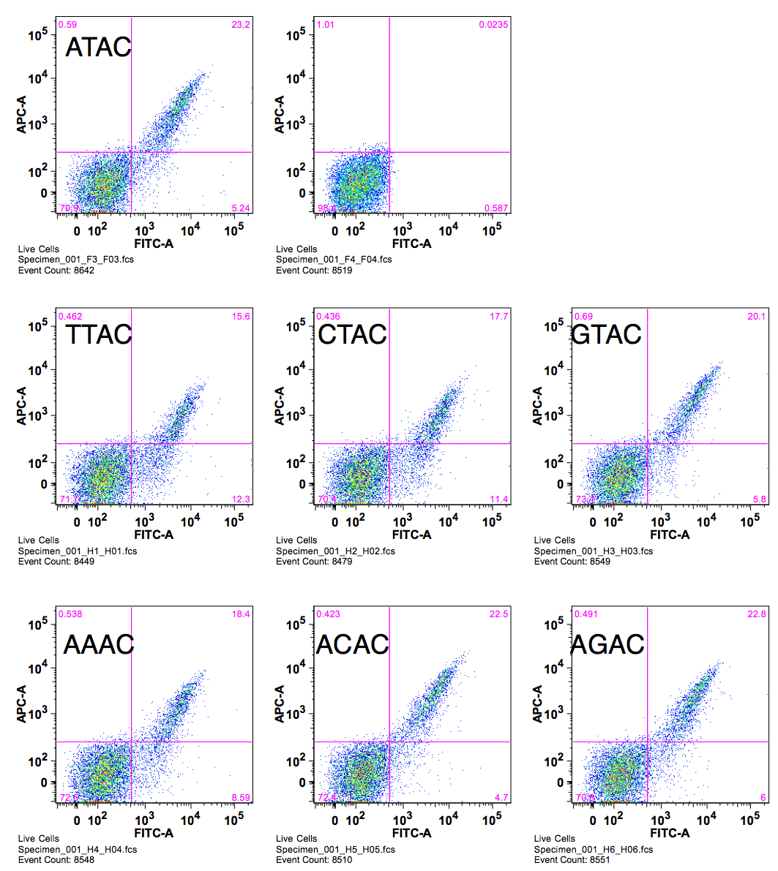
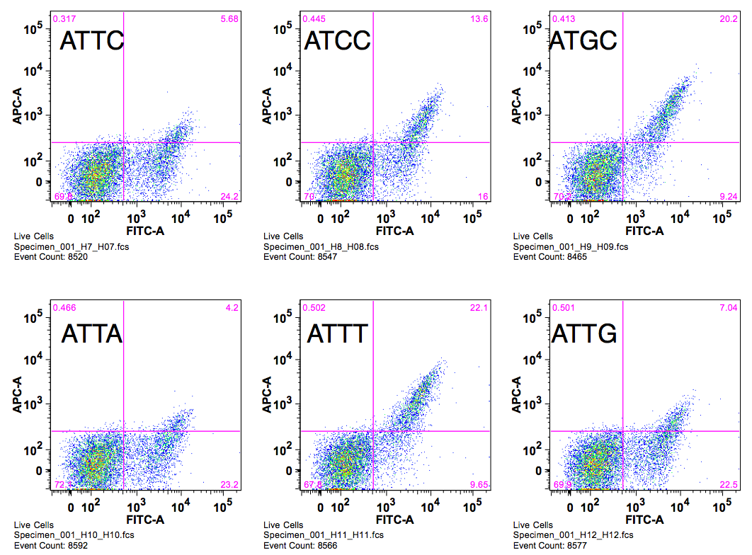
I-LtrI
wt ATAC
Binding
400pM DNA substrate
TTAC
CTAC
GTAC
AAAC
ACAC
AGAC
ATTC
ATCC
ATGC
ATAA
ATAT
ATAG

Slide 16
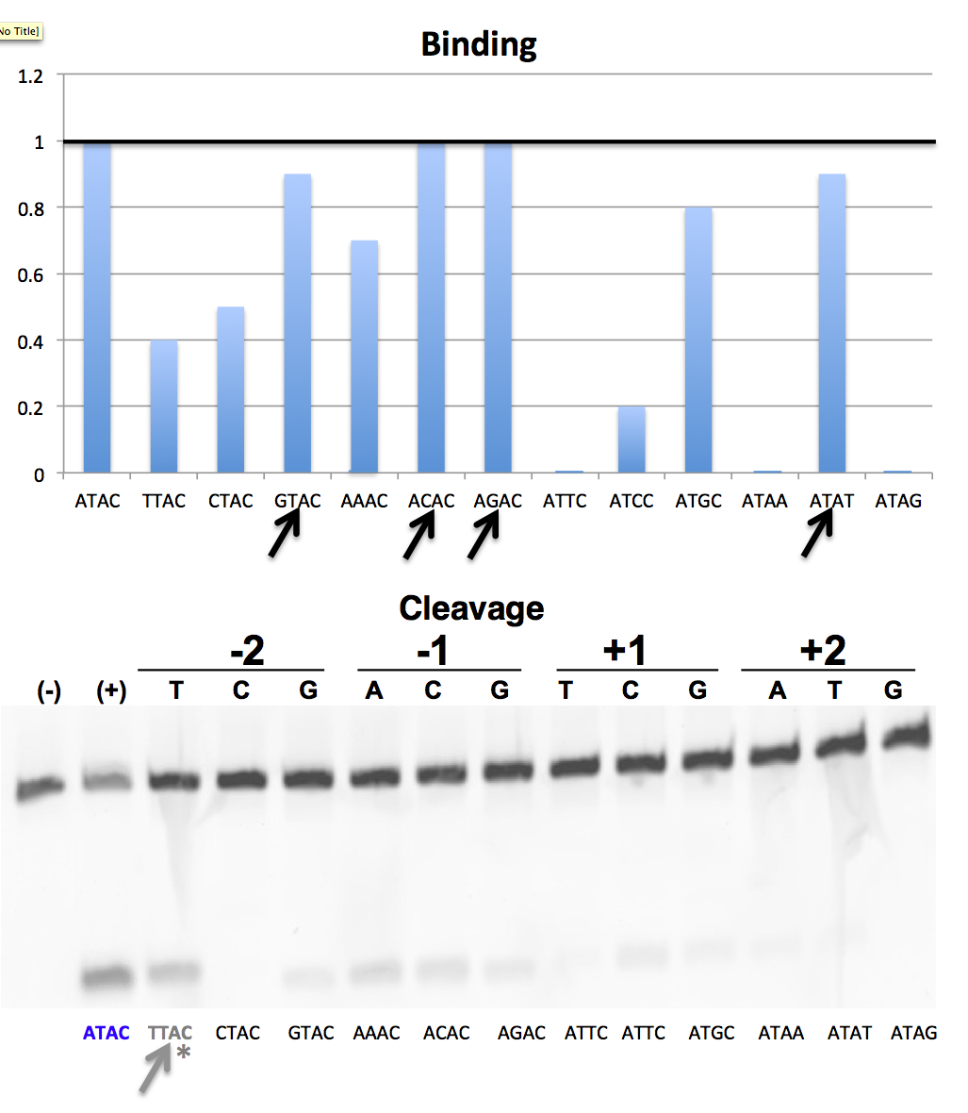
I-LtrI
In-Vitro | 57% | 0% | 17% | 35% | 34% | 15% | 3% | 21% | 14% | 7% | 3% | 0%
Tethered-Flow | 58% | 1% | 8% | 32% | 13% | 8% | 13% | 24% | 11% | 14% | 6% | 1%

Slide 17
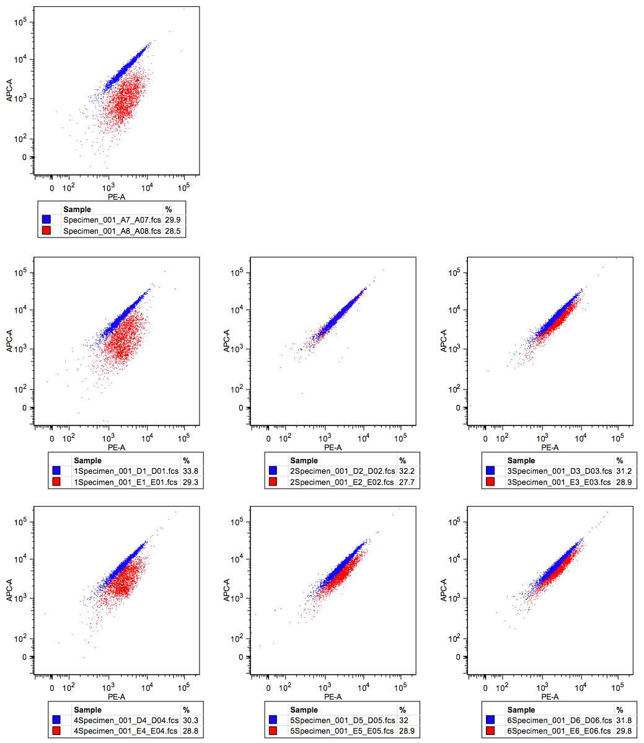
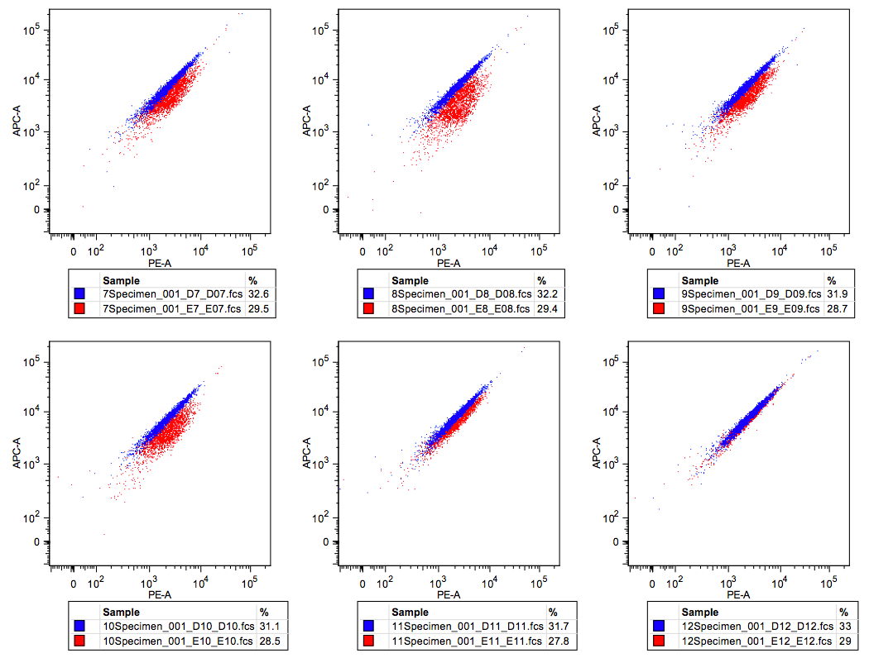
I-LtrI
Tethered Cleavage Activity
wt ATAC
TTAC
CTAC
GTAC
AAAC
ACAC
AGAC
ATTC
ATCC
ATGC
ATAA
ATAT
ATAG

Slide 18
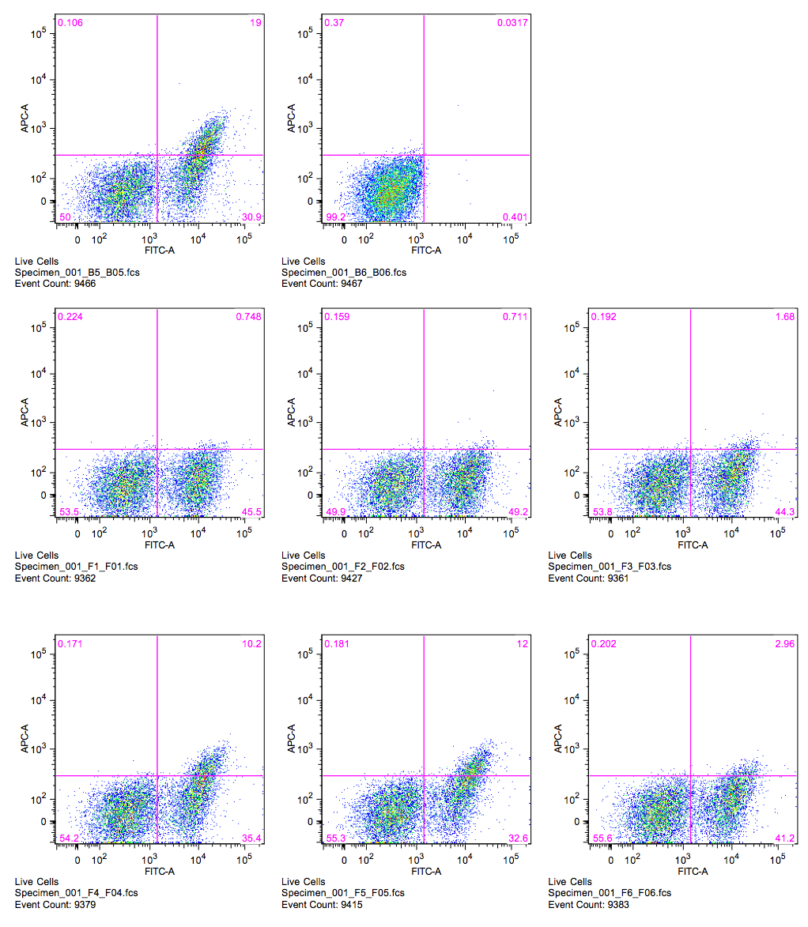
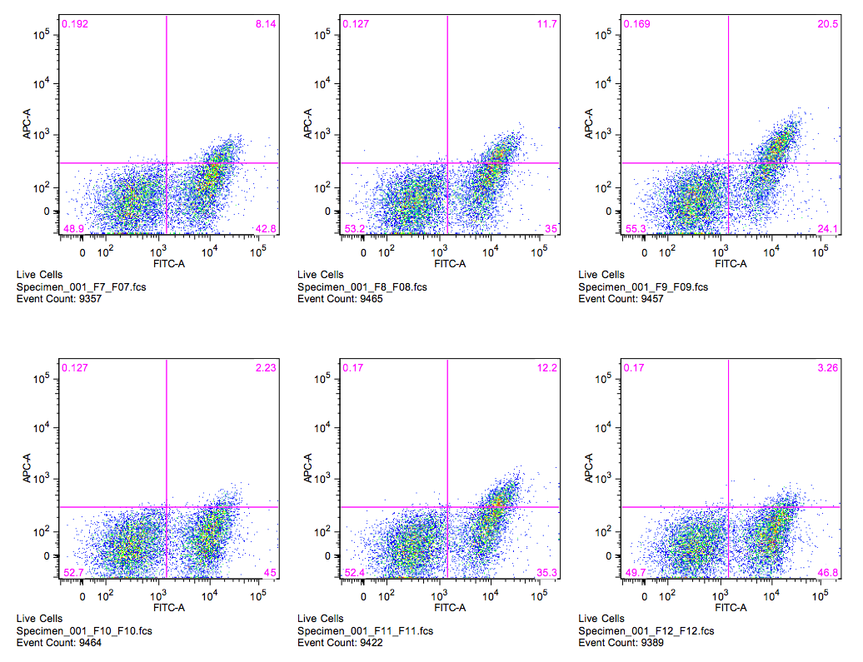
I-LtrWI
wt GTAT
Binding
200pM DNA substrate
ATAT
TTAT
CTAT
GAAT
GCAT
GGAT
GTTT
GTCT
GTGT
GTAA
GTAC
GTAG

Slide 19
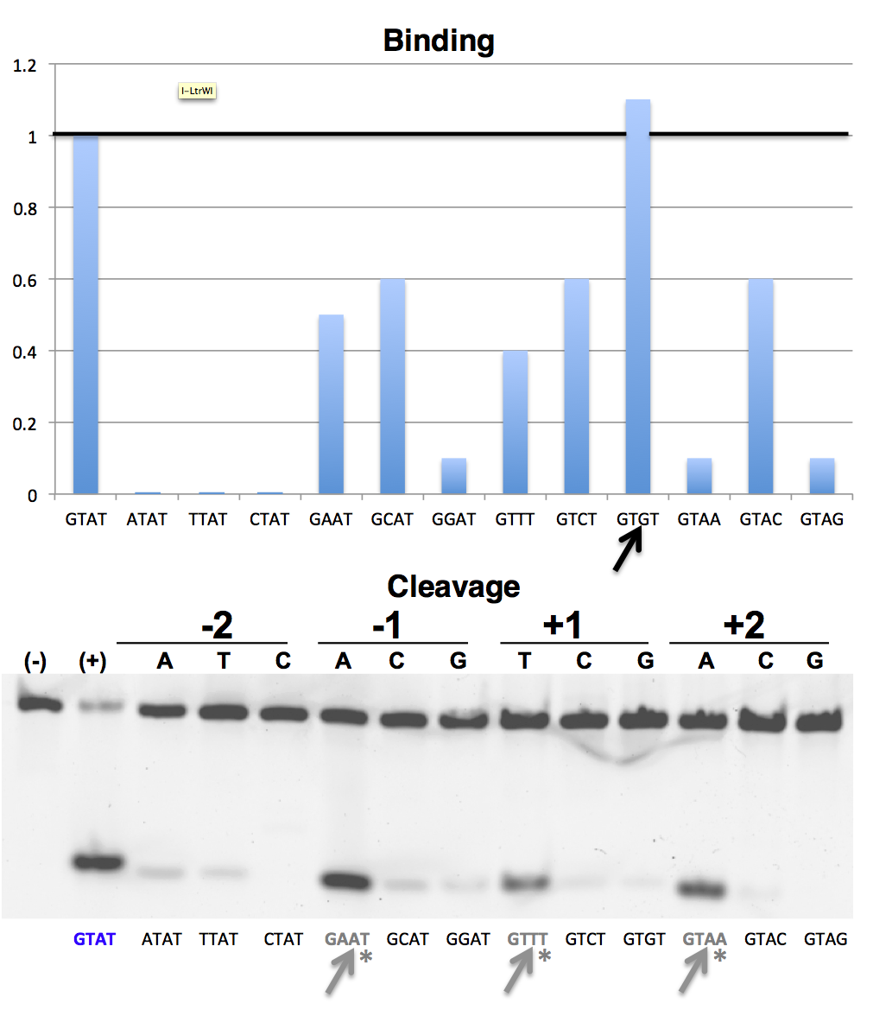
I-LtrWI
GTAT | ATAT | TTAT | CTAT | GAAT | GCAT | GGAT | GTTT | GTCT | GTGT | GTAA | GTAC | GTAG
In-Vitro | 14% | 14% | 0% | 74% | 17% | 11% | 55% | 1% | 1% | 58% | 2% | 0%
Tethered-Flow | 32% | 20% | 0% | 50% | 9% | 18% | 29% | 4% | 4% | 58% | 14% | 9%

Slide 20
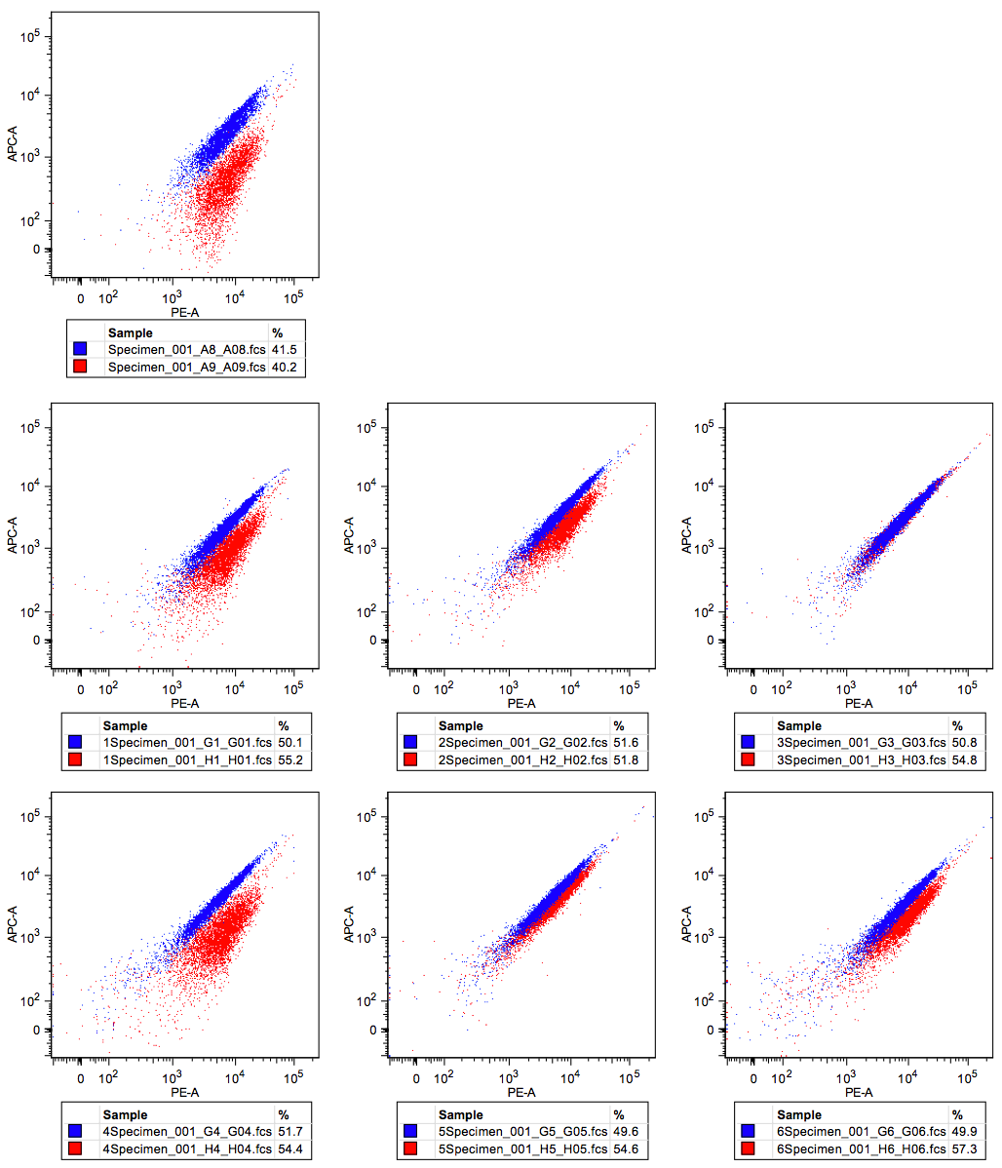
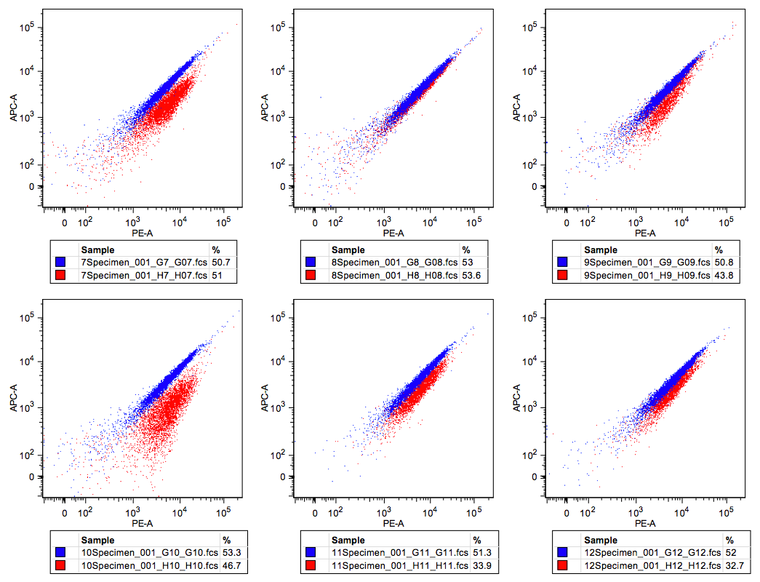
I-LtrWI
wt GTAT
Tethered Cleavage Activity
ATAT
TTAT
CTAT
GAAT
GCAT
GGAT
GTTT
GTCT
GTGT
GTAA
GTAC
GTAG

Slide 21
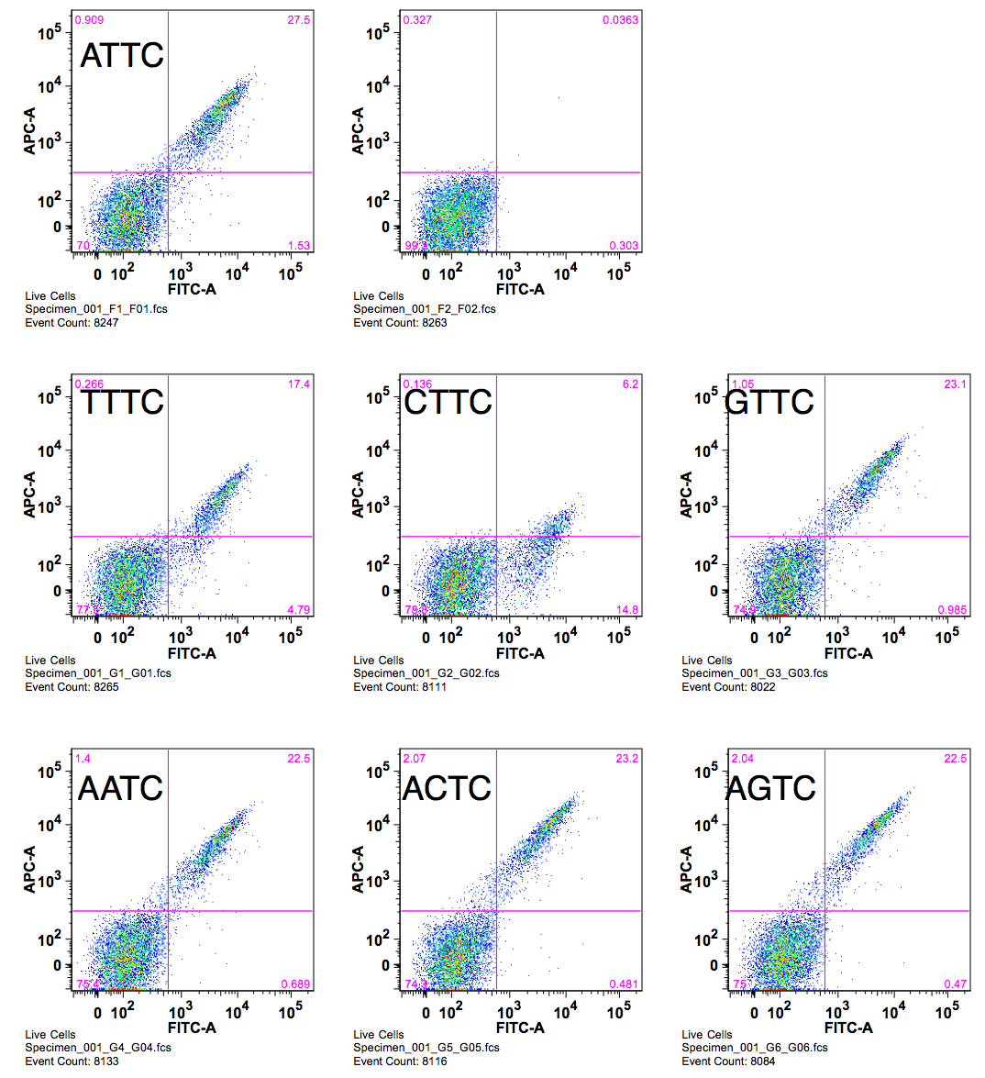
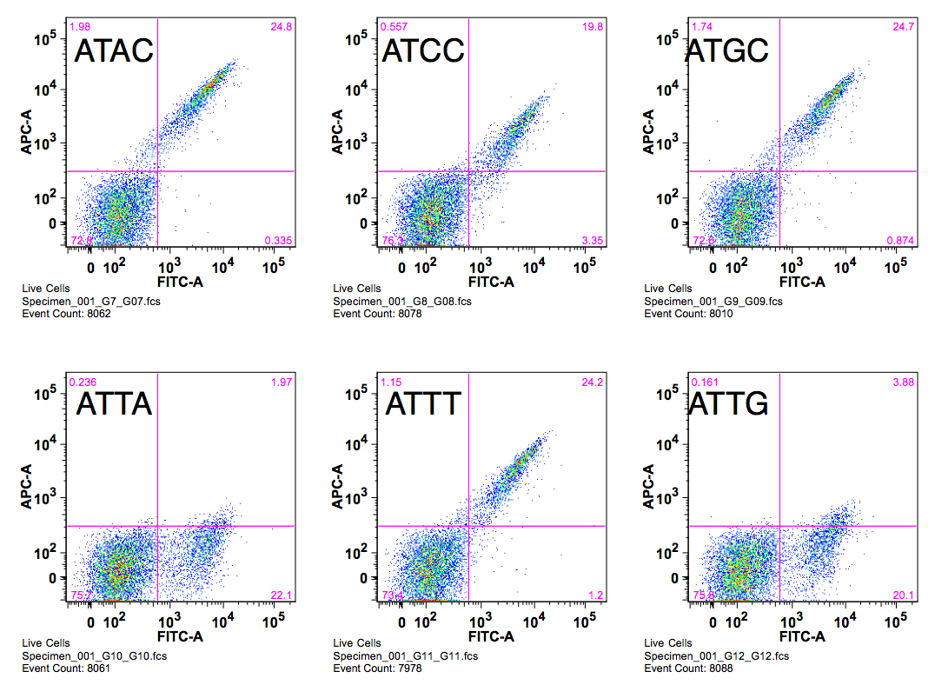
I-OnuI
wt ATTC
Binding
200pM DNA substrate
TTTC
CTTC
GTTC
AATC
ACTC
AGTC
ATAC
ATCC
ATGC
ATTA
ATTT
ATTG

Slide 22
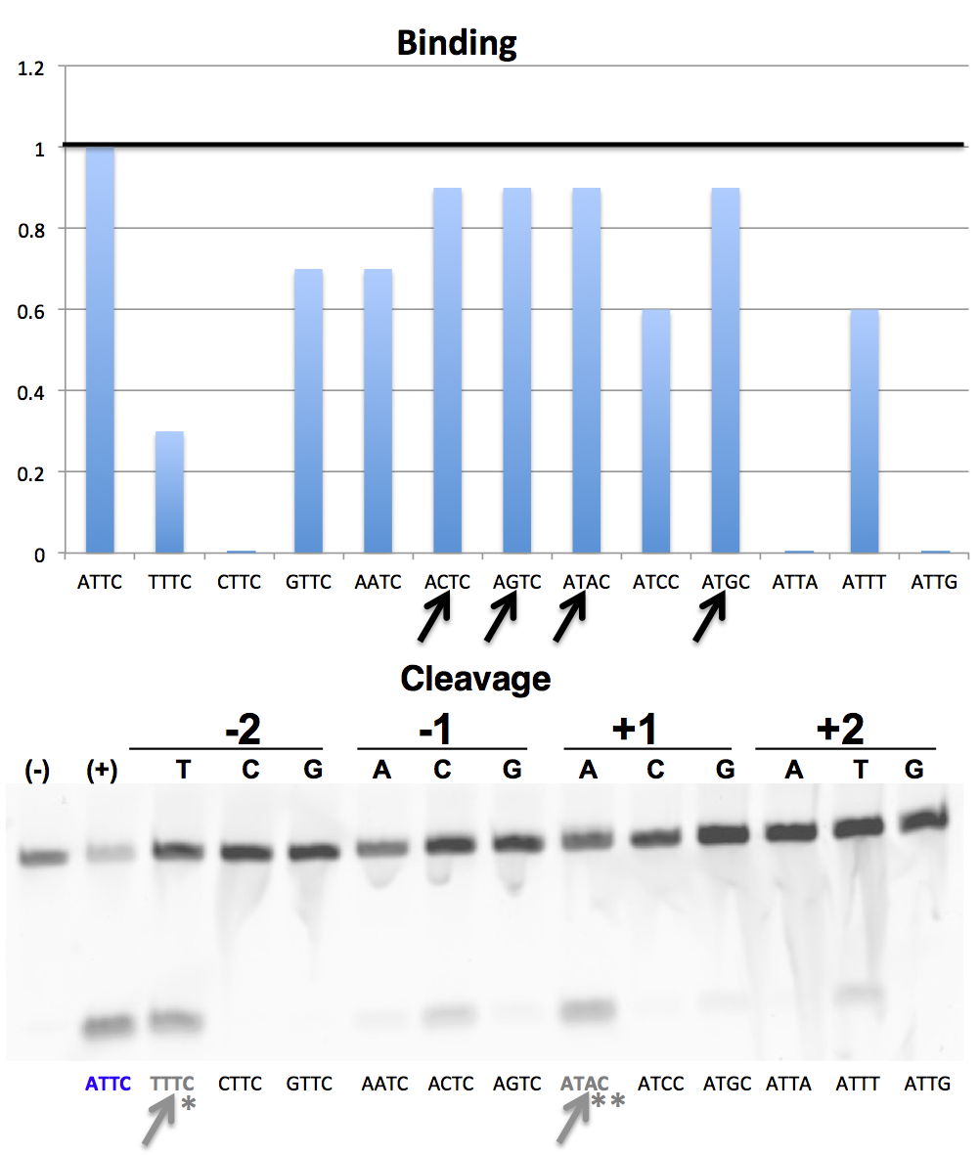
I-OnuI
ATTC | TTTC | CTTC | GTTC | AATC | ACTC | AGTC | ATAC | ATCC | ATGC | ATTA | ATTT | ATTG
In-Vitro | 52% | 0% | 0% | 17% | 38% | 18% | 57% | 6% | 11% | 0% | 31% | 0%
Tethered-Flow | 144% | 0% | 4% | 26% | 33% | 15% | 96% | 11% | 19% | 15% | 41% | 0%

Slide 23
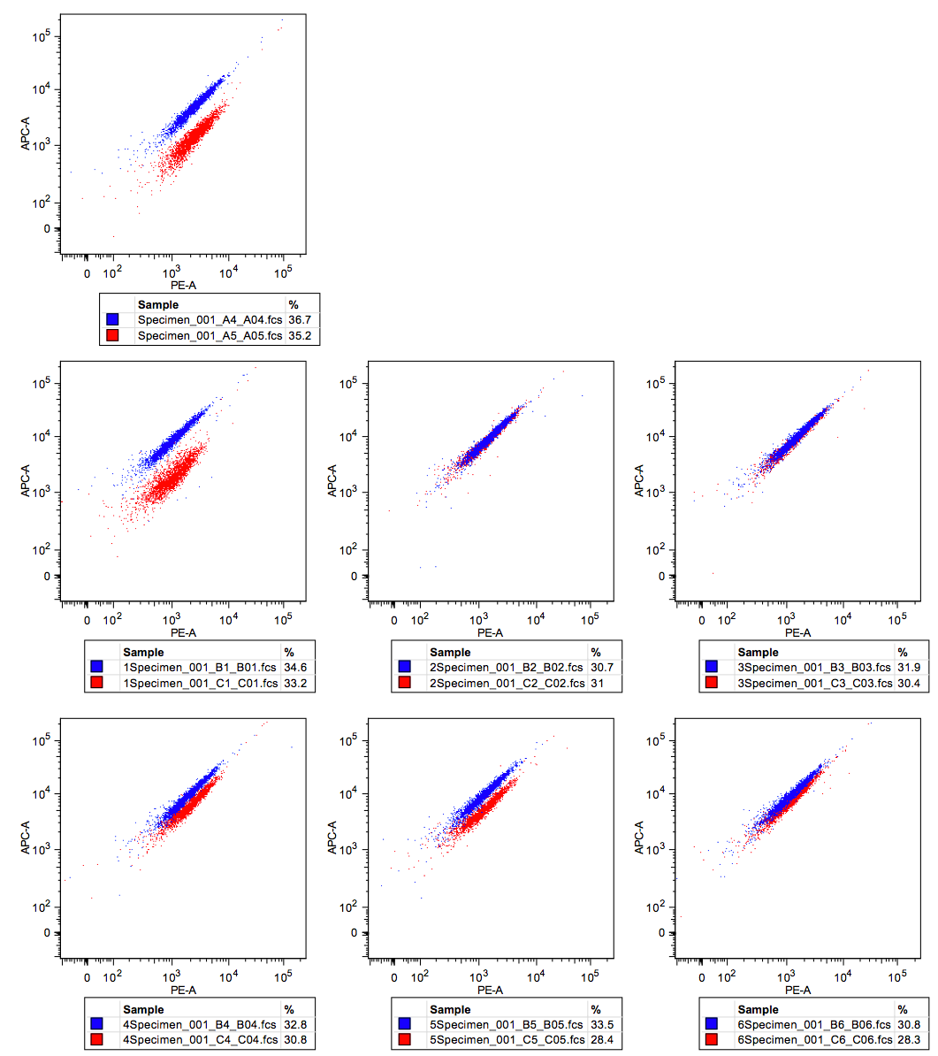
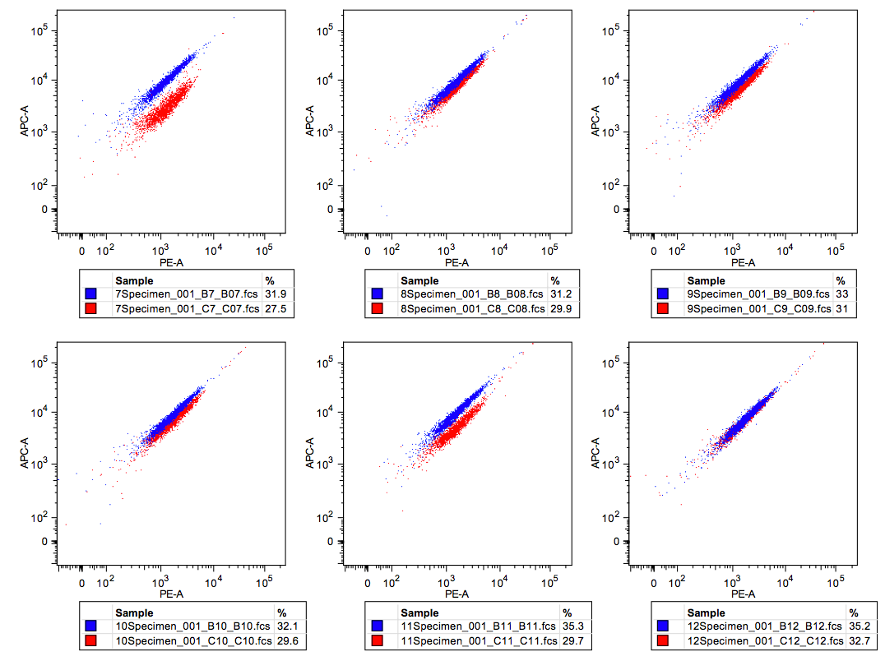
I-OnuI
Tethered Cleavage Activity
wt ATTC
TTTC
CTTC
GTTC
AATC
ACTC
AGTC
ATAC
ATCC
ATGC
ATTA
ATTT
ATTG

Slide 24
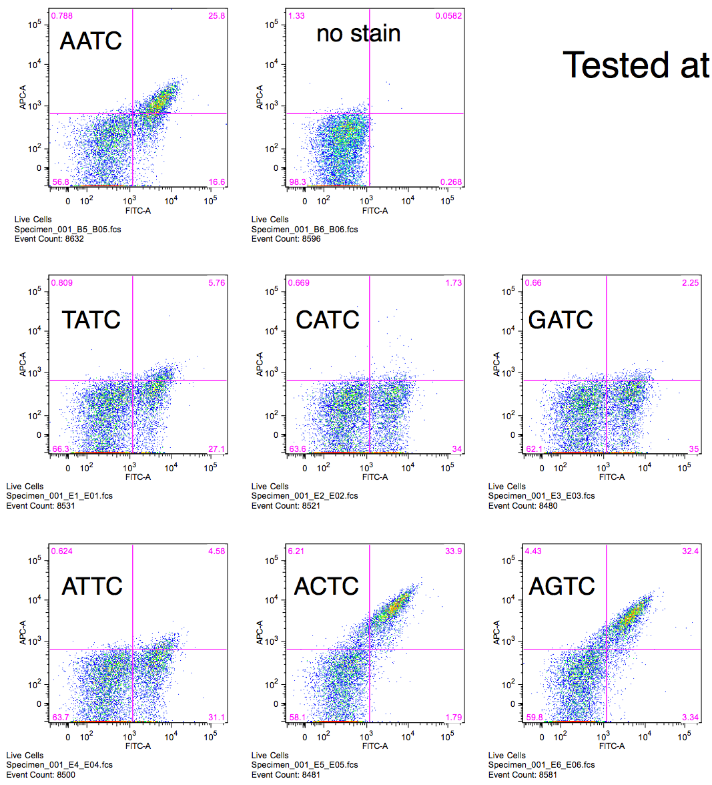
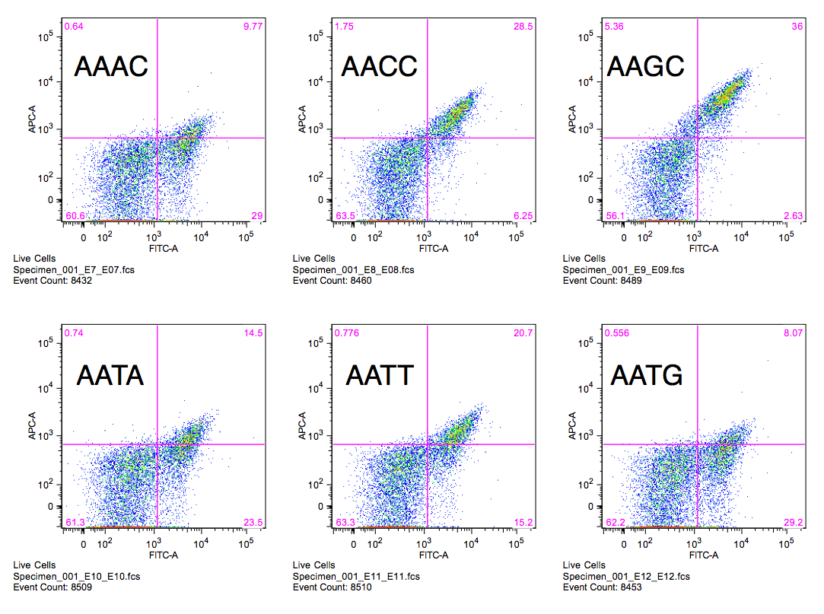
I-PanMI
wt AATC
Binding
100pM DNA substrate
TATC
CATC
GATC
ATTC
ACTC
AGTC
AAAC
AACC
AAGC
AATA
AATT
AATG

Slide 25
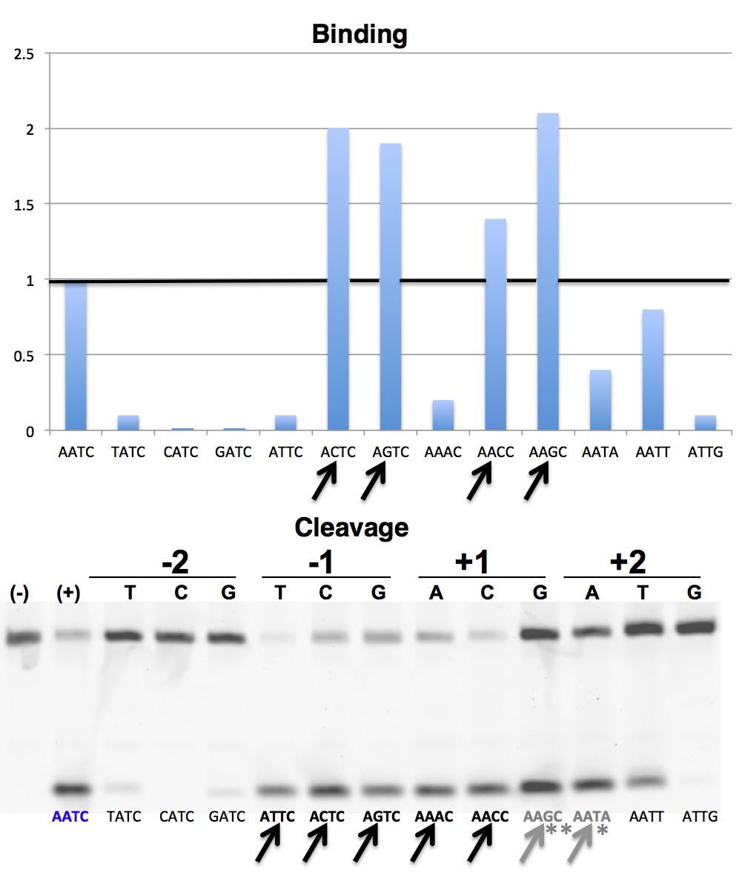
I-PanMI
AATG
AATC | TATC | CATC | GATC | ATTC | ACTC | AGTC | AAAC | AACC | AAGC | AATA | AATT | AATG
In-Vitro | 18% | 0% | 15% | 120% | 97% | 81% | 90% | 108% | 67% | 75% | 50% | 4%
Tethered-Flow | 6% | 0% | 4% | 143% | 74% | 87% | 135% | 115% | 52% | 87% | 28% | 2%

Slide 26
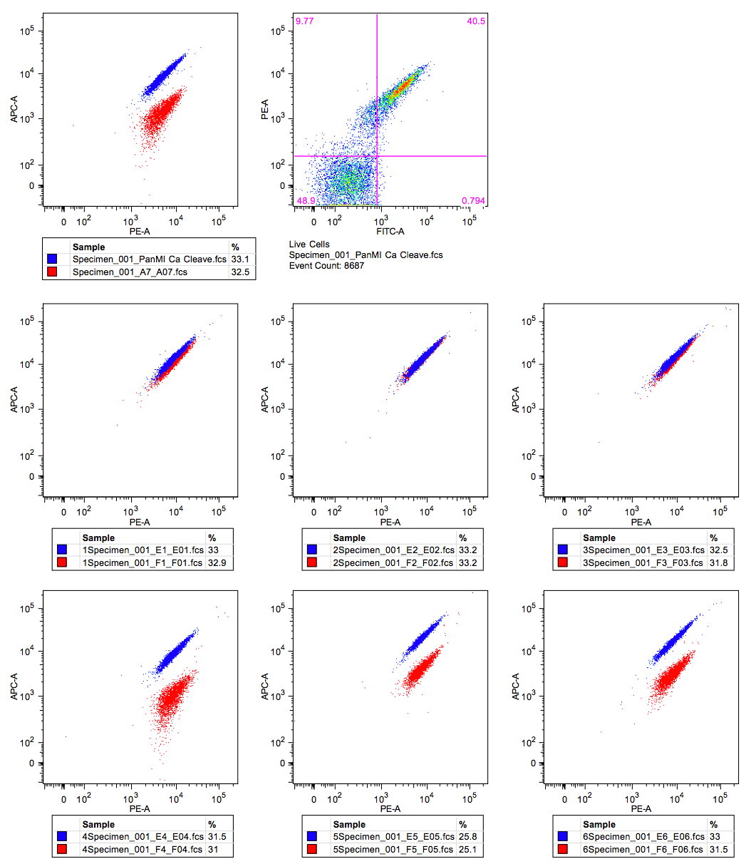
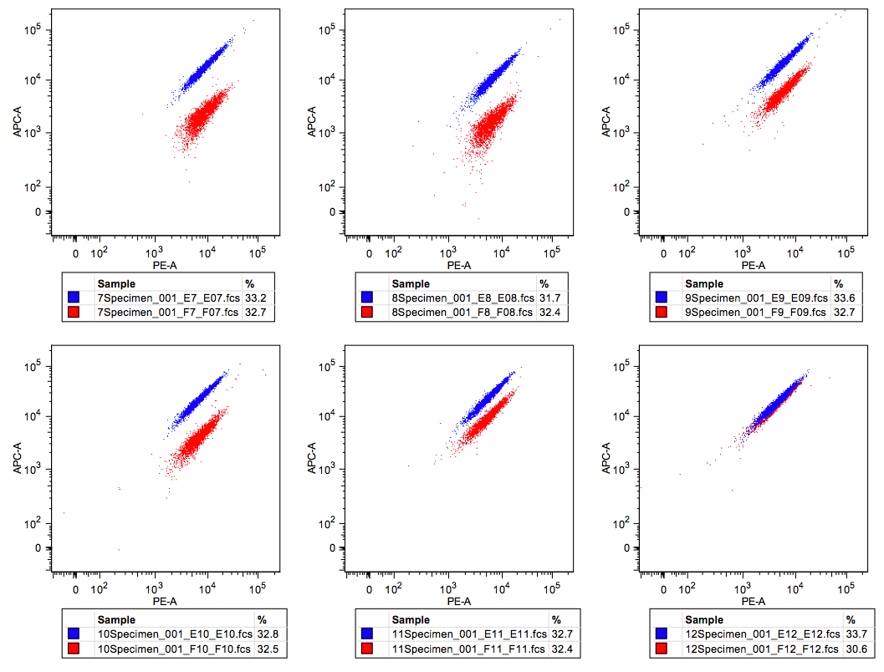
I-PanMI
Tethered Cleavage Activity
wt AATC
TATC
CATC
GATC
ATTC
ACTC
AGTC
AAAC
AACC
AAGC
AATA
AATT
AATG

Slide 27


I-SmaMI
wt TTAT
Binding
100pM DNA substrate
ATAT
CTAT
GTAT
TAAT
TCAT
TGAT
TTTT
TTCT
TTGT
TTAA
TTAC
TTAG

Slide 28

I-SmaMI
TTAT | ATAT | CTAT | GTAT | TAAT | TCAT | TGAT | TTTT | TTCT | TTGT | TTAA | TTAC | TTAG
In-Vitro | 106% | 93% | 108% | 17% | 7% | 0% | 3% | 19% | 15% | 16% | 39% | 0%
Tethered-Flow | 77% | 46% | 100% | 8% | 0% | 0% | 0% | 0% | 0% | 12% | 8% | 0%

Slide 29


I-SmaMI
Tethered Cleavage Activity
wt TTAT
ATAT
CTAT
GTAT
TAAT
TCAT
TGAT
TTTT
TTCT
TTGT
TTAA
TTAC
TTAG

