Slide 1
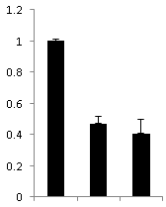
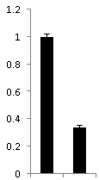
Figure S2
B
NK92
A
Empty
vector
KIR2DL4 shRNA
KIR2DL4 1st or 2nd shRNA
1.2
1
0.8
0.6
0.4
0.2
0
1st 2nd
Psi+
(Psi packaging element)
KIR3DL4 shRNA- MSCV-LMP
5’ LTR
Puro r
IRES
eGFP
3’ LTR
5’MIR30
3’MIR30
Ppgk
XhoI
EcoRI
Relative mRNA expression
C
KIR2DL4 1st shRNA
KIR2DL4 2nd shRNA
Psi+
(Psi packaging element)
KIR2DL4-double-
shRNA-MSCV-LMP
5’ LTR
Puro r
IRES
eGFP
3’ LTR
5’MIR30
3’MIR30
3’MIR30
3’MIR30
Ppgk
XhoI
EcoRI
EcoRI
D
Empty
vector
KIR2DL4-
double –
shRNA
1.2
1
0.8
0.6
0.4
0.2
0
Relative mRNA expression

