Slide 1
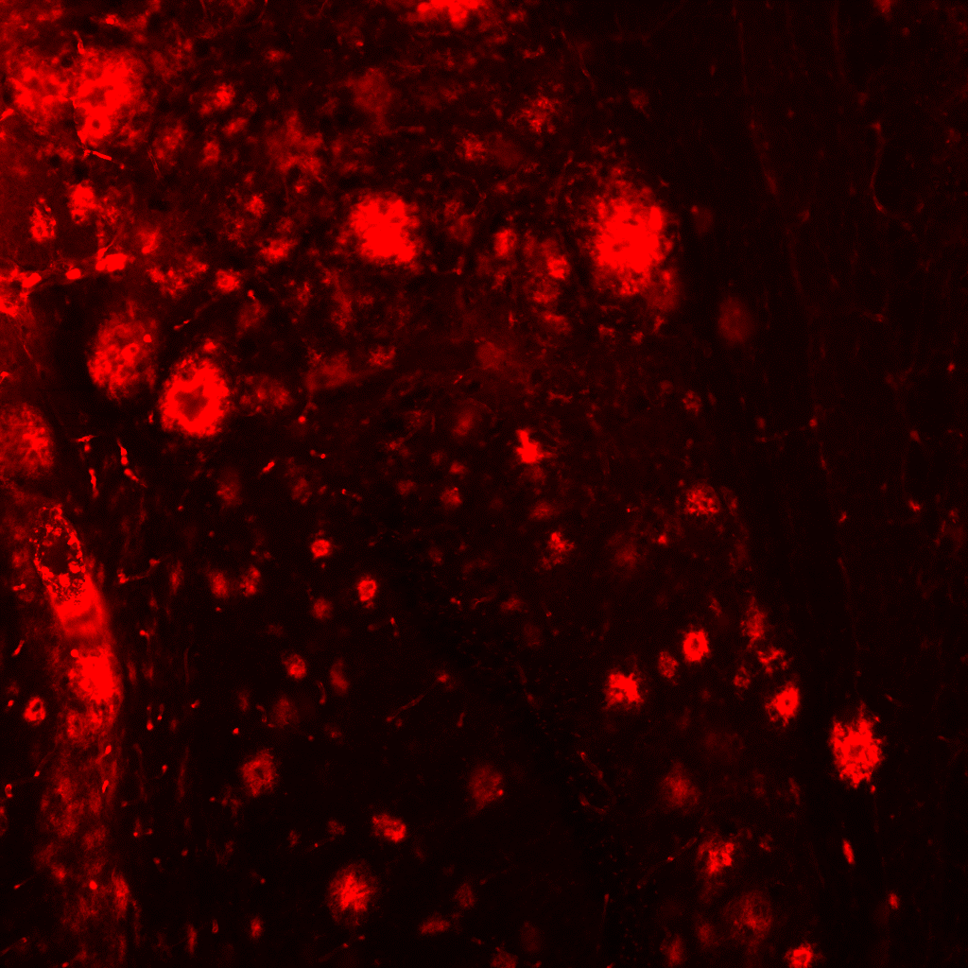
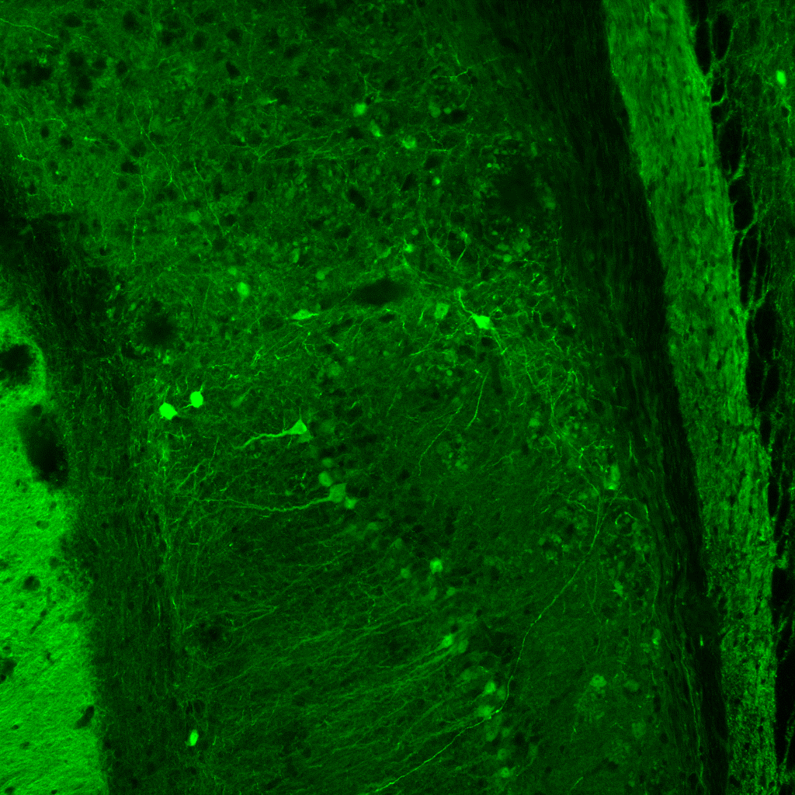
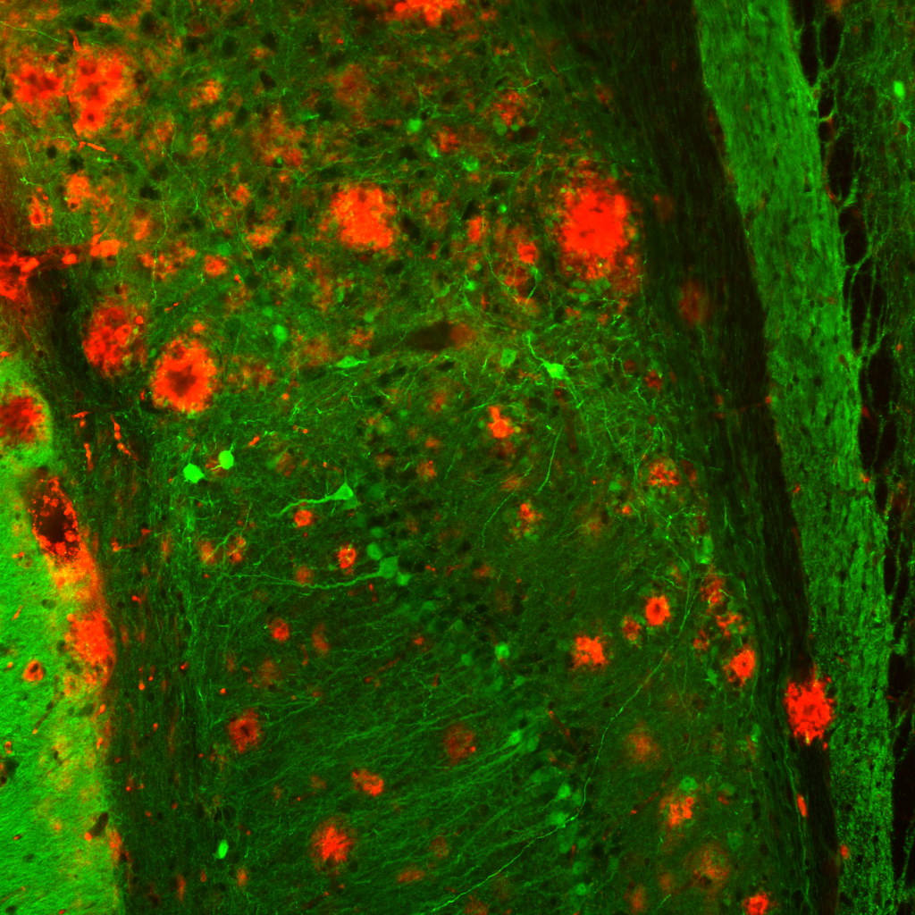
Figure S1
a
Aβ
b
Calbindin
c
Merge
200µm
200µm
200µm

