Slide 1
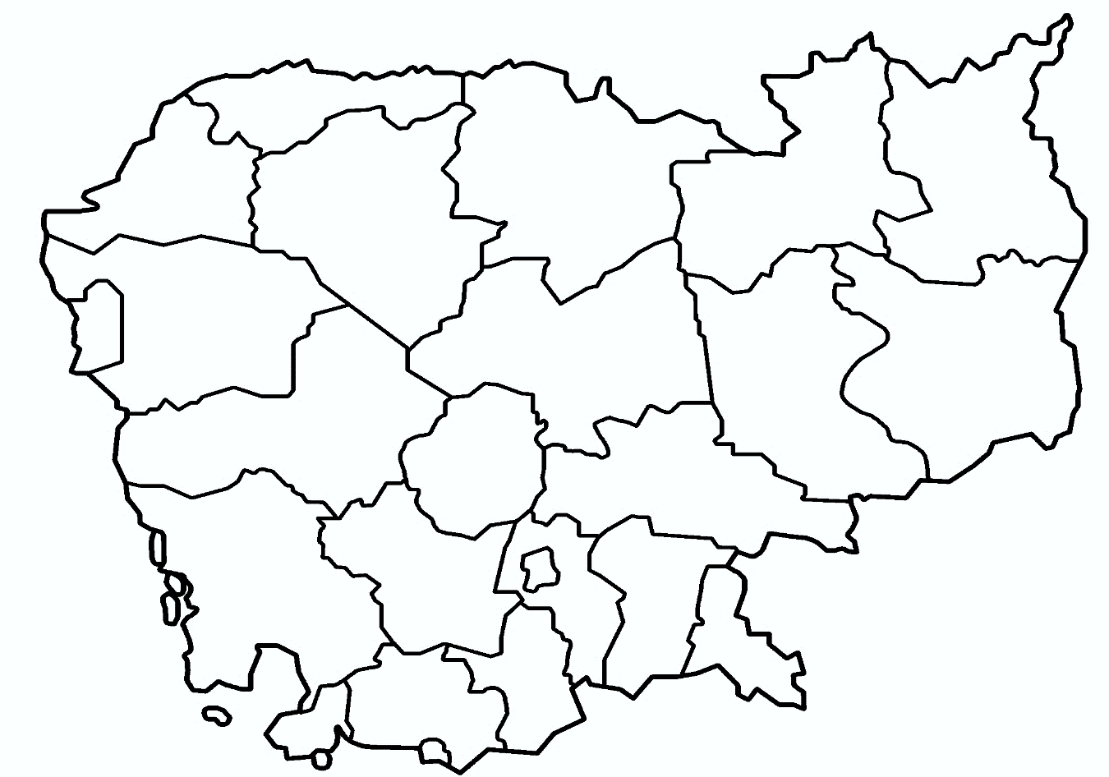















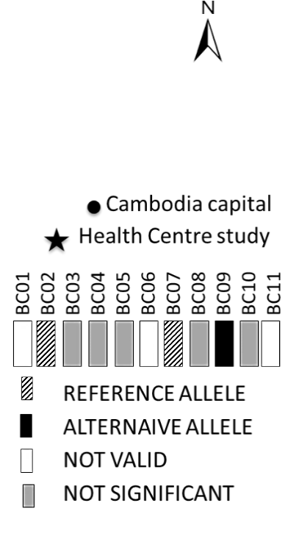


Additional file 9
A.
1: Tasanh HC
2: Pailin RH
3: Ou Chra HC
4: Sampoev Loun RH
5: Battambang RH
6: Anlong Veng RH
7: Trapaing Prasat HC
8: Veurn Say HC
9: Keov Seima HC
10: Khsim HC
11: Chhouk HC
12: Koh Slar HC
13: Takavit HC
14: Oral HC
15: Promoy HC
16: Pursat
BC01
6
7
8
4
5
3
2
1
Health centres
15
16
9
Cambodia capital
10
BC01
BC02
BC03
BC04
BC05
BC06
BC07
BC08
BC09
BC10
BC11
14
REF
ALT
13
REFERENCE ALLELE
12
ALTERNATIVE ALLELE
11
NOT VALID
NOT SIGNIFICANT

Slide 2
Additional file 9
B.
1: Tasanh HC
2: Pailin RH
3: Ou Chra HC
4: Sampoev Loun RH
5: Battambang RH
6: Anlong Veng RH
7: Trapaing Prasat HC
8: Veurn Say HC
9: Keov Seima HC
10: Khsim HC
11: Chhouk HC
12: Koh Slar HC
13: Takavit HC
14: Oral HC
15: Promoy HC
16: Pursat
BC02
6
7
8
4
5
3
2
1
Health centres
15
16
9
Cambodia capital
10
BC01
BC02
BC03
BC04
BC05
BC06
BC07
BC08
BC09
BC10
BC11
14
REF
ALT
13
REFERENCE ALLELE
12
ALTERNATIVE ALLELE
11
NOT VALID
NOT SIGNIFICANT

Slide 3
Additional file 9
C.
BC03
1: Tasanh HC
2: Pailin RH
3: Ou Chra HC
4: Sampoev Loun RH
5: Battambang RH
6: Anlong Veng RH
7: Trapaing Prasat HC
8: Veurn Say HC
9: Keov Seima HC
10: Khsim HC
11: Chhouk HC
12: Koh Slar HC
13: Takavit HC
14: Oral HC
15: Promoy HC
16: Pursat
6
7
8
4
5
3
2
1
Health centres
15
16
9
Cambodia capital
10
BC01
BC02
BC03
BC04
BC05
BC06
BC07
BC08
BC09
BC10
BC11
14
REF
ALT
13
REFERENCE ALLELE
12
ALTERNATIVE ALLELE
11
NOT VALID
NOT SIGNIFICANT

Slide 4
Additional file 9
D.
1: Tasanh HC
2: Pailin RH
3: Ou Chra HC
4: Sampoev Loun RH
5: Battambang RH
6: Anlong Veng RH
7: Trapaing Prasat HC
8: Veurn Say HC
9: Keov Seima HC
10: Khsim HC
11: Chhouk HC
12: Koh Slar HC
13: Takavit HC
14: Oral HC
15: Promoy HC
16: Pursat
BC04
6
7
8
4
5
3
2
1
Health centres
15
16
9
Cambodia capital
10
BC01
BC02
BC03
BC04
BC05
BC06
BC07
BC08
BC09
BC10
BC11
14
REF
ALT
13
REFERENCE ALLELE
12
ALTERNATIVE ALLELE
11
NOT VALID
NOT SIGNIFICANT

Slide 5
Additional file 9
E.
1: Tasanh HC
2: Pailin RH
3: Ou Chra HC
4: Sampoev Loun RH
5: Battambang RH
6: Anlong Veng RH
7: Trapaing Prasat HC
8: Veurn Say HC
9: Keov Seima HC
10: Khsim HC
11: Chhouk HC
12: Koh Slar HC
13: Takavit HC
14: Oral HC
15: Promoy HC
16: Pursat
BC05
6
7
8
4
5
3
2
1
Health centres
15
16
9
Cambodia capital
10
BC01
BC02
BC03
BC04
BC05
BC06
BC07
BC08
BC09
BC10
BC11
14
REF
ALT
13
REFERENCE ALLELE
12
ALTERNATIVE ALLELE
11
NOT VALID
NOT SIGNIFICANT

Slide 6
Additional file 9
F.
1: Tasanh HC
2: Pailin RH
3: Ou Chra HC
4: Sampoev Loun RH
5: Battambang RH
6: Anlong Veng RH
7: Trapaing Prasat HC
8: Veurn Say HC
9: Keov Seima HC
10: Khsim HC
11: Chhouk HC
12: Koh Slar HC
13: Takavit HC
14: Oral HC
15: Promoy HC
16: Pursat
BC06
6
7
8
4
5
3
2
1
Health centres
15
16
9
Cambodia capital
10
BC01
BC02
BC03
BC04
BC05
BC06
BC07
BC08
BC09
BC10
BC11
14
REF
ALT
13
REFERENCE ALLELE
12
ALTERNATIVE ALLELE
11
NOT VALID
NOT SIGNIFICANT

Slide 7
Additional file 9
G.
1: Tasanh HC
2: Pailin RH
3: Ou Chra HC
4: Sampoev Loun RH
5: Battambang RH
6: Anlong Veng RH
7: Trapaing Prasat HC
8: Veurn Say HC
9: Keov Seima HC
10: Khsim HC
11: Chhouk HC
12: Koh Slar HC
13: Takavit HC
14: Oral HC
15: Promoy HC
16: Pursat
BC07
6
7
8
4
5
3
2
1
Health centres
15
16
9
Cambodia capital
10
BC01
BC02
BC03
BC04
BC05
BC06
BC07
BC08
BC09
BC10
BC11
14
REF
ALT
13
REFERENCE ALLELE
12
ALTERNATIVE ALLELE
11
NOT VALID
NOT SIGNIFICANT

Slide 8
Additional file 9
H.
1: Tasanh HC
2: Pailin RH
3: Ou Chra HC
4: Sampoev Loun RH
5: Battambang RH
6: Anlong Veng RH
7: Trapaing Prasat HC
8: Veurn Say HC
9: Keov Seima HC
10: Khsim HC
11: Chhouk HC
12: Koh Slar HC
13: Takavit HC
14: Oral HC
15: Promoy HC
16: Pursat
BC08
6
7
8
4
5
3
2
1
Health centres
15
16
9
Cambodia capital
10
BC01
BC02
BC03
BC04
BC05
BC06
BC07
BC08
BC09
BC10
BC11
14
REF
ALT
13
REFERENCE ALLELE
12
ALTERNATIVE ALLELE
11
NOT VALID
NOT SIGNIFICANT

Slide 9
Additional file 9
I.
1: Tasanh HC
2: Pailin RH
3: Ou Chra HC
4: Sampoev Loun RH
5: Battambang RH
6: Anlong Veng RH
7: Trapaing Prasat HC
8: Veurn Say HC
9: Keov Seima HC
10: Khsim HC
11: Chhouk HC
12: Koh Slar HC
13: Takavit HC
14: Oral HC
15: Promoy HC
16: Pursat
BC09
6
7
8
4
5
3
2
1
Health centres
15
16
9
Cambodia capital
10
BC01
BC02
BC03
BC04
BC05
BC06
BC07
BC08
BC09
BC10
BC11
14
REF
ALT
13
REFERENCE ALLELE
12
ALTERNATIVE ALLELE
11
NOT VALID
NOT SIGNIFICANT

Slide 10
Additional file 9
J.
1: Tasanh HC
2: Pailin RH
3: Ou Chra HC
4: Sampoev Loun RH
5: Battambang RH
6: Anlong Veng RH
7: Trapaing Prasat HC
8: Veurn Say HC
9: Keov Seima HC
10: Khsim HC
11: Chhouk HC
12: Koh Slar HC
13: Takavit HC
14: Oral HC
15: Promoy HC
16: Pursat
BC10
6
7
8
4
5
3
2
1
Health centres
15
16
9
Cambodia capital
10
BC01
BC02
BC03
BC04
BC05
BC06
BC07
BC08
BC09
BC10
BC11
14
REF
ALT
13
REFERENCE ALLELE
12
ALTERNATIVE ALLELE
11
NOT VALID
NOT SIGNIFICANT

