Slide 1
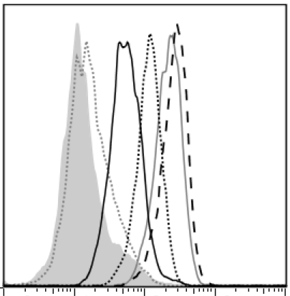
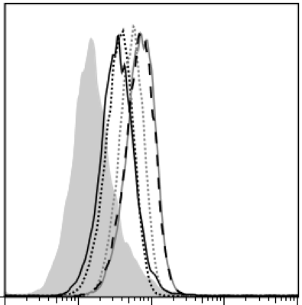
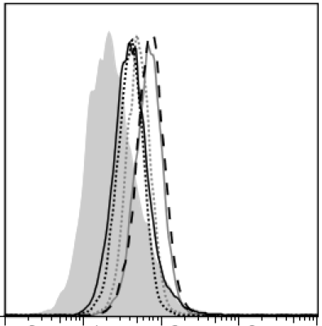
Supplemental Figure 1
Du145
A549
Cell number
MCF7
TR1-IgM(J+) 401
TR1-IgM(J+) 404
TR1-IgM(J+) 419
TR1-IgM(J+) 422
TR1-IgM(J+) 438
Control-IgM(J+)
Log fluorescence intensity
Supplementary Figure 1 Binding of TR1-IgMs to MCF7, A549, and DU145 cell lines.
Cells were stained with 5 μg/ml biotinylated-TR1-IgM(J+)s and control-IgM(J+) as indicated, followed by PE-conjugated streptavidin, and analyzed by flow cytometry. X-axis; fluorescence intensity of PE, Y-axis; relative cell number. Representative data of three independent experiments with similar results are shown.

Slide 2
Supplemental Figure 2
Cell viability (%)
Cell viability (%)
50
50
70
9
Antibodies concentration (ng/ml)
Antibodies concentration (ng/ml)
Cell viability (%)
Cell viability (%)
50
50
12
0.5
Antibodies concentration (ng/ml)
Antibodies concentration (ng/ml)
Cell viability (%)
50
100
Antibodies concentration (ng/ml)
Supplementary Figure 2 TR1-IgMs induce Colo205 cells killing.
Colo205 cells were plated and incubated with indicated antibodies for 24 h. Then, cell viability was measured as described in Figure 2A. Dotted lines show the concentration of each TR1-IgM(J+) at which the dose induced 50% of cell death. Representative data of three independent experiments with similar results are shown.

Slide 3
Supplemental Figure 3
Cell viability (%)
Cell viability (%)
Antibodies concentration (ng/ml)
Antibodies concentration (ng/ml)
Cell viability (%)
Antibodies concentration (ng/ml)
Supplementary Figure 3 Comparison of cytotoxic activity of IgG type and IgM type of TR1 antibodies .
Cytotoxic activities of Colo205 cell line by TR1-IgM or TR1-IgG in the absence or presence of goat anti-human IgG (2nd Ab, 10μg/ml) were examined. Colo205 cells were plated and incubated with indicated antibodies for 24 h. Cell viability was measured as described in Figure 2A. Representative data of three independent experiments with similar results are shown.

Slide 4
Supplemental Figure 4
Du145
Cell viability (%)
A549
Cell viability (%)
MCF7
Cell viability (%)
Supplementary Figure 4 TR1-IgMs induce tumor cell killing.
MCF7, A549, and DU145 cells were incubated with indicated antibodies for 24 h. Then, cell viability was measured as described in Figure 2A. Representative data of three independent experiments with similar results are shown.

