Slide 1
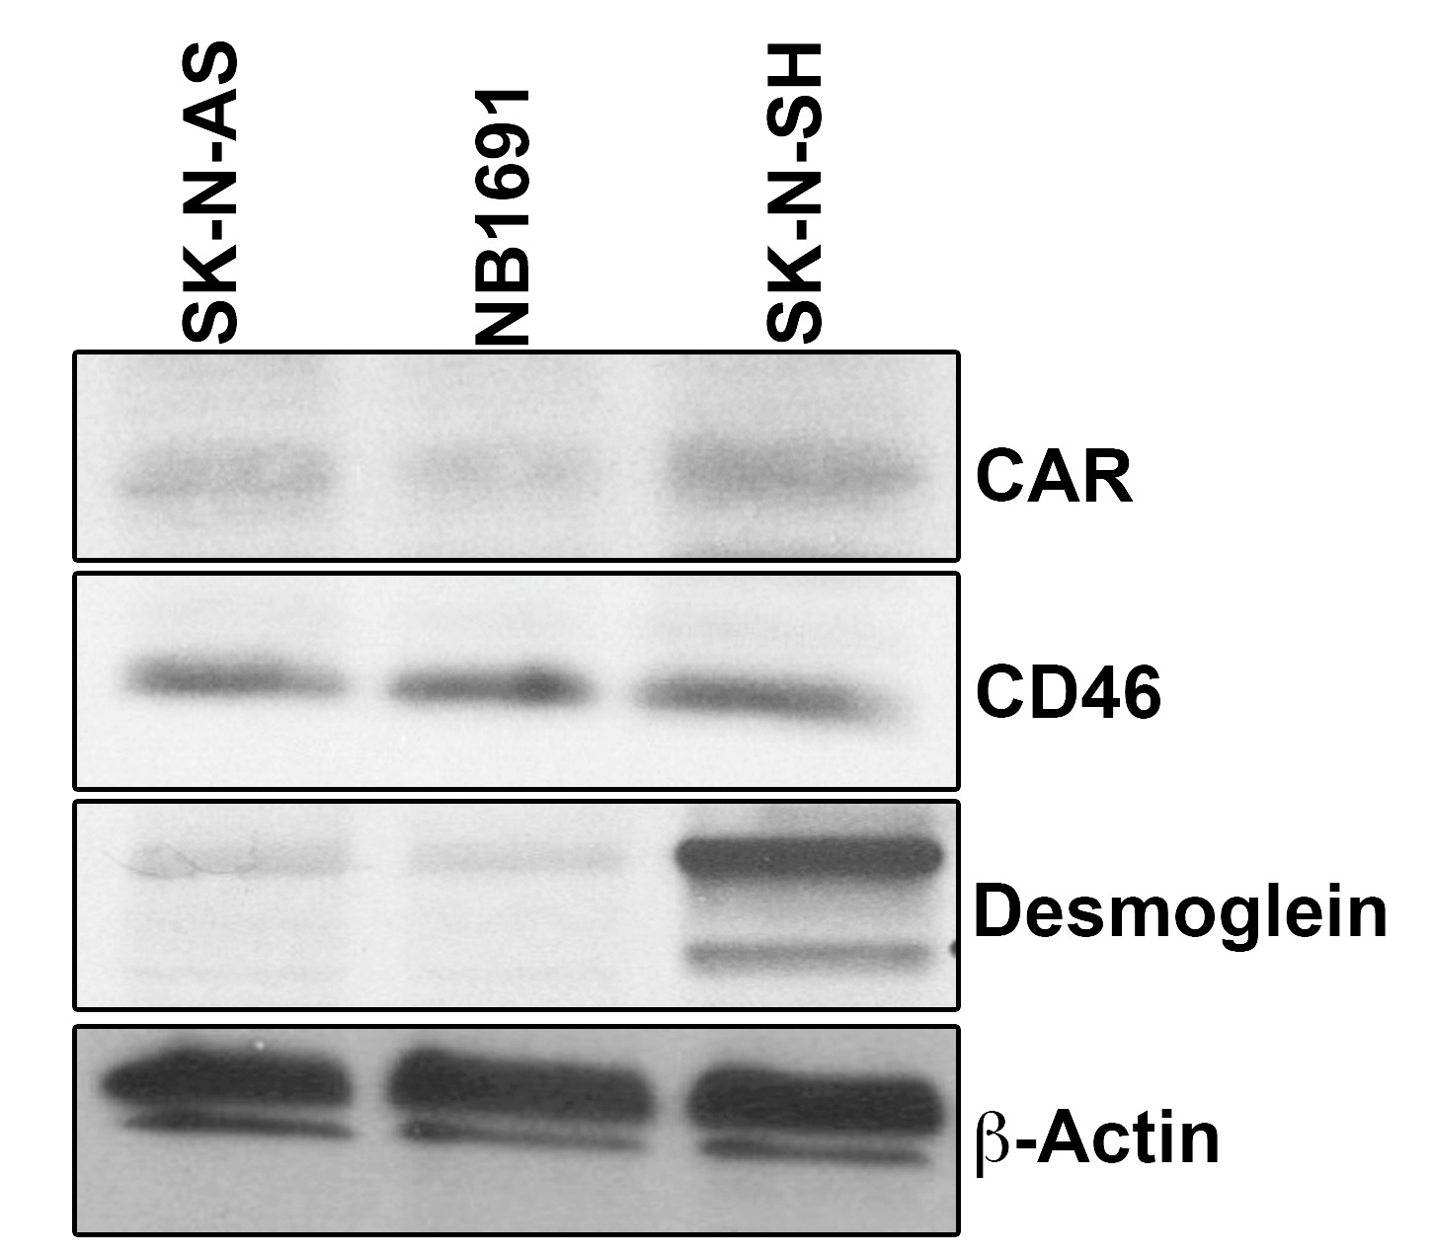
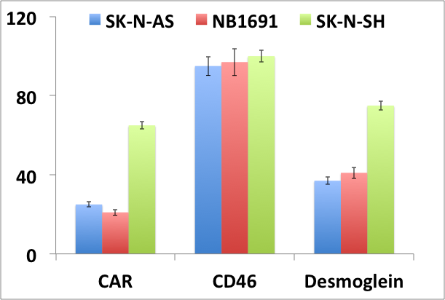
Supplementary Figure 1
% Positive cells

Slide 2
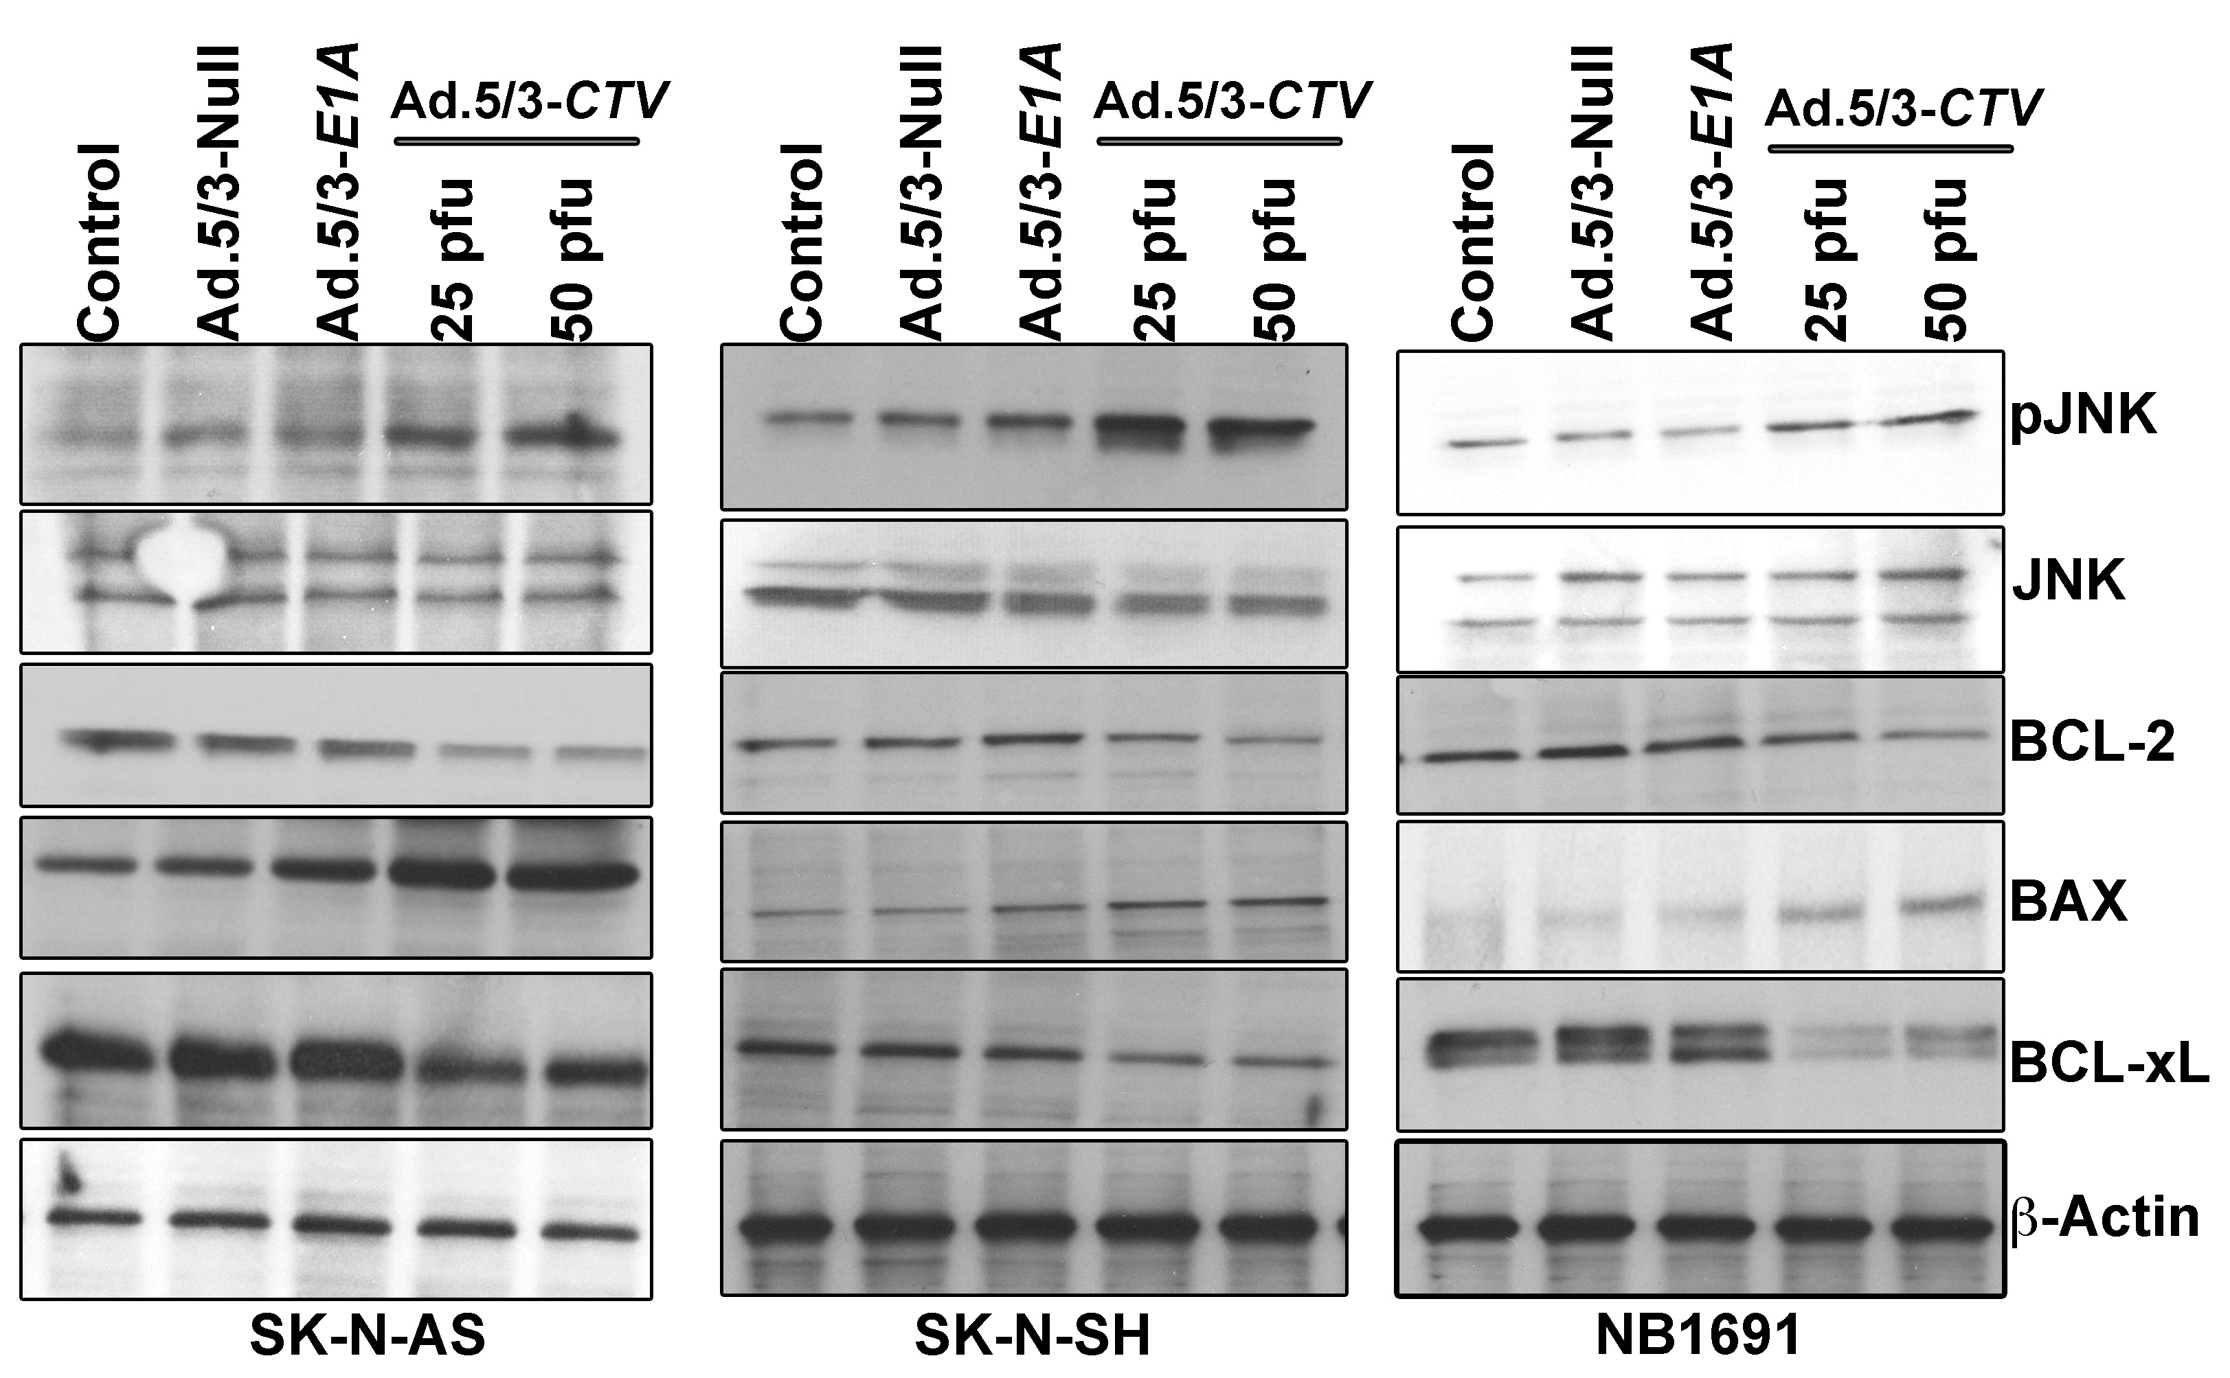
Supplementary Figure 2

Slide 3
Supplementary Figure 3

Slide 4
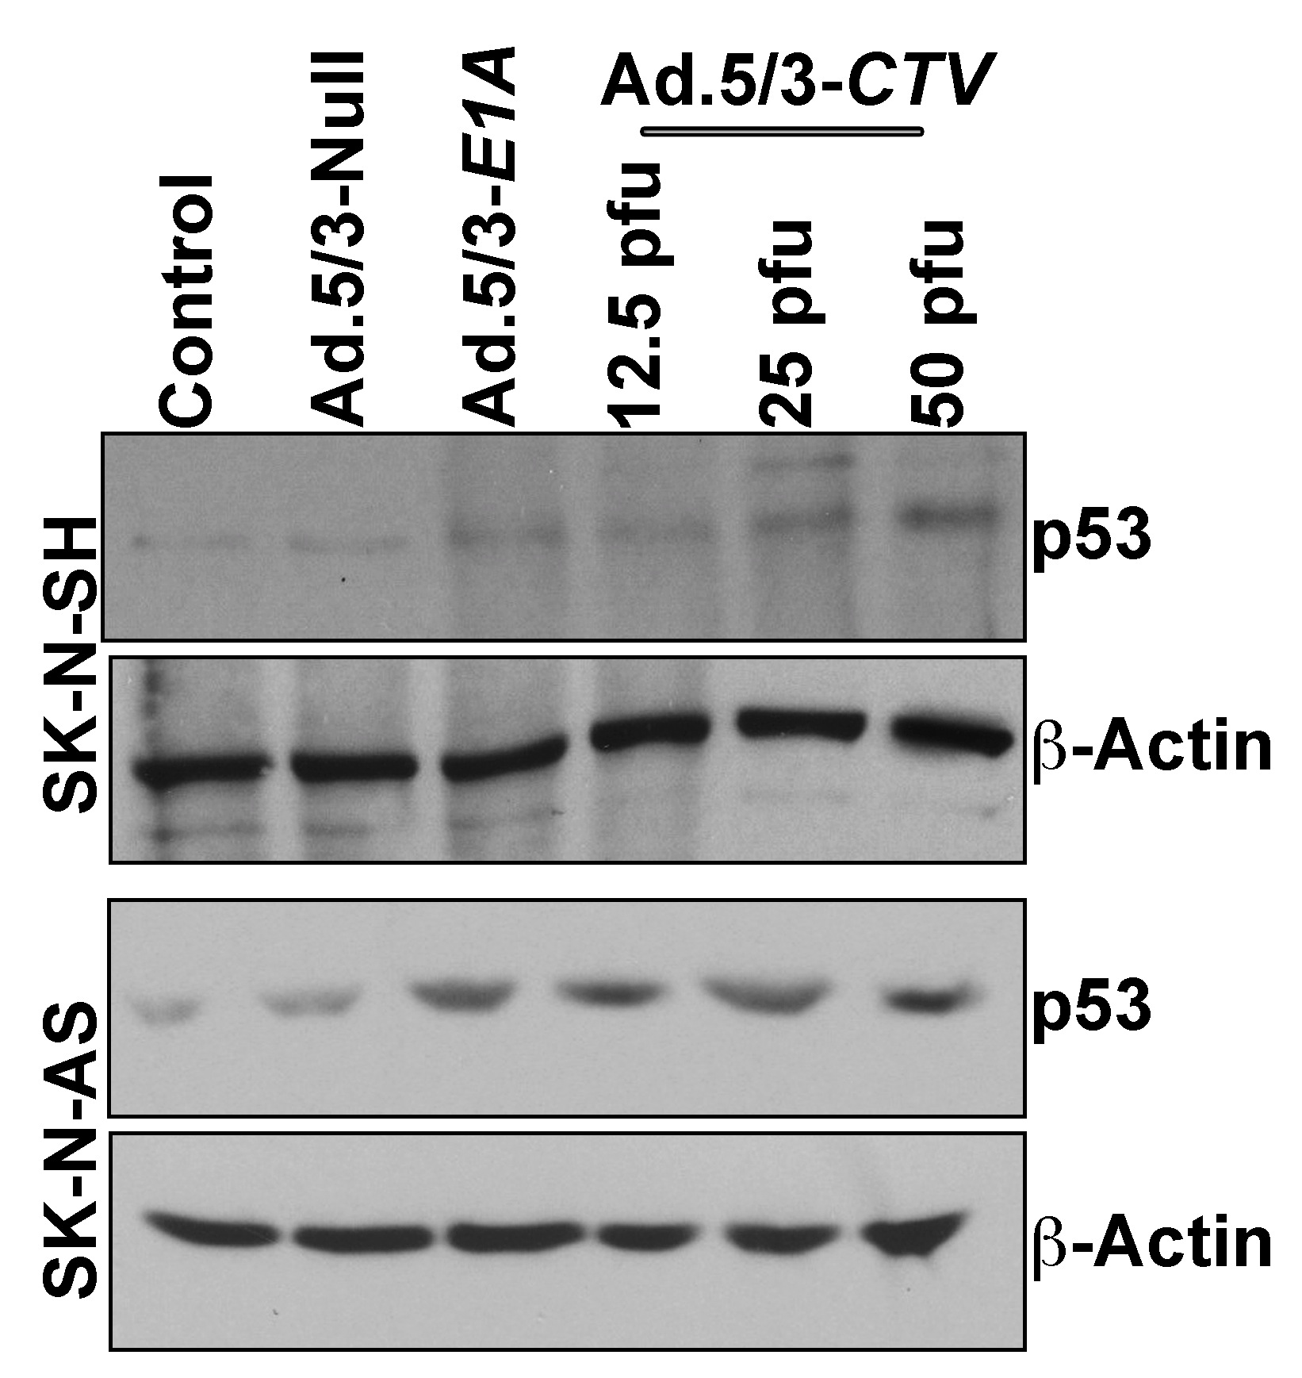
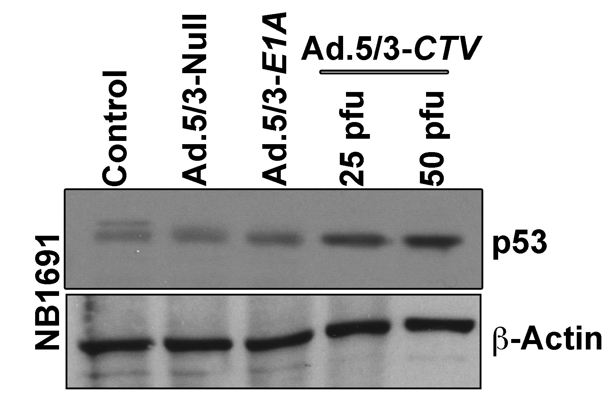
Supplementary Figure 4

Slide 5
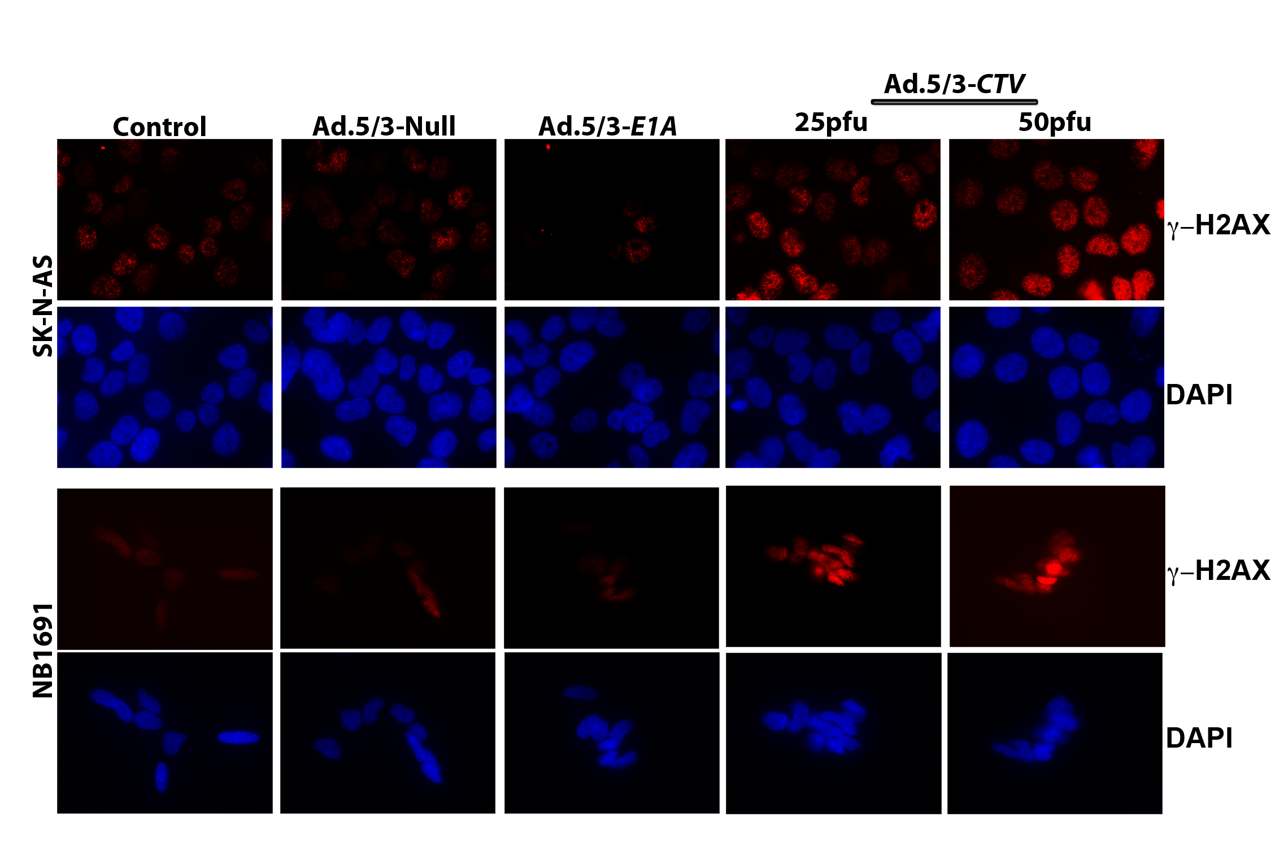
Supplementary Figure 5

Slide 6
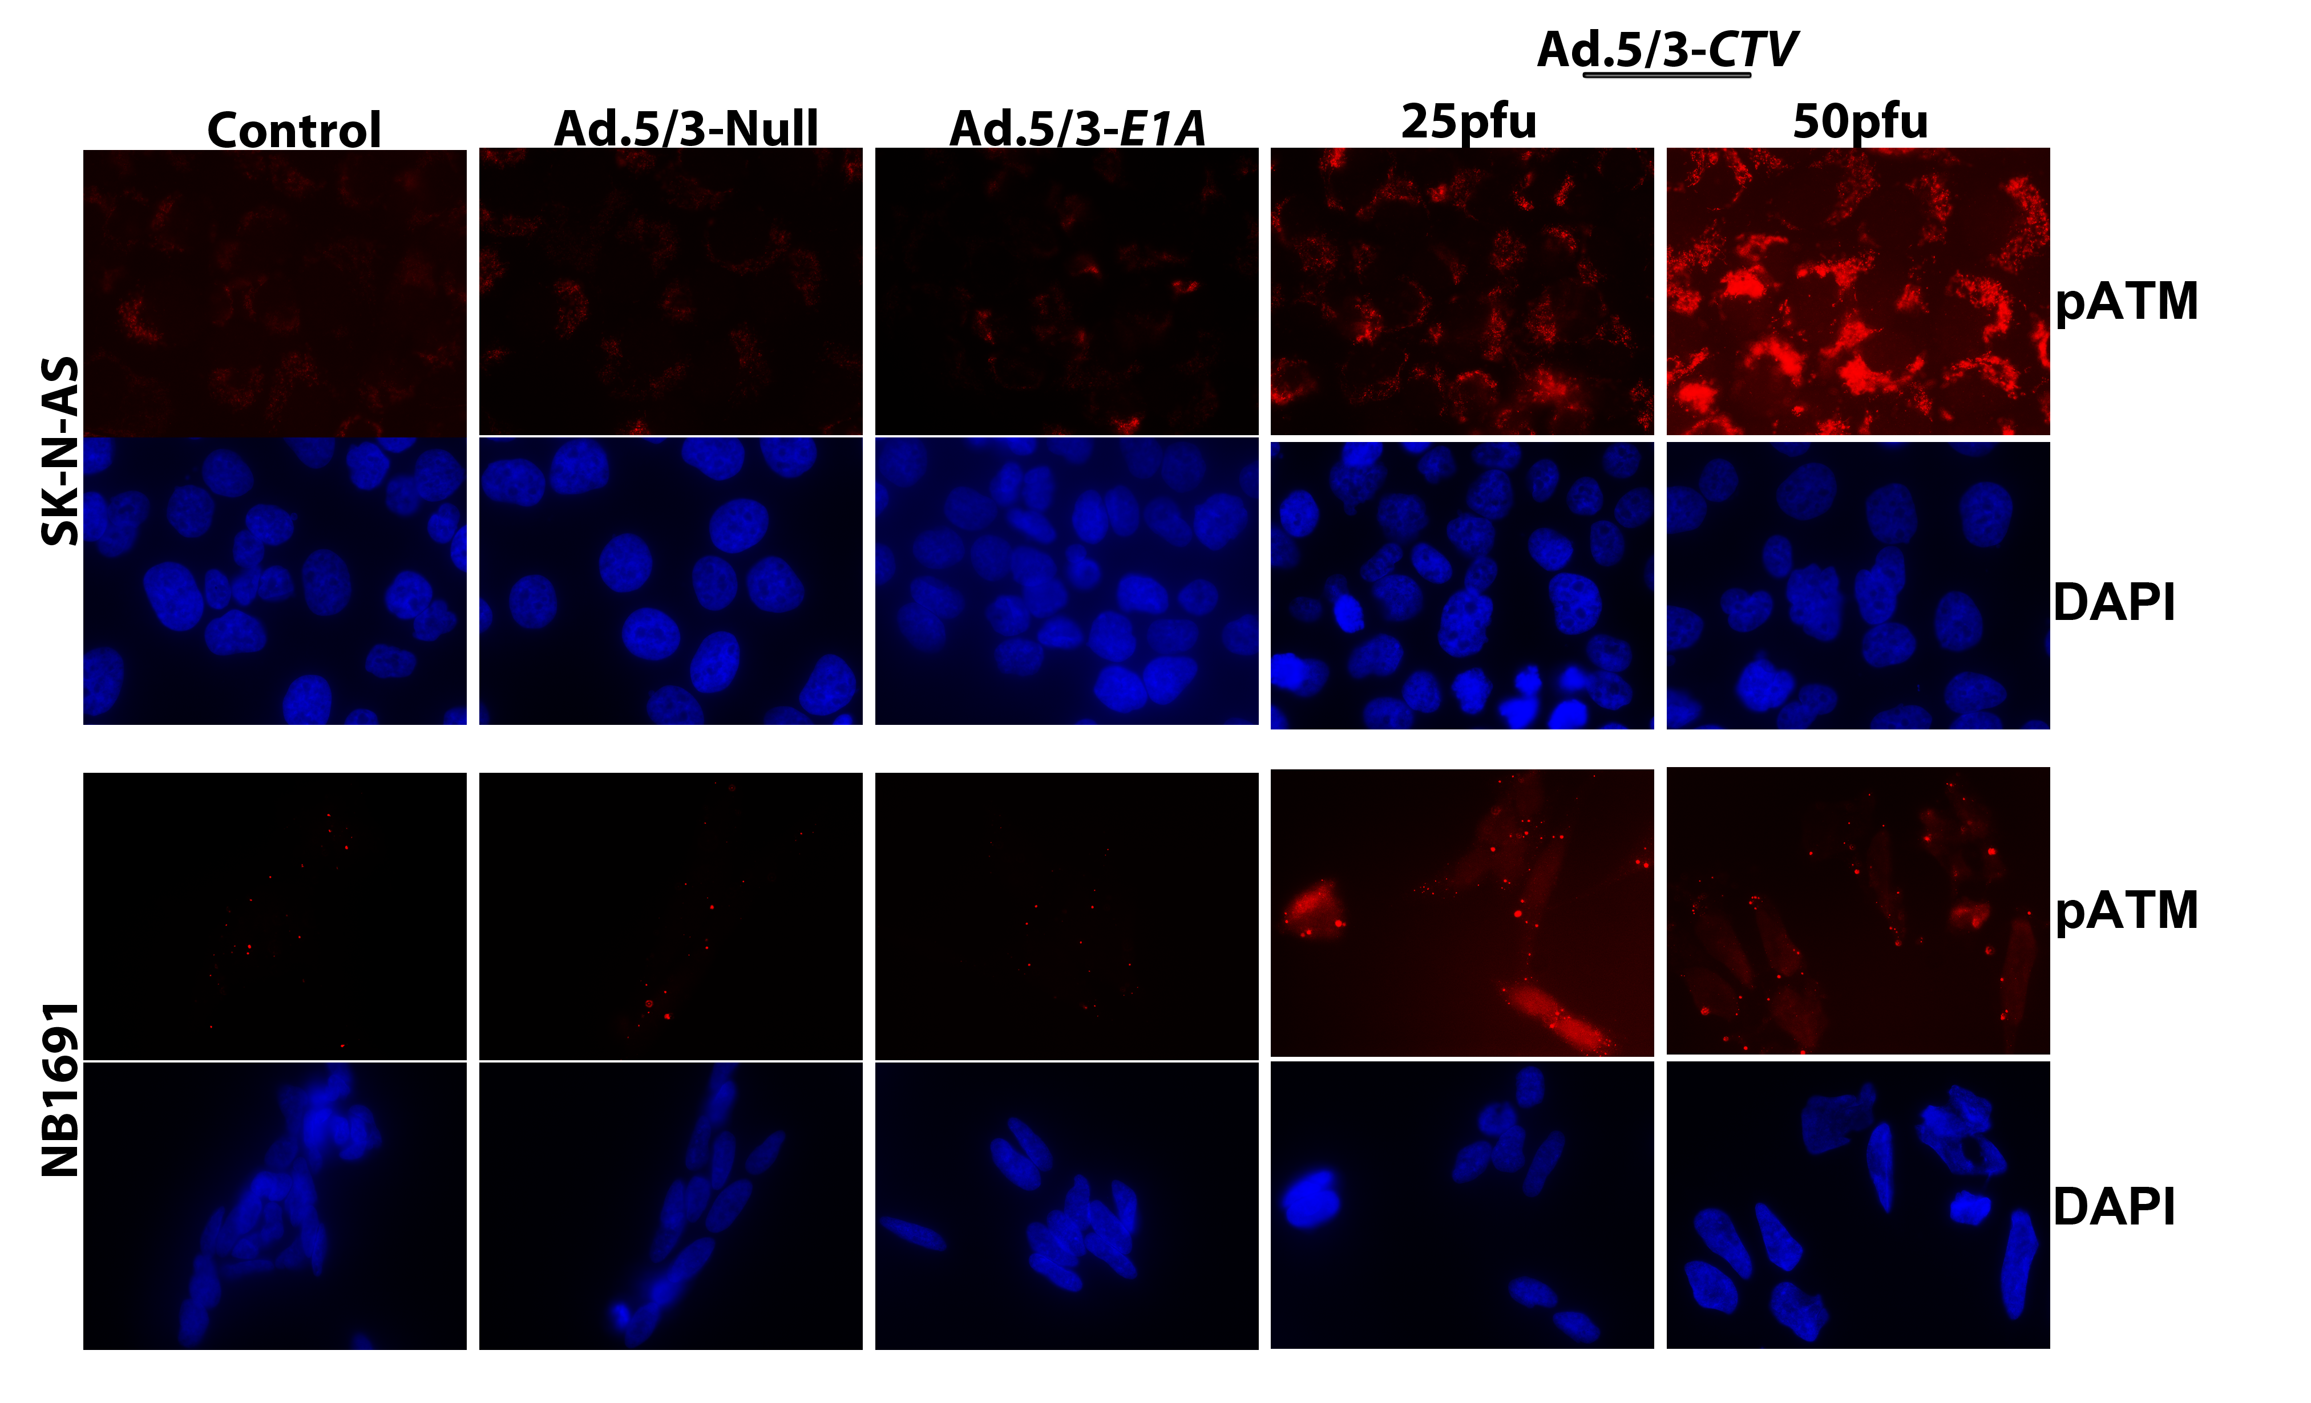
Supplementary Figure 6

Slide 7
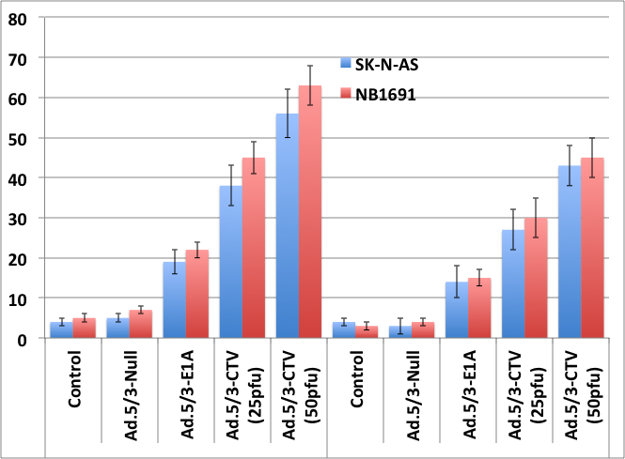
Supplementary Figure 7
*
*
@
TUNEL positive cells (%)
@
KU-55933

Slide 8
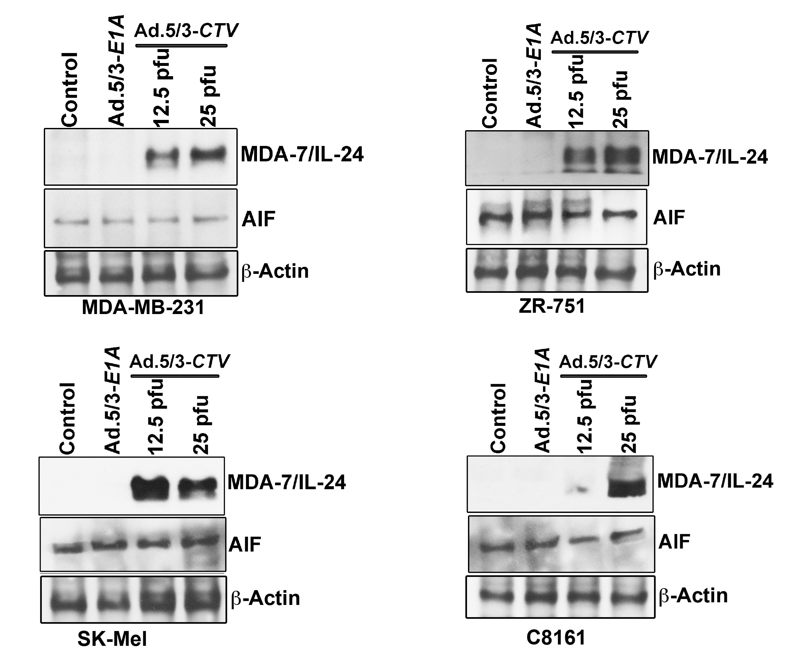
Supplementary Figure 8

