Slide 1
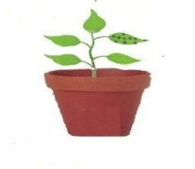
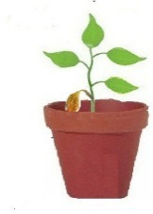
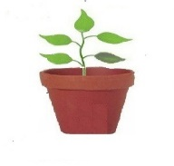
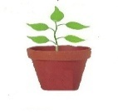
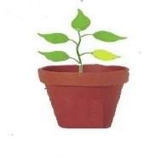
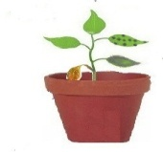

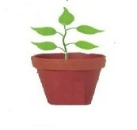

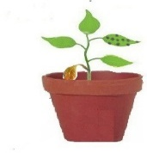

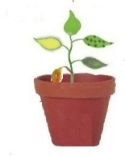

A
Sample collection
Drought
(5 days water with-holding)
NaCl (200 mM
4 days)
Oxidative stress (5 µm MV 12 h)
Pathogen
(5 days)
Cold (4⁰C 2 h)
B
Sample collection
3 days
Pathogen + Drought
i)
Pathogen spore inoculation (3 days)
3 days of water withholding
P+S+C+D+ MV
5 days
7 day old plants
Pathogen inoculation(3 days)
NaCl (200 mM)
2 day after pathogen infection
3 days of water withholding
5 µm MV spray
ii)
Cold (2 h @ 4⁰C)
Figure S5. Protocol for individual and combined stress imposition in sunflower. Sunflower plants were exposed to A) independent stress (n=3) and, B) combined stress for drought and pathogen (i. drought + pathogen combined) and all stress (ii. pathogen, NaCl, drought, cold and methyl viologen (MV) stress combined) (n=3). For pathogen treatment, plants were exposed to Plasmopara halstedii oomycete that cause downy mildew disease by growing the plants in the pathogen infected field (‘sick plot’ at GKVK Bangalore, n=3). The naturally infected leaf were rubbed to treat the new leaves.
Note: Focus in the manuscript is mainly on the drought plus pathogen combined stress (i). Combination of all stresses (ii) data is presented only in Fig 4 and Fig S8.

