Slide 1
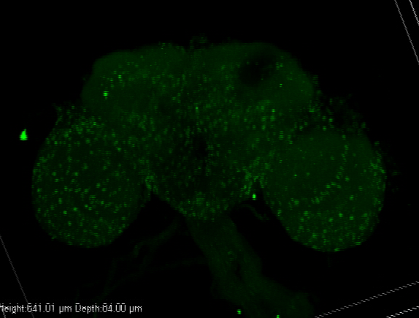
3D reconstruction of one typical ClkWT fly brain stained for VRI
ClkWT
Movie S1

