Slide 1
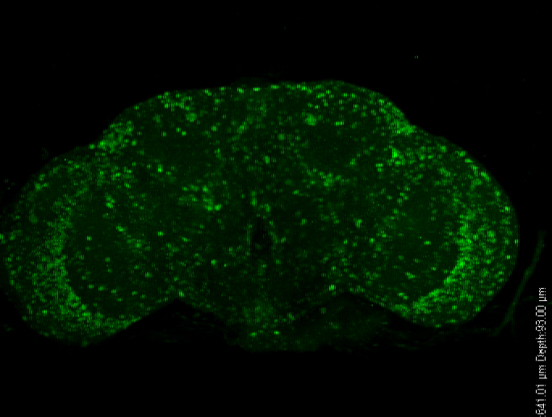
3D reconstruction of one typical ClkSV40 fly brain stained for VRI
ClkSV40
Movie S2

