Slide 1
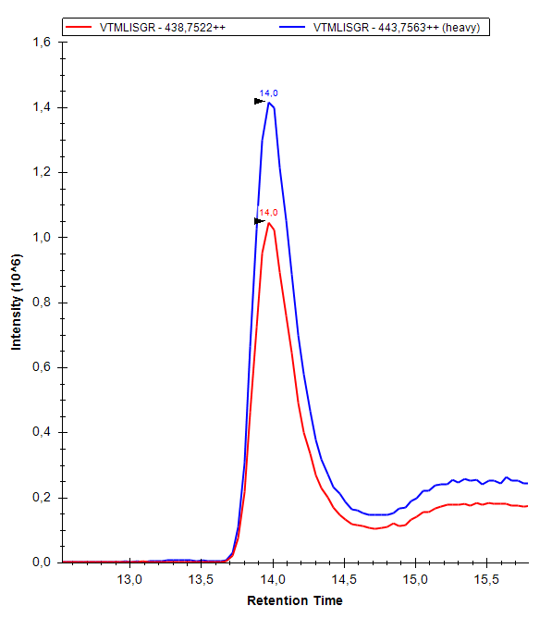
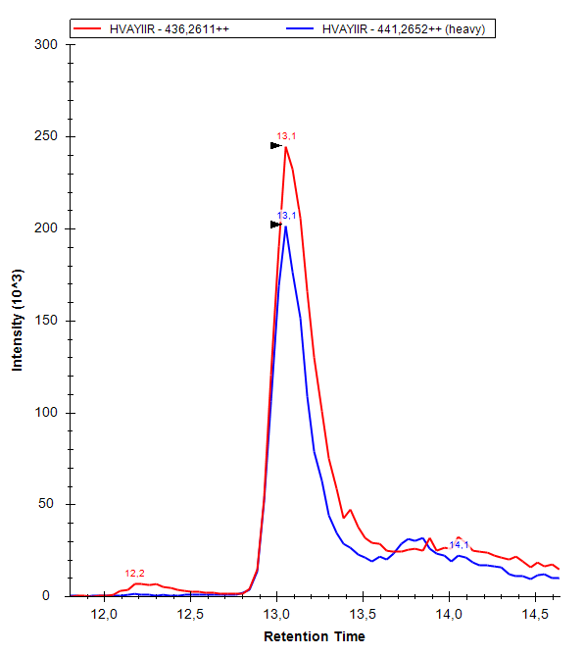
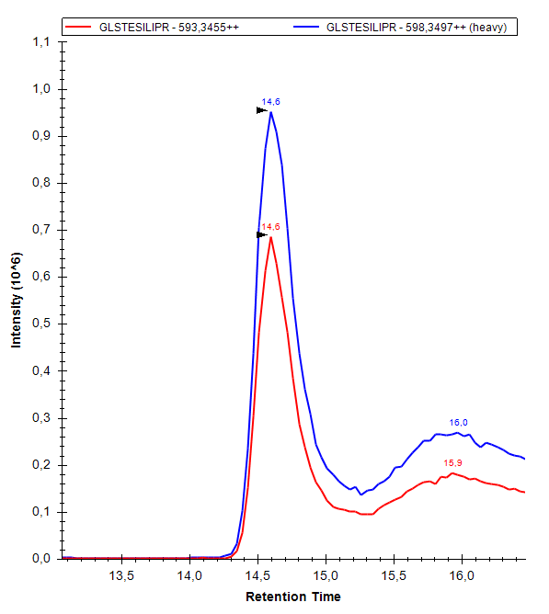
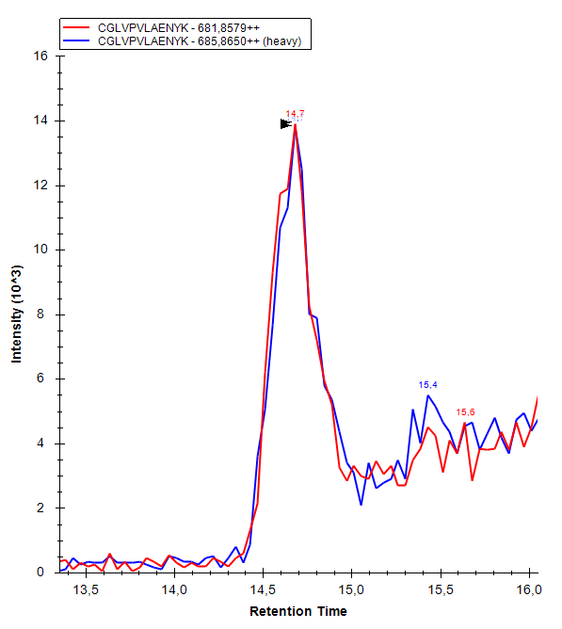
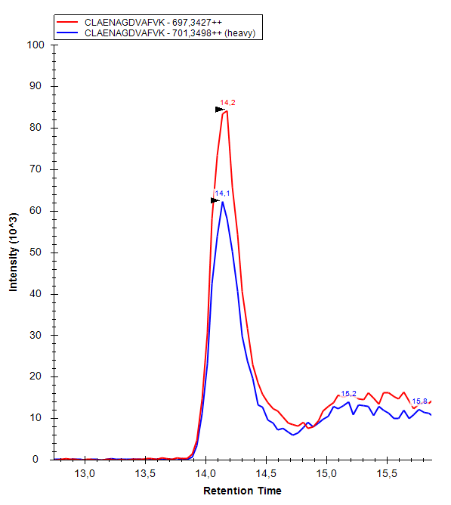
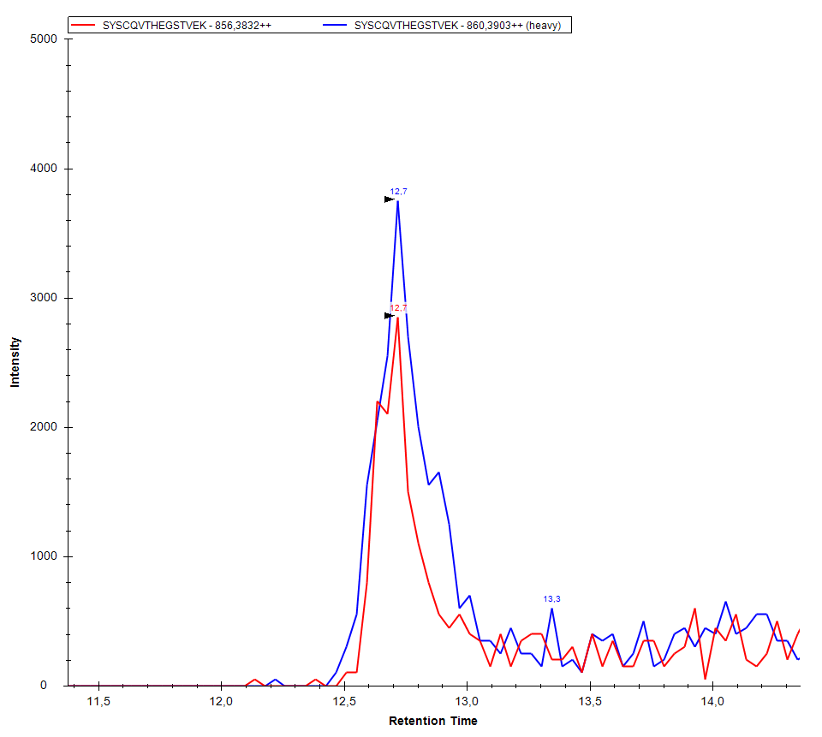
SUPPLEMENTARY FIGURE 1
LCN1 VTMLISGR
LCN1 HVAYIIR
LCN1 GLSTESILIPR
LTF CGLVPVLAENYK
LTF CLAENAGDVAFVK
IGLC SYSCQVTHEGSTVEK

Slide 2
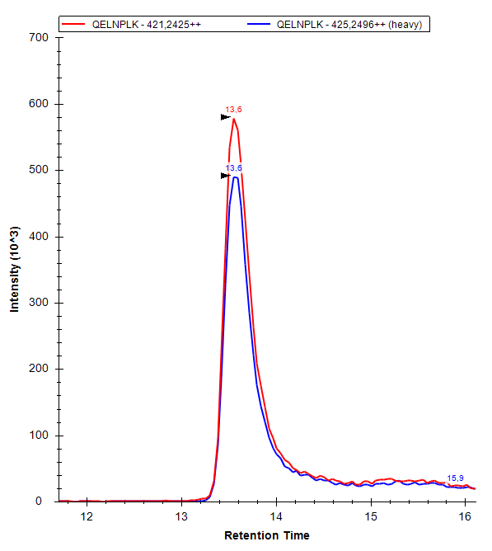
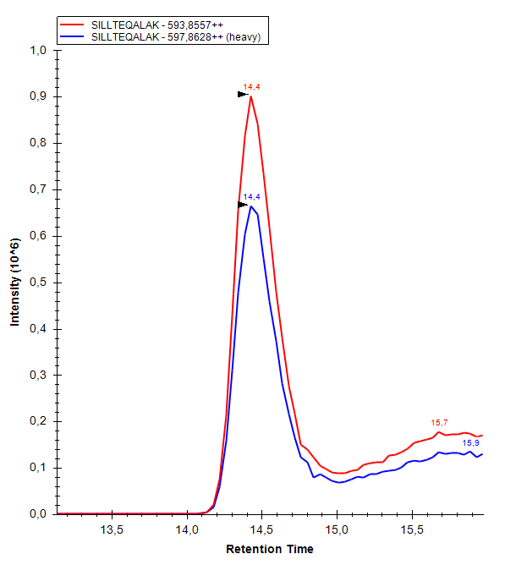
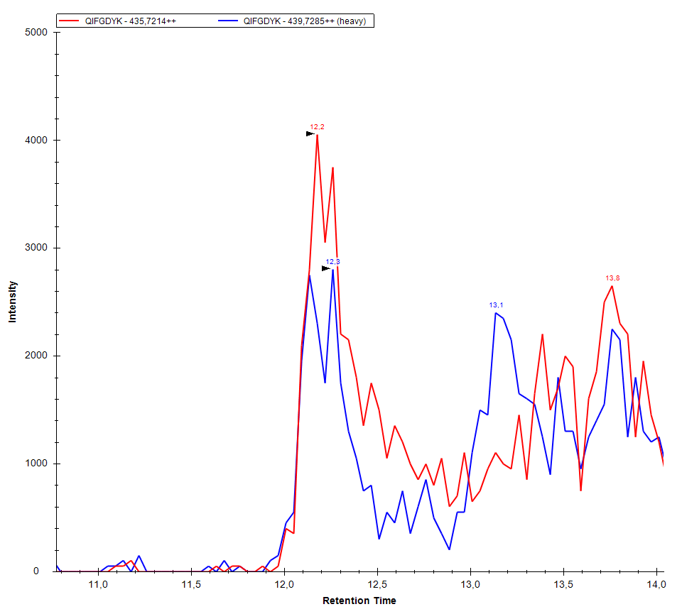
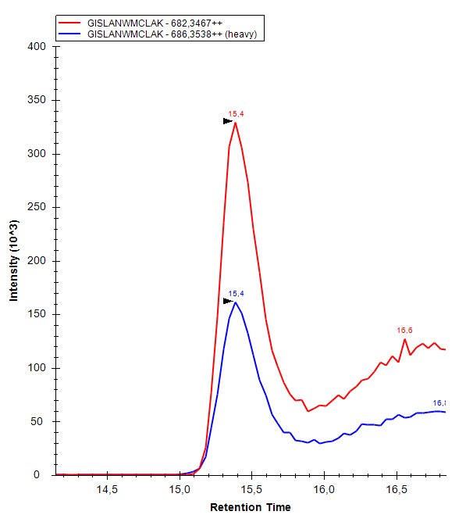
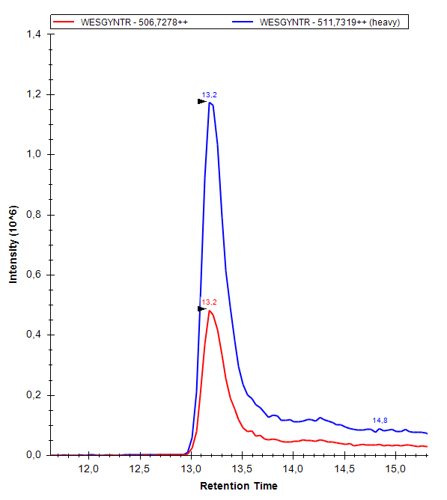
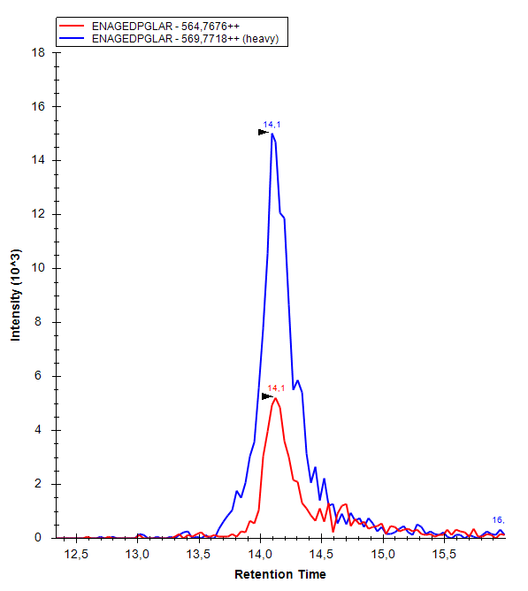
SUPPLEMENTARY FIGURE 1
LACRT QELNPLK
LACRT SILLTEQALAK
LPNA QIFGDYK
LYZ GISLANWMCLAK
LYZ WESGYNTR
DCD ENAGEDPGLAR

Slide 3
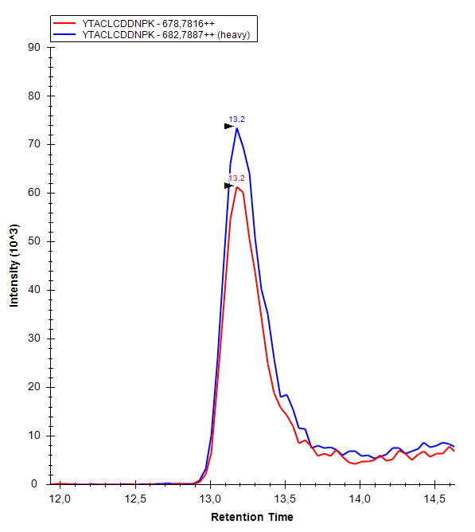
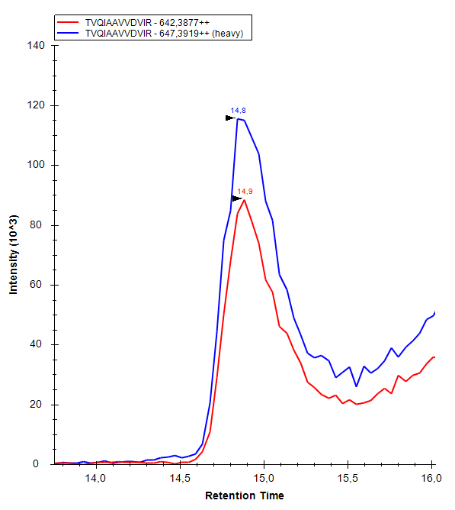
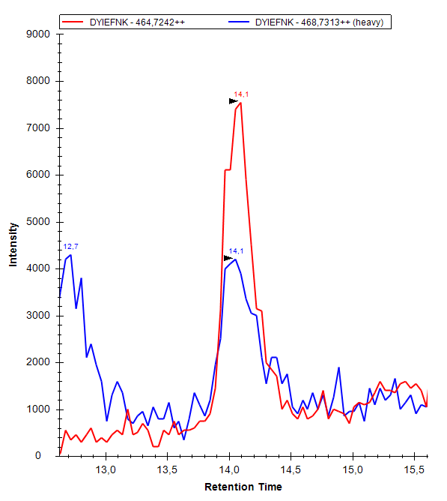
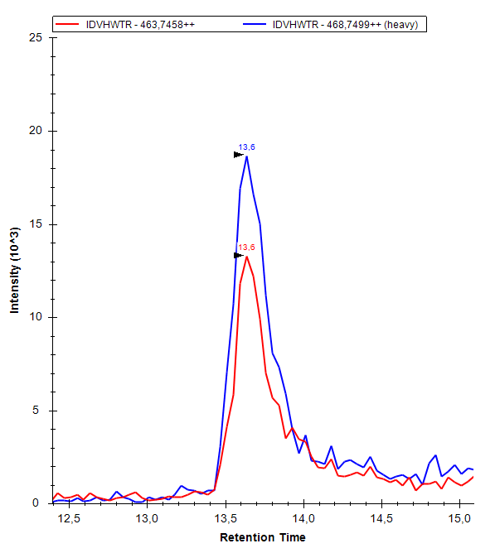
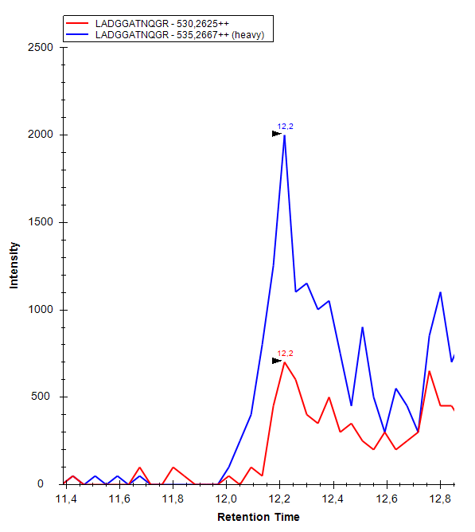
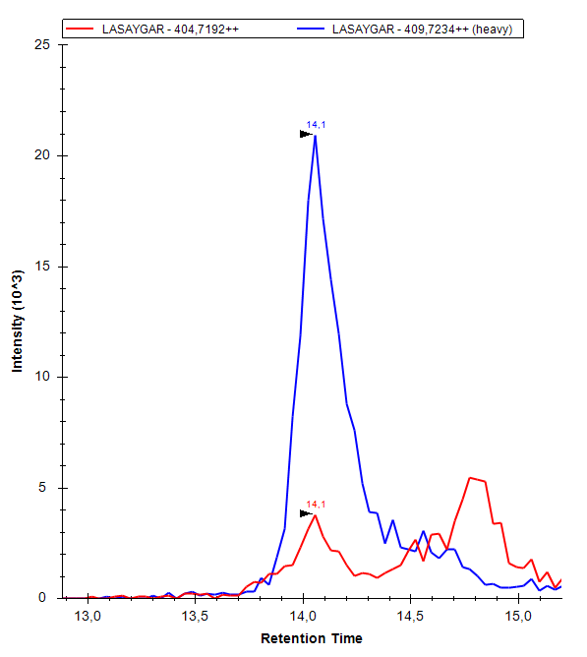
SUPPLEMENTARY FIGURE 1
PIP YTACLCDDNPK
PIP TVQIAAVVDVIR
AZGP1 DYIEFNK
AZGP1 IDVHWTR
GAL3BP LADGGATNQGR
GAL3BP LASAYGAR

