Slide 1
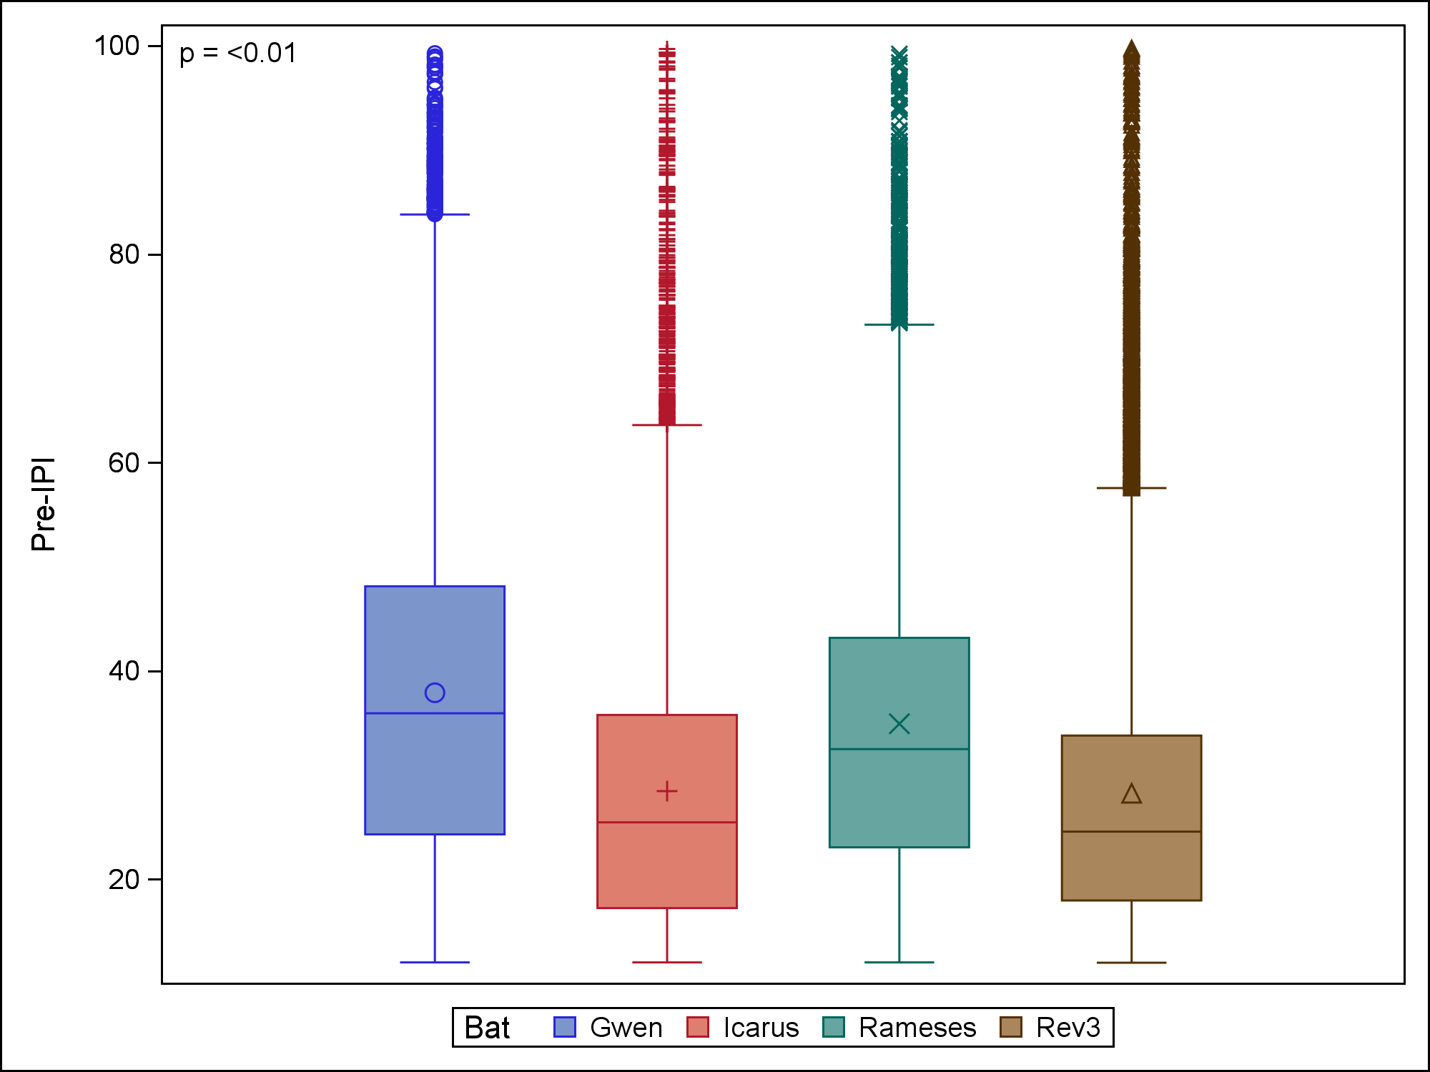
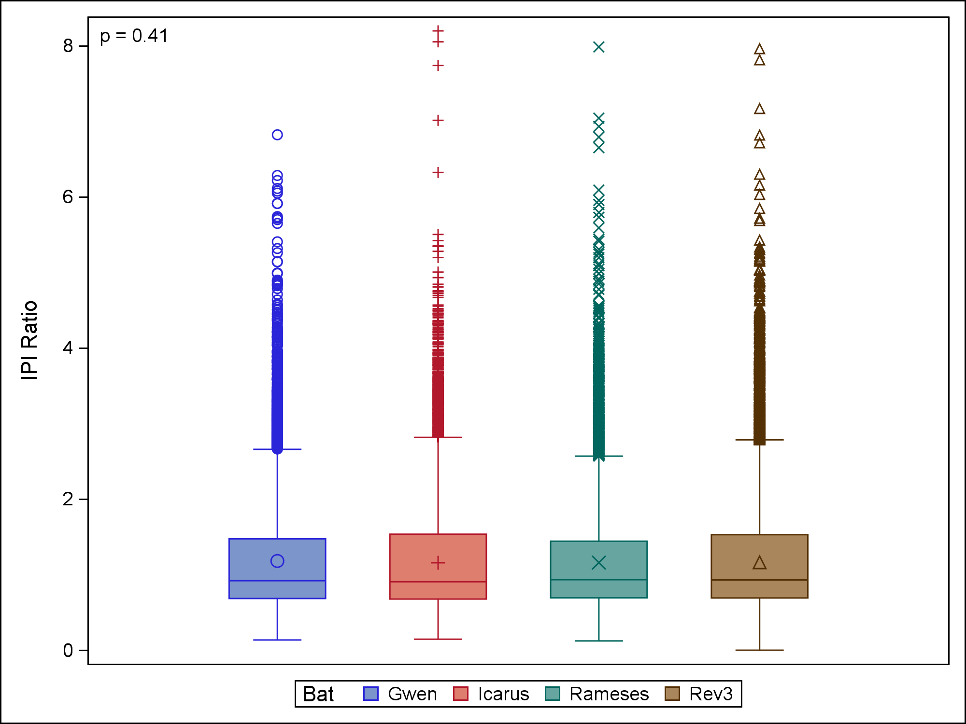
Figure S1. Individual differences between bats. Significant differences (Kruskal-Wallis, p < 0.01) were found between IPIs (left panel) emitted by individual bats, and these differences were accounted for in the GLMM. No significant differences were found between individual bats for IPI ratio (Kruskal-Wallis, p = 0.41).

Slide 2
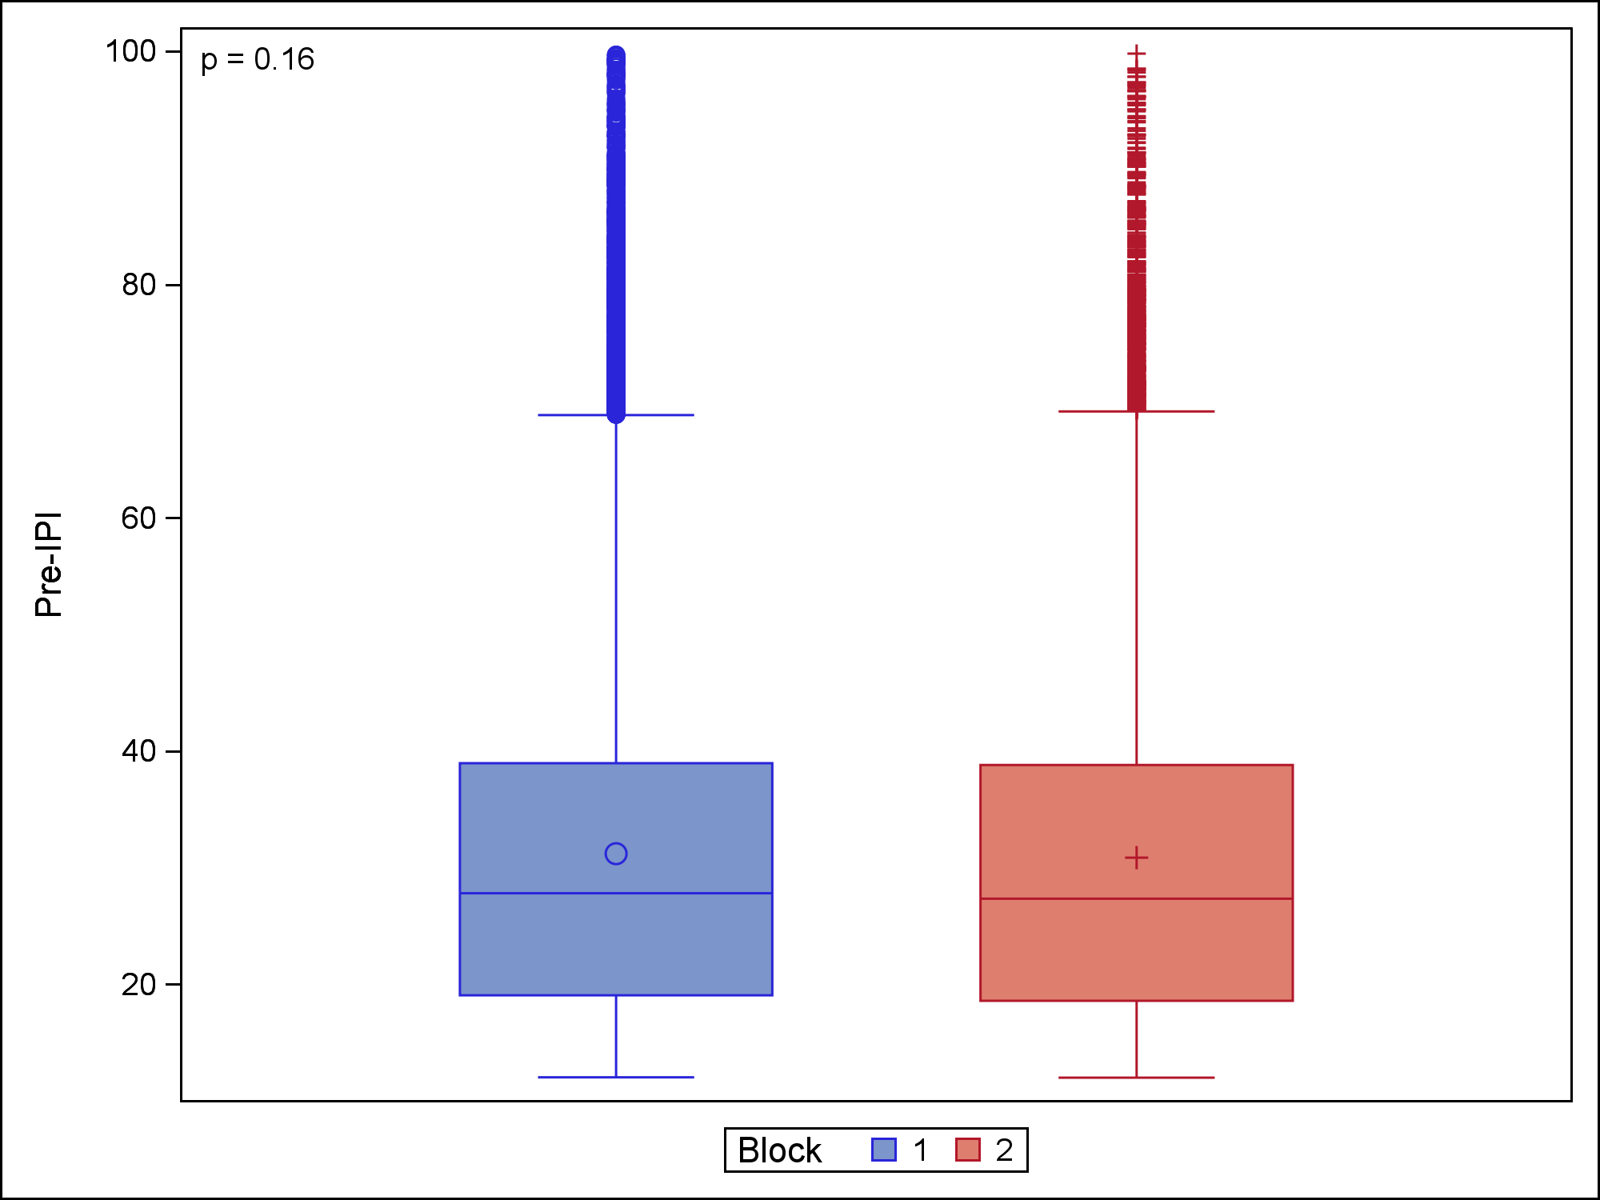
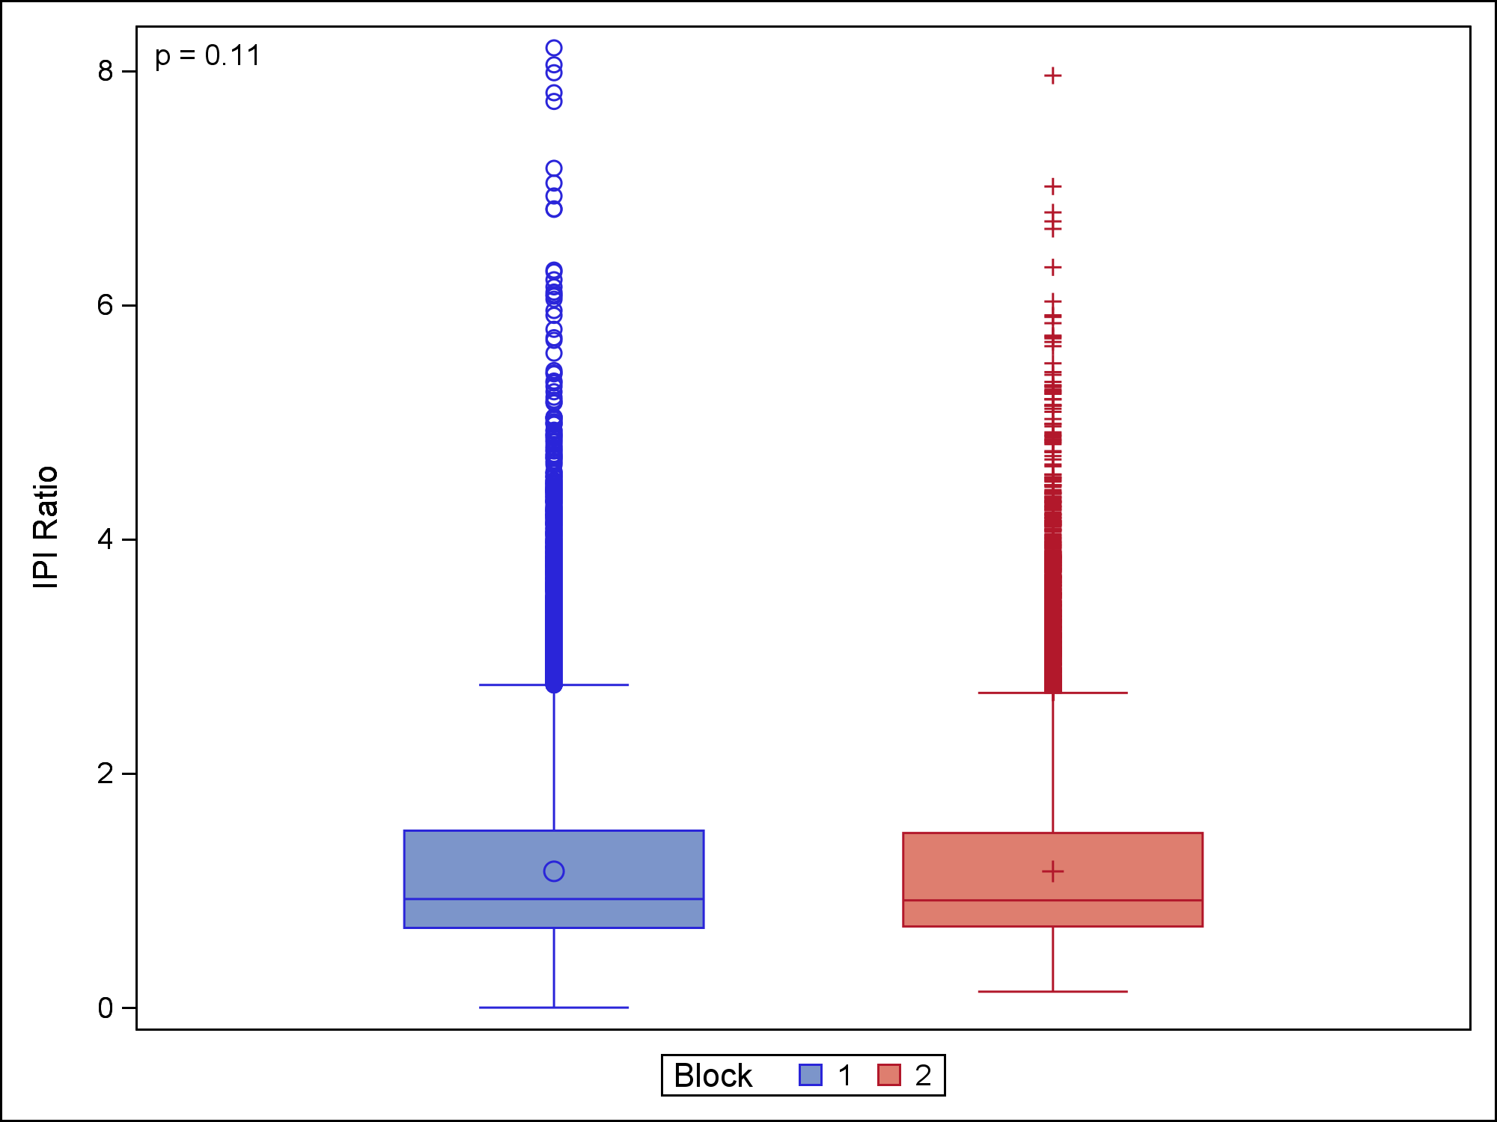
Figure S2. No effect of Block. Practice effects were controlled for in this experiment by dividing it into two “Blocks.” In Block 1, the corridor was progressively narrowed over many days, and in Block 2 the corridor was progressively widened again. Neither IPIs (left panel) nor IPI ratios (right panel) were dependent on Block (Wilcoxon Rank-Sum, p = 0.16 and p = 0.11, respectively) , and therefore practice effects were ruled out.

Slide 3
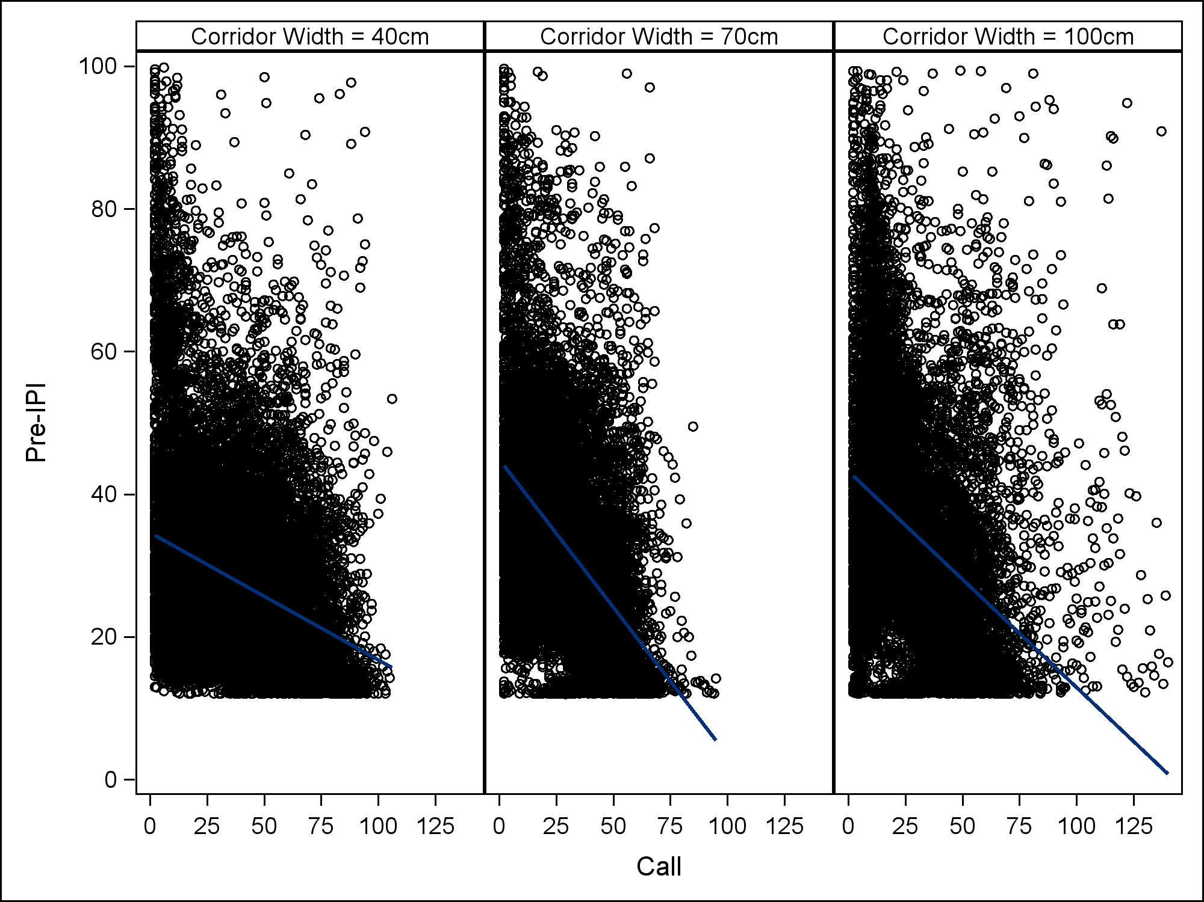
Figure S3. Interaction between call and pre-IPI. Each call’s pre-IPI is plotted as an open circle. Regression lines indicate average rate of decrease in IPI length over the course of a flight in the 40 cm (left), 70 cm (middle), and 100 cm (right) corridors.
Notes:
Figure S1 –
The slope of pre-IPI over successive calls is different within each corridor width condition. Therefore we need to model an interaction term between call and corridor width.

Slide 4
Table S1. Parameter estimates for GLM versus TRM
Parameter | GLM Estimate* (95% CI) | P-value | Truncated Estimate (95% CI) | P-value
Intercept () | 42.17 (41.84, 42.50) |  | 43.00 (42.12, 43.88)
Call () | -0.27 (-0.28, -0.26) | <0.0001 | -0.88 (-0.91, -0.85) | <0.0001
40cm vs. 100cm Corridor Width () | -4.05 (-4.39, -3.72) | <0.0001 | -12.48 (-13.49, -11.47) | <0.0001
70cm vs. 100cm Corridor Width() | -1.57 (-1.91, -1.23) | <0.0001 | -3.65 (-4.56, -2.75) | <0.0001
40cm vs. 70cm Corridor Width (- | -2.48 (-2.80, -2.17) | <0.0001 | -8.83 (-9.77,-7.88) | <0.0001
*We can see that the parameter estimates for the GLM are biased. By failing to take into account the truncated nature of the pre-IPI data, the effects of call and corridor width are underestimated. Even though the degree of bias is fairly large, it is acceptable: since the parameter estimates are biased towards 0, using a GLM will not result in false positives or false associations. It will simply underestimate the effect size of any associations, while simultaneously reducing the variance of those estimates. Since GLMs are a more flexible class of models than truncated regression models, this bias/variance trade-off is acceptable.

Slide 5
Table S2. Sources of variance in IPI ratio data
Random effect | Variance Estimate | ICC* | P-value (H0: Var=0)
Bat () | =0.000027 | <0.0001% | 0.4077
Day () | =0.001343 | 0.0025% | <0.0001
Flight () | =5.86E-7 | <0.0001% | 1.000
*ICC reports the proportion of variance attributable to that level. In this case, only the day level is significant, but still less than 1% of the variance in the IPI ratio data exists between bats, days, and flights. That is, >99% of the variance is between calls, regardless of which bat, on which day, on which flight.

Slide 6
Table S3. Two normal distributions and adjustments
Distribution | Unadjusted mixing probability | Unadjusted parameters | Adjusted* mixing probability
1 | 0.6180 | Mean = -0.24; St. Dev. = 0.07 | 0.7894
2 | 0.3820 | Mean = 0.47; St. Dev. = 0.08 | 0.2106
* Adjusted for corridor width, bat, day, and flight.

