Slide 1
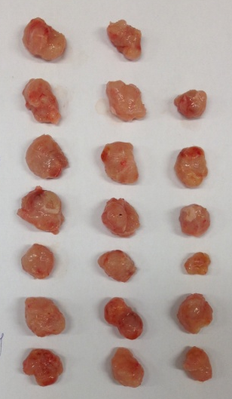
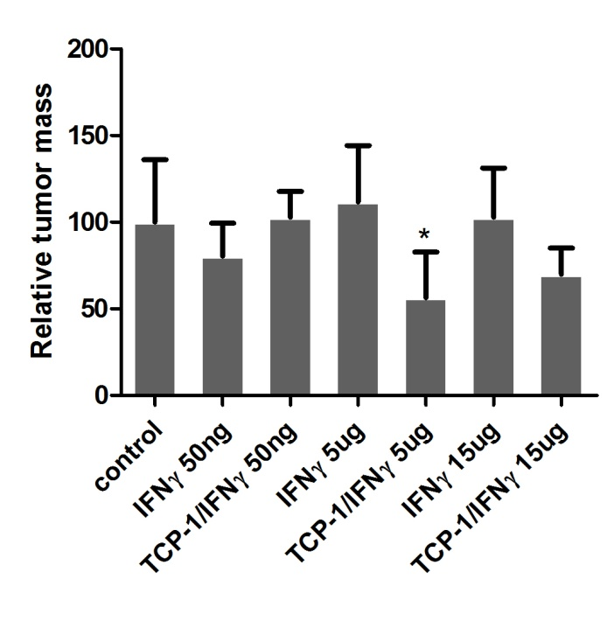
Fig. S3
A
B
Control
IFNγ 50ng
TCP-1/IFNγ 50ng
IFNγ 5μg
TCP-1/ IFNγ 5μg
IFNγ 15μg
TCP-1/ IFNγ 15μg

