Slide 1
Supplemental Data:
Table S1: Primer List
Gene | Rat | Human
SnU6 | F: CGC TTC GGC AGC ACA TAT AC R:AAA ATA TGG AAC GCT TCA CGA
18s | TaqMan primer assay: Eukaryotic 18s rRNA
pri-miR17-92 | TaqMan primer assay: Rn04272657_pri (Rat) Hs03302603_pri (Human)
TGFβRII | F: CAA CCA CAA CAC AGA GCT GC R: GTG TTC TGC TTC AGC TTG GC
αSMA | F: TTC AAT GTC CCA GCC ATG TA R: GAA GGA ATA GCC ACG CTC AG
Col1α2 | F: GCC AAG AAT GCA TAC AGC CG R: GAC ACC CCT TCT GCG TTG TA | F: GGG AGT AAT GCA AGG ACC AA R: ATC ATC ACC AGG CTT TCC AG
GAPDH | F: GAG TCA ACG GAT TTG GTC GT R: TTG ATT TTG GAG GGA TCT CG
DDX5 (p68) | F: CTC CAG AGG GCT AGA TGT GG R: ATG AGG TCG CTC ACT TGC TT
DDX17(p72) | F: CAG GCC ATC AAT CCA AAG TT R: CTT CCA TAG CCA CTG CCA TT
Drosha | F: ACT TCG CCA CCT CTT AGC AA R: TCA GAA CAG GCA GCA TCA TC
MeCP2 | F: GGG CTC AGG GAG GAA AAG TC R: GGC TGA AGG CTG TAG TGG TT | F: CTG TTT TGA GCC CTG AGG AG R: GCC TCT GTG CTT TCC TCA AC
miR17a * | CAAAGTGCTTACAGTGCAGGTAG
miR18a * | TAAGGTGCATCTAGTGCAGATAG
miR19a * | TCGTTTTGCATAGTTGCACT
miR20a * | ACTGCATTACGAGCACTTACA
miR19b * | AGTTTTGCAGGTTTGCATCC
miR92 * | ATAACGTGAACAGGGCCGGAC
*universal reverse primer used for qRT PCR per manufacturer’s protocol

Slide 2
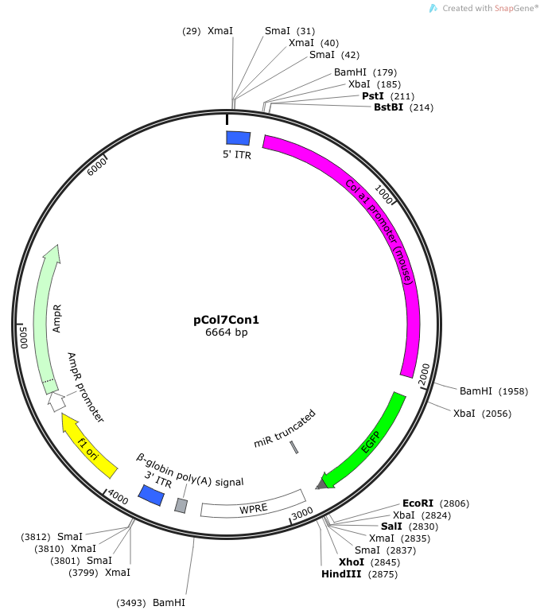
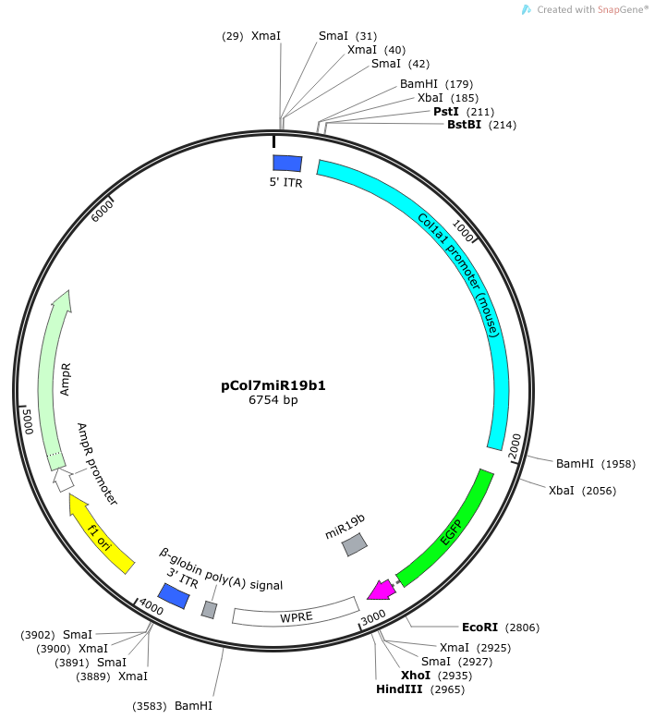
Supplemental Data
Fig. S1
A. B.
Table S2: miR19b sequence or truncated control
AAV2 Control | pCol7con1 | tccgaggcag taggcagctg cgcaaatcca tgcaaagctg atacatctgt ggcttcacta tcag
AAV2 miR19b | pCol7miR19b1 | tccgaggcag taggcagctg cgcaaatcca tgcaaagctg atacatctgt ggcttcacta tcagttttgc atggatttgc acagtcgctc actgtcaaca gcaatatacc ttc

Slide 3



Supplemental Data:
Fig. S2: Immunoblot alcohol metabolizing proteins
E25 E0 E25 E0
ADH
ALDH
CYP2E1
Table S3: Residual alcohol in tissue culture media
Ethanol (25 mM)
TCM (24 hour) | SEM
8.71 µm | ±1.23
Table S4: Target sequence for miR19b:MeCP2
MeCP2 | Predicted pairing of target region (top) and miR19b (bottom)
Position 239-245 Human 3’UTR hsa-miR-19b-3p | 5’…AGG GCC AGA AGU AGC UUU GCA CU… 3’…AGU CAA AAC GUA CCU AAA CGU GU…
Position 238-244 Rat 3’UTR rno-miR-19b-3p | 5’…AGG GCC AGA AGU AGC UUU GCA CU… 3’…AGU CAA AAC GUA CCU AAA CGU GU…

Slide 4
Supplemental Data
Fig. S3:
A.
B.

