Slide 1
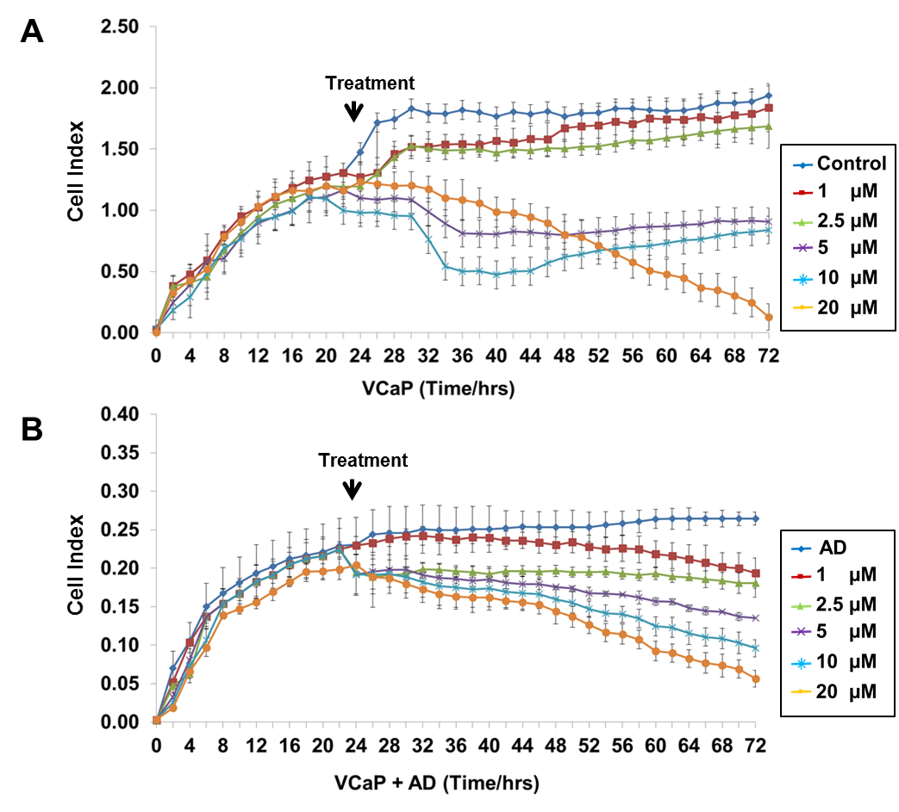
Supplementary Figure S1
Udayakumar et al., 2015

