Slide 1
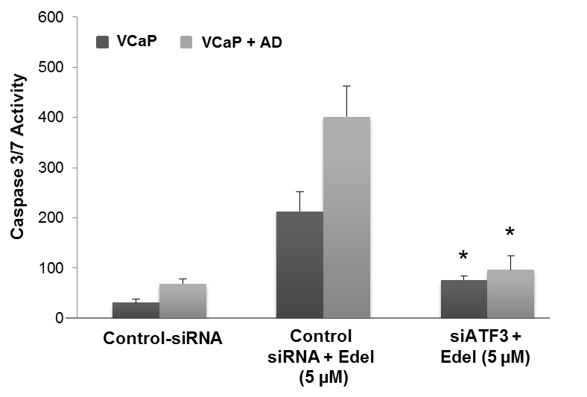
Supplementary Figure S2
Udayakumar et al., 2015

