Slide 1
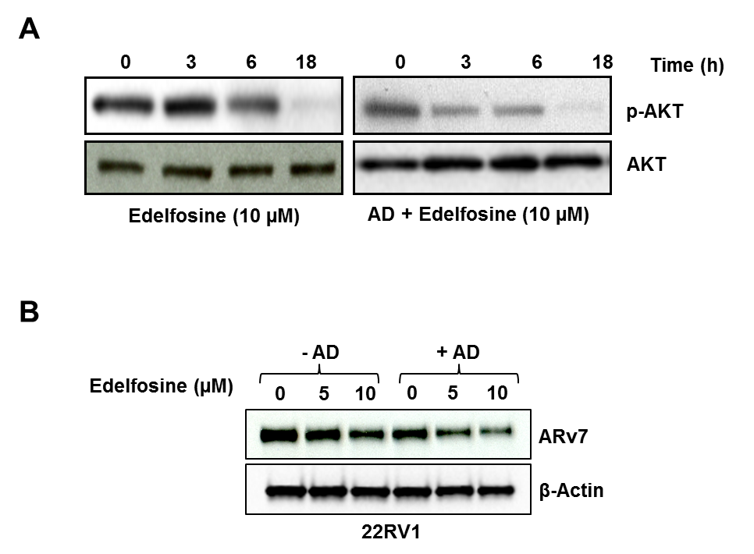
Supplementary Figure S3
Udayakumar et al., 2015

