Slide 1
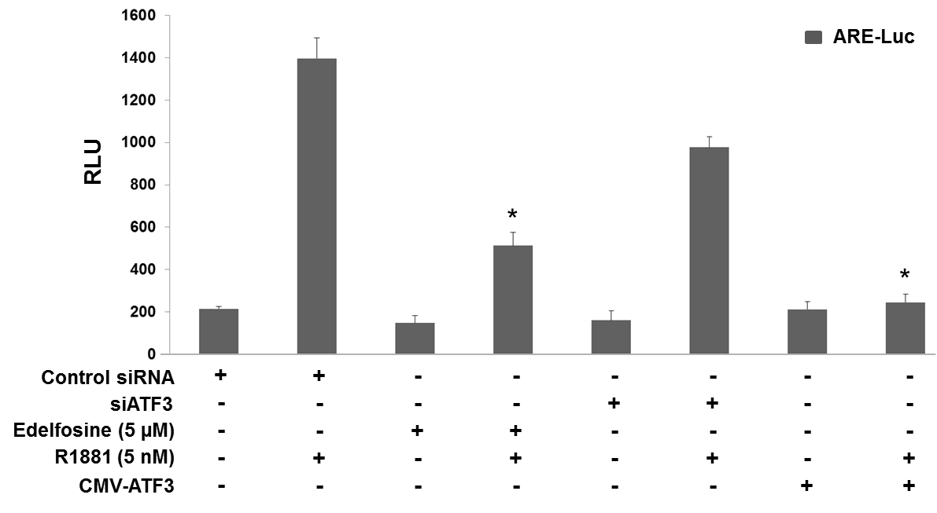
Supplementary Figure S5
Udayakumar et al., 2015

