Slide 1
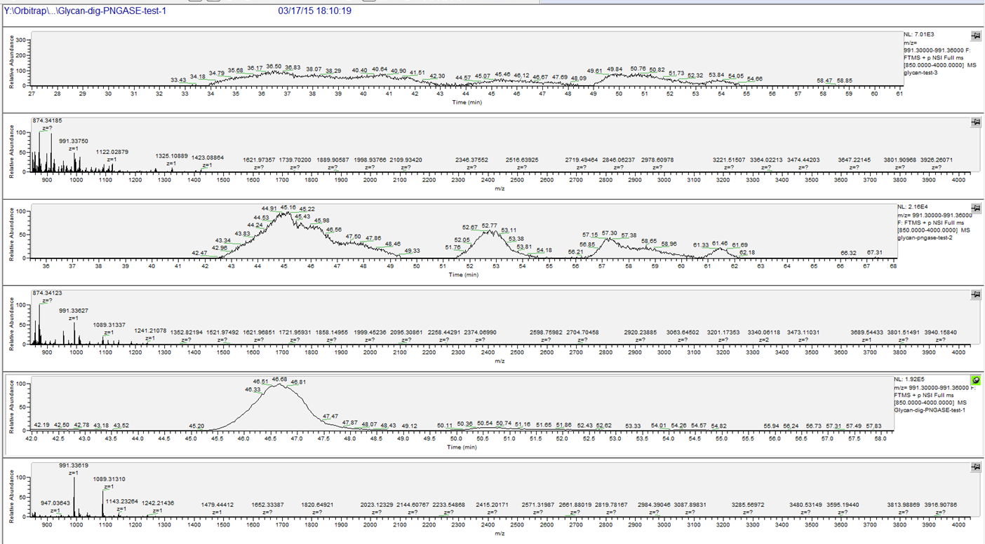
Released glycans or free glycans?
Intensity
nothing
X3
Trypsin
X10
Trypsin + PNGase F
Mannose-6
Notes:
We investigated the origin of labeled O-glycan with the use or not of Trypsin, PNGase F without TMT reporters. O-glycan seemed to be released and not free in our samples. Released from Serine or threonine or to phosphate groups? It still a pending question.

