Slide 1
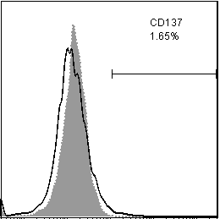
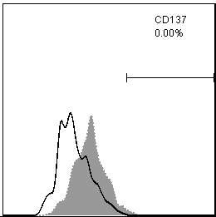
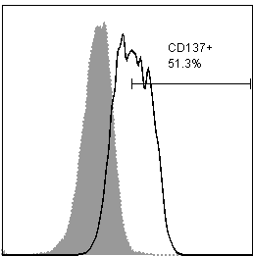
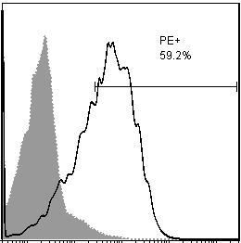
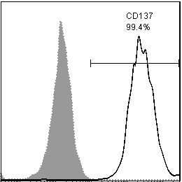
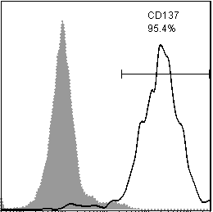
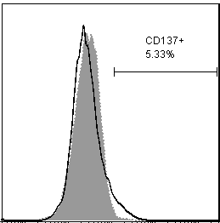
Suppl Fig 1
L-428-control
L-1236-control
KM-H2-control
HDLM-2
1.65%
0.00%
51.3%
59.2%
L-428-CD137
L-1236-CD137
KM-H2-CD137⁻
99.4%
95.4%
5.33%
Isotype
CD137
CD137
Suppl Fig 1. Expression of CD137 in HRS cell lines. Percentages of CD137 positive cells are represented in the top right corners of panels. Open histograms (anti-CD137); grey histograms (isotype control). Data are representative of 3 independent experiments.

Slide 2
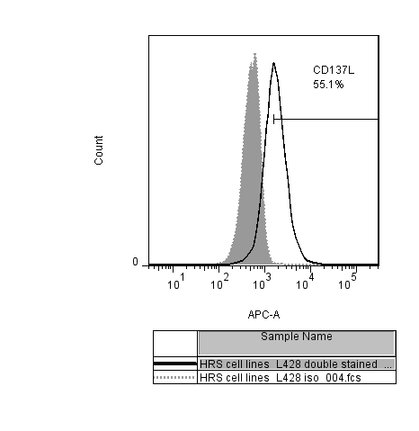
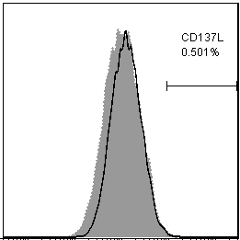
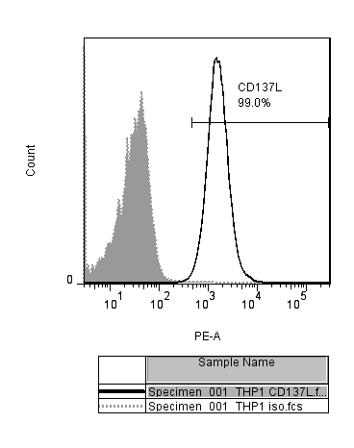
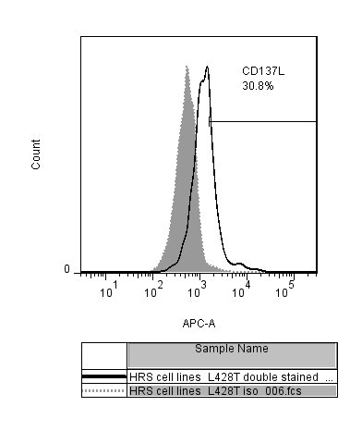
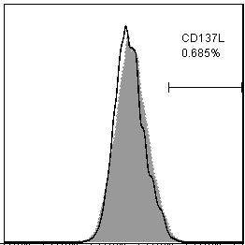
L-428-control
L-1236-control
Suppl Fig 2
THP-1
55.1%
0.5%
99.1%
L-428-CD137
L-1236-CD137
30.8%
0.69%
Isotype
CD137L
CD137L
Suppl Fig 2. Expression of CD137L in HRS cell lines and THP-1. Percentages of CD137L positive cells are indicated in the top right corner of the panels. Open histograms (anti-CD137L); grey histograms (isotype control).

Slide 3
Suppl Fig 3
Anti-IL-13 (μg/ml)
Suppl Fig 3. Neutralisation of IL-13 reduces the proliferation of L1236-control cells. Indicated concentrations of anti-IL-13 antibody have been added to the cells for 24 h. Proliferation was measured by ³H-thymidine incorporation. Depicted are means ± standard deviations of 5 replicates.

