Slide 1
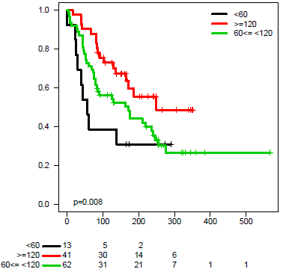
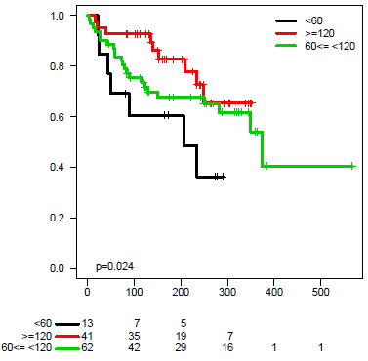
A
B
Progression Free Survival (%)
Overall Survival (%)
Days
Days
Supplementary Figure 1

