Slide 1
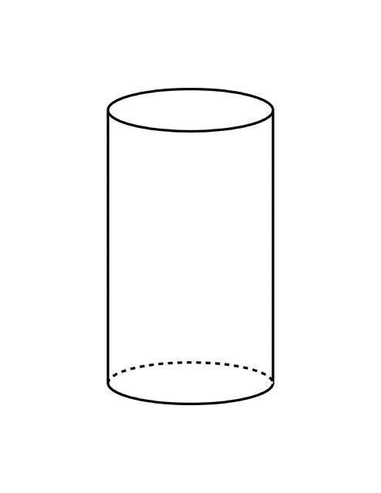
Mild Moderate Severe
Common mental health problems
Behavior Problems / Parenting
Depression
Substance use
Trauma
Anxiety
Arrows above are all points of referral
Referral point
Referral point
Universal Prevention
Specialty Services: Hospitalization or Medication
  Each silo needs a different provider OR one provider would have to train and master multiple treatments
  Multiple referral points within this box
  No training on how to handle comorbidity or differences in severity
Notes:
Mark:
Points to make:
Multiple referall points (the red stars)
Treatment exist in silos
** I need double sided arrows looking around between all the silos also (so the craziness of arrows shows all the referral needs.
Mark – still need lines between depression and SU, trauma and anxiety.
Red stars are referral points where we would loose people
Should box this all in and put a “table” of sorts explaining this?

