Slide 1
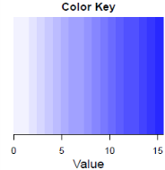
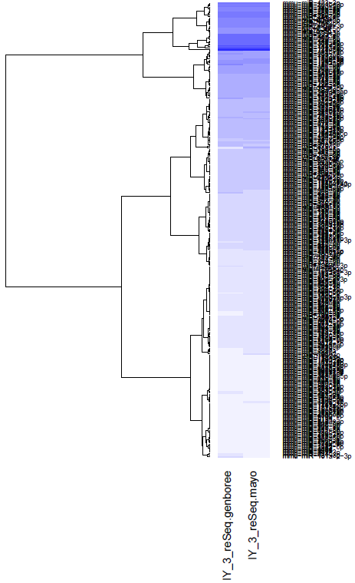
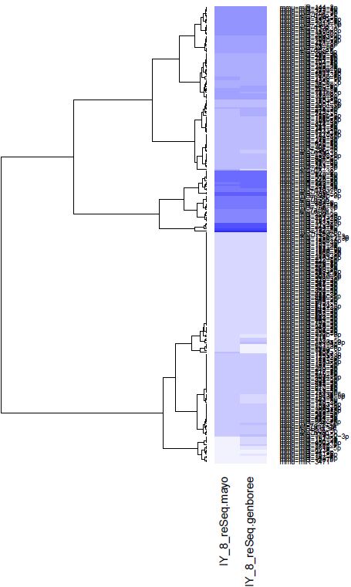
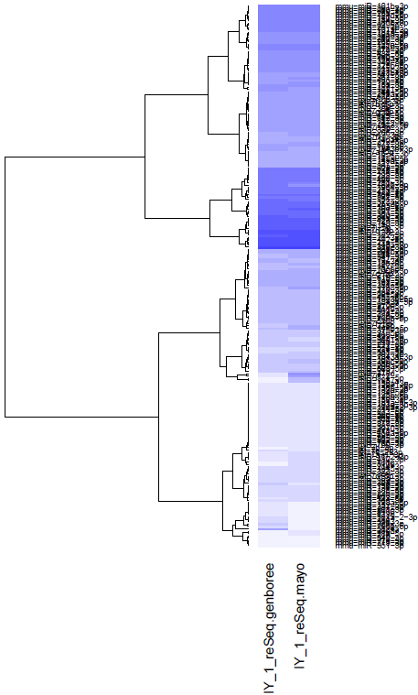
S2 Figure: Heat-map of miRNA expression. Normalized Reads Count:
log2(1 + raw_read_count * 100000/(reads_mapped_to_mature_miRBase) )
Baseline
1 hour
24 hours
N=227
GENBOREE
Mayo
N=336
N=237
GENBOREE
Mayo
GENBOREE
Mayo

