Slide 1
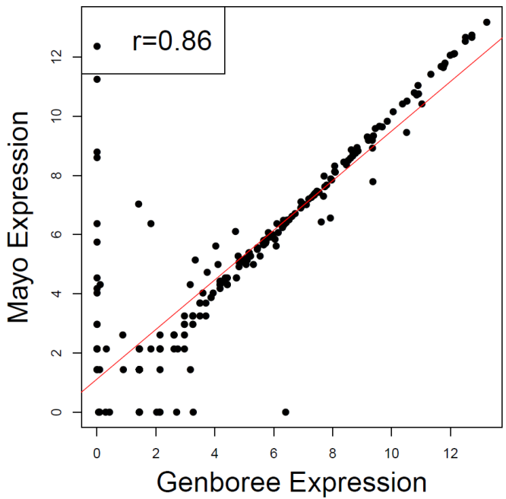
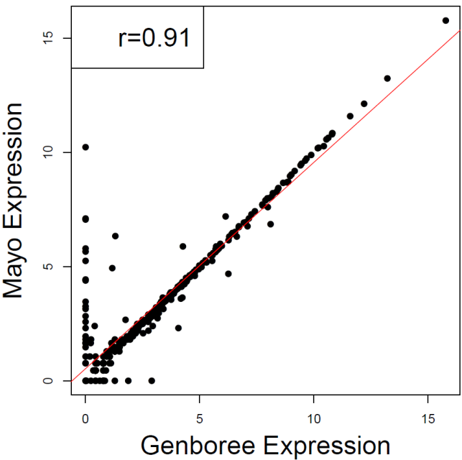
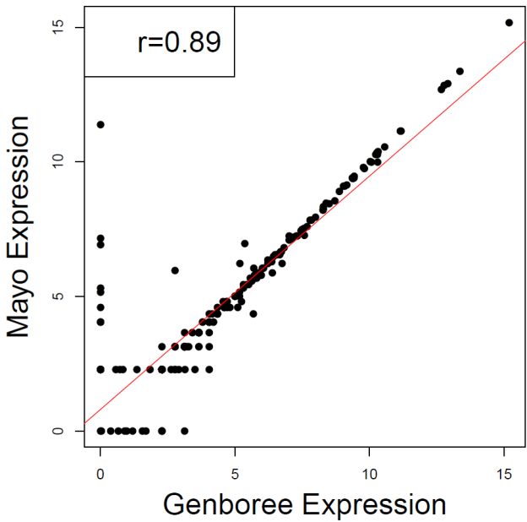
S3 Figure A: Pair-wise Correlations of Normalized miRNA Counts Between Two Pipelines
Baseline, N=242
1 hr, N=354
24 hr, N=252
Normalized reads count: log2(1 + raw_read_count * 100000/(reads_mapped_to_miRBase) )

Slide 2
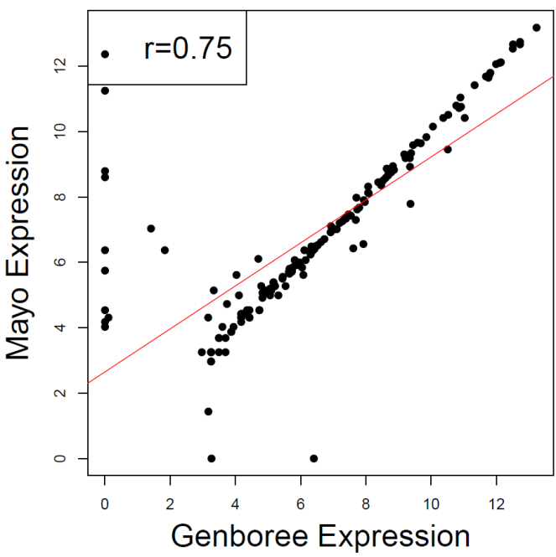
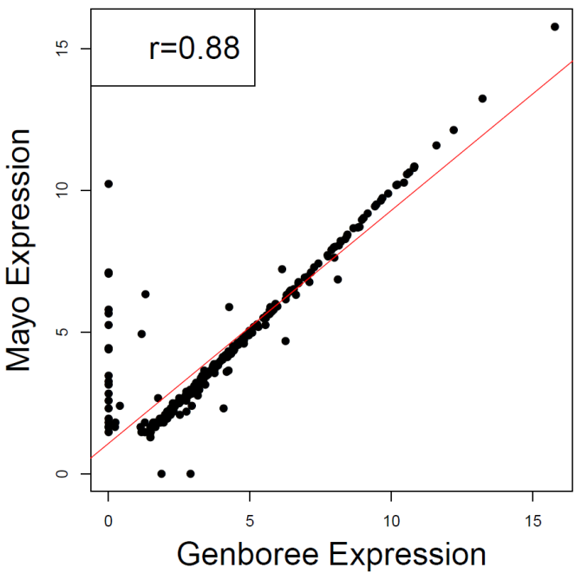
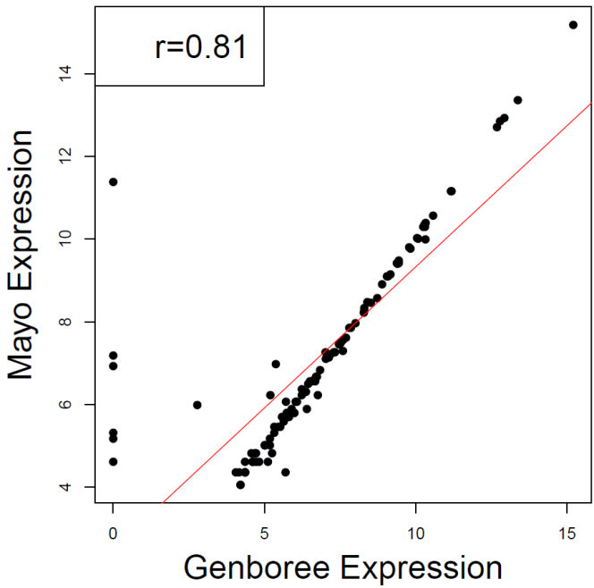
S3 Figure B: Pair-wise Correlations of Normalized miRNA Counts Between Two Pipelines for miRNA with >=5 raw read counts in at least 1 sample
Baseline, N=167
1 hr, N=243
24 hr, N=115
Normalized reads count: log2(1 + raw_read_count * 100000/(reads_mapped_to_miRBase) )

