Slide 1
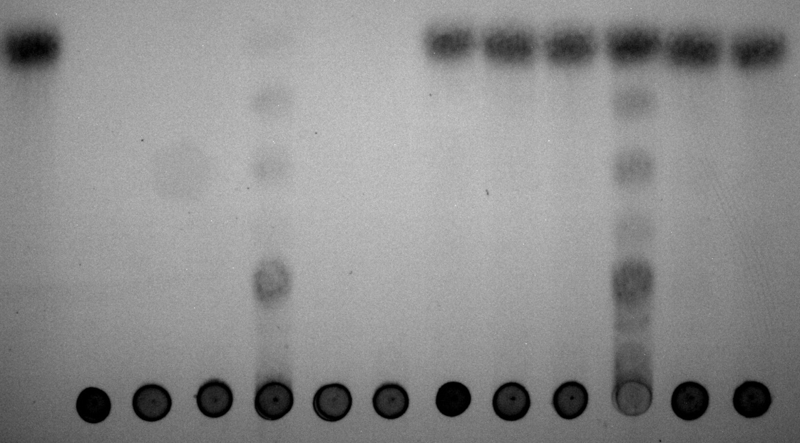
EPS R1
EPS R1
EPS R1
EPS R1
Glucose
EPS E44
EPS E44
EPS E44
EPS E44
Glycogen
Glycogen
Glycogen
Glycogen
α-amylase
pullulanase
α-amylase + pullulanase
Figure S1. Thin layer chromatography of the digestion of glycogen and EPS E44 and R1 fractions with enzymes α-amylase, pullulanase, and with a mixture of α-amylase and pullulanase.

