Slide 1
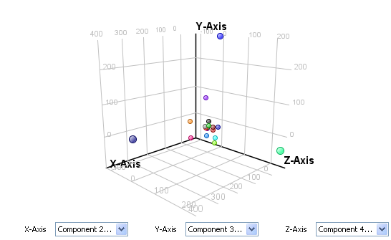
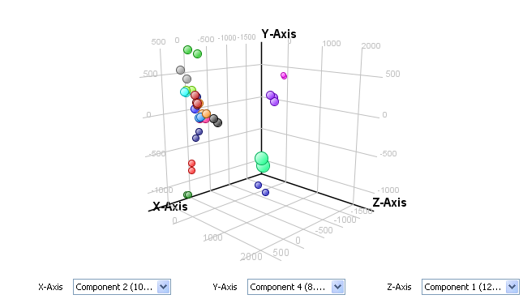
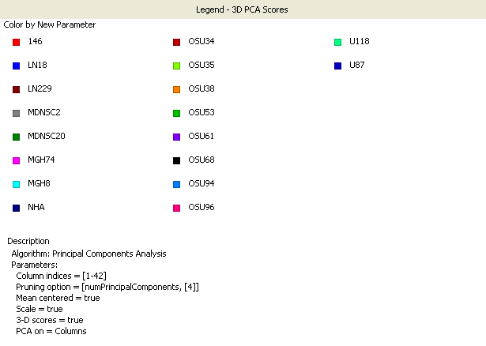
Figure S1. Extracellular and intracellular metabolites of commercially available and patient derived GBM
cells and NHAs
A
B
C
D
PCA plot of Intracellular Metabolites PCA Plot of Extracellular Metabolites
GBM
GBM
NHA
NHA

Slide 2
Figure S2. Total and extracted ion chromatograms of intracellular metabolites
Extracted Ion Chromatogram
Tryptophan
5ꞌ-methylthioadenosine
Methionine
Kynurenine
Counts
Total Ion Chromatogram
GBM
NHA
Acquisition Time (min)

Slide 3
Figure S3. Total and extracted ion chromatograms of extracellular metabolites
Extracted Ion Chromatogram
5ꞌ-methylthioadenosine
Kynurenine
Counts
GBM
NHA
Total Ion Chromatogram
Acquisition Time (min)

Slide 4
Figure S4. Targeted analysis MS/MS product ion spectrum of methionine
GBM
Synthetic
Counts
[M+H]⁺
Mass-to-Charge (m/z)

Slide 5
Figure S5. Targeted analysis MS/MS product ion spectrum of tryptophan
GBM
Synthetic
Counts
[M+H]⁺
Mass-to-Charge (m/z)

Slide 6
Figure S6. Targeted analysis MS/MS product ion spectrum of kynurenine
GBM
Synthetic
Counts
[M+H]⁺
Mass-to-Charge (m/z)

Slide 7
Figure S7. Targeted analysis MS/MS product ion spectrum of MTA
GBM
Synthetic
Counts
[M+H]⁺
Mass-to-Charge (m/z)

Slide 8
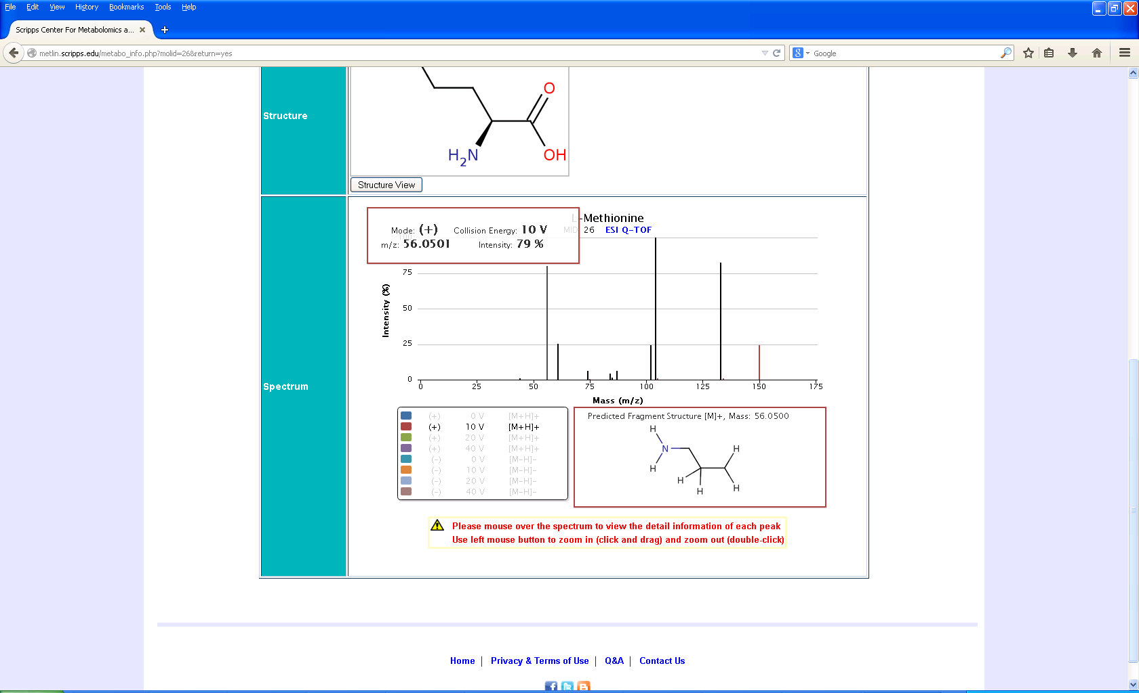
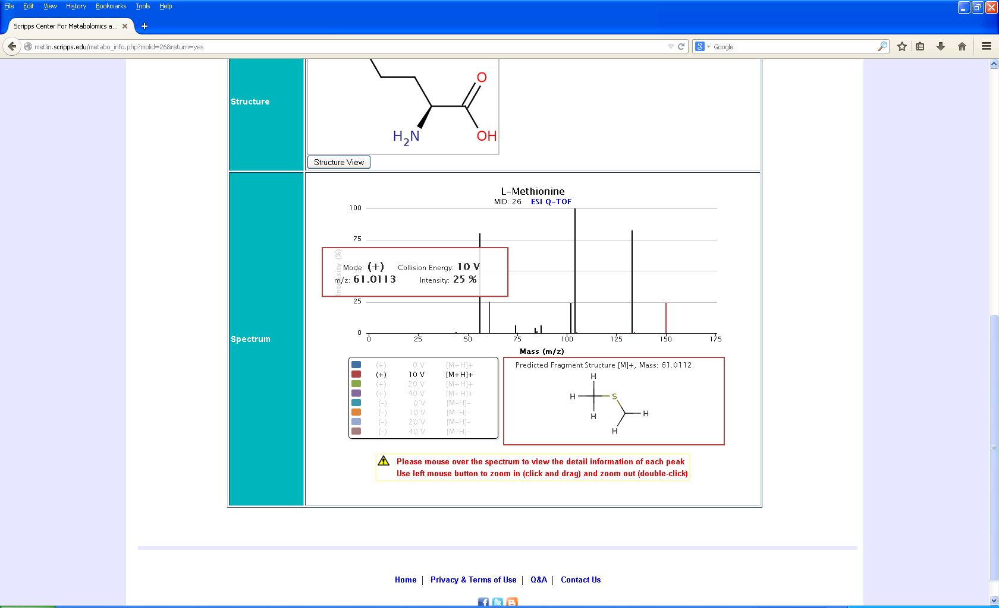
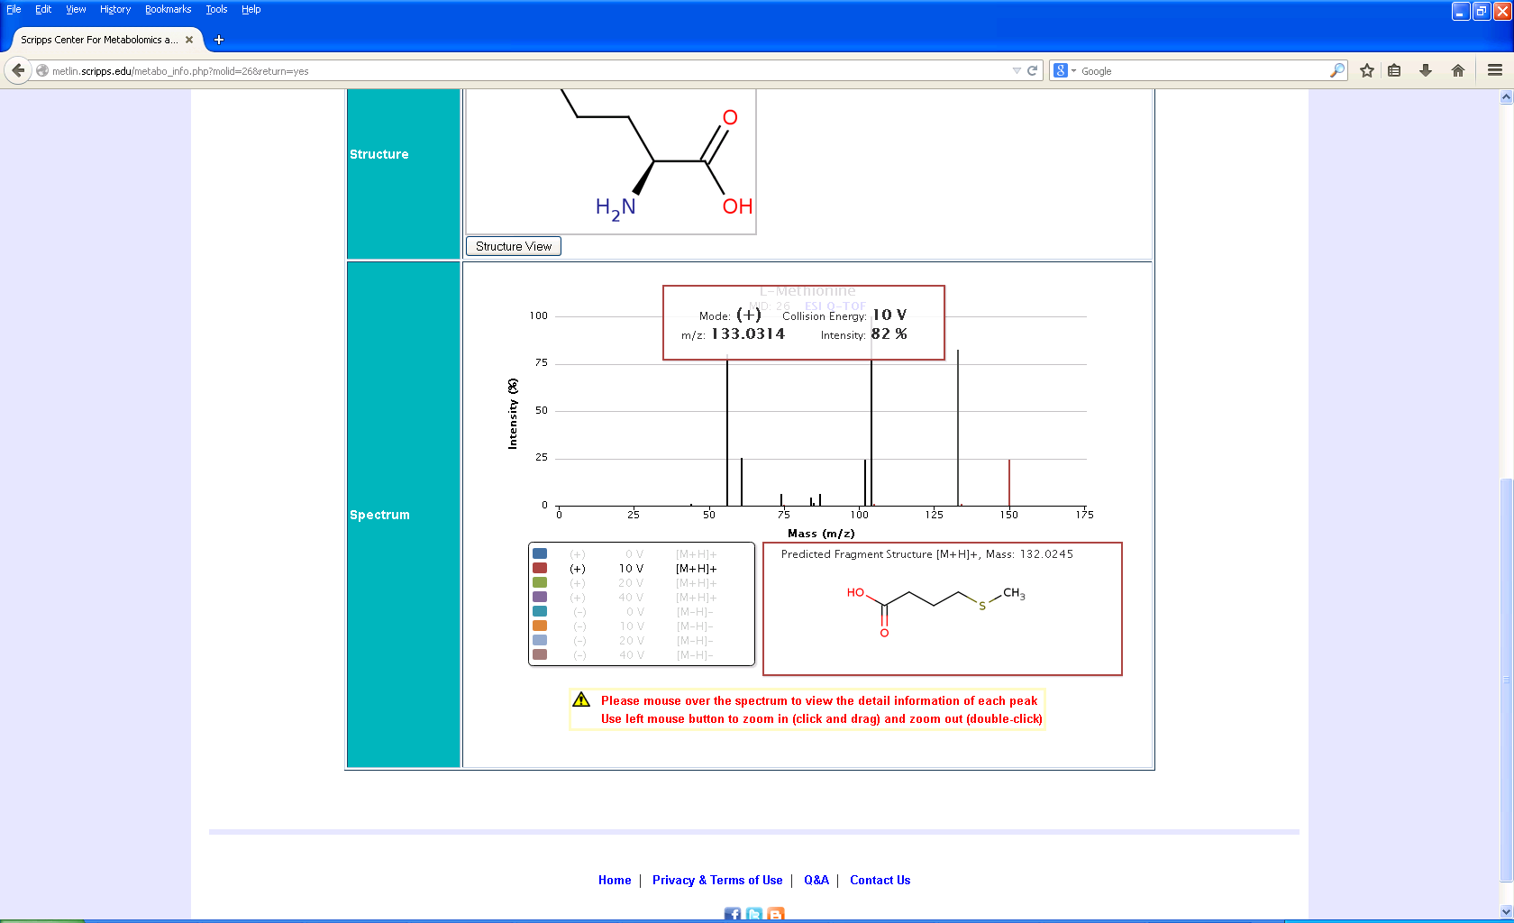
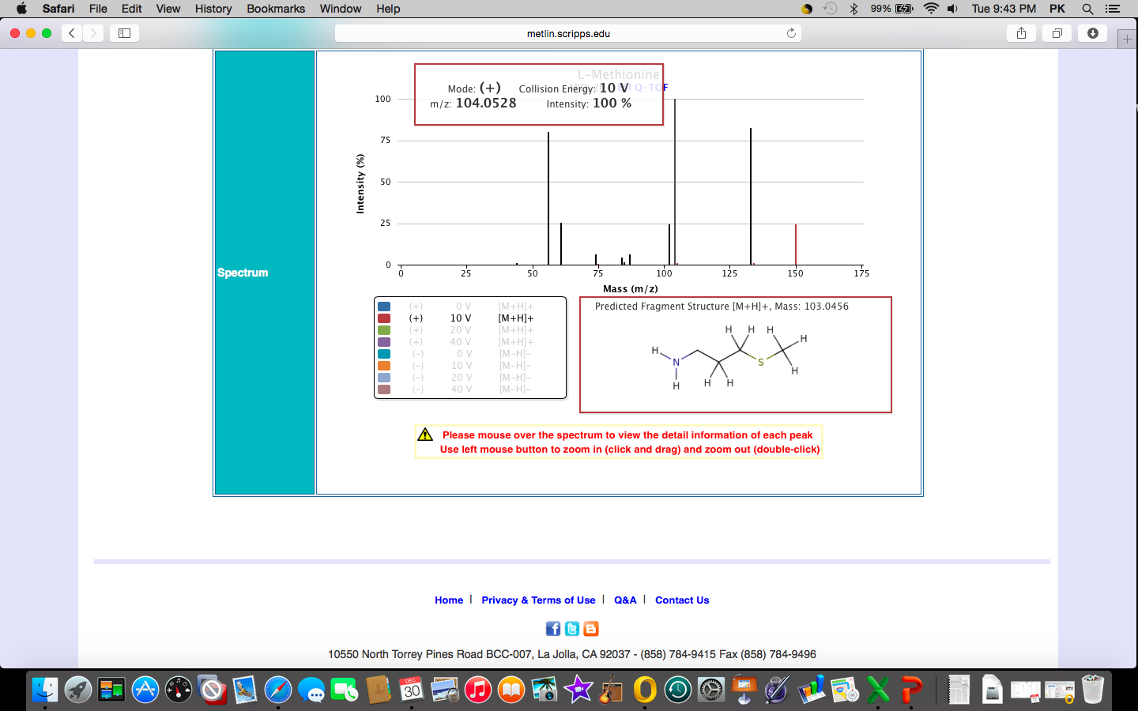
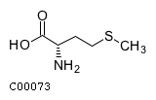
Figure S8. Total ion chromatogram and multiple reaction monitoring of different concentrations of methionine
B
A
y=1.673969*x + 153.027416
R^2 = 0.99839809
Responses
C
Concentration (ng/ml)
Relative Intensity
Counts
Acquisition Time (min)
Mass-to-Charge (m/z)

Slide 9
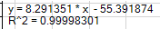
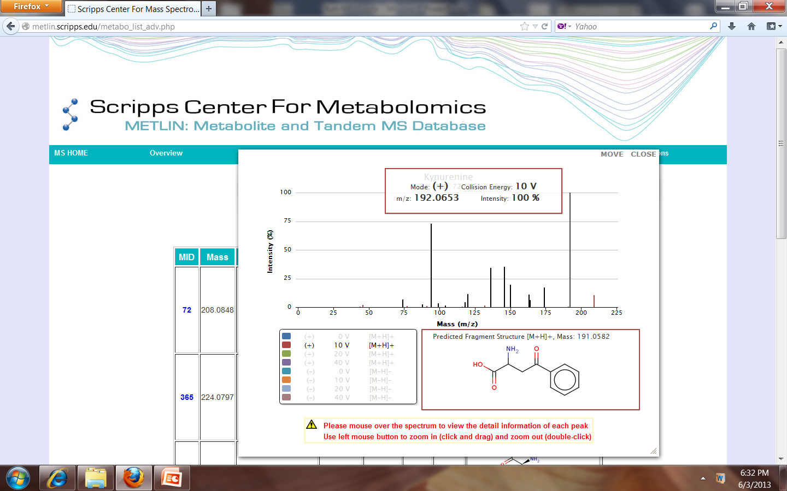
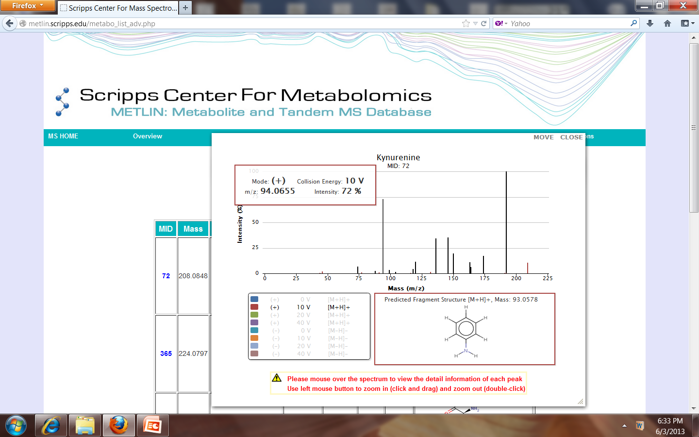
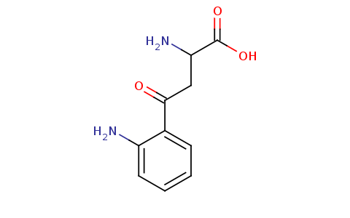
Figure S9. Total ion chromatogram and multiple reaction monitoring of different concentrations of kynurenine
A
B
1000 ng
Responses
500 ng
Concentration (ng/ml)
C
Relative Intensity
250 ng
Counts
125 ng
63 ng
32 ng
Mass-to-Charge (m/z)
Acquisition time (minutes)

Slide 10
Figure S10. Key metabolites in methionine pathway

Slide 11
Figure S11. Calibration Curve and Multiple Reaction Monitoring of SAM and SAH
A
B
y=24.502600*x – 421.347343
R^2 = 0.99680341
Responses
Counts
C
Concentration (ng/ml)
D
Mass-to-Charge (m/z)
y=318.733078*x – 6632.339456
R^2 = 0.99684146
Responses
Counts
Concentration (ng/ml)
Mass-to-Charge (m/z)

Slide 12








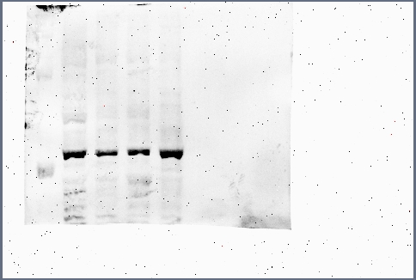
Figure S12. Key metabolites in tryptophan pathway
A
Normal cells
Cancer cells
KMO / KYNU triggers immune surveillance
MDNSC 20
OSU 35
OSU 38
OSU 34
OSU 53
OSU 96
LN18
LN229
U118
OSU 61 OSU 68
U87
MDNSC 20
OSU 35
OSU 38
OSU 34
OSU 53
OSU 96
LN18
B
LN229
U118
OSU 61 OSU 68
TDO2
IDO
β-Actin
KMO
β-Actin

Slide 13
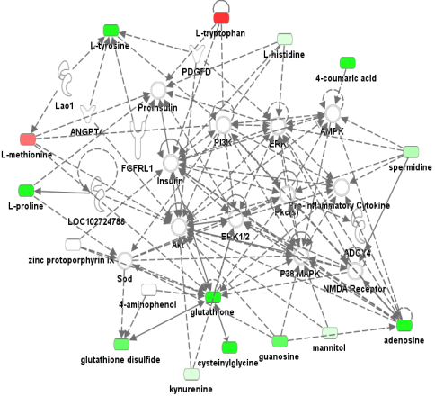
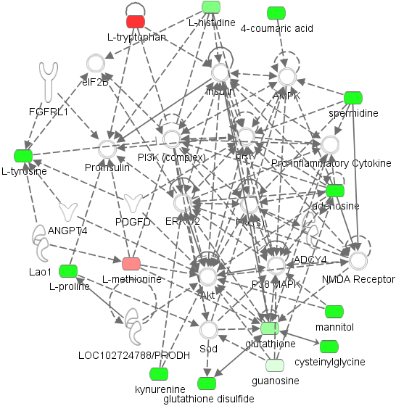
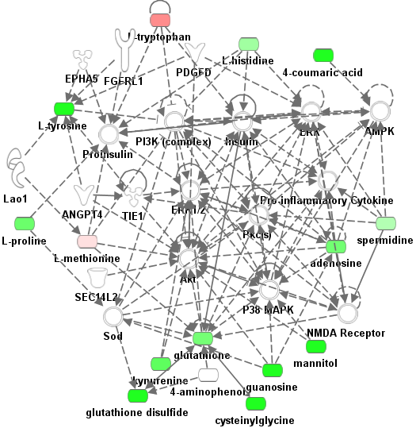
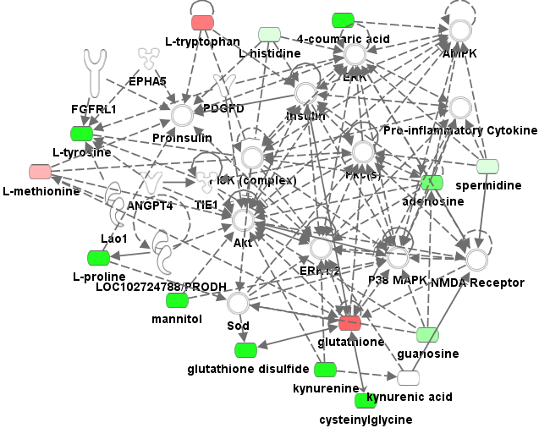
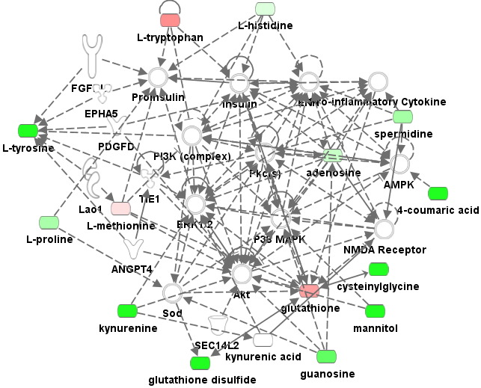
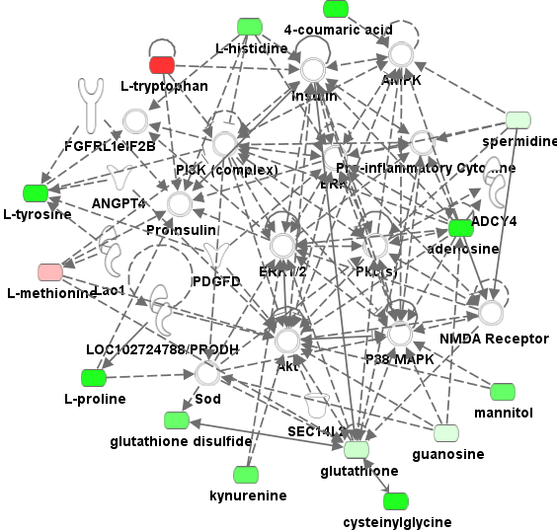
Figure S13. Insilico analysis – Connecting metabolome and proteome in GBM cells
U87
U118
OSU53
OSU61
OSU68
OSU96

Slide 14
Figure S14. Densitometric quantification of the chemiluminescence signals
*
*
*
*
*
*
*
*
*

