Slide 1
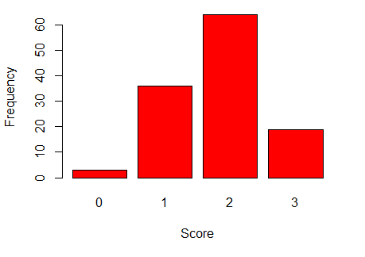
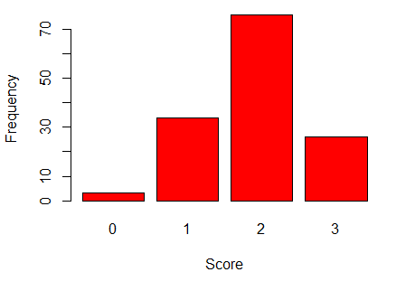
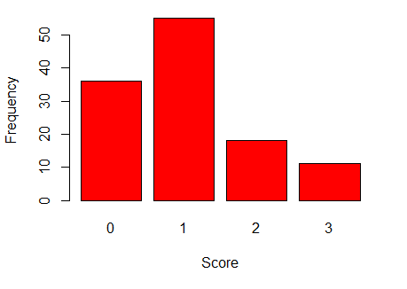
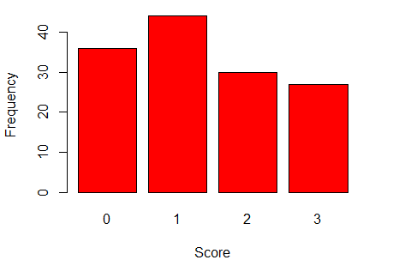
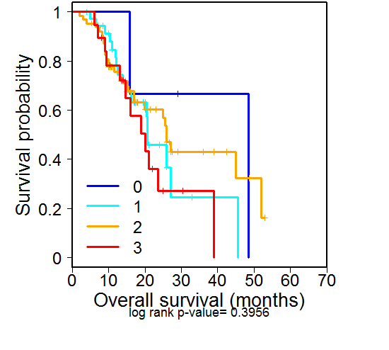
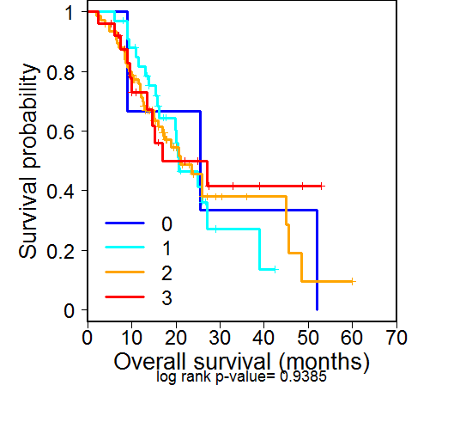
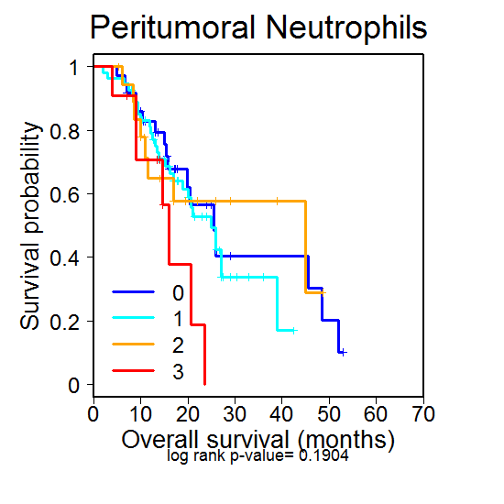
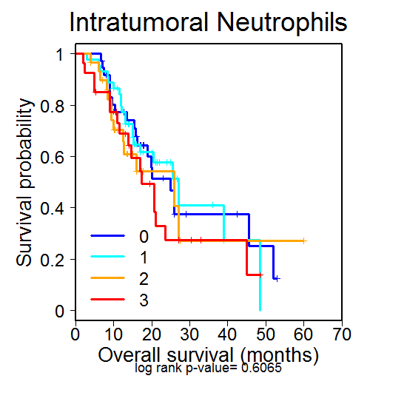
Supplementary Figure 1
A
Lymphocytes - Intra
Lymphocytes - Peri
Neutrophils - Intra
Neutrophils - Peri
B
Lymphocytes - Intra
Lymphocytes - Peri
Neutrophils - Intra
Neutrophils - Peri
Supplementary Figure 1. Lymphocyte or neutrophil frequency is not associated with prolonged survival in PDA. (A) Intra- or peritumoral frequency of lymphocyte or neutrophil accumulation. (B) Kaplan-Meier plots indicating survival probability in human patients based on lymphocyte or neutrophil accumulation. Extent of identified cells: 0=None, 1=Rare, 2=Intermittent, 3=Frequent.

