Slide 1


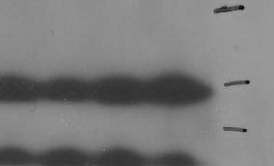



Figure S4. Further Characterization of MV4;11 sublines obtained from in vitro treatment with ABT-263 or SAR. A, Cell growth inhibition of ABT-263 Cells were treated for 4 days with ABT-263 or SAR and cell viability was determined by WST assay. B, Apoptosis induction by ABT-263 or SAR in MV4;11 sublines. Cells were treated with ABT-263 or SAR for 48 h for apoptosis analysis by flow cytometry with Annexin V/P.I. double staining. C, Immunoblotting for p53, Bcl-2 family members and GAPDH in MV4;11 sublines.
A
B
C
MV.C MV.ABTR MV.MIR
p53
Mcl-1
Bcl-xL
Bcl-2
BAX
BAK
GAPDH

