Slide 1
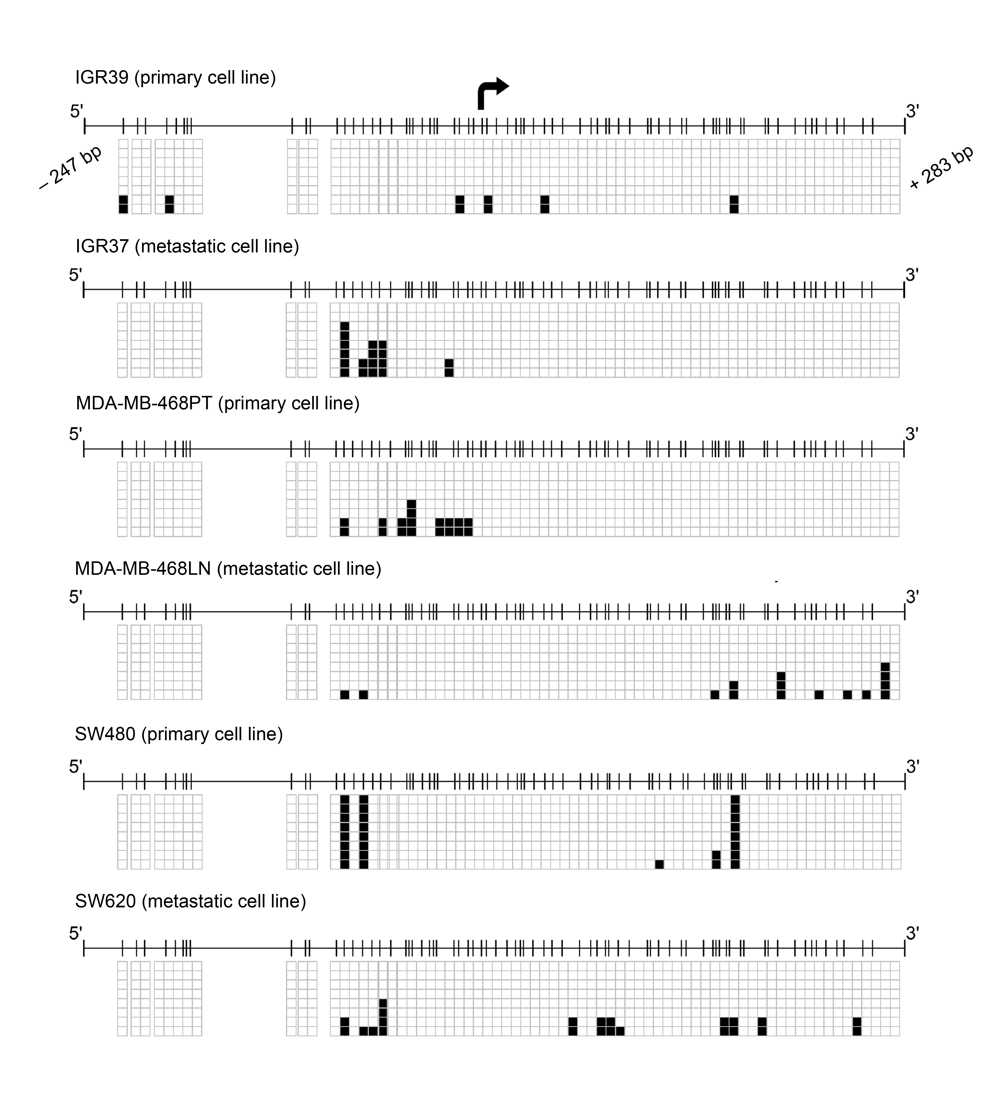
Supplementary Figure 1

Slide 2
Supplementary Fig.1. Bisulfite genomic sequencing in the TBC1D16-86KD promoter CpG island. Bisulfite genomic sequencing of eight individual clones in the TBC1D16-86KD promoter CpG island was used to determine DNA methylation status in paired primary/metastasis cancer cell lines for melanoma, breast, and colon, respectively. Presence of a methylated or unmethylated cytosine is indicated by a black or a white square, respectively.

Slide 3
Supplementary Figure 2

Slide 4
Supplementary Fig.2. Experimental assays for the TBC1D16-45KD isoform.
(a) Representation of the TBC1D16 gene. Transcription start sites are indicated as black arrows. Exons are numbered and represented as black boxes. The differential sizes of exons 6 and 7 provide information about the distinctive sequences of each isoform. Green bars specified the CpG island distribution along the TBC1D16 gene. qRT-PCR specific primers for each variant are denoted by blue arrows and BS-sequencing primers by black arrows.
(b) Left panel, quantitative RT-PCR analyses of TBC1D16-45KD and 47KD expression in paired primary/metastasis cancer cell lines. Right panel, reactivation of the TBC1D16-45KD and 47KD transcripts upon using the DNA demethylating agent 5-aza-2′-deoxycytidine.
(c) Coimmunoprecipitation experiments confirmed the interaction between TBC1D16-45KD or 47KD with RAB5C. Immunoprecipitation and western blot were performed using anti-FLAG and anti-RAB5C antibodies. UB, unbound fraction; B, bound fraction.
(d) Cell proliferation differences determined by the MTT assay in mock and TBC1D16-45KD overexpressed IGR39, WM793, and WM115 cells. Values shown were obtained from two independent experiments with 12 replicates and expressed as mean ± SEM; significance was determined from a 10,000-permutation t-test with Holm correction of the difference between growth curves. **, p < 0.01; ***, p < 0.001.
(e) Real-Time measurement of cell invasion in mock and TBC1D16-45KD overexpressed IGR39, WM793, and WM115 cells using the xCELLigence system. Matrigel invasion RTCA assay with FBS (10%) stimulation. Data are depicted as mean ± SEM of n wells processed in parallel. The cell index represents the capacity for cell invasion, and the slope of the curve is related to the invasion velocity of tumor cells. ANOVA analysis was done to test the significance of the slopes using a linear regression model.
(f) Total EGFR and phospho-EGFR protein levels after reintroduction of TBC1D16-45KD protein in the primary melanoma cell lines IGR39, WM793, WM115 and densitometries of the western blot relative to the control (mocks without stimulation). e.e., ectopic expression.

Slide 5
Supplementary Figure 3

Slide 6
Supplementary Fig.3. Experimental assays for the TBC1D16-86KD isoform.
(a) TBC1D16-86KD expression levels upon treatment with the DNA demethylating agent 5-aza-2´-deoxycytidine in IGR39, WM115, and WM793 wild type cells.
(b) TBC1D16-86KD expression levels upon lentiviral transduction with TBC1D16-47KD vector in IGR39, WM115, and WM793 cell lines.
(c) Top, lentiviral short-hairpin RNA interference of the TBC1D16-86KD protein isoform in the melanoma metastatic cell line IGR37 demonstrated by western blot. Bottom, the MTT cell viablility assay shows shRNA mediated-downregulation of TBC1D16-86KD induced higher resistance to BRAF and MEK inhibitors in comparison with the shRNA-scrambled control cells.

Slide 7
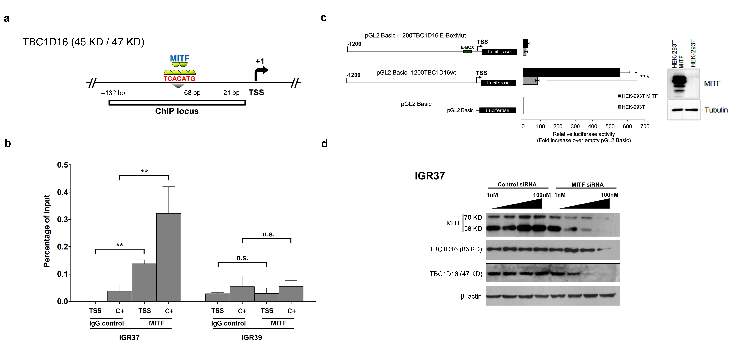
Supplementary Figure 4

Slide 8
Supplementary Fig.4. Experimental assays for MITF.
(a,b) Quantitative chromatin-immunoprecipitation assay to assess MITF occupancy at the E-box of the TBC1D16-45KD/47KD promoter in primary (methylated) and metastatic (unmethylated) IGR39 and IGR37 melanoma cell lines, respectively. Data are presented as percentage of input ± SEM, n = 3. Data of three independent experiments are shown. Significance of Student’s t-tests is shown. IgG, Immunoglobulin G; C+, positive control for MITF binding in its known target MLANA.
(c) Luciferase reporter assays to test TBC1D16-45KD/47KD promoter functionality. Three different constructions were used (wild type TBC1D16-45KD/47KD promoter, mutant TBC1D16-45KD/47KD promoter for MITF binding site, and empty vector), Left panel, schematic diagram depicting the strategy followed. Right panel, HEK-293T cells were transfected with the indicated reporter vector alone (grey bars) or in combination with pCMV-Tag4A-MITF wt (black bars). Relative firefly luciferase/renilla activity was determined and compared with the control vector (pGL2 Basic). Error bars represent SD.
(d) siRNA assay in metastatic melanoma cell line IGR37 to interrogate TBC1D16-47KD and 86KD silencing by MITF knockdown.

Slide 9
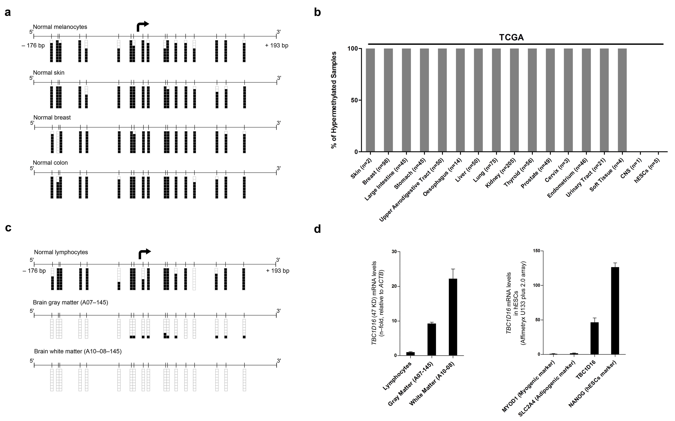
Supplementary Figure 5

Slide 10
Supplementary Fig.5. TBC1D16-45KD/47KD methylation and expression patterns in normal tissues.
(a) Bisulfite sequencing of TBC1D16-45KD/47KD promoter in normal melanocytes, normal skin, normal breast, and normal colon. Presence of a methylated or unmethylated cytosine is indicated by a black or white square, respectively.
(b) Percentage of TBC1D16-45KD/47KD promoter hypermethylated cases in a set of normal samples obtained from TCGA database.
(c) Bisulfite sequencing of normal lymphocyte and brain samples (gray and white matter). Presence of a methylated or unmethylated cytosine is indicated by a black or white square, respectively.
(d) TBC1D16-47KD expression, determined by quantitative RT-PCR, in the samples previously analyzed by bisulfite genomic sequencing. In the case of hESCs, the data were obtained from the GEO database.

Slide 11
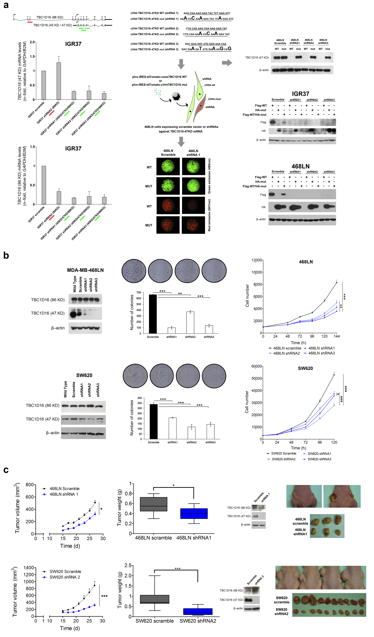
Supplementary Figure 6

Slide 12
Supplementary Fig.6. Functional assays for short-hairpin RNA interference of TBC1D16.
(a) Left panel, TBC1D16 mRNA levels in IGR37 cell line upon lentiviral transductions with short-hairpin RNAs, targeting the isoform of 86KD (shRNA-2) or 45KD/47KD (shRNA 1, 2, and 3). Centre and top right panels, contructs of TBC1D16-47KD mRNA insensitive to RNAi-mediated depletion in metastatic breast cell line 468LN and confocal images showing TBC1D16-47KD overexpression associated fluorescence upon shRNAs influence. Bottom right panel, cotransfection experiments in IGR37 and 468LN cell lines in which the wild type cDNA was fused to a Flag-tag and the mutated cDNA was fused to a HA-tag. Western Blot against each tag confirms the fact that the mutant TBC1D16 ORF is RNAi-insensitive.
(b) Left panel, lentiviral short-hairpin RNA interference of the TBC1D16-47KD protein isoform in the breast and colon metastatic cell lines demonstrated by western blot. Centre panel, colony formation assays in scramble and shRNA TBC1D16-47KD depleted 468LN and SW620 cells. The number of colonies formed 2 weeks after seeding 600 and 300 cells respectively on 6-well culture plates and maintained on selection media were quantified and plotted. Significance of Student’s t-tests: ***, p < 0.001. Right panel, cell proliferation differences determined by the MTT assay in scramble and shRNA TBC1D16-47KD depleted 468LN and SW620 cells. Values shown were obtained from three independent experiments with 12 replicates and expressed as mean ± SD; significance was determined from a 10,000-permutation t-test with Holm correction of the difference between growth curves. **, p < 0.01; ***, p < 0.001.
(c) Left panel, measurement of tumor volume changes in subcutaneously grafted scramble and shRNA TBC1D16-47KD-depleted 468LN and SW620 cells. Center panel, mean ± SEM tumor weights of orthotopic tumors in the scramble and shRNA TBC1D16-47KD depleted 468LN (n=8) and SW620 (n=15) groups, respectively. Right panel, illustrative tumor samples obtained at the end-point of the growth nude mice experiment and TBC1D16 expression levels by western blot.

Slide 13
Supplementary Figure 7

Slide 14
Supplementary Fig.7. Experimental assays for the WM115 and WM266.4 cell lines.
(a) WM115 and WM266.4 DNA methylation profile of CpG island promoters for the long (86KD) and short (45KD/47KD) isoforms of the TBC1D16 gene with respect to DNA methylation microarray values. Single CpG absolute methylation levels (0-1) are shown. Green, unmethylated; red, methylated. The primary melanoma cell line WM115 is methylated and repressed for TBC1D16-47KD; whilst the metastatic melanoma cell line WM266.4 (paired) is unmethylated and expresses the TBC1D16-47KD protein.
(b) Left panel, cell proliferation differences determined by the MTT assay in mock and TBC1D16-47KD overexpressed WM115 cells. Values shown were obtained from three independent experiments with 12 replicates and expressed as mean ± SEM; significance was determined from a 10,000-permutation t-test with Holm correction of the difference between growth curves (***, p < 0.001). Real-time measurement of cell invasion in mock and TBC1D16-47KD overexpressed WM115 cells using the xCELLigence system. Matrigel invasion RTCA assay with FBS (10%) stimulation. Data are depicted as mean ± SEM of n wells processed in parallel. The cell index represents the capacity for cell invasion, and the slope of the curve is related to the invasion velocity of tumor cells. ANOVA analysis was done to test the significance of the slopes using a linear regression model. Center panel, measurement of tumor volume changes in subcutaneous implanted mock and TBC1D16-47KD overexpressed WM115 cells. TBC1D16-47KD and 86KD protein levels show the stability of the infection. Illustrative tumor samples obtained at the end-point of the subcutaneous growth nude mice experiment (n=7). Significance was determined from a 10,000-permutation t-test with Holm correction of the difference between growth curves (***, p < 0.001). Mean ± SEM tumor weights of subcutaneous tumors are also shown. Student’s t-test: *, p < 0.05. Right panel, in vivo spleen assay showed an enrichment of metastatic liver nodes upon TBC1D16-47KD overexpression in WM115 cell line. Total numbers of metastatic nodes were counted selecting at leat two different randomly liver areas, representing the mean ± SEM. Student’s t-test: *, p < 0.05.
(c) Left panel, cell proliferation differences determined by the MTT assay in scramble and shRNA TBC1D16-47KD depleted WM266.4 cells. Values shown were obtained from two independent experiments with 12 replicates and expressed as mean ± SEM; significance was determined from a 10,000-permutation t-test with Holm correction of the difference between growth curves (**, p < 0.01; ***, p < 0.001). Real-Time measurement of cell invasion in scramble and shRNA TBC1D16-47KD depleted WM266.4 cells using the xCELLigence system. Matrigel invasion RTCA assay with FBS (10%) stimulation. Data are depicted as mean ± SEM of n wells processed in parallel. The cell index represents the capacity for cell invasion, and the slope of the curve is related to the invasion velocity of tumor cells. ANOVA analysis was done to test the significance of the slopes using a linear regression model. Center panel, measurement of tumor volume changes in subcutaneous implanted scramble and shRNA TBC1D16-47KD depleted WM266.4 cells. Western blots of TBC1D16-47KD and 86KD protein are not shown (protein extracts could not be obtained from the underdeveloped shRNA TBC1D16-47KD depleted WM266.4 tumors). Illustrative tumor samples obtained at the end-point of the subcutaneous growth nude mice experiment (n=10). Significance was determined from a 10,000-permutation t-test with Holm correction of the difference between growth curves (**, p < 0.01). Mean ± SEM tumor weights of subcutaneous tumors are shown. Student’s t-test: **, p < 0.01.
(d) Western blot showing differentially expressed proteins TBC1D16-47KD and EGFR but not TBC1D16-86KD in WM115 and WM266.4 cell lines in association with the methylation status of the secondary promoter of TBC1D16.
(d) Upper panel, total EGFR and phospho-EGFR protein levels after reintroduction of TBC1D16-45KD/47KD protein in the primary melanoma cell line WM115. Bottom panel, densitometry of the western blot relative to the control (WM115 mock without stimulation).

Slide 15
Supplementary Figure 8

Slide 16
Supplementary Fig.8. Experimental assays for the WM793 and SKMEL28 cell lines.
(a) WM793 and SKMEL28 DNA methylation profile of CpG island promoters for the long (86KD) and short (45KD/47KD) isoforms of the TBC1D16 gene with respect to DNA methylation microarray values. Single CpG absolute methylation levels (0-1) are shown. Green, unmethylated; red, methylated. The primary melanoma cell line WM793 is methylated and repressed for TBC1D16-47KD; whilst the metastatic melanoma cell line SKMEL28 is unmethylated and expresses the TBC1D16-47KD protein.
(b) Left panel, cell proliferation differences determined by the MTT assay in mock and TBC1D16-47KD overexpressed WM793 cells. Values shown were obtained from three independent experiments with 12 replicates and expressed as mean ± SEM; significance was determined from a 10,000-permutation t-test with Holm correction of the difference between growth curves (**, p < 0.01). Real-time measurement of cell invasion in mock and TBC1D16-47KD overexpressed WM115 cells using the xCELLigence system. Matrigel invasion RTCA assay with FBS (10%) stimulation. Data are depicted as mean ± SEM of n wells processed in parallel. The cell index represents the capacity for cell invasion, and the slope of the curve is related to the invasion velocity of tumor cells. ANOVA analysis was done to test the significance of the slopes using a linear regression model. Center panel, measurement of tumor volume changes in subcutaneous implanted mock and TBC1D16-47KD overexpressed WM793 cells. TBC1D16-47KD and 86KD protein levels show the stability of the infection. Illustrative tumor samples obtained at the end-point of the subcutaneous growth nude mice experiment (n=10). Significance was determined from a 10,000-permutation t-test with Holm correction of the difference between growth curves (n.s., non-significant). Mean ± SEM tumor weights of subcutaneous tumors are also shown. Student’s t-test: n.s., non-significant.
(c) Left panel, cell proliferation differences determined by the MTT assay in scramble and shRNA TBC1D16-47KD depleted SKMEL28 cells. Values shown were obtained from two independent experiments with 12 replicates and expressed as mean ± SEM; significance was determined from a 10,000-permutation t-test with Holm correction of the difference between growth curves (n.s., non-significant; *, p < 0.05). Real-Time measurement of cell invasion in scramble and shRNA TBC1D16-47KD depleted WM266.4 cells using the xCELLigence system. Matrigel invasion RTCA assay with FBS (10%) stimulation. Data are depicted as mean ± SEM of n wells processed in parallel. The cell index represents the capacity for cell invasion, and the slope of the curve is related to the invasion velocity of tumor cells. ANOVA analysis was done to test the significance of the slopes using a linear regression model. Center panel, measurement of tumor volume changes in subcutaneous implanted scramble and shRNA TBC1D16-47KD depleted SKMEL28 cells. Western blots of TBC1D16-47KD and 86KD protein levels show the stability of the infection. Illustrative tumor samples obtained at the end-point of the subcutaneous growth nude mice experiment (n=10). Significance was determined from a 10,000-permutation t-test with Holm correction of the difference between growth curves (*, p < 0.05). Mean ± SEM tumor weights of subcutaneous tumors are shown. Student’s t-test: *, p < 0.05.
(d) Left, western blot showing differentially expressed proteins TBC1D16-47KD and EGFR but not TBC1D16-86KD in WM793 and SKMEL28 cell lines in association with the methylation status of the secondary promoter of TBC1D16. Center, western blot analyses in SKMEL28 show that shRNA-mediated downregulation of TBC1D16-45KD induces higher levels of EGFR and phospho-EGFR in comparison to the control cells, particularly after 30min of EGF stimulation. Protein levels were determined 0, 15, 30, and 60 min after EGF stimulation. Right, total EGFR and phospho-EGFR protein levels after reintroduction of TBC1D16-45KD/47KD protein in the primary melanoma cell line WM793. Densitometry of the western blot relative to the control (WM793 mock without stimulation).
(e) Left, TBC1D16-47KD transfection in WM793 increased drug sensitivity. Right, shRNA-depletion of TBC1D16-47KD in SKMEL28 cells increased resistance to BRAF/MEK inhibitors. Cell viability was determined by MTT and SRB assays.

Slide 17
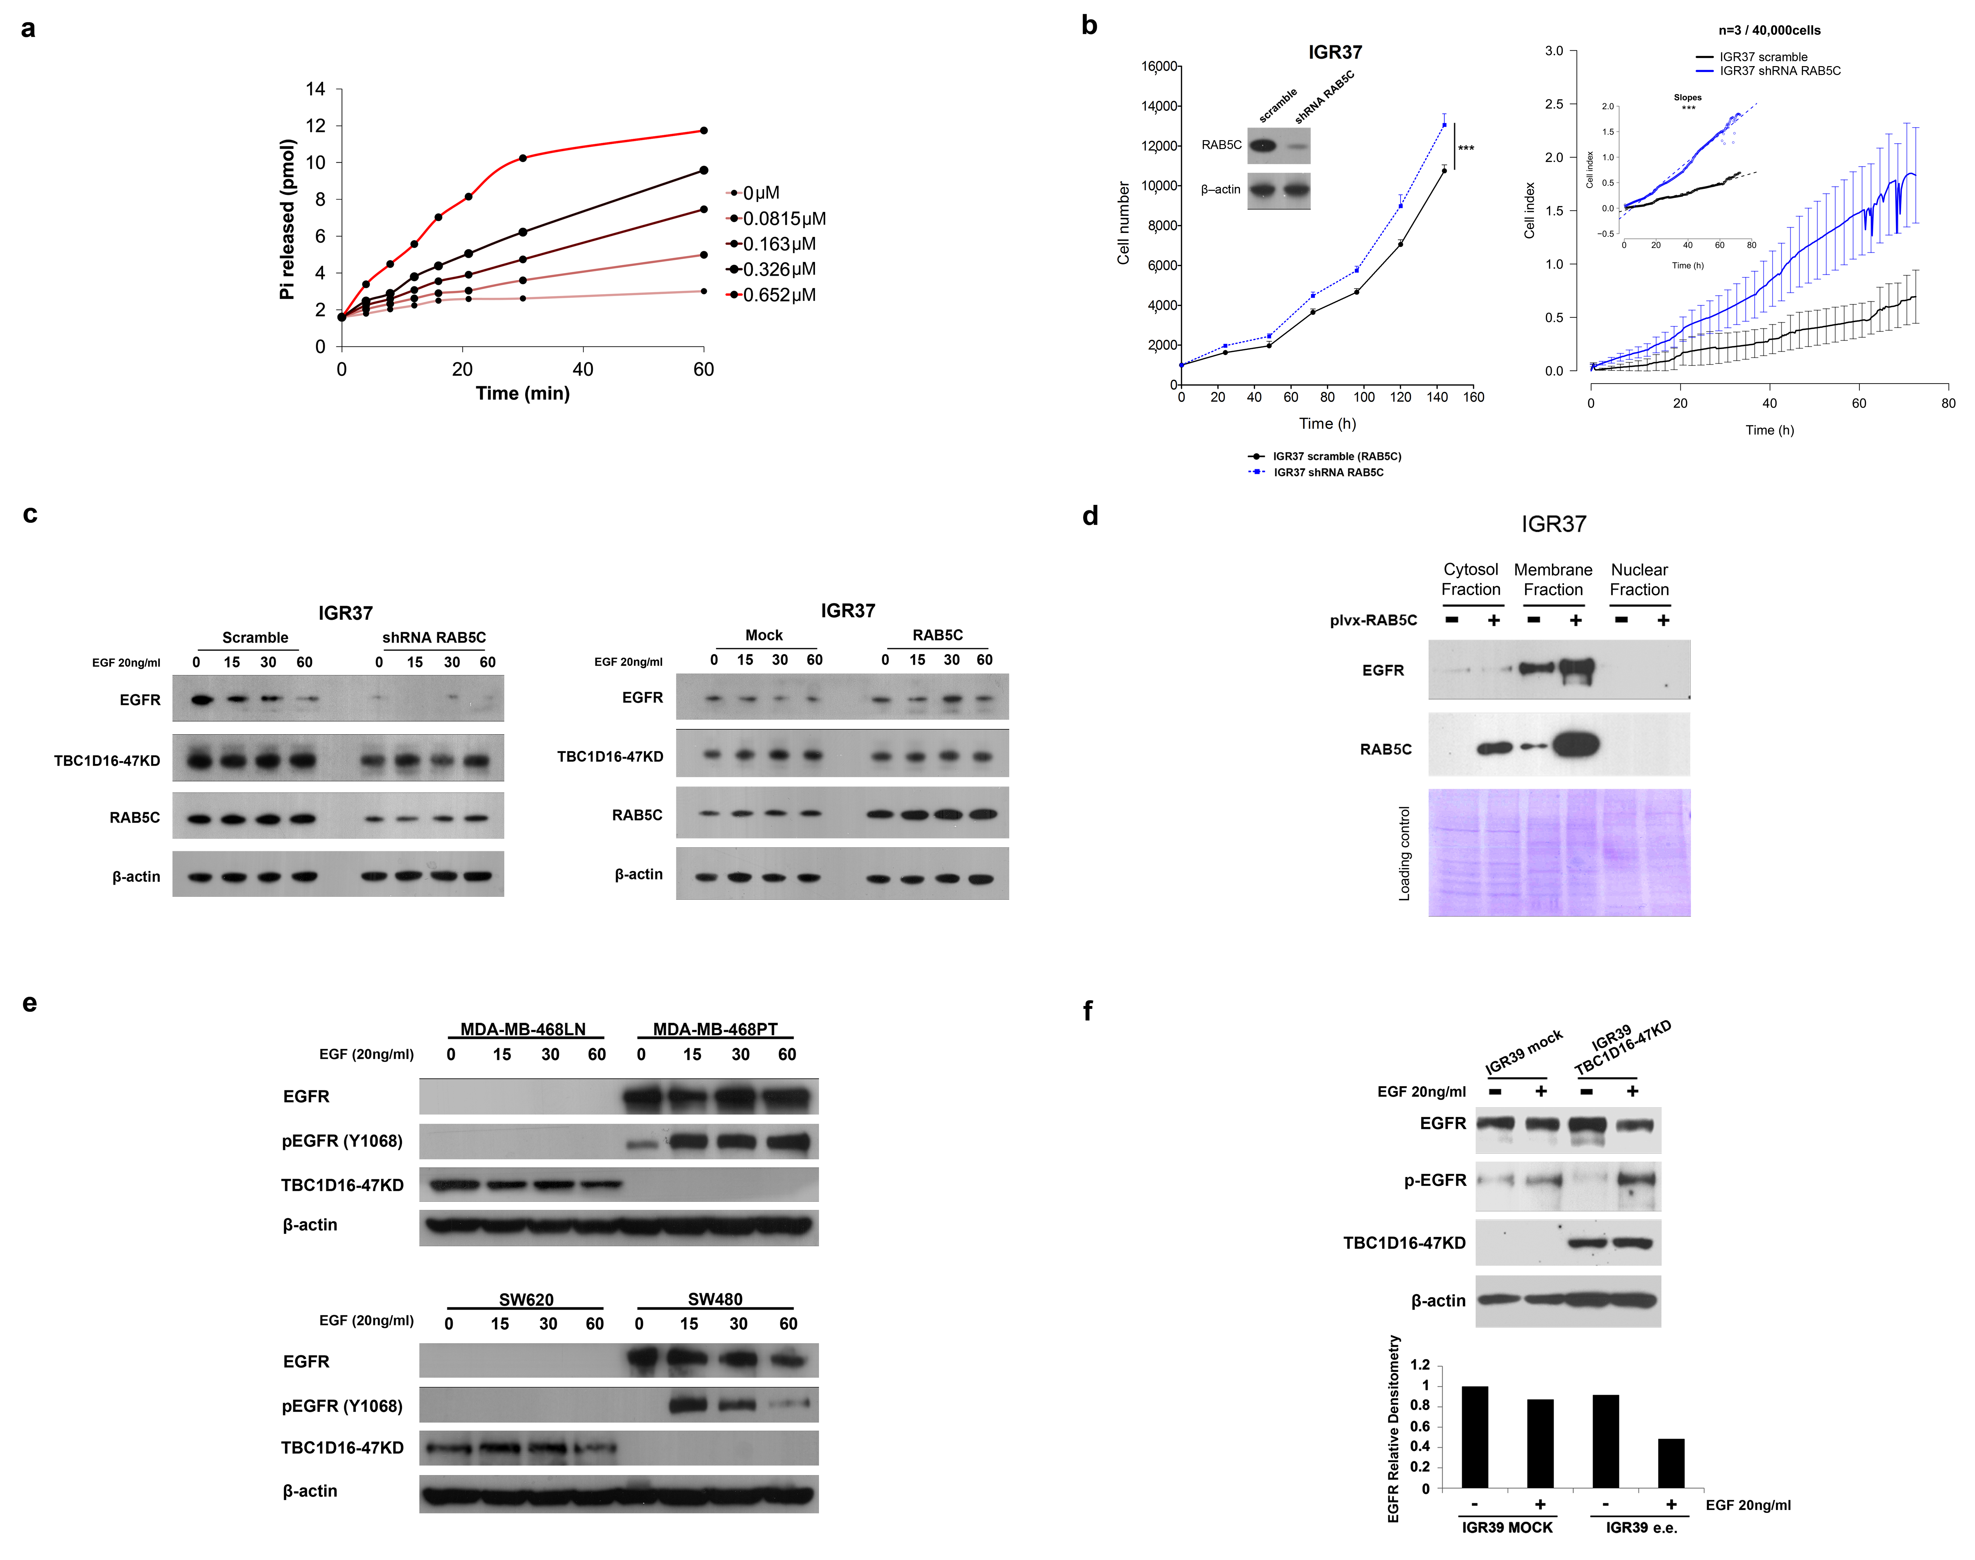
Supplementary Figure 9

Slide 18
Supplementary Fig.9. Functional assays for GAP and EGFR activity.
(a) TBC1D16 displays GAP activity for RAB5C in vitro. GTP hydrolysis by recombinant RAB5C was assayed in reactions containing 0.3 μM of [γ-³²P]GTP-loaded RAB5C in the presence of purified TBC1D16-47KD at the indicated concentrations.
(b) Left panel, cell proliferation differences determined by the MTT assay in scramble and shRNA RAB5C depleted IGR37 cells. Values shown were obtained from two independent experiments with 12 replicates and expressed as mean ± SEM; significance was determined from a 10,000-permutation t-test with Holm correction of the difference between growth curves. ***, p < 0.001. Right panel, real-time measurement of cell invasion in scramble and shRNA RAB5C depleted IGR37 cells using the xCELLigence system. Matrigel invasion RTCA assay with FBS (10%) stimulation. Data are depicted as mean ± SEM of n wells processed in parallel. The cell index represents the capacity for cell invasion, and the slope of the curve is related to the invasion velocity of tumor cells. ANOVA analysis was done to test the significance of the slopes using a linear regression model.
(c) Western blot analyses show that shRNA-mediated downregulation of RAB5C induces lower levels of EGFR in comparison to the control cells. Conversely, RAB5C overexpression promotes EGFR accumulation in the same cell line. Protein levels were determined at 0, 15, 30, and 60 min after EGF stimulation.
(d) EGFR protein levels in three cell compartments (cytosol, membranes, and nucleus) in the metastatic melanoma cell line IGR37 in basal conditions and after overexpression of RAB5C.
(e) Total EGFR and phospho-EGFR protein levels in an EGF time course in paired primary/metastatic cell lines of breast and colon, respectively. Western blot analyses indicate that MDA-MB-468PT and SW480 (methylated and silenced for TBC1D16-47KD) show high amount of EGFR and its phosphorylated Y1068 form, whilst MDA-MB-468LN and SW620 cells (unmethylated and expressing TBC1D16-47KD) had minimal amounts of EGFR.
(f) Top panel, total EGFR and phospho-EGFR protein levels after reintroduction of TBC1D16-47KD protein in the primary melanoma cell line IGR39. Down panel, densitometry of the western blot relative to the control (IGR39 mock without estimulation). e.e., ectopic expression.

Slide 19
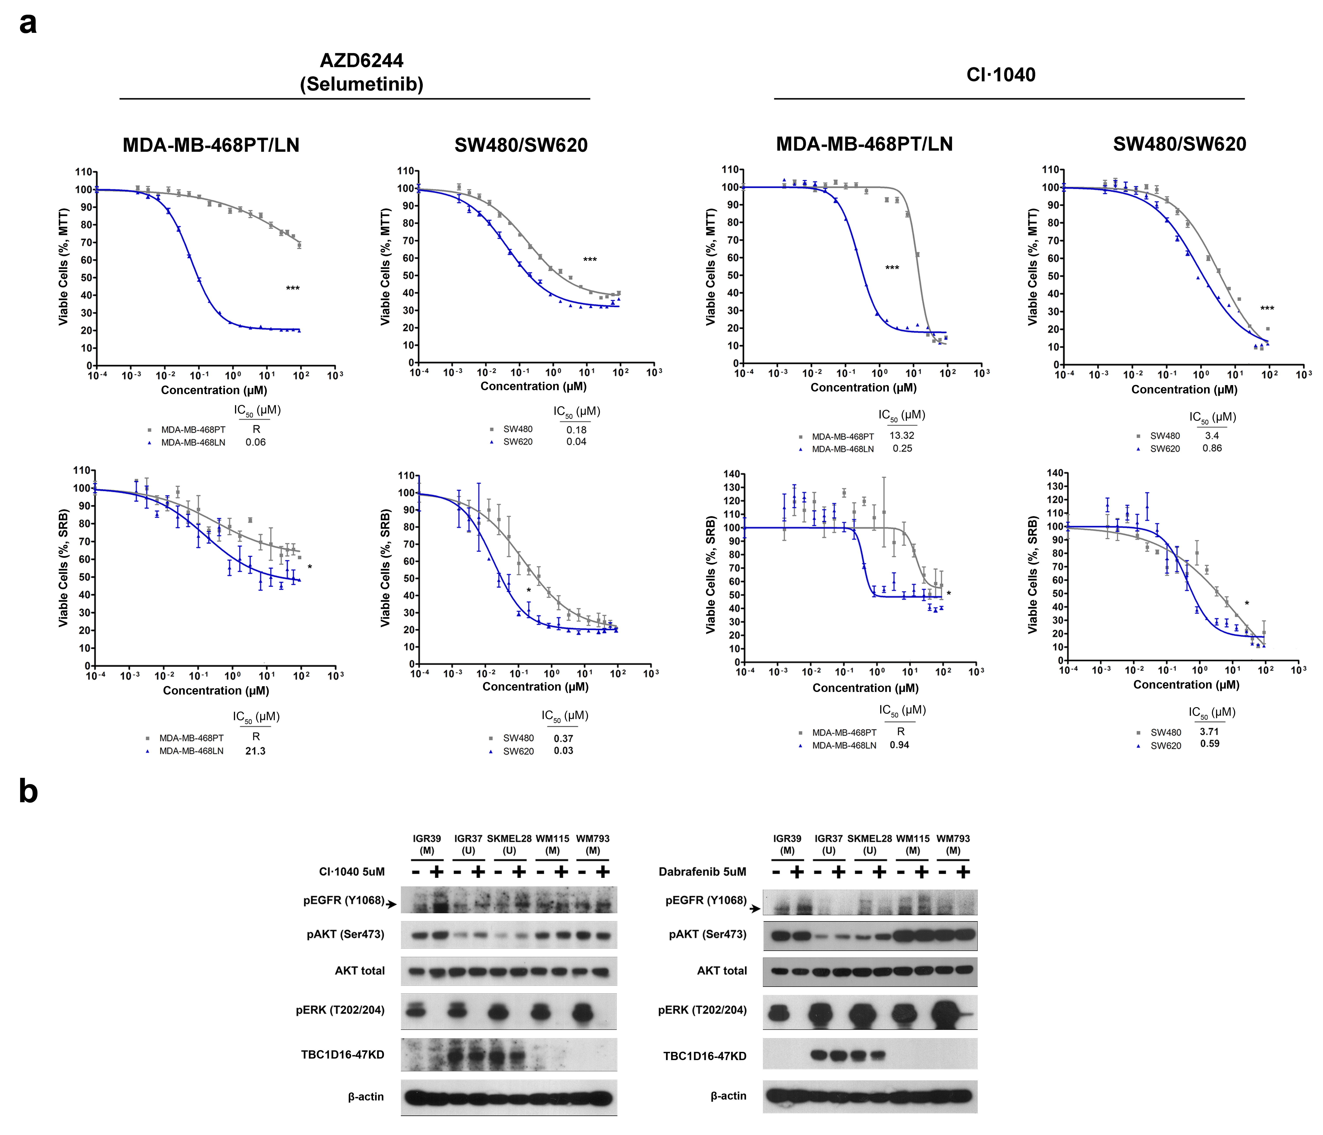
Supplementary Figure 10

Slide 20
Supplementary Fig.10. Assays for MEK and BRAF inhibition in cell lines.
(a) MTT and SRB cell viability assays show the significantly higher sensitivity of the unmethylated TBC1D16-47KD breast MDA-MB-468LN and colon SW620 cell lines to MEK inhibitors in comparison to the paired methylated cell lines MDA-MB-468PT and SW48. IC50 values (µM) are indicated. Survival curves represent the average of two independent replicates. P-values were obtained from a 10,000 permutation t-tests with Holm correction (*, p < 0.05; ***, p < 0.001).
(b) Western blot analyses of the RAS/BRAF/MEK/ERK and PI3K/AKT signaling pathways in TBC1D16-47KD unmethylated (U) or methylated (M) melanoma cells upon using the MEK inhibitor CI1040 or dabrafenib in high serum conditions, respectively.

Slide 21
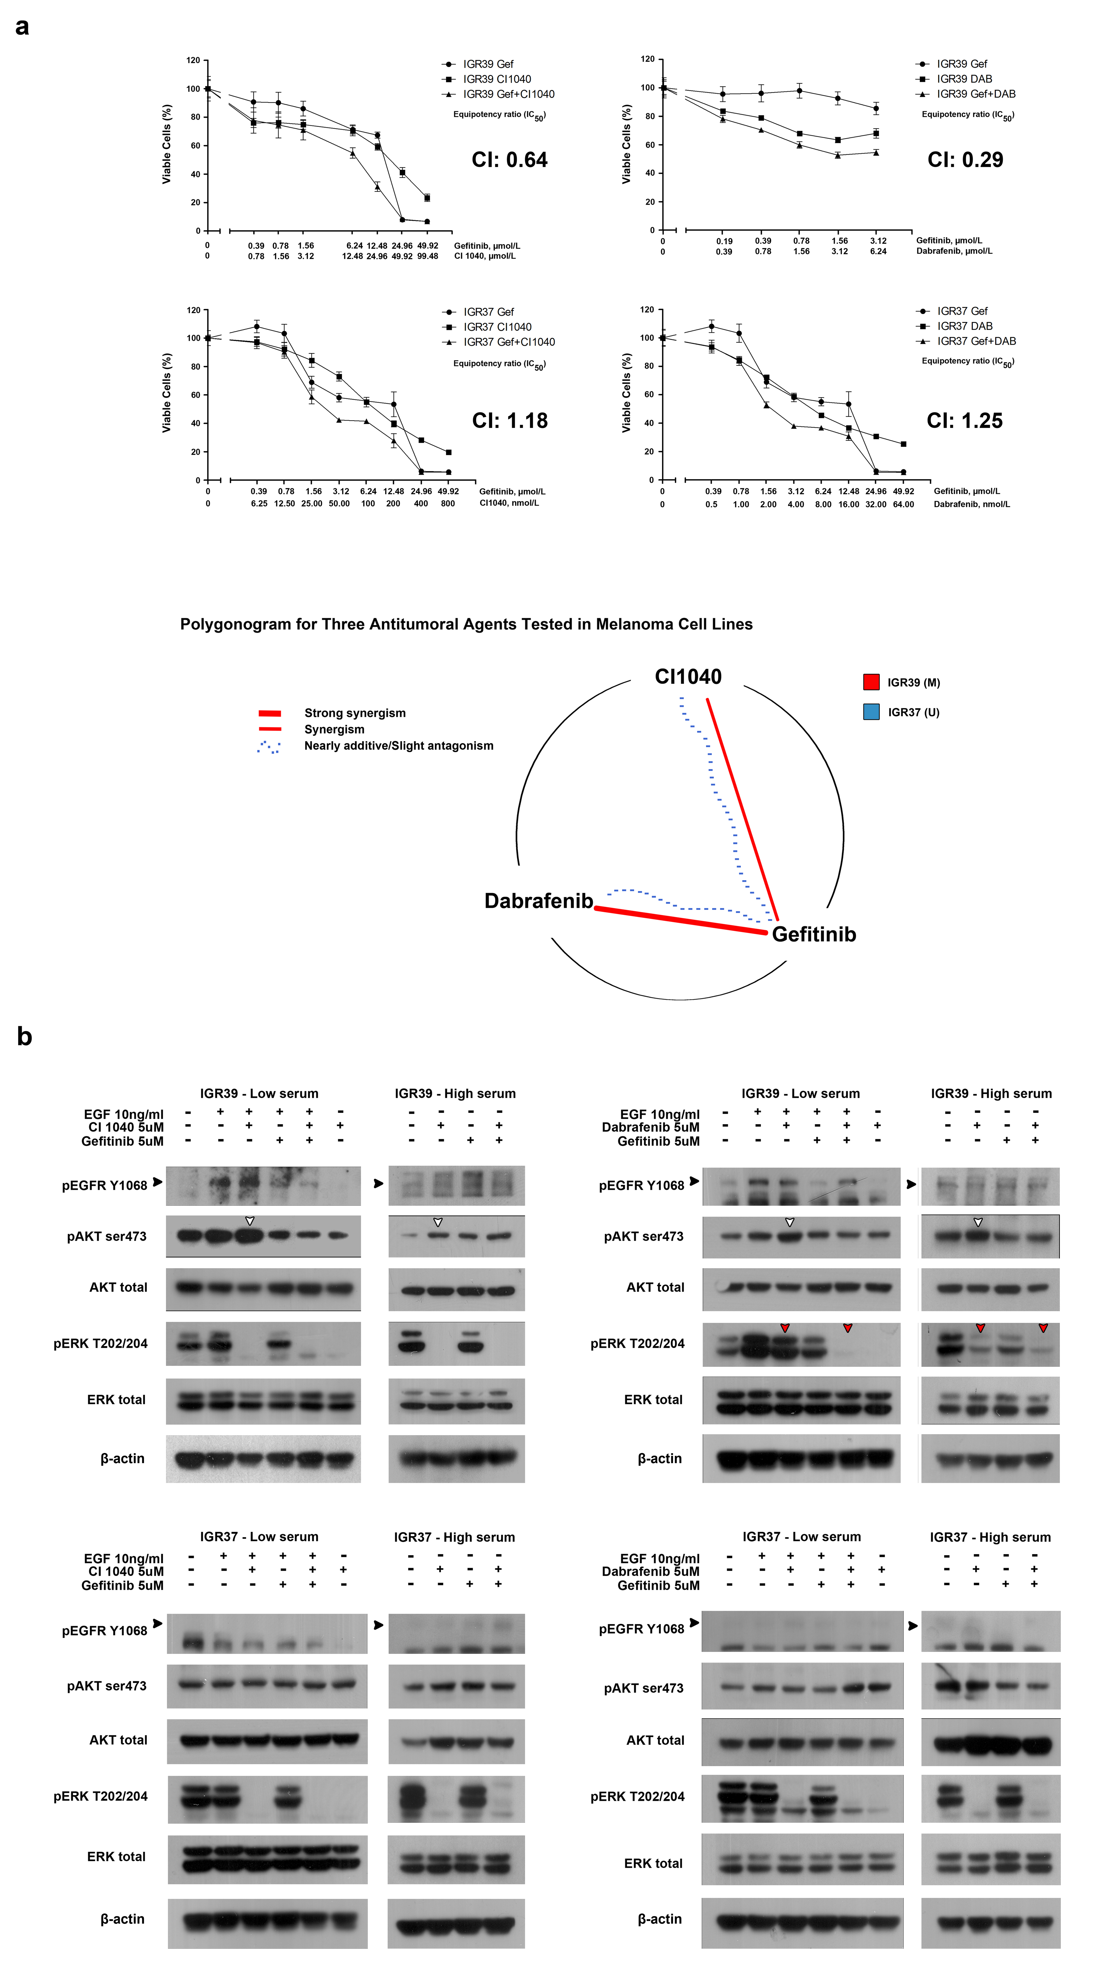
Supplementary Figure 11

Slide 22
Supplementary Fig.11. Assays for EGFR inhibition in melanoma cell lines.
(a) Top, synergistic effect of combination of BRAF (Dabrafenib), MEK (CI1040) and EGFR (Gefitinib) inhibitors on IGR39 (methylated and repressed for TBC1D16-47KD) cell viability. Bottom, nearly additive/slight antagonism effect of combination of BRAF (Dabrafenib), MEK (CI1040) and EGFR (Gefitinib) inhibitors on IGR37 (unmethylated and expressing for TBC1D16-47KD) cell viability. Dose/effect curves for single inhibitors Dabrafenib, CI1040, and Gefitinib and their combinations at equipotency ratio based on the IC50s are presented. Cell viability was measured at 72h after drug treatment using MTT-based cell viability assay. Relative cell viability of drug-treated cells was calculated as a fraction of the cells treated with DMSO (0.1%). Combination indexs (CI) at 50% dose response are calculated using CalcuSyn software. The polygonogram of the three antitumoral agents tested in the paired melanoma cell lines IGR39 and IGR37 is shown.
(b) Western blot analyses of the biochemical response of IGR39 (methylated and repressed for TBC1D16-47KD) and IGR37 (unmethylated and expressing for TBC1D16-47KD) cells treated with MEK inhibitor CI1040, BRAF inhibitor dabrafenib, and EGFR inhibitor gefitinib, or their combination in low (0.1%) and high (10% FBS) serum conditions. Cells were harvested at 4h after drug treatment. In IGR39 (methylated and repressed for TBC1D16-47KD ), in low serum conditions and in the presence of EGF, MEK and BRAF inhibition results in strong phosphorilated EGFR and AKT proteins, which is abrogated by EGFR inhibitor gefitinib (black and white arrow heads, respectively). Blocking the RAS/BRAF/MEK/ERK pathway upstream of MEK protein using dabrafenib is not sufficient to avoid ERK activation (red arrow heads) given the activation of the contralateral PI3K/AKT pathway upon EGFR stimulation (red arrow heads). Conversely, in IGR37 (unmethylated and expressing for TBC1D16-47KD) whith lower EGFR levels, AKT activation cannot occurs and ERK is always repressed using both MEK and BRAF inhibitors. Similar results were observed in high serum conditions.

Slide 23
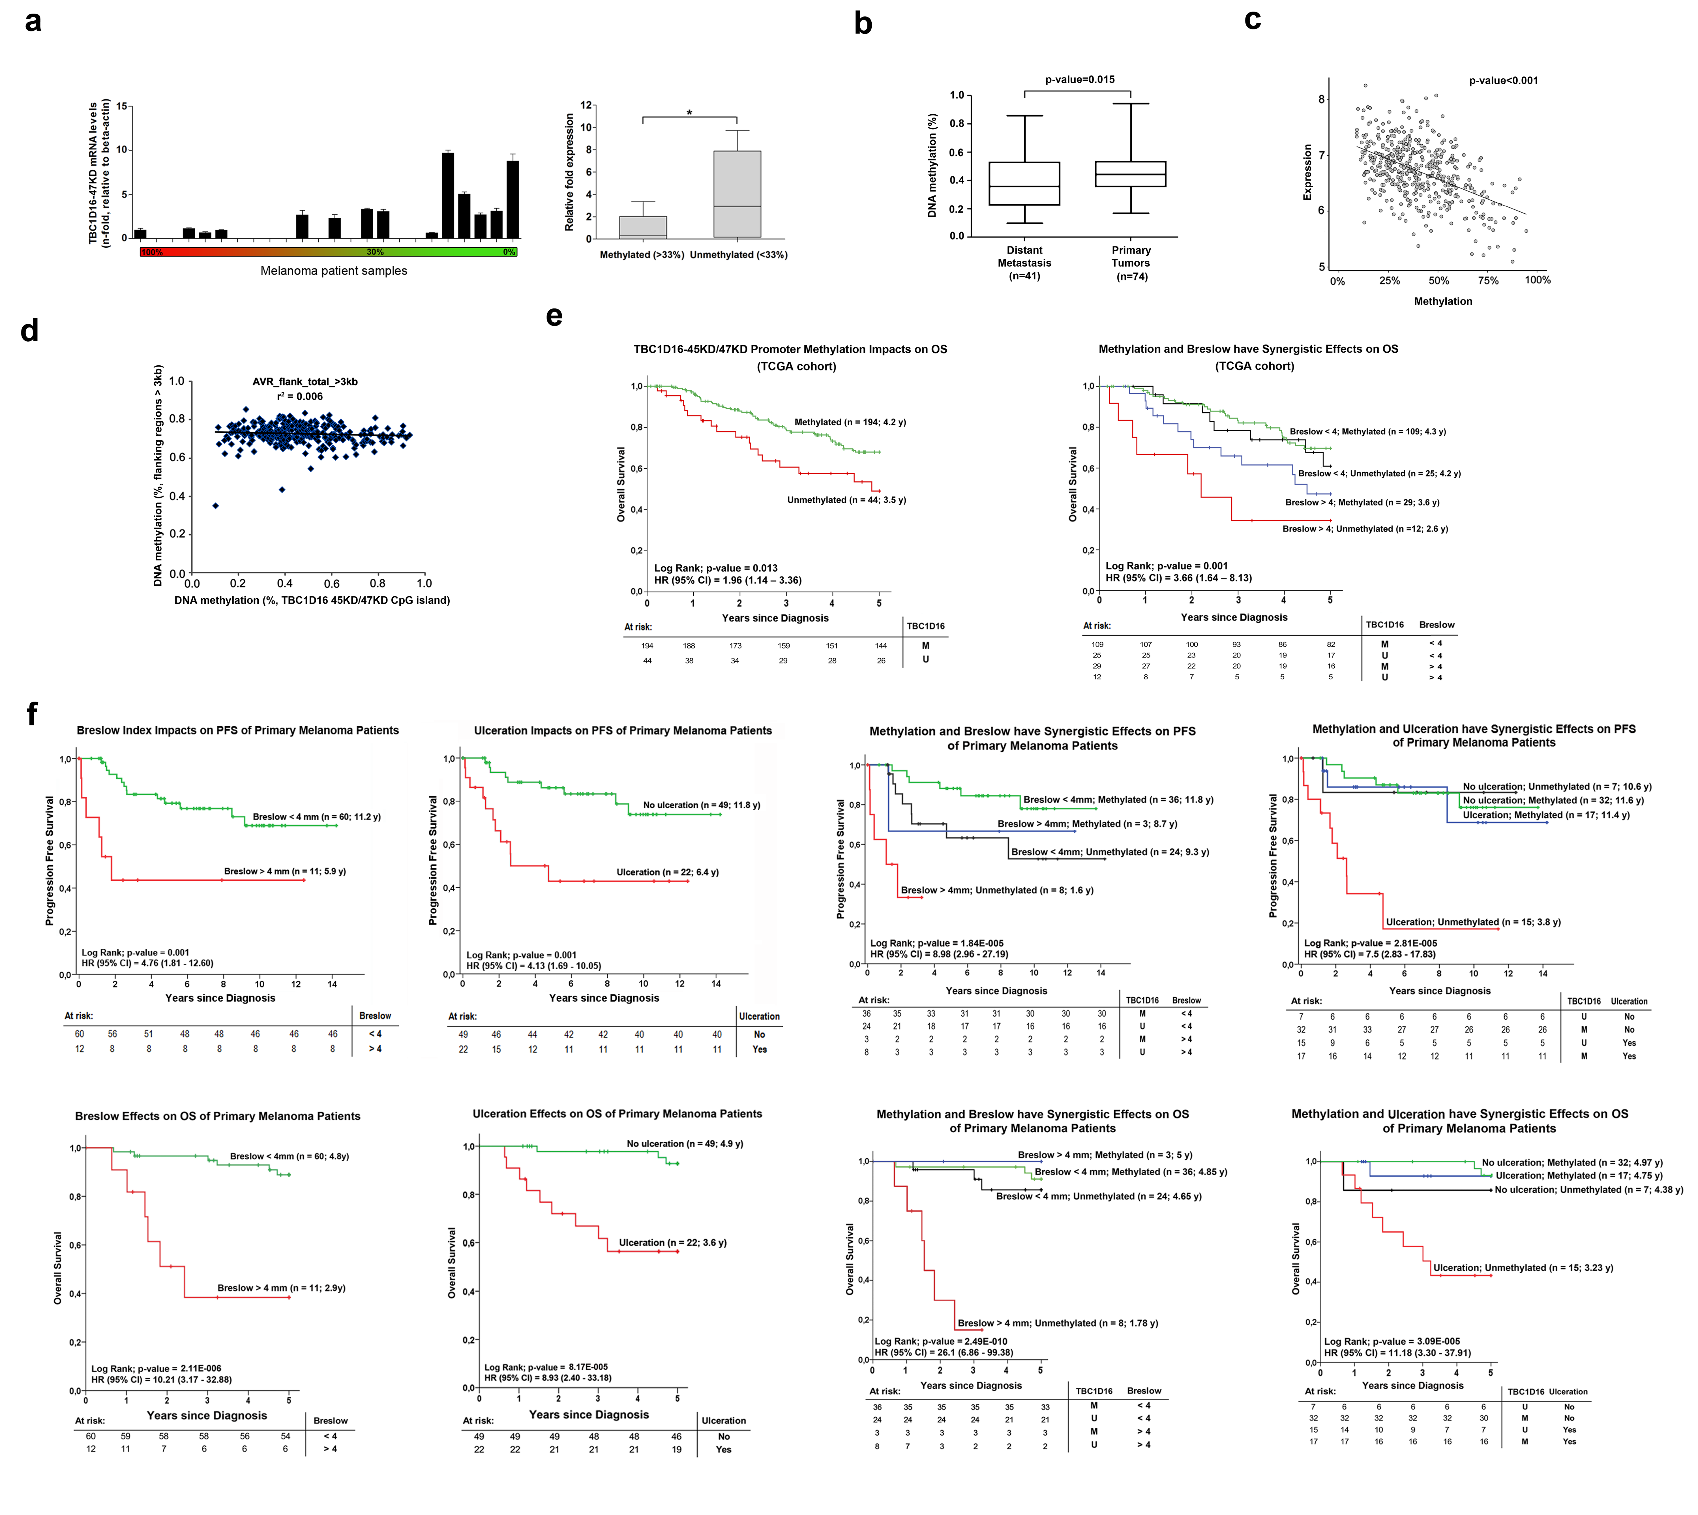
Supplementary Figure 12

Slide 24
Supplementary Fig.12. TBC1D16-47KD methylation/expression data and clinical outcome.
(a) Quantitative RT-PCR taqman assay of the TBC1D16-47KD mRNA expression levels in 24 melanoma patients with different levels of TBC1D16-45KD/47KD promoter methylation. Absolute methylation levels (0-100%) are shown. Green, unmethylated; Red, methylated.
(b) The TCGA data set confirmed that TBC1D16-47KD hypomethylation was enriched in distant melanoma metastases in comparison to non-disseminated primary melanomas (Mann Whitney test, p=0.015).
(c) The RNA-sequencing data from TCGA melanoma cases showed that TBC1D16-47KD hypomethylation was associated with increased expression of the transcript (Spearman correlation test, rho:-0.44, p<0.00001).
(d) The TCGA dataset highlighted the functional relevance of TBC1D16-47KD hypomethylation by showing that, in the context of widespread blocks of DNA hypomethylation in cancer, there was not an association between our identified demethylation event and a global DNA methylation loss within this region (r²=0.006).
(e) Left panel, Kaplan-Meier analysis of Overall Survival (OS) among the melanoma TCGA cohort according to TBC1D16-47KD methylation status. Right panel, Kaplan-Meier analysis of Progression-Free Survival (PFS) and Overall Survival (OS) among the melanoma TCGA cohort stratified by TBC1D16-47KD methylation status and Breslow index. The p-value corresponds to the Log Rank test. Cox regression univariate analysis is represented by Hazard Ratio (HR) with a 95% of confidence interval (95% CI).
(f) Left panel, Kaplan-Meier analysis of PFS and OS among the melanoma validation cohort according to Breslow index and ulceration status. The p-value corresponds to the Log Rank test. Cox regression univariate analysis is represented by Hazard Ratio (HR) with a 95% of confidence interval (95% CI). Right panel, Kaplan-Meier analysis of PFS and OS among the melanoma validation cohort stratified by TBC1D16-47KD methylation status and Breslow index. Kaplan-Meier analysis of PFS and OS among the melanoma validation cohort stratified by TBC1D16-47KD methylation and ulceration status. Significance of the Log Rank test is shown. Results of the univariate Cox regression analysis are represented by the HR and 95% CI. The number of cases (n) and the mean time to progression/survival in years (y) is indicated for each group.

