Slide 1



VCaP
C4-2
LNCaP
LAPC4
DU145
PC-3
RWPE
PNT1A
Supplemental Figure 1
A
B
siRNA C NCOR1
AR
NCOR1
AR
Actin
NCOR2
NCOR1
Tubulin
C
D
*
*
*
*
CSS FBS FBS+Bic
LNCaP
LAPC4
E
CSS FBS FBS+Bic
Comparison of NCOR1 and NCOR2 knockdown in LAPC4 and LNCaP cells. A. AR, NCOR1, and NCOR2 expression in prostate cell lines derived from malignant and non-malignant epithelium. B. LAPC4 cells were transfected with noncoding control (C) or NCOR1 specific siRNAs. Cells were grown for 48hours in complete medium, proteins extracted and analyzed for NCOR1, AR, and Actin expression. C. Level of downregulation of NCOR1 mRNA after NCOR1 knockdown with two different siRNA in LNCaP and LAPC4 cell lines. D. Cells were transfected as in B, grown in media supplemented with css or FBS as indicated. Next, 1 µM bicalutamide or ethanol vehicle were added as indicated for another 24 hours and the rates of DNA synthesis compared by [³H]-Thymidine incorporation. E. LNCaP cells were transfected with control or NCOR2 specific siRNAs, treated and assayed for DNA synthesis as in D.

Slide 2
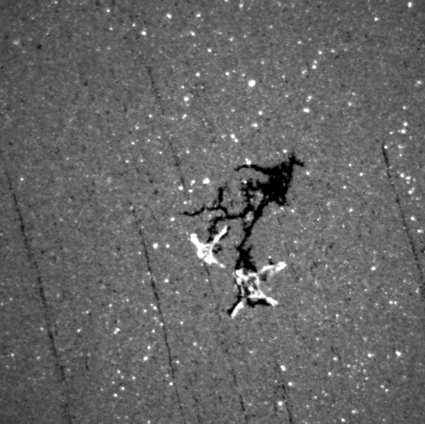
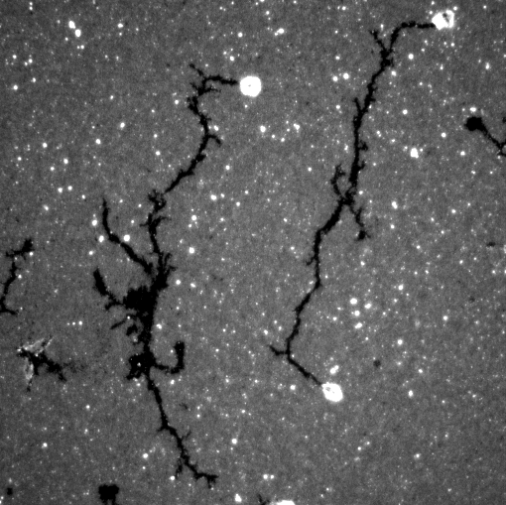
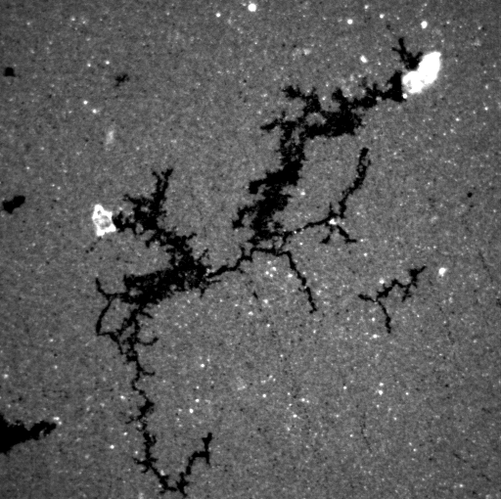
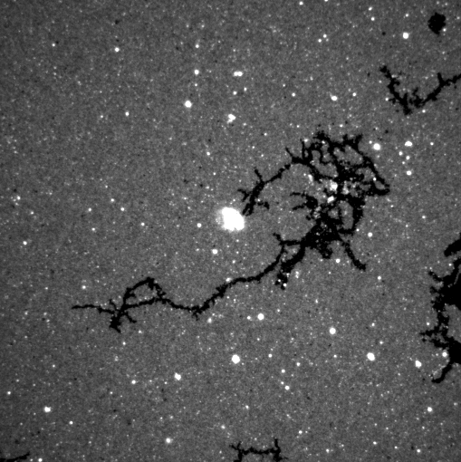
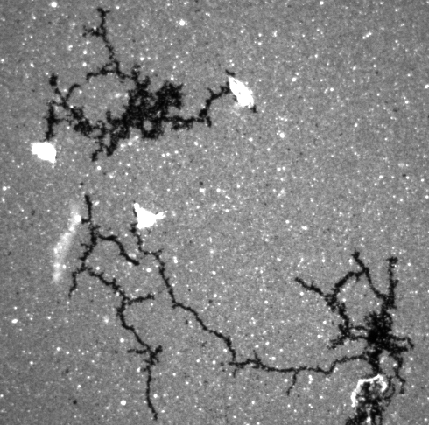
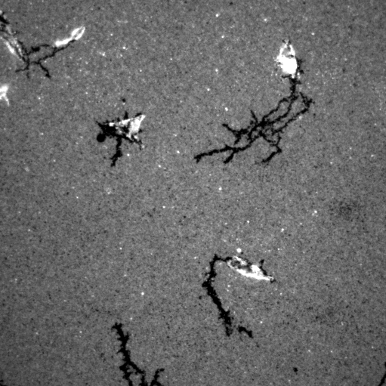
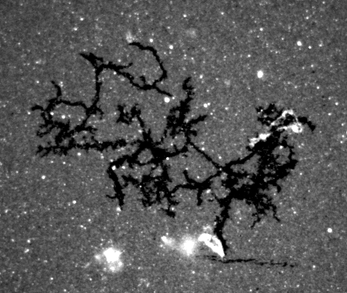
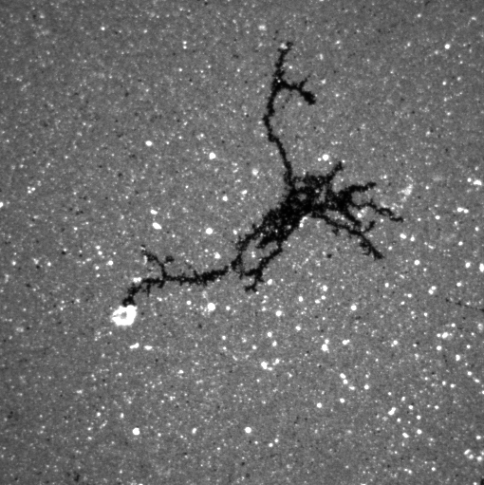
Supplemental Figure 2
A
Control siRNA
NCOR1 siRNA
Bicalutamide Vehicle
B
NCOR1 regulates motility of LNCaP cells. A. LNCaP cells were transfected with either Control or NCOR1 specific siRNA. 48 hours later cell were trypsinized and plated on a fluorescent bead covered plate in media supplemented with FBS or FBS and 1 µM bicalutamide. 24 hours later cell tracks were captured on fluorescent microscope. B. Cells transfected as in A were plated onto xCelligence CIM plate with the bottom chamber filled with medium supplemented with 10% FBS and 1 µM bicalutamide. Cellular Impedance was measured as a function of time and is directly proportional to the number of cells migrated through the porous membrane.

Slide 3
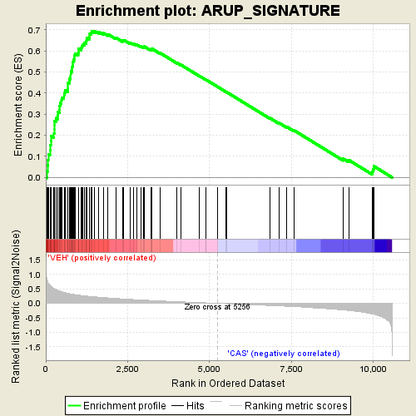
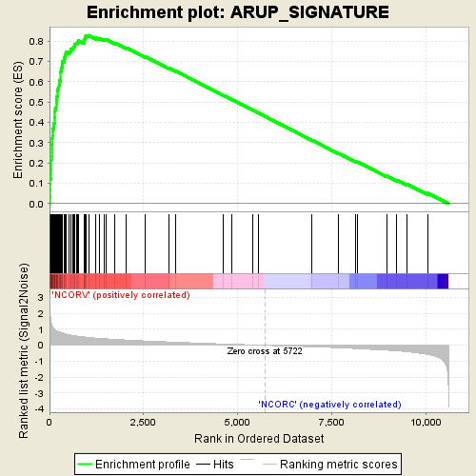
Supplemental Figure 3
A
B
NES=1.5549
FDR q-value=0.0952
NOM p-value<0.0001
NES=1.46358
FDR q-value=0.0886
NOM p-value<0.0001
C
NES=1.2258
FDR q-value=0.2101
p-value=0.046
AR signature is present among bicalutamide treated genes in both control and NCOR1 depleted cells. A. GSEA of AR signature among genes regulated by bicalutamide in control siRNA transfected LNCaP cells. B. GSEA of AR signature among genes regulated by bicalutamide in NCOR1 depleted LNCaP cells. C. GSEA of SIAH2 signature in genes set Control_bicalutamide – NCOR1_bicalutamide .

Slide 4

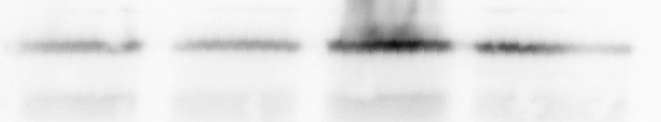
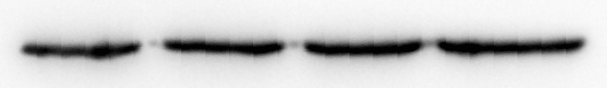
Supplemental Figure 4
A
B
C4-2 LNCaP
FBS css FBS css
NCOR1
AR
Tubulin
C
D
Comparative levels of UGT2B15 and UGT2B17 mRNA expression in LNCaP and C4-2 cells. A. LNCaP or C4-2 cells were plated in medium supplemented with FBS or cssas indicated and treated with either vehicle (ethanol), 1 µM bicalutamide, or 1 µM MDV3100 for 48 hours. RNA was analyzed for NCOR1 and 18S expression. B. C4-2 or LNCaP cells were grown for 48 hours in medium supplemented with FBS or css as indicated. Proteins were extracted and analyzed for NCOR1, AR and tubulin protein levels by Western blotting. C-D. RNA from A was used to compare UGT2B15 (C) and UGT2B17 (D) expression by quantitative RT-PCR. Due to large scale differences in expression logarithmic Y axis was used.

Slide 5
Supplemental Figure 5
A
B
C siRNa UGT2B15 siRNA
C siRNa UGT2B17 siRNA
C
Loss of both UGT2B 15 and UGT2B 17 lead to elevated DHT-dependent PSA expression. A-B. LNCaP cells were transfected with noncoding control or NCOR1 specific siRNAs and cells were grown in medium supplemented with css for 24 hours. Next, ethanol vehicle or DHT were added at indicated concentrations for another 24 hours and assayed for UGT2B15 (A), UGT2B17 (B), and 18S mRNA levels by quantitative PCR. C LNCaP cells were transfected with either control siRNA or the combination of UGT2B15 and UGT2B17 specific siRNAs, treated with indicated concentration of DHTnfor 24 hours and assayed for PSA and 18S expression.

Slide 6
Supplemental Figure 6
A
*
*
*
*
Vehicle R1881 vehicle Bic
10% css
10% FBS
B
*
*
Vehicle R1881 vehicle Bic
10% CSS
10% FBS
NCOR1 is required for optimal TARP and CHEK1 expression in LAPC4 cells. A. LAPC4 cells were transfected with noncoding control or NCOR1 specific siRNAs and cells were grown in the presence of css or FBS as for 24 hours. Next, treatments were added as indicated for another 24 hours. RNA was extracted and and assayed for TARP and 18S expression. Levels of TARP in LAPC4 cells transfected with control siRNA, incubated in css, and with vehicle were assigned a value of 1 and all other values adjusted accordingly. B. LAPC4 cells were transfected and treated as in A and RNA assayed for CHEK1 expression. CHEK1 expression was normalized for 18S.

Slide 7
Supplemental Figure 7
A
B
C
D
AR
IgG
AR
IgG
AR is recruited to PSA enhancer and INPP4B promoter after NCOR1 depletion. Three plates of 2x10⁶ LNCaP cells grown in medium supplemented with css and 1 nM R1881 were each split in half and used for CHIP assay using either NCOR1 or IgG antibody. B. 6x10 cm plates were seeded with 2x10⁶ LNCaP cells in medium with css and transfected with either Control or two different NCOR1 specific siRNAs. 24 hours later three plates were treated with ethanol vehicle and another 3 plates were treated with 1 nM R1881 for additional 24 hours. Cells were harvested and split to perform CHIP assay with either AR or IgG antibodies.

Slide 8
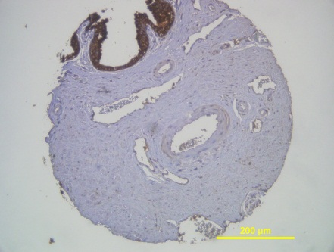
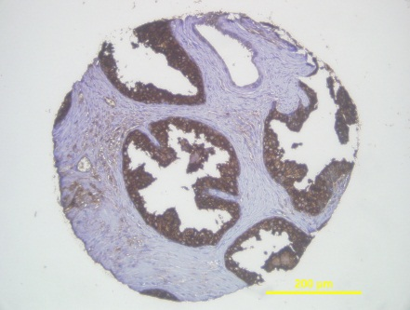
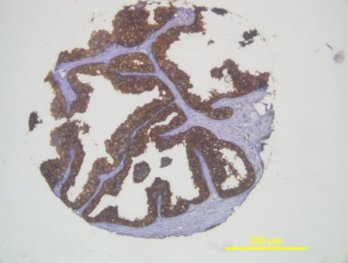
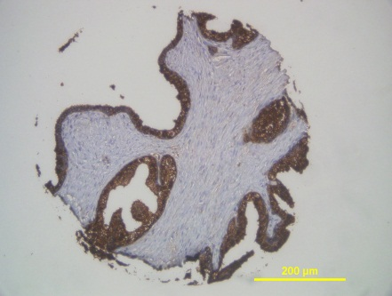
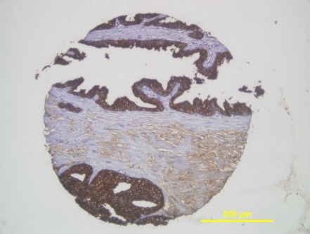
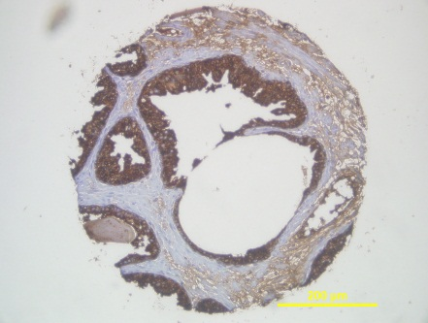
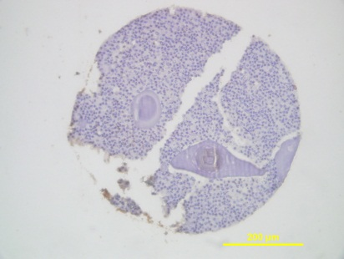
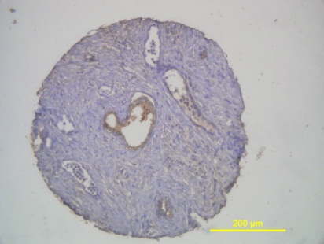
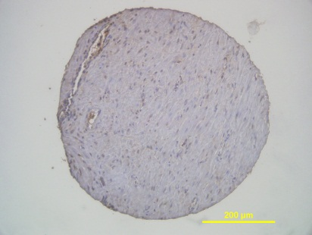
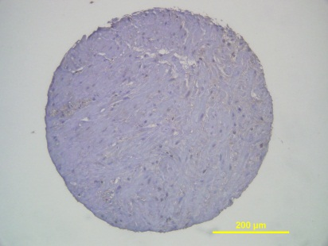
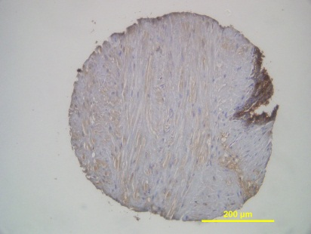
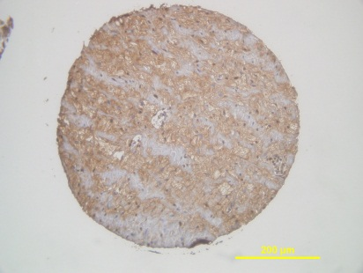
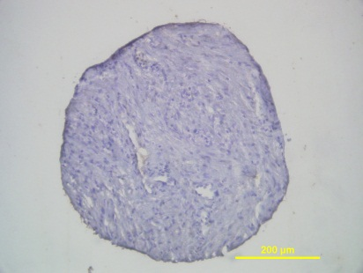
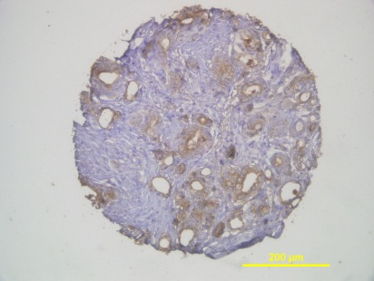
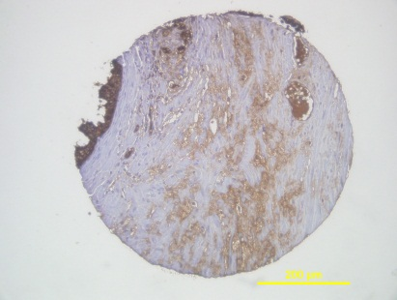
Supplemental Figure 8
Examples of variable NCOR1 staining in normal prostate epithelium, PIN, and prostate cancer on tissue microarray.

