Slide 1
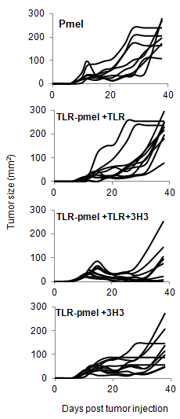
Supplemental Figure 4: Co-administration of agonistic 4-1BB antibody and TLR1-TLR2 ligand reduces growth of B16 melanomas in mice. 10⁵ B16-F1 melanoma cells were injected subcutaneously into C57B6 mice. When palpable tumors were detected (approximately 25mm²) the mice were irradiated (400rads) and 24 hours later 5-7.5×10⁶ activated pmel T cells or pmel T cells treated with TLR1-TLR2 ligand (2ug/ml) (TLR-Pmel) for 24 hours prior were injected intravenously. TLR1-TLR2L (10ug/mouse), 3H3 (100ug/mouse) or TLR1-TLR2 ligand (10ug/mouse) plus 3H3 (100ug/mouse) were injected intraperitoneally. Growth of B16 melamonas on individual mice in various treatment groups were measured using a caliper and plotted.

