Slide 1
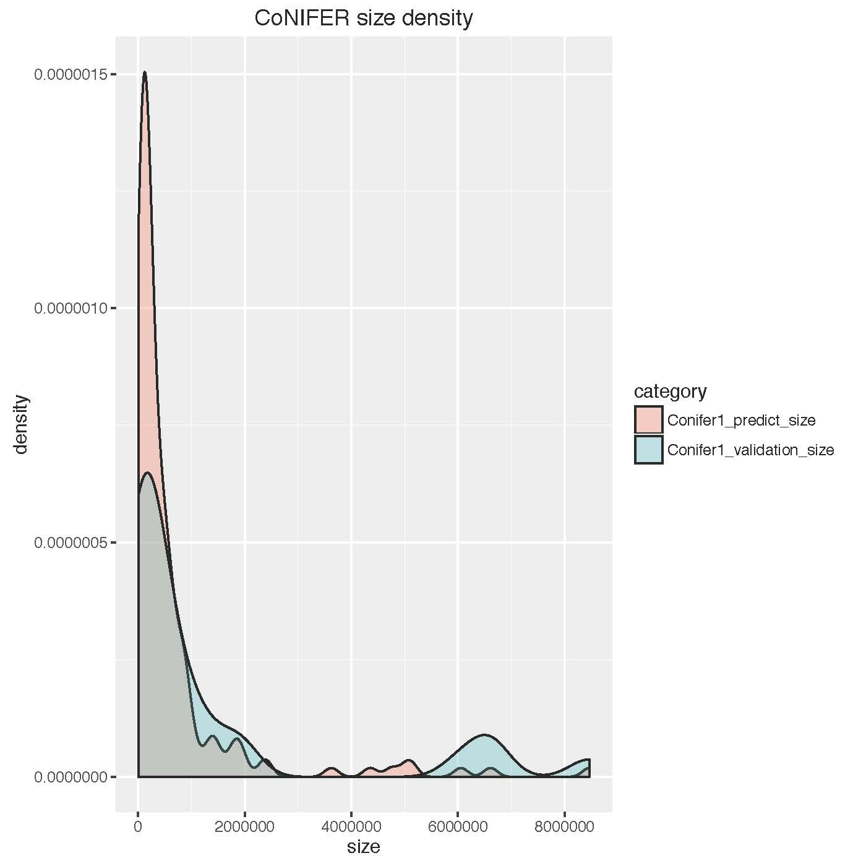
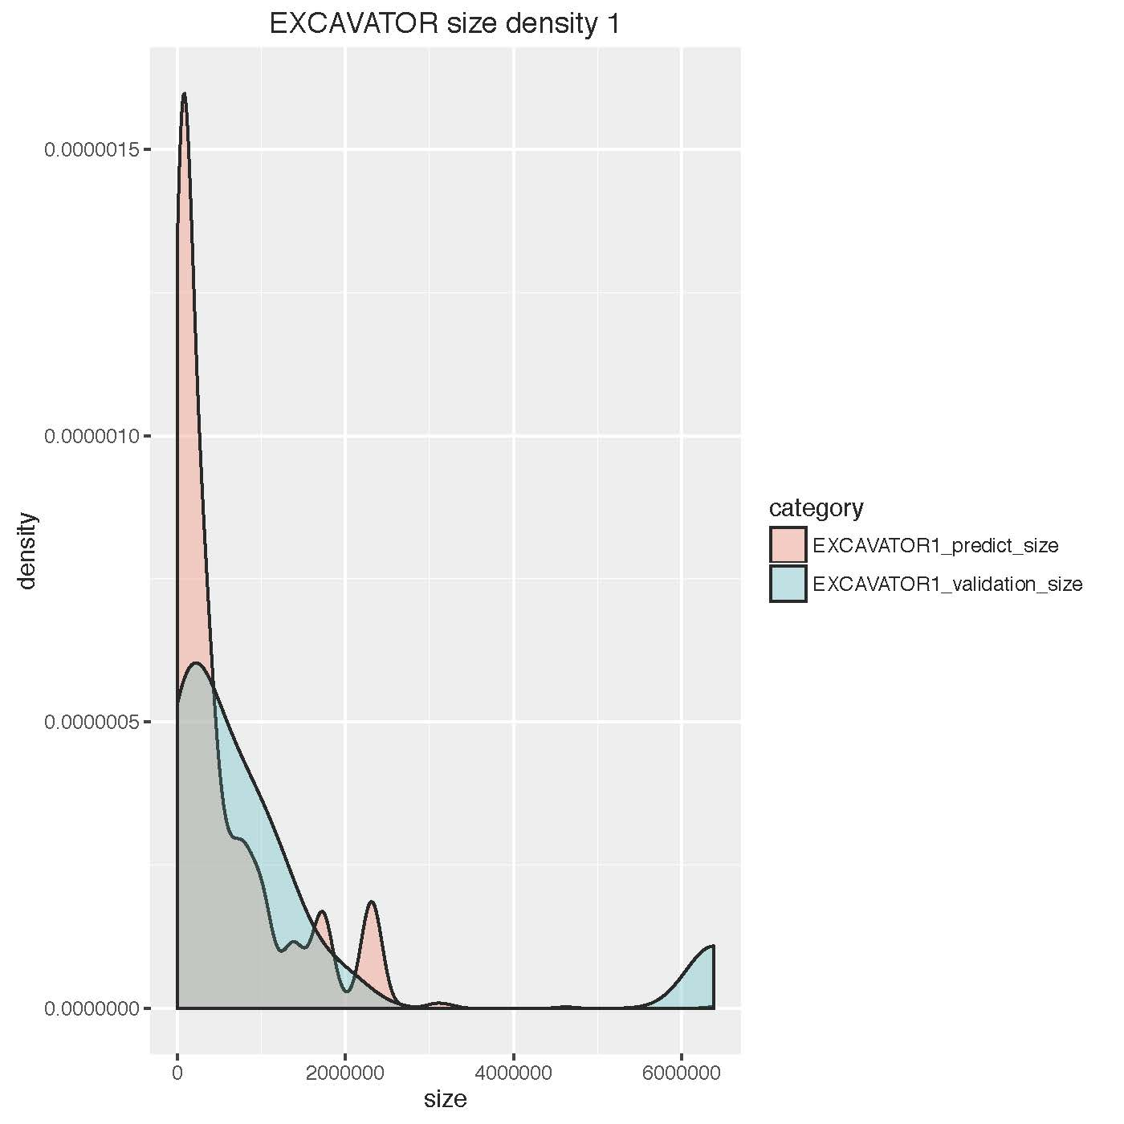
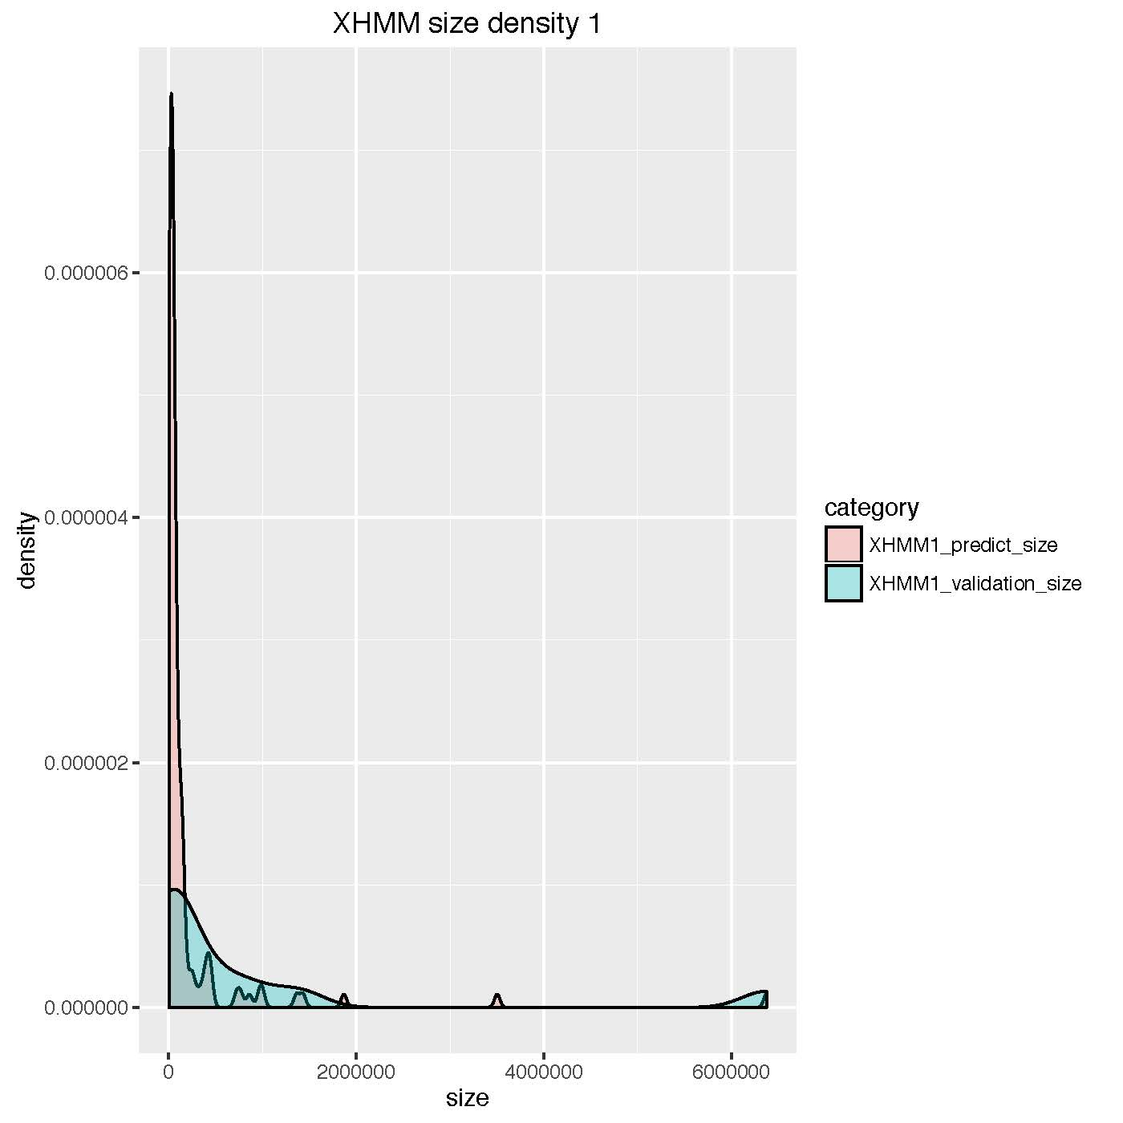
Figure S1. The density plot of comparison of predicted CNVs and the validated CNV in base pairs. The density plot is shown to compare the sizes of CNVs that were predicted and validated using 300 ClinSeq© samples.

Slide 2
Venn diagram of non-validated CNVs (FP)
CoNIFER (74)
EXCAVATOR (1434)
XHMM (56)
32
14
14
20
Figure S2. The overlap of false positive CNV calls using 300 ClinSeq© samples.

