Slide 1
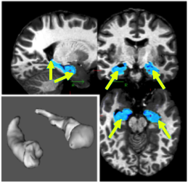
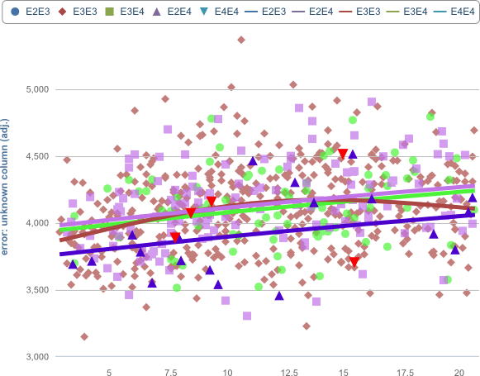
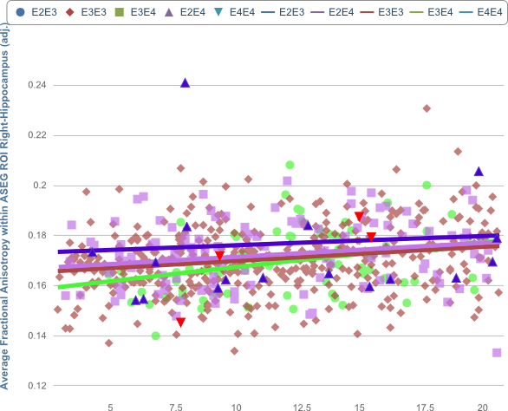
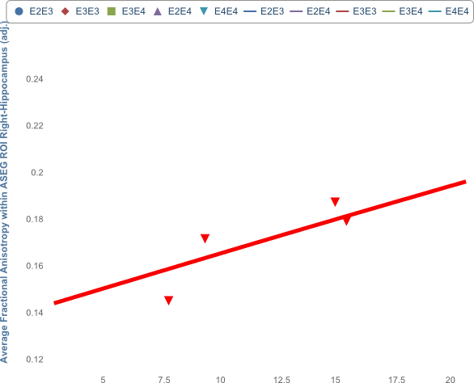
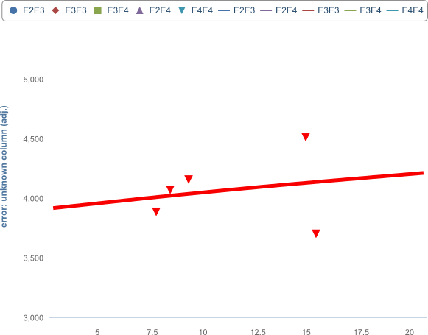
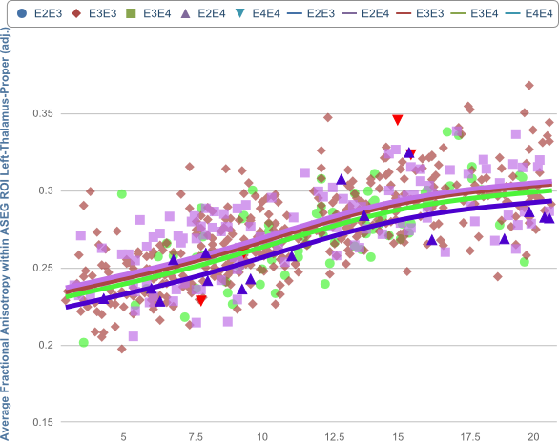
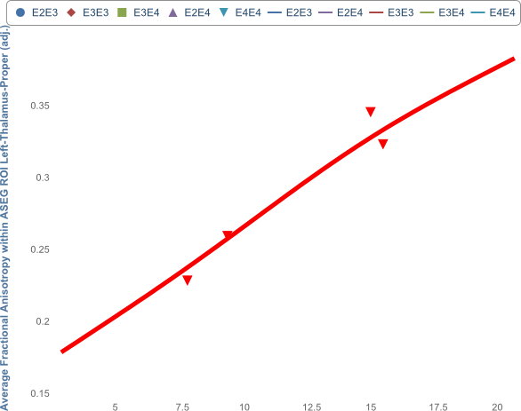
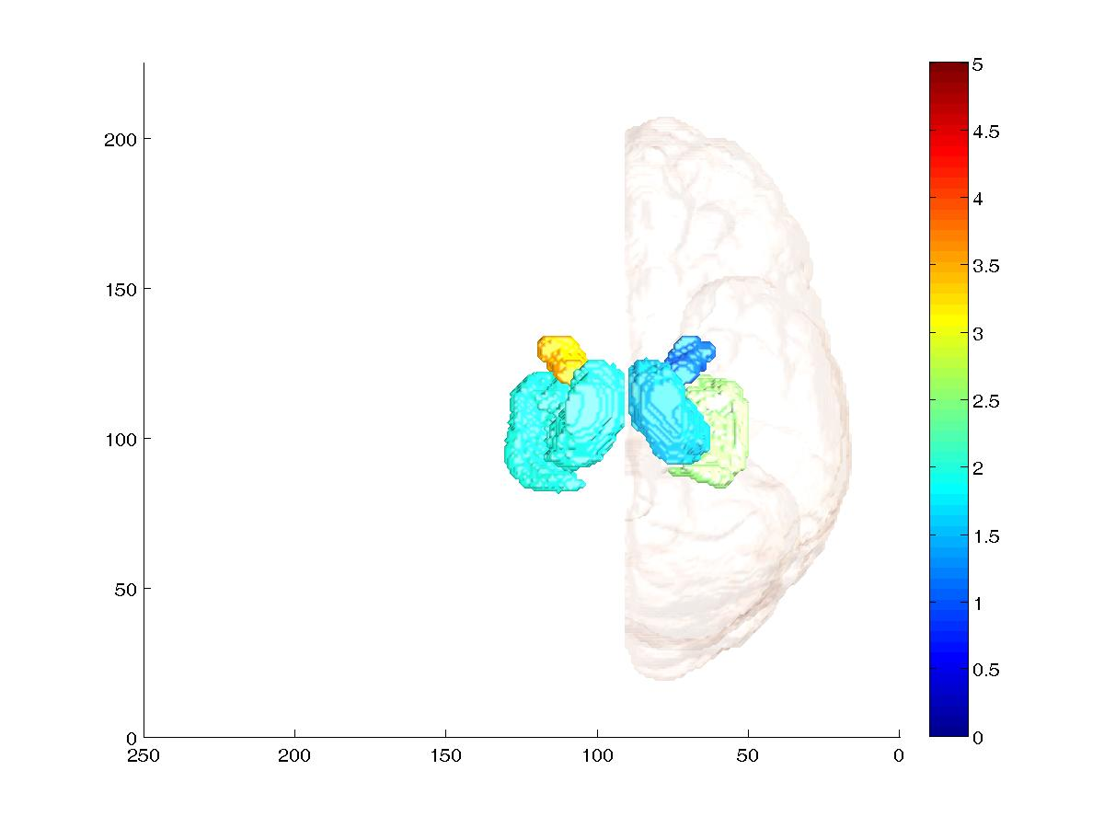
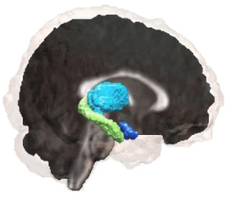
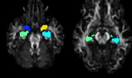
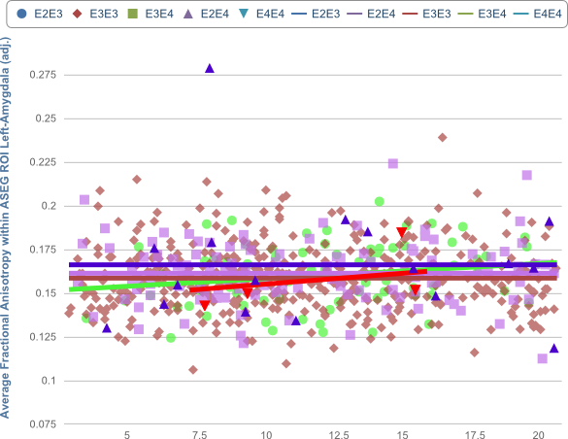

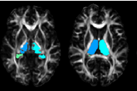
Figure e-1. APOEε Genotypic Variations on Age-Dependent Changes of Subcortical Volumes and Fractional Anisotropy (FA) in Children with Primarily European Ancestry
(a)
APOEε x Age Interaction: p=0.04
APOEε: p=0.08
Age: p=0.0001
(b)
APOEε x Age Interaction-p=0.05
APOEε: p=0.36
Age: p=0.004
(c)
5.0
0.22
0.20
4.5
R & L Hippocampal Volume (cm³)
0.18
4.0
R Hippocampal FA
0.16
3.5
0.14
3.0
0.12
4
6
8
10
12
14
16
18
20
4
6
8
10
12
14
16
18
20
Age (years)
Age (years)
ε4-
ε4+
ε2ε3
ε3ε3
ε3ε4
ε4ε4
ε2ε4
(d)
APOEε x Age Interaction: p=0.03
APOEε: p=0.42
Age: p=0.96
(e)
APOEε x Age Interaction: p=0.004
APOEε: p=0.06
Age: p<0.0001
(f)
0.225
0.325
Amygdala
0.200
0.300
0.175
0.275
Hippocampus
L Thalamus FA
Thalamus
0.150
0.250
L Amygdala FA
Amygdala
0.125
0.225
Thalamus
0.100
0.200
0.075
0.175
Hippocampus
R
L
4
6
8
10
12
14
16
18
20
4
6
8
10
12
14
16
18
20
Age (years)
Age (years)
Notes:
Figure e-1. APOEε Genotypic Variations on Age-Dependent Changes of Subcortical Volumes and Fractional Anisotropy (FA) in Children with Primarily European Ancestry . (a) Right and left hippocampal volumes are shown as averaged values (since they were not significantly different) across the six APOEε genotypes. Similar to findings in Fig. 1a, the smallest volumes across the age range and genotype groups are in those with ε2ε4 (blue, ε2ε4<ε3ε3, p=0.09), (b) Also similar to findings in Fig. 1b, Right hippocampal FA was relatively stable across the age range, except for the children with ε4ε4 (red), especially those at younger ages (similar age-related curve is seen in the left hippocampus, Table e-2). (c) Segmented hippocampi shown in three orientations. (d) In contrast to Fig. 1d, only the younger children (<10 years) with ε2ε3 and ε4ε4, but not those with ε2ε4 showed relatively lower FA in left amygdala. (e) Somewhat similar to Fig. 1e, Younger children with ε4ε4 and all those with ε2ε4 also show relatively lower FA in left thalamus (post-hoc test: ε2ε4<ε3ε3, p=0.04). (f) Log p-value maps of the brain regions showing age-by-genotype interactions. (See also Table e-2).

Slide 2
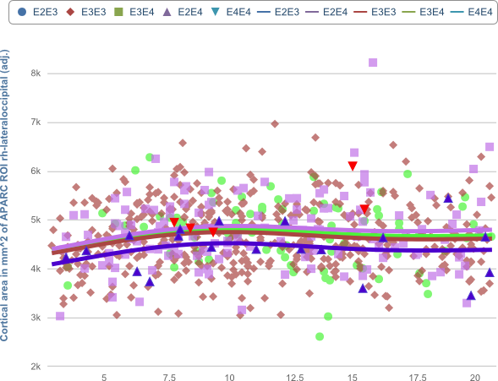
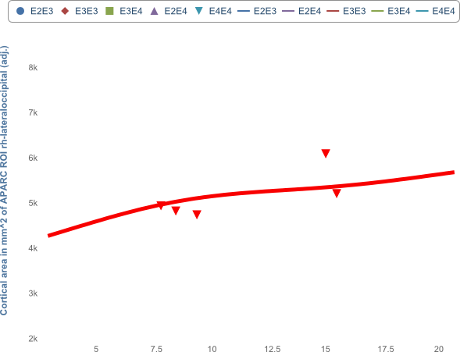
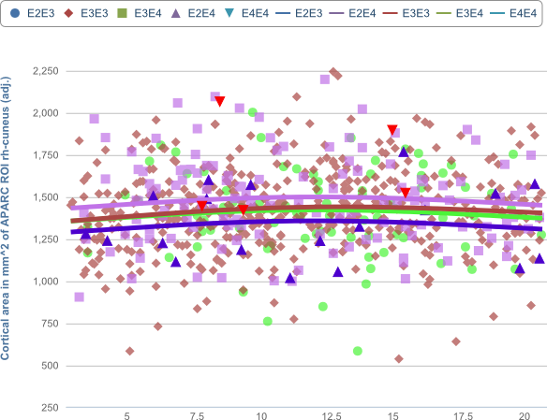
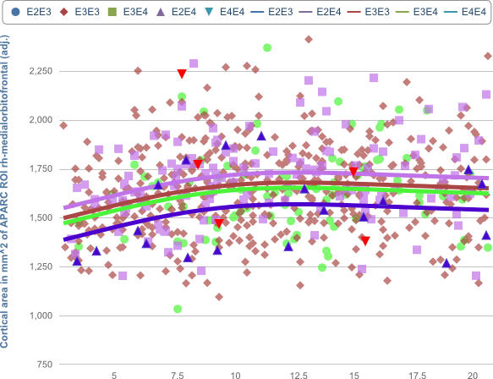
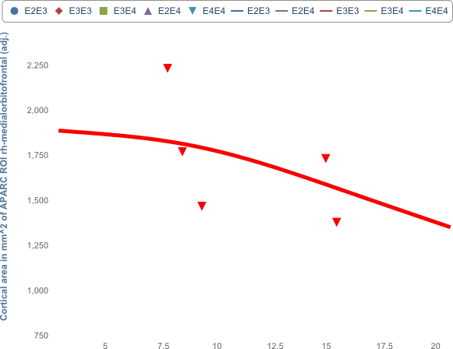
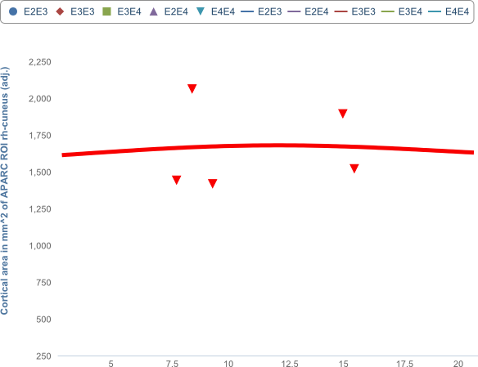
Figure e-2. APOEε Genotypic Variations on Cortical Areas in Children with European Ancestry
(a)
APOEε: p=0.05
Age: p<0.0001
7
6
5
R Lateral Occipital Cortical Area (cm²)
4
ε4-
ε4+
3
ε2ε3
ε3ε3
ε3ε4
ε4ε4
ε2ε4
2
4
6
8
10
12
14
16
18
20
Age (years)
(b)
(c)
APOEε: p=0.01
Age: p<0.0001
2.25
APOEε: p=0.009
Age: p=0.07
2.25
2.00
2.00
1.75
R Cuneus Area (cm²)
1.75
R Medial Orbitofrontal Cortical Area (cm²)
1.50
1.50
1.25
1.00
1.25
0.75
4
6
8
10
12
14
16
18
20
1.00
4
6
8
10
12
14
16
18
20
Age (years)
Age (years)
Notes:
Figure e-2. APOEε Genotypic Variations on Cortical Areas of Children with Primarily European Ancestry. Similar to the findings in Fig. 2b-d, the ε2ε4 group showed the smallest cortical areas across the age range in the right lateral occipital cortex (a), right cuneus (b) and right medial orbitofrontal cortex (c). Post-hoc analysis show that, relative to the reference ε3ε3 group (brown), the ε2ε4 group (blue) had significantly smaller right medial orbitofrontal cortical areas (p=0.03) and smaller right cuneus areas (p=0.10), while the ε3ε4 group (purple) tended to be larger in the lateral occipital cortex (p=0.06). The ε4ε4 group (red) also tended to have the largest areas amongst all groups in the right cuneus (ε4ε4> to ε2ε4, p=0.18) and right lateral occipital area (ε4ε4>ε2ε4, p=0.004), see also Table e-3. Note that the surface maps comparing APOEε genotype effects on cortical surface area could not be performed since the sample size in the ε4ε4 group was too small.

Slide 3
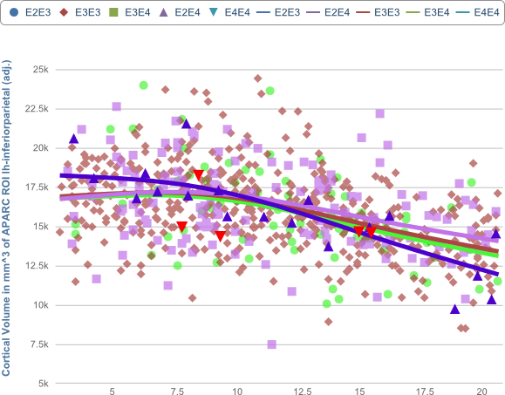
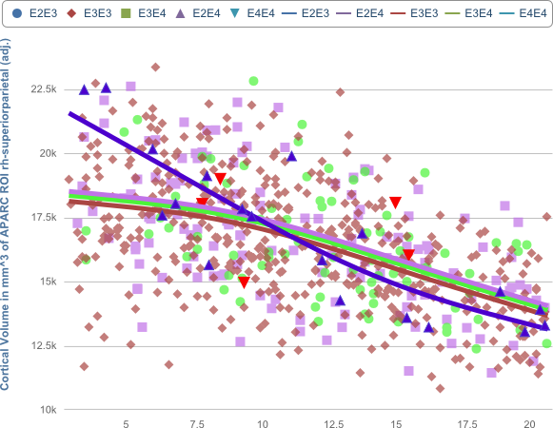
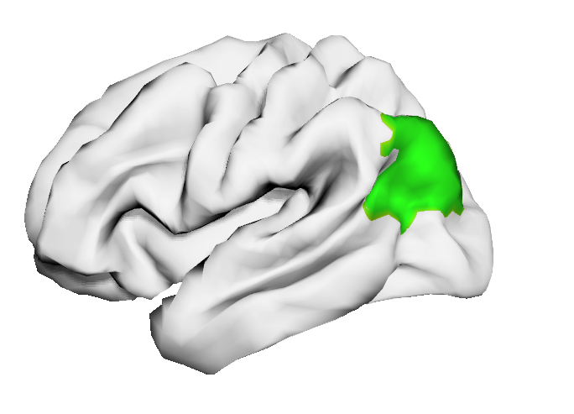

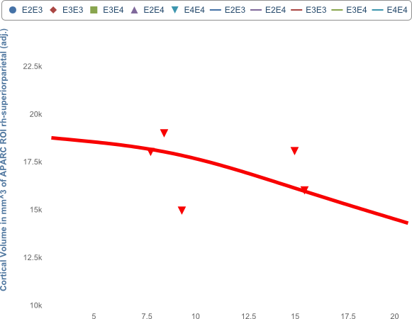
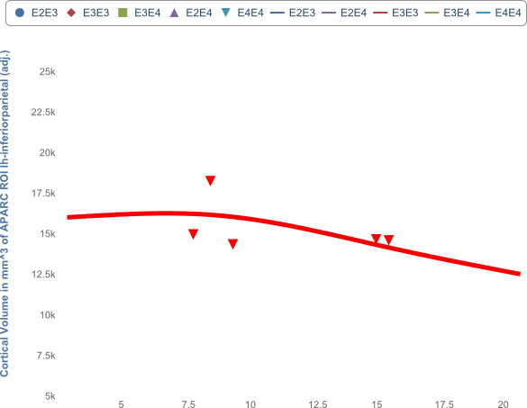
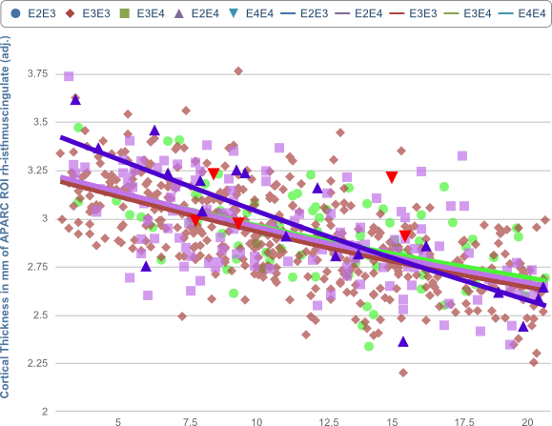
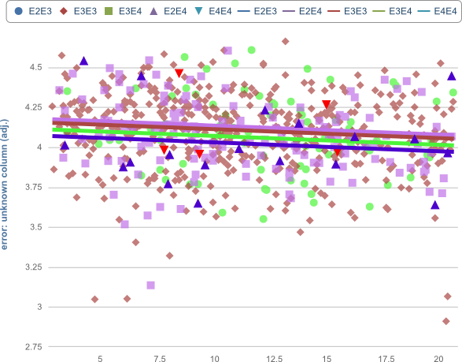
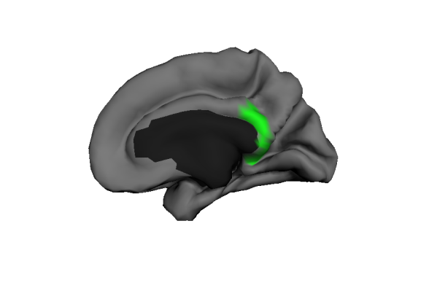
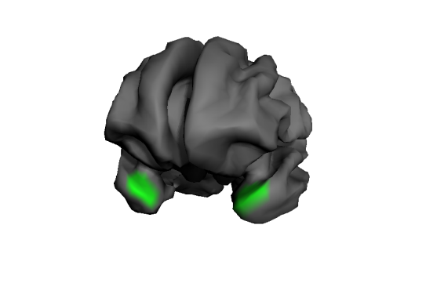
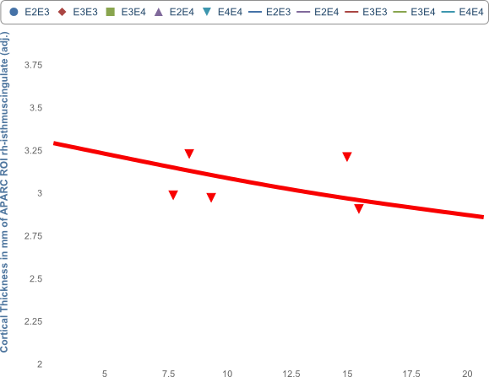
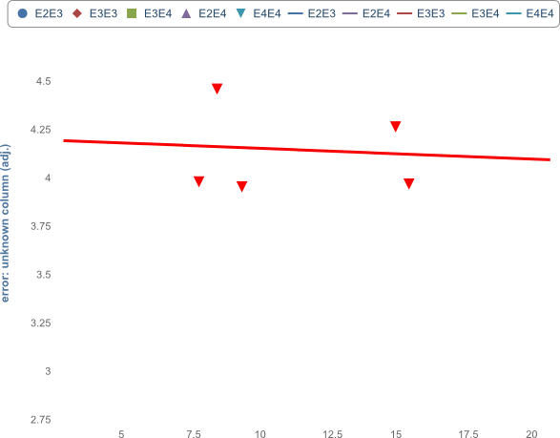
Figure e-3. APOEε-by-Age Interactions or APOE effects on Selected Cortical Volumes and Thickness in Children with Primarily European Ancestry
(a)
(b)
APOEε x Age-Interaction: p=0.01
APOEε : p=0.55
Age: p<0.0001
25.0
APOEε x Age-Interaction: p=0.02
APOEε: p= 0.53
Age: p<0.0001
IPG
SPG
22.5
22.5
20.0
20.0
17.5
17.5
L Inferior Parietal Gyral Volume (cm³)
R Superior Parietal Gyral Volume (cm³)
15.0
15.0
Left Lateral
12.5
Right Lateral
10.0
12.5
7.50
4
6
8
10
12
14
16
18
20
10.0
4
6
8
10
12
14
16
18
20
Age (years)
Age (years)
ε4-
ε4+
ε2ε3
ε3ε3
ε3ε4
ε4ε4
ε2ε4
(c)
APOEε x Age-Interaction: p=0.009
APOEε: p=0.20
Age: p<0.0001
(d)
APOEε x Age-Interaction: p>0.5
APOEε: p=0.79
Age: p=0.002
3.75
Isthmus
Anterior
4.5
3.50
3.25
4.0
R Isthmus Cingulate Thickness (mm)
Temporal Pole Thickness (mm)
3.00
2.75
3.5
Right Medial
2.50
Temporal pole
2.25
4
6
8
10
12
14
16
18
20
3.0
4
6
8
10
12
14
16
18
20
Age (years)
Age (years)
Notes:
Figure e-3. APOEε-by-Age interactions or APOEε Effects on Cortical Volumes and Thickness in Children with Primarily European Ancestry. Brain regions with APOEε-by-Age interactions are shown (green). (a & b) Similar to findings in Fig, 3a & 3b, the ε2ε4 group showed the largest average volumes in inferior and superior parietal cortices in those at younger ages (<10 years), but the smallest average volumes during adolescence. (c) Also similar to Fig, 3c, the isthmus of the cingulate showed age-dependent thinning in all subjects but to a lesser degree in those with ε4ε4. (d) In contrast, all subjects showed relatively stable temporal pole thickness across the age range, including those homozygous for ε4 (which showed age-dependent increases when the entire cohort was evaluated regardless of genetic ancestry in Figure 3d). All models for ROIs were generated from the general using an additive model (GAM) with thickness or volume of the ROI as dependent variable, co-varying for sex, scanner device, SES and GAF.

