Slide 1
Supplementary material
1. ERPs
2. Analysis, revised procedure
3. Topographic analysis
4. Stimulus pairs
5. Stimulus properties

Slide 2
1. Supplementary ERPs
Congruent
Within category
Between category
Grand average, overview, N=42

Slide 3



NH
FCz
Oz
Pre
Post
Congruent
Mean amplitude
350-500ms
(μV)
Within category
+10
Between category
-10

Slide 4
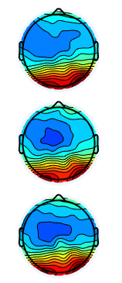
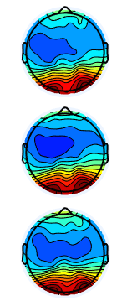
HA
FCz
Oz
Pre
Post
Congruent
Mean amplitude
350-500ms
(μV)
Within category
+10
Between category
-10

Slide 5
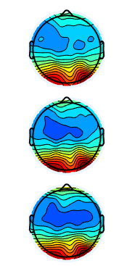
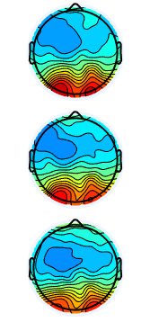
CI
FCz
Oz
Pre
Post
Congruent
Mean amplitude
350-500ms
(μV)
Within category
+10
Between category
-10

Slide 6
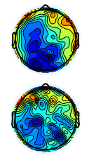
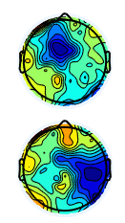
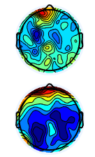
Group mismatch difference plots
NH
HA
CI
Within-category
-Congruent
Between-category
-Congruent
Mean amplitude
350-500ms
(μV)
+1.5
-1.5

Slide 7
2. Supplementary analysis, revised procedure
The analysis of all participants (A) are compared with a subset (B) to investigate possible differences due to small revision of the procedure.
A: Main results based on all participants.
N=42
B: Supplementary results. Same analysis parts with the ten first participants excluded.
N=32

Slide 8
Semantic mismatch effects over time
A
B

Slide 9
ANOVA, main analysis
A
Semantic main effect
F(2,78)=19.41, p=0.00, η²_{p}=0.332
Semantic × Group
F(4,78)=3.42, p=0.012, η²_{p} = 0.149
Semantic × Training × Group
F(4,78)=2.49 p=0.05, η²_{p} =0.113
B
Semantic main effect
F(2,58)=25.53, p=0.00, η²_{p}=0.468
Semantic × Group
F(4,58)=2.89, p=0.032, η²_{p} = 0.166
Semantic × Training × Group
F(4,58)=2.49 p=1.02, η²_{p} =0.124
Note that effect sizes for the semantic effect is increased in B, indicating that the change in procedure did make measurements clearer. The three way interaction with training, which we dismiss as it does not show positive effects on semantics due to training does not reach significance in B.

Slide 10
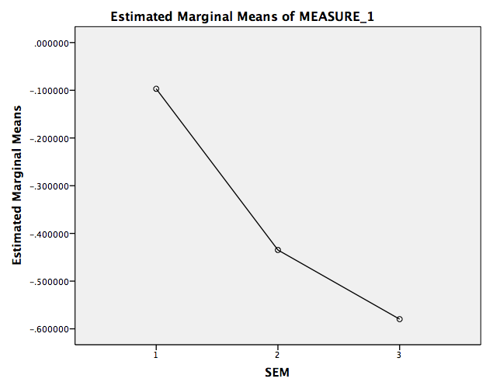
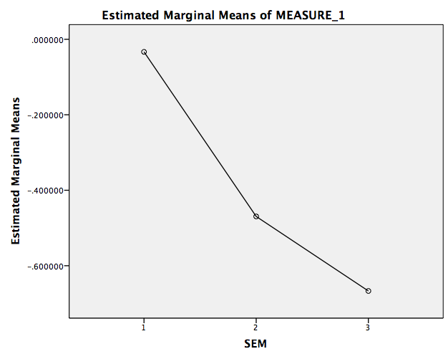
ANOVA – Semantic main effect
A
B

Slide 11
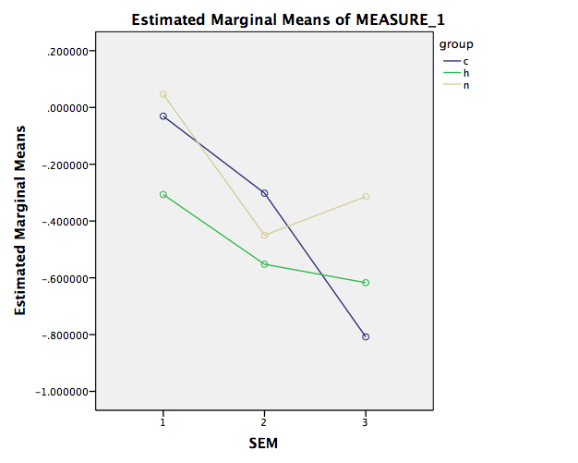
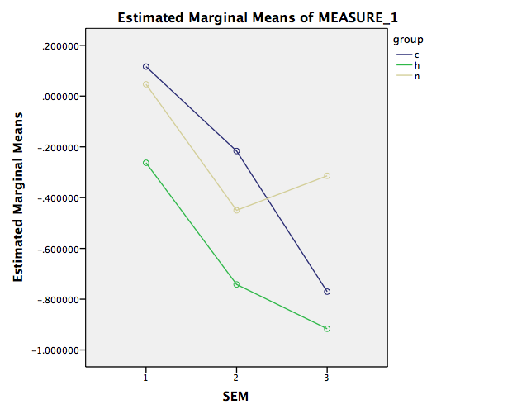
ANOVA – Semantic × group interaction
A
B

Slide 12
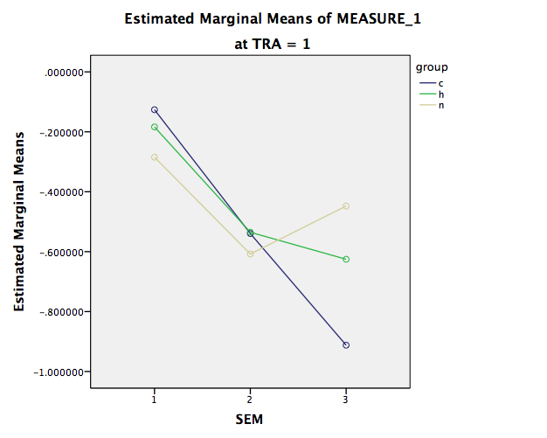
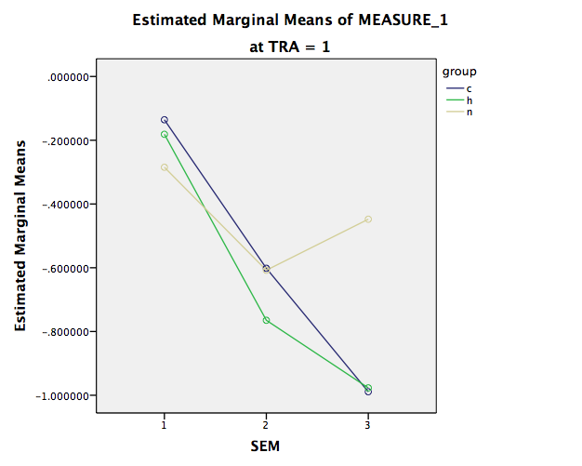
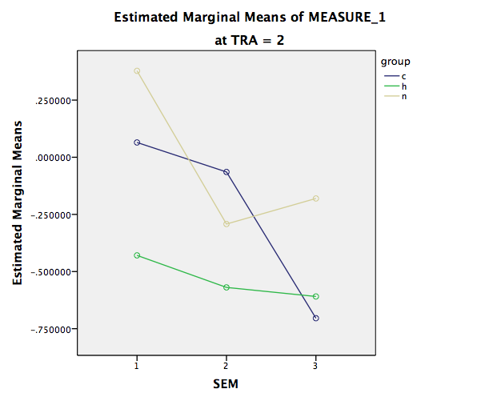
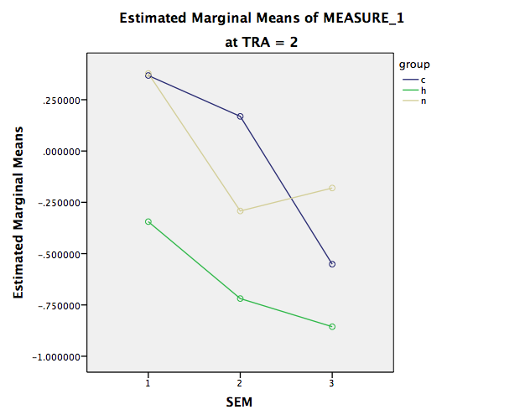
Training × Semantic × Group interaction
A
B

Slide 13
Groups: Congruent versus Within or Between category incongruence
A
T-values of match vs mismatch ROI mean
B
NH
(N=12)
NH
(N=12,
same)
HA
(N=15)
HA
(N=9)
CI
(N=15)
CI
(N=11)

Slide 14
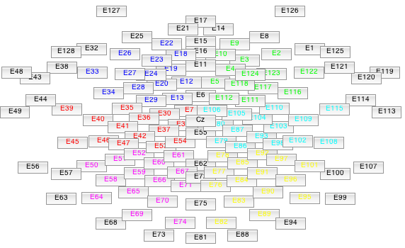
3. Topographic follow up analysis
Mismatch effect difference waves, based on collapsed pre- and post-intervention data were analyzed with topographical factors: lateralization (left, right) and anteriority (frontal, central, parieto-occipital) and hearing amplification group as between subject factor (NH, HA, CI). Each mismatch effect was tested separately (see following slides).
Left
Right
Frontal
Central
Parieto-occipital

Slide 15
Topographic analysis 1: Within-category effect
Both topographic analysis 1 and 2 was made using the robust ANOVA in J. Dien’s EP-toolkit, a robust test that avoid ANOVA assumptions often violated in ERP by using Welch-James approximate DF’s, trimmed means and winsorized variances (trimming: 0.05), and bootstrapping (50000 bootstrap samples). In the present analysis there were 12, 15 and 15 subjects in each group and no subjects were trimmed. Uncorrected alpha criteria at 0.05 was used.
ANT * LAT INTERACTION EFFECT
T_{WJt}/c(2.0,31.4)=4.24, p=0.025
Averaged Trimmed Cell Means:
fl fr cl cr pl pr
-0.38 +0.54 -0.40 -0.14 -0.16 -0.32
Holding level f of factor ANT constant.
LAT MAIN EFFECT
T_{WJt}/c(1.0,37.9)=8.27, p=0.0064
Averaged Trimmed Cell Means:
l r
-0.38 +0.54
Summary: Stronger lateralization among the frontal electrodes, no group effects
Abbrivations:
ANT(f,c,p)= anteriority (frontal, central, parieto-occipital)
LAT(l,r)=lateralization(left, right)
TWJt/c = comparison t-values obtained with trimmed means, Winsorized windows, and Welch-James approximate DF’s.

Slide 16
Topographic analysis 2: Between-category effect
ANT MAIN EFFECT
T_{WJt}/c(2.0,31.1)=7.24, p=0.0037
Averaged Trimmed Cell Means:
f c p
+0.34 -0.62 -0.42
ANT * LAT INTERACTION EFFECT
T_{WJt}/c(2.0,33.9)=4.28, p=0.023
Averaged Trimmed Cell Means:
fl fr cl cr pl pr
+0.06 +0.62 -0.56 -0.68 -0.27 -0.57
Holding level f of factor ANT constant.
LAT MAIN EFFECT
T_{WJt}/c(1.0,36.5)=4.68, p=0.036
Averaged Trimmed Cell Means:
l r
+0.06 +0.62
Summary: There were three effects: stronger positivity at frontal electrodes, stronger lateralization among the frontal electrodes, and more differences over the right side of the scalp. There were no group effects.
Abbrivations:
ANT(f,c,p)= anteriority (frontal, central, pariteto-occipital)
LAT(l,r)=lateralization(left, right)
TWJt/c = comparison t-values obtained with trimmed means, Winsorized windows and Welch-James approximate DF’s.
Holding level r of factor LAT constant.
ANT MAIN EFFECT
T_{WJt}/c(2.0,32.3)=9.43, p=0.0024
Averaged Trimmed Cell Means:
f c p
+0.62 -0.68 -0.57

Slide 17
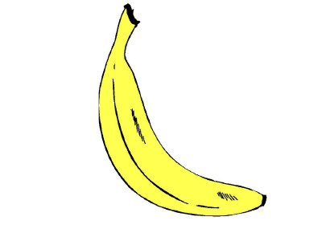
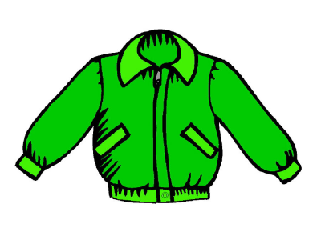
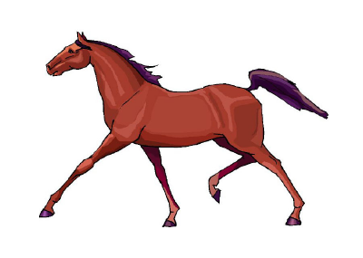
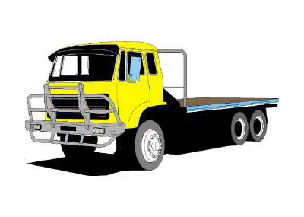
4. Stimulus pairs, picture examples
congruent pairs
spoken prime | picture target | English translation
badkar | badkar | bathtube
banan | banan | banana
bi | bi | bee
bil | bil | car
björn | björn | bear
blomma | blomma | flower
boll | boll | ball
bröd | bröd | bread
choklad | choklad | chocolate
fågel | fågel | bird
finger | finger | finger
fisk | fisk | fish
gås | gås | goose
glass | glass | ice-cream
gris | gris | pig
groda | groda | frog
gurka | gurka | cuecumber
haklapp | haklapp | bib
häst | häst | horse
höna | höna | hen
katt | katt | cat
kex | kex | bisquit
kind | kind | cheek
kött | kött | meat
morot | morot | carrot
mus | mus | mouse
myra | myra | ant
navel | navel | navel
ost | ost | cheese
pannkaka | pannkaka | pancake
pizza | pizza | pizza
shorts | shorts | shorts (trousers)
soppa | soppa | soup
spaghetti | spaghetti | spaghetti
stjärna | stjärna | star
tänder | tänder | teeth
trehjuling | trehjuling | tricycle
tunga | tunga | tongue
tupp | tupp | rooster
varg | varg | wolf
within category mismatch pairs
spoken prime | picture target | English translation
anka | uggla | duck-owl
apelsin | päron | orange-pear
baby | blöja | baby-diaper
bord | stol | table-chair
dörr | fönster | door-window
ekorre | apa | squirrel-monkey
elefant | kanin | elefant-rabbit
fjäril | fluga | butterfly-fly
fot | knä | foot-knee
fötter | stövlar | feet-boots
gaffel | tallrik | fork-plate
giraff | zebra | giraffe-zebra
glas | mugg | glass-mug
hand | vantar | hand-mittens
hår | huvud | hair-head
hund | gris | dog-pig
jacka | byxor | jackett-trousers
kanin | sköldpadda | rabbit-turtle
klänning | rosett | dress-ribbon
knä | arm | knee-arm
korv | potatis | sausage-potato
lastbil | kärra | truck-cart
lejon. | tiger | lion-tiger
mössa | halsduk | (winter) hat-scarf
motorcykel | cykel | motorcycle-bike
napp | skallra | pacifier-rattle
näsa | öra | nose-ear
öga | näsa | eye-nose
päron | äpple | pear-apple
potatis | hamburgare | potato-hamburger
rosett | slips | ribbon-tie
sked | gaffel | spoon-fork
sked | glas | spoon-glass
sko | tröja | shoe-sweater
sköldpadda | ekorre | turtle-squirrel
soffa | säng | sofa-bed
tåg | flygplan | train-plane
tiger | isbjörn | tiger-polar bear
tröja | jacka | sweater-jacket
zebra | ko | zebra-cow
between category mismatch pairs
spoken prime | picture target | English translation
apa | hatt | monkey-hat
arm | tårta | arm-cake
armbåge | sko | elbow-shoe
åsna | napp | donkey-pacifier
båt | broccoli | boat-broccoli
blöja | apelsin | diaper-orange
bord | uggla | table-owl
byxor | hår | trousers-hair
cykel | jordgubbe | bike-strawberry
dörr | tunga | door-tongue
får | kniv | sheep-knife
fjäril | smörgås | butterfly-sandwich
fluga | båt | fly-boat
flygplan | ansikte | plane-face
gryta | giraff | pot-giraffe
halsduk | gryta | scarf-pot
hamburgare | öga | hamburger-eye
hatt | varg | hat-wolf
hus | fisk | house-fisk
isbjörn | visp | polar bear-beater
jordgubbe | fötter | strawberry-feet
kärra | bi | cart-bee
kniv | hund | knife-dog
ko | låda | cow-box
låda | mun | box-mouth
lejon | öra | lion-ear
mugg | fot | mug-foot
mun | bil | mouth-car
öra | jello | ear-jelly
säng | hand | bed-hand
stol | tunga | chair-tongue
stövlar | tandborste | boots-toothbrush
strand | armbåge | beach-elbow
strumpa | lastbil | sock-truck
tallrik | strumpa | plate-sock
tandborste | mössa | toothbrush-(winter) hat
tårta | motorcykel | cake-motorcycle
uggla | soffa | owl-sofa
vantar | dinosaur | mittens-dinosaur
visp | anka | beater-duck

Slide 18
5. Stimulus properties
A multivariate ANOVA was used to test if lexical properties (word frequency, word length, number of syllables) of the prime stimuli differed between the three semantic conditions (congruent, within-category, between-category). No significant differences were found.
Lexical variables | DF, error DF | F | Sig. | Partial Eta Squared
word frequency | 2, 117 | 1.278 | 0.283 | 0.021
word length | 2, 117 | 0.112 | 0.894 | 0.002
number of syllables | 2, 117 | 2.147 | 0.121 | 0.035

