Slide 1
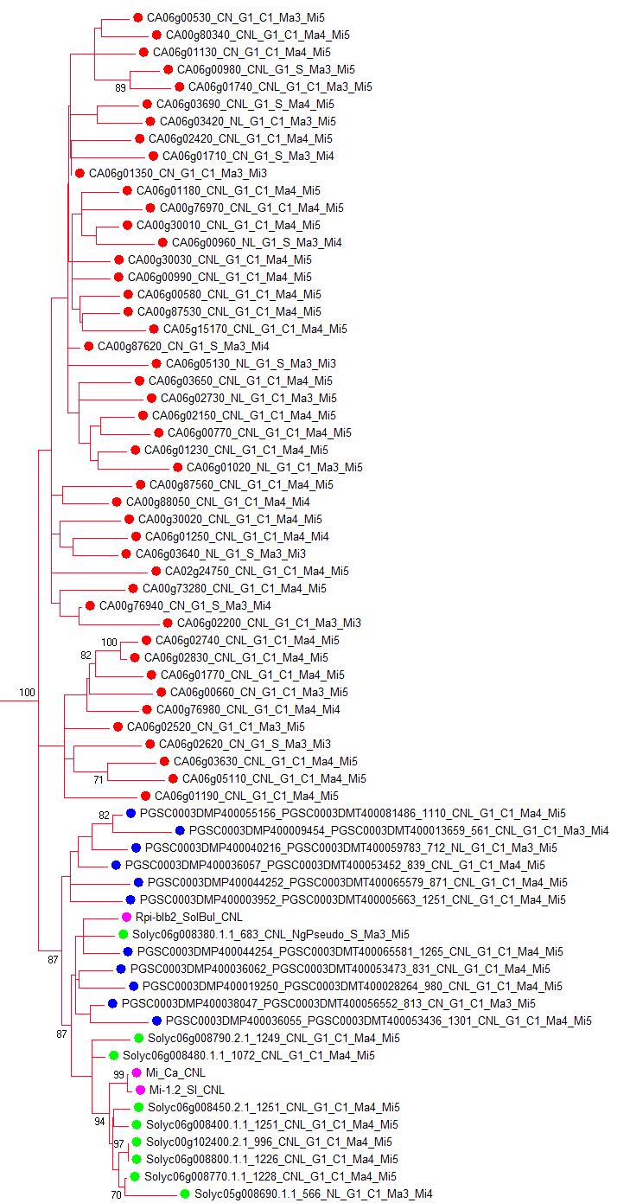
Location on
chr 6
-
-
-
-
-
-
-
-
-
-
-
-
-
-
Supplementary Figure 2. Detailed phylogenetic relationships of CNL-G1. Part of Fig. 1 is shown. Similar colors mean close distance on chromosome 6.

