Slide 1
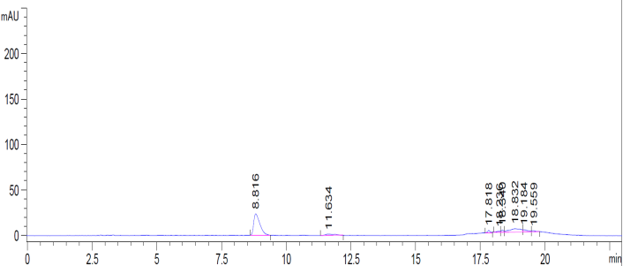
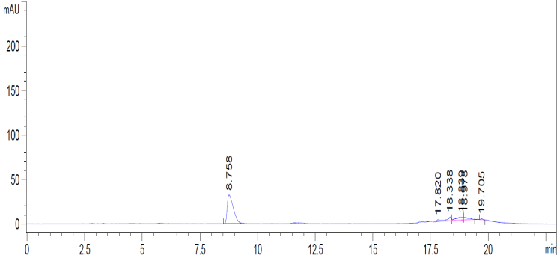
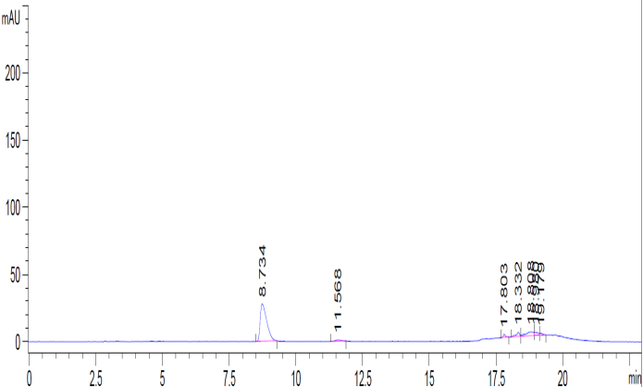
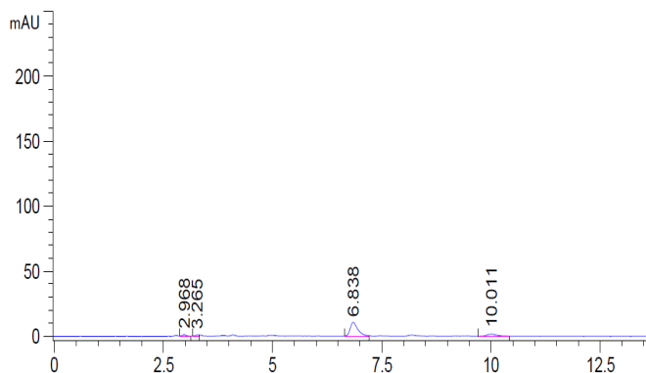
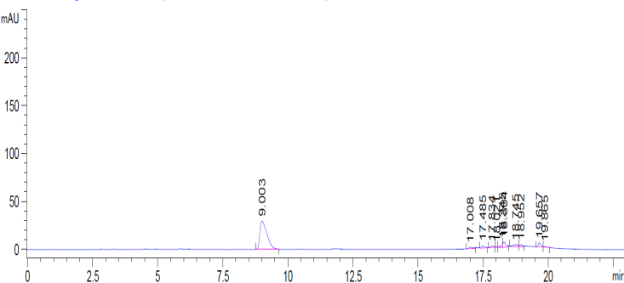
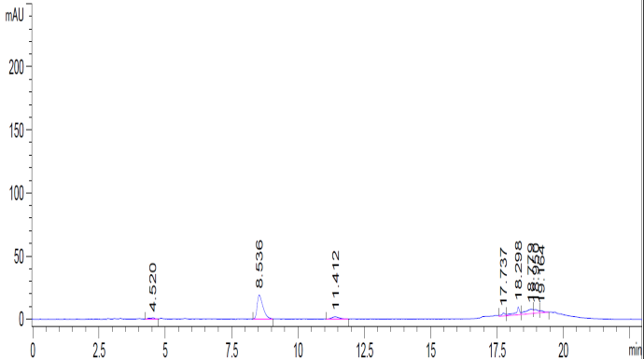
[S3 Fig, Ahmad et al.]
(A)
(C)
(E)
mAU(290nm)
SL341S-48h
mAU(290nm)
SL341R-48hr
mAU(290nm)
SL341G-48hr
Retention time (min)
Retention Time (min)
Retention Time (min)
(B)
(D)
(F)
SL341S-72h
SL341S-72hr
Retention Time (min)
(D)
mAU(290nm)
SL341G-72hr
mAU(290nm)
mAU(290nm)
SL341R-72hr
Retention time (min)
Retention Time (min)
Retention Time (min)
S3 Fig. HPLC analysis for HGA detection. HPLC analysis of the culture filtrate of R. solanacearum mutants for the detection of HGA, an intermediate for pyomelanin synthesis. (A, B) Culture filtrate analysis of SL341S after 48 and 72 h growth, respectively, (C, D) SL341R culture filtrate analysis after 48 and 72 h growth, respectively (E, F) Culture filtrate analysis of SL341G after 48 and 72 h growth, respectively.

