Slide 1
S1
Gene | Forward primer (5' 3') | Reverse primer (5' 3')
GAPDH | AGGTGACACTATAGAATAAAGGTGAAGGTCGGAGTCAA | GTACGACTCACTATAGGGAGATCTCGCTCCTGGAAGATG
ID2 | AGGTGACACTATAGAATACTCGCATCCCACTATTGTCA | GTACGACTCACTATAGGGACAGGATGCTGATATCCGTGTT
FCGRT | AGGTGACACTATAGAATACCTTCTCCTTCTACCCTCCG | GTACGACTCACTATAGGGAGTGGAAGGATCCGTCACTGT
NR0B1 | AGGTGACACTATAGAATATGATGCTGGAAATGCTCTGT | GTACGACTCACTATAGGGATTACACTCTTTTGCCCACAGC
CAV1 | AGGTGACACTATAGAATACCAGCTTCACCACCTTCACT | GTACGACTCACTATAGGGACCCAGATGTGCAGGAAAGAG
NKX2.2 | TGAAAACGACGGCCAGT | CAGGAAACAGCTATGACC
GSTM4 | CTGAAGGTGGAATACTTGGAGC | GCCCAGGAACTGTGAGAAGA
NPY1R | GAGGCGATGTGTAAGTTGAATCC | TGGAACGGCTCATCAGTCATT
EZH2 | GTACACGGGGATAGAGAATGTGG | GGTGGGCGGCTTTCTTTATCA
WRN | GACAGCGGACTTCAACCTTC | TTTGGCAAACCACACAGGTA
SIRPA | GCCCTCTACCTCGTCCGAAT | CATACTCCGTGTGGTTGTTGG
STEAP2 | AGGTGACACTATAGAATATTAGAGTGGGTTGGGTGCAT | GTACGACTCACTATAGGGAAGGCTCATGTTCCAAGCAAG
IL1RAP | AGGTGACACTATAGAATATGGTTGTTCTAAGCCCCAAC | GTACGACTCACTATAGGGAACCTGCCCTGTGGATACTTG
KDSR | AGGTGACACTATAGAATATTGCTTACCCACCAGACACA | GTACGACTCACTATAGGGAAGCATGTACCCATCTGAGCC
RCOR1 | AGGTGACACTATAGAATAGCAGTCAAGAACGGGACAAT | GTACGACTCACTATAGGGAACTGCGTCTTGCCAGTTTG
CDKN1A | CGATGGAACTTCGACTTTGTCA | GCACAAGGGTACAAGACAGTG
PHLDA1 | GAAGATGGCCCATTCAAAAGCG | GAGGAGGCTAACACGCAGG
TAF1C | CTGAAAGCACCGACCATAGGT | CAGTCAGGTTGGGTGTCGC
LOX1 | CGGCGGAGGAAAACTGTCT | TCGGCTGGGTAAGAAATCTGA
FOSL2 | CAGAAATTCCGGGTAGATATGCC | GGTATGGGTTGGACATGGAGG
EWS/FLI1 | AGGTGACACTATAGAATACACCTCCATCCTACCCTCCT | GTACGACTCACTATAGGGAGGACTTTTGTTGAGGCCAGA
Table S1, PCR primers used in gene signature panel.
Notes:
Supplementary 1A, PCR primer pairs

Slide 2
S2 (EWS-FLI1 target genes)
Induced Targets | Kauer et al. | Hancock et al | Grohar et al | WEI CHIP | Gangwal CHIP | DELATTRE CHIP | DAVIS CHIP* | other
ID2 |  |  |  |  |  | X |  | Nishimori et al (2002); Bilke et al (2013) see refs
FCGRT | X | X | X | X | X | X
NR0B1 | X | X | X | X | X |  | X | Mendiola et al (2006); Kinsey et al (2006) see refs
CAV1 |  |  |  |  | X |  |  | Tirado et al (2006);Boro, A et al 2012 (see refs)
NKX2.2 | X | X |  |  |  | X | X | Smith et al (2006) see ref
GSTM4 | X | X | X |  |  |  |  | Luo et al (2009)
NPY1R | X | X |  | X |  |  |  | Tilan et al (2013) see ref
EZH2 | X | X |  |  |  |  |  | Riggi et al (2008); Richter et al (2009)
WRN |  |  |  |  |  |  |  | Grohar et al (2014)
SIRPA |  |  | X | X |  |  | X
STEAP2 | X | X |  |  |  |  |  | Grunewald et al (2012) see refs
IL1RAP | X | X | X | X |  |  | X
KDSR/FVT1 |  | X | X | X |  | X
RCOR1 | X | X | X | X |  |  | X
Repressed
CDKN1A | X |  |  |  |  |  |  | Nakatani et al (2003) see refs
PHLDA1 |  |  |  |  |  |  |  | Boro, A et al 2012 (see refs);
TAF1C |  |  |  |  | X
LOX1 | X | X |  | X |  |  |  | Sankar S (2013); Agra (2013) see refs
FOSL2 | X | X |  | X
 |  |  |  |  |  |  |  | *mapped from published peaks
Table S2, Evidence for selection of each gene as an EWS-FLI1 target.
Notes:
S1B,

Slide 3
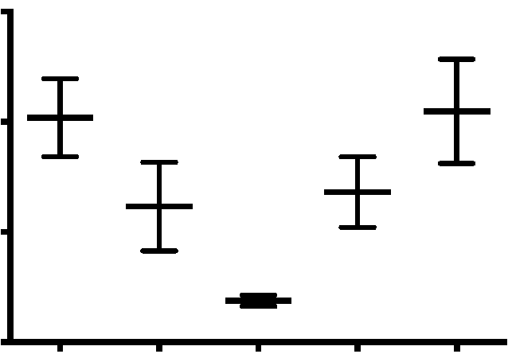
S3A
1.5
P=0.0002
P =0.0002
1.0
Fold Change NR0B1 (2^{ΔΔCT})
0.5
0.0
S
MMA
50nM
EC8105
15nM
EC8105
5nM
EC8105
1.5nM
S3A Mean fold change in expression of NR0B1 as a function of GAPDH (2^{ΔΔCT}) following treatment with MMA or EC-8105. Data is the average of 3 independent experiments as measured by qPCR.

Slide 4
S3B
Fold Change (2^{ΔΔCT})
EWS/FLI1 Induced Targets
S3B Mean fold change in expression of EWS-FLI1-induced targets as a function of GAPDH (2^{ΔΔCT}) for treatment with an siRNA targeted at the breakpoint of EWS/FLI1 for 24 h. Data is the average of 3 independent experiments as measured by qPCR
Notes:
S2A, Mean fold change in expression of EWS/FLI1 induced targets as a function of GAPDH (2^{ΔΔCT}) as measured by qPCR for treatment with an siRNA targeted at the breakpoint ofEWS/FLI1for 24 hours. All induced targets are suppressed by treatment with siRNA. Data is the average of 3 independent experiments.

Slide 5
S3C
Fold Change (2^{ΔΔCT})
EWS/FLI1 Supressed Targets
S3C Mean fold change in expression of EWS-FLI1-suppressed targets as a function of GAPDH (2^{ΔΔCT}) for treatment with an siRNA targeted at the breakpoint of EWS-FLI1for 24 h. Data is the average of 3 independent experiments as measured by qPCR.
Notes:
S2B, Mean fold change in expression of EWS/FLI1 induced targets as a function of GAPDH (2^{ΔΔCT}) as measured by qPCR for treatment with siRNA targeted at the breakpoint of EWS/FLI1. All suppressed targets show induction after treatment. Data is the average of 3 independent experiments.

Slide 6
S4A
EC-code | NSC #
MMA (EC-7071) | 24559
EC-7073 | 747289
EC-7092 | 747291
EC-8042 | 748680
EC-8043 | 748681
EC-8044 | 748682
EC-8062 | 748684
EC-8063 | 748685
EC-8071 | 748686
EC-8072 | 748687
EC-8074 | 748688
EC-8073 | 750377
EC-8105 | 759484
EC-8106 | 759485
EC-8108 | 759486
EC-7072 | 711781
EC-9012 | 759489
S4A: Structures and NSC numbers of mithramycin analogs.

Slide 7
S4B
EC-code | NSC #
EC-8011 | 747976
EC-8041 | 759488
EC-7074 | 747290
EC-8061 | 748683
EC-9013 | n.a.
EC-9041 | 759490
S4A: Structures and NSC numbers of mithramycin analogs (cont’d).

Slide 8
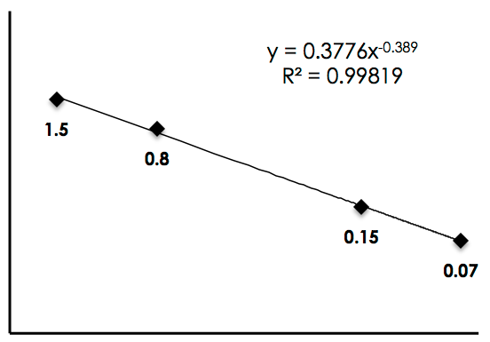
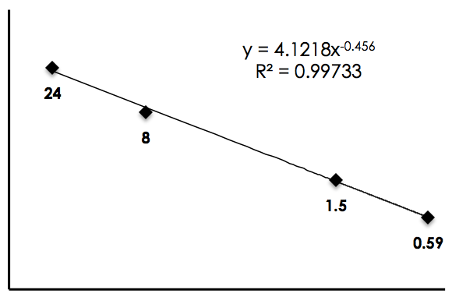
S4C
10
1
1.5
MMA (mg/kg)
0.8
0.1
0.15
0.07
0.01
0.1
1
10
100
Weight (kg)
100
10
24
EC-8042 (mg/kg)
8
1
0.1
1.5
0.59
0.01
0.1
1
10
100
Weight (kg)
S4C. Allometric scaling estimates for dosing as a function of weight of an organism for mithramycin (MMA) and EC-8042. (see text for reference).
Notes:
C, Graphs depicting predicting MTD by weight based on MTDs reported in multiple animal species.

Slide 9
S5A
EC-8105
EC-8042
S5A Pearson correlation analysis showing similar responses of the PPTP panel of cell lines for EC-8105 and EC-8042 relative to mithramycin.

Slide 10
S5B
 |  |  |  |  |  | minus Rhabdoid |  |  |  |  |  | minus Rhabdoid and ALL
Cell Line | Histotype | MMA rIC₅₀ (nM) | EC-8042 rIC₅₀ (nM) | EC-8105 rIC₅₀ (nM) |  | Cell Line | Histotype | MMA rIC₅₀ (nM) | EC-8042 rIC₅₀ (nM) | EC-8105 rIC₅₀ (nM) |  | Cell Line | Histotype | MMA rIC₅₀ (nM) | EC-8042 rIC₅₀ (nM) | EC-8105 rIC₅₀ (nM)
RD | Rhabdomyosarcoma | 24.10 | 58.90 | 21.10 |  | RD | Rhabdomyosarcoma | 24.10 | 58.90 | 21.10 |  | RD | Rhabdomyosarcoma | 24.10 | 58.90 | 21.10
Rh41 | Rhabdomyosarcoma | 19.60 | 57.20 | 13.50 |  | Rh41 | Rhabdomyosarcoma | 19.60 | 57.20 | 13.50 |  | Rh41 | Rhabdomyosarcoma | 19.60 | 57.20 | 13.50
Rh18 | Rhabdomyosarcoma | 46.20 | >100 | 16.90 |  | Rh18 | Rhabdomyosarcoma | 46.20 | >100 | 16.90 |  | Rh18 | Rhabdomyosarcoma | 46.20 | >100 | 16.90
Rh30 | Rhabdomyosarcoma | 19.70 | 45.70 | 13.50 |  | Rh30 | Rhabdomyosarcoma | 19.70 | 45.70 | 13.50 |  | Rh30 | Rhabdomyosarcoma | 19.70 | 45.70 | 13.50
BT-12 | Rhabdoid | 16.40 | 30.60 | 4.00 |  | BT-12 | Rhabdoid |  |  |  |  | BT-12 | Rhabdoid
CHLA-266 | Rhabdoid | 14.50 | 40.80 | 9.90 |  | CHLA-266 | Rhabdoid |  |  |  |  | CHLA-266 | Rhabdoid
SJ-GBM2 | Glioblastoma | 34.40 | 58.20 | 22.70 |  | SJ-GBM2 | Glioblastoma | 34.40 | 58.20 | 22.70 |  | SJ-GBM2 | Glioblastoma | 34.40 | 58.20 | 22.70
NB-1643 | Neuroblastoma | 35.20 | 64.50 | 22.30 |  | NB-1643 | Neuroblastoma | 35.20 | 64.50 | 22.30 |  | NB-1643 | Neuroblastoma | 35.20 | 64.50 | 22.30
NB-EBc1 | Neuroblastoma | 25.40 | 73.70 | 24.00 |  | NB-EBc1 | Neuroblastoma | 25.40 | 73.70 | 24.00 |  | NB-EBc1 | Neuroblastoma | 25.40 | 73.70 | 24.00
CHLA-90 | Neuroblastoma | 40.90 | 83.50 | 25.80 |  | CHLA-90 | Neuroblastoma | 40.90 | 83.50 | 25.80 |  | CHLA-90 | Neuroblastoma | 40.90 | 83.50 | 25.80
CHLA-136 | Neuroblastoma | 94.60 | >100 | 71.70 |  | CHLA-136 | Neuroblastoma | 94.60 | >100 | 71.70 |  | CHLA-136 | Neuroblastoma | 94.60 | >100 | 71.70
NALM-6 | ALL | 18.60 | 27.00 | 9.60 |  | NALM-6 | ALL | 18.60 | 27.00 | 9.60 |  | NALM-6 | ALL
COG-LL-317 | ALL | 5.40 | 15.40 | 5.10 |  | COG-LL-317 | ALL | 5.40 | 15.40 | 5.10 |  | COG-LL-317 | ALL
RS4;11 | ALL | 12.80 | 17.20 | 12.30 |  | RS4;11 | ALL | 12.80 | 17.20 | 12.30 |  | RS4;11 | ALL
MOLT-4 | ALL | 15.10 | 17.00 | 9.10 |  | MOLT-4 | ALL | 15.10 | 17.00 | 9.10 |  | MOLT-4 | ALL
CCRF-CEM (1) | ALL | 70.90 | 47.10 | 25.80 |  | CCRF-CEM (1) | ALL | 70.90 | 47.10 | 25.80 |  | CCRF-CEM (1) | ALL
CCRF-CEM (2) | ALL | 28.90 | 43.50 | 28.70 |  | CCRF-CEM (2) | ALL | 28.90 | 43.50 | 28.70 |  | CCRF-CEM (2) | ALL | 28.90
Kasumi-1 | AML | 36.20 | 84.60 | 16.90 |  | Kasumi-1 | AML | 36.20 | 84.60 | 16.90 |  | Kasumi-1 | AML | 36.20 | 84.60 | 16.90
Karpas-299 | ALCL | 31.40 | 78.40 | 21.30 |  | Karpas-299 | ALCL | 31.40 | 78.40 | 21.30 |  | Karpas-299 | ALCL | 31.40 | 78.40 | 21.30
Ramos-RA1 | NHL | 37.20 | 66.50 | 20.50 |  | Ramos-RA1 | NHL | 37.20 | 66.50 | 20.50 |  | Ramos-RA1 | NHL | 37.20 | 66.50 | 20.50
 | mean | 31.38 | 50.54 | 19.74 |  |  |  | 33.14 | 52.40 | 21.16 |  |  |  | 36.45 | 67.12 | 24.18
 | st dev | 20.87 | 22.73 | 14.17 |  |  |  | 21.30 | 23.43 | 14.22 |  |  |  | 19.20 | 12.72 | 15.47
TC-71 | Ewing sarcoma | 25.60 | 50.80 | 14.60 |  |  | Ewing sarcoma | 25.60 | 50.80 | 14.60 |  |  | Ewing sarcoma | 25.60 | 50.80 | 14.60
CHLA-9 | Ewing sarcoma | 15.60 | 77.50 | 9.40 |  |  | Ewing sarcoma | 15.60 | 77.50 | 9.40 |  |  | Ewing sarcoma | 15.60 | 77.50 | 9.40
CHLA-10 | Ewing sarcoma | 26.00 | 73.20 | 13.20 |  |  | Ewing sarcoma | 26.00 | 73.20 | 13.20 |  |  | Ewing sarcoma | 26.00 | 73.20 | 13.20
CHLA-258 | Ewing sarcoma | 25.80 | 58.60 | 7.80 |  |  | Ewing sarcoma | 25.80 | 58.60 | 7.80 |  |  | Ewing sarcoma | 25.80 | 58.60 | 7.80
 | mean | 23.25 | 65.03 | 11.25 |  |  |  | 23.25 | 65.03 | 11.25 |  |  |  | 23.25 | 65.03 | 11.25
 | st dev | 5.10 | 12.46 | 3.18 |  |  |  | 5.10 | 12.46 | 3.18 |  |  |  | 5.10 | 12.46 | 3.18
 | ttest | 0.14 | 0.11 | 0.03 |  |  |  | 0.09 | 0.17 | 0.01 |  |  |  | 0.04 | 0.79 | 0.02
S5B IC₅₀ values for cell lines in PPTP. Columns are all cell lines tested, exclusion of rhabdoid tumor (minus rhabdoid) and exclusion of rhabdoid tumor and acute lymphoblastic leukemia cell lines (minus rhabdoid and ALL). The statistics are shown in boxes at the bottom.

Slide 11
S5C
P = 0.01
P = 0.02
MMA-P53 Mut MMA-P53 WT EC-8105-P53 Mut EC-8105-P53 wt
S5C Graph of IC₅₀ as a function of p53 status. Cell lines with wild-type p53 (P53 wt) were more sensitive to treatment with mithramycin (MMA) and EC-8105 than lines with mutant p53 (P53 Mut) across the entire PPTP panel of cell lines independent of histology. Note there was no difference with the non-DNA damaging analogy, EC-8042.

Slide 12
S6
S6 Prediction plot showing mean tumor volume as a function of days of treatment with EC-8105 (1.0 mg/kg IP, M/W/F schedule, 8 doses). Thick, dotted lines represent mean tumor growth and the individual lines in the back represent the individual tumor growth by cohort.
Notes:
S7A, Mean tumor volume of the entire cohort of ESFT TC71 xenograft mice measured after treatment with control (black) or EC8105 (red) 1 mg/kg/dose IP every 3rd day for 8 doses

Slide 13
S7
Mouse Weight (g)
S7 Weight of each mouse in cohort of EC-8105 treated mice (black lines) treated on a 1.5 mg/kg/dose IV Q3D X 8 doses schedule relative to weight change of control mice (grey line).

Slide 14
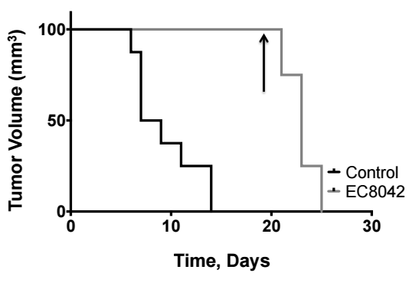
S8A
S8B
% Survival (Time to 2 cm)
% Survival (Time to 2 cm)
End of Treatment
End of Treatment
S8 Survival curves for control mice (black) relative to EC-8042-treated mice (grey) treated at 24 mg/kg dose X 8 either intravenously (S8A) or intraperitoneal (S8B). Arrows indicate end of treatment.
Notes:
S6B, Survival curves for mice bearing the TC71 xenografts demonstrating time to 2cm in control (black) and EC8042 (blue) for IV administration.

Slide 15
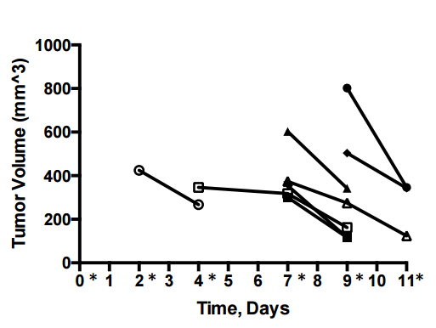
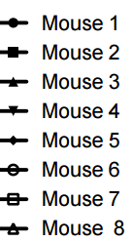
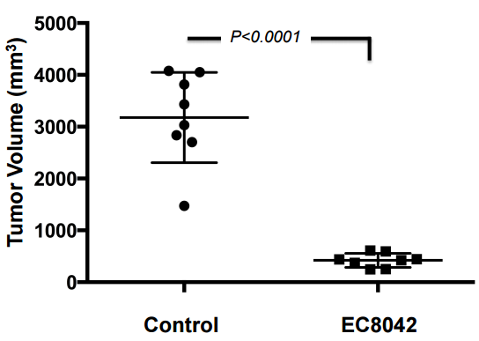
S9A
S9B
S9. Response of mice treated with 24 mg/kg/dose EC-8042 IP M, W, F X8 (S9A). Regression of tumors for every mouse mouse in the cohort. Each line represents an individual mouse. Asterisks (*) highlight treatment days. S9B Mean tumor volume (+/- SEM) of every mouse in the control cohort (3177 mm³ +/- 308.2) relative to the EC-8042-treated cohort (422.5 mm³ +/- 48) on day 11 of treatment (P < 0.0001).

Slide 16
S10
S10: Suppression of NR0B1 staining in cells treated with 1.5 mg/kg EC-8105 IV, 48 hours after treatment. Three representative sections are shown stained for NR0B1 (red) or DAPI (blue) since the tumors were large and showed a range of staining.

