Slide 1

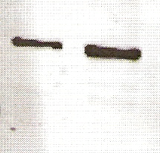
Figure S6
3T3-WT-EGFR
3T3-EGFRΔ768
GFP:
170
130
Tubulin:
55

