Slide 1
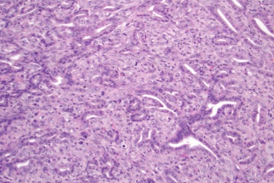
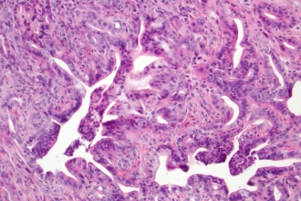
Figure S7
A
Xenograft
KRAS^{G12D}/p53^{-/-}
CTRL
BETi
CTRL
BETi
H&E
B
Xenograft
KRAS^{G12D}/p53^{-/-}
Trichrome
CD31
Trichrome
CD31
CTRL
BETi
p=0.11
p=0.70
p=0.09
p=0.80
CTRL
BETi
CTRL
BETi
CTRL
BETi
CTRL
BETi
C
D
BRD2
BRD3
BRD4
*
Normal
*
*
*
Cancer
*
*

