Slide 1
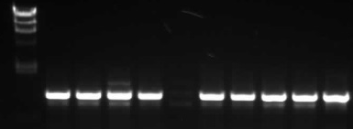
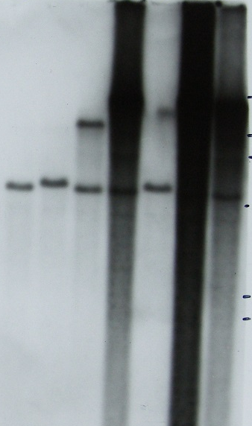

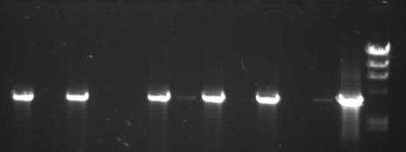
A: PpALC1 (8.8kb)
HindIII
HindIII
NPTII
Ppalc1-KO
5.5kb in KO
1-72
1-65
1-56
1-45
1-20
S4 Fig: Ppalc1-KO
A: Schematic of gene structure and knockout
construct.
B: Identification of targeted loci by PCR
amplification with cassette-specific “outward”
and gene-specific “inward” primers
C:Identification of single-copy targeted
transformants with external gene-specific
Primers (Tracks “P” and “wt” = plasmid and
wild-type genomic DNA controls)
D: Southern blot (HindIII digest) to identify
transformants containing only a single,
targeted selection cassette. Analysed on
same gel as Ppchd5-KO: see Fig S5 for
wild-type control).
B
1-49
1-18
1-3
1-51
1-56
1-60
1-63
1-65
1-71
1-72
1-72
P
D
5’
23
9.4
6.6
3’
4.4
1-20
1-33
1-45
1-49
1-51
1-56
1-60
1-65
1-71
1-72
C
1-77
wt
P
2.2
2.0

