Slide 1
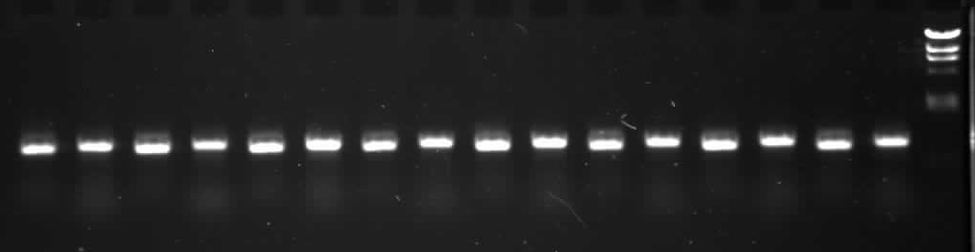
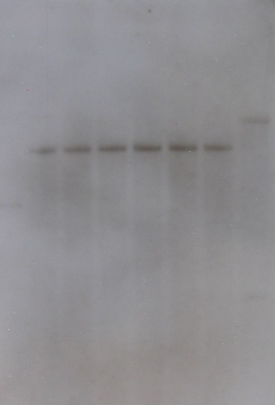
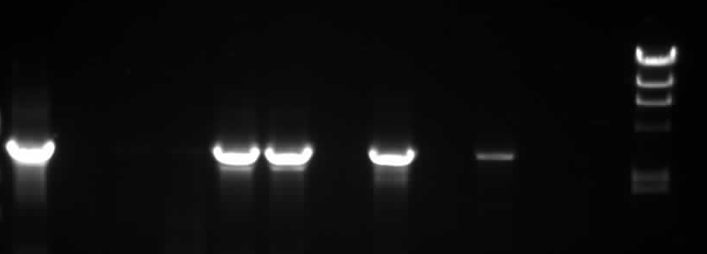
A: PpRTEL1 (9.4 kb)
EcoRV
EcoRV
NPTII
Pprtel-KO
7.7kb in KO
2-103
2-55
2-106
2-68
2-73
2-90
B
2-60
2-65
2-66
2-68
2-70
2-71
2-72
2-73
D
WT
2-99
5’
3’
5’
3’
5’
3’
5’
3’
5’
3’
5’
3’
5’
3’
5’
3’
23
9.4
2-12
6.6
2-49
2-52
2-55
2-68
2-71
2-73
2-75
2-76
2-77
C
P
2-79
4.4
2.2
2.0
S6 Fig: Pprtel-KO
A: Schematic of gene structure and knockout construct. B: Identification of targeted loci by PCR
amplification with cassette-specific “outward” and gene-specific “inward” primers. C:Identification of single-copy targeted transformants with external gene-specific primers (Track “P” = plasmid control). D: Southern blot (EcoRV digest) to identify transformants containing only a single, targeted selection cassette

