Slide 1
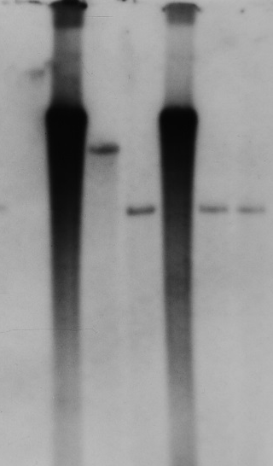
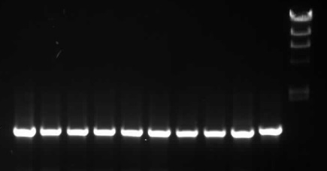

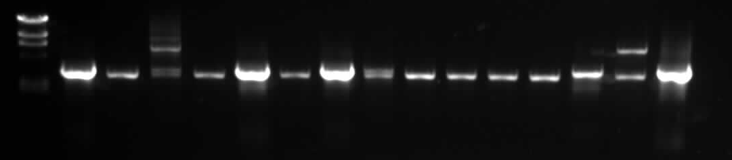
A: PpERCC6 (5.3 kb)
BglII
BglI
NPTII
Ppercc-KO
4.8kb in KO
3-19
3-114
3-34
3-77
3-13
3-46
D
WT
3-7
3-89
3-17
3-18
3-19
3-28
3-34
S7 Fig: Ppercc6-KO
A: Schematic of gene structure and
knockout construct.
B: Identification of targeted loci by PCR
amplification with cassette-specific “outward”
and gene-specific “inward” primers
C:Identification of single-copy targeted
transformants with external gene-specific
Primers primers (Tracks ”P” and “wt” =
plasmid and wild-type genomic DNA
controls).
D: Southern blot (BglII digest) to identify
transformants containing only a single,
targeted selection cassette
3-7
3-35
B
P
23
9.4
5’
6.6
4.4
2.2
2.0
3’
3-13
3-46
3-17
3-18
3-19
3-28
3-34
3-35
3-59
3-66
3-74
C
3-7
3-77
wt
P

