Slide 1
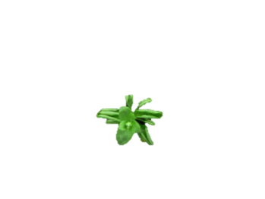
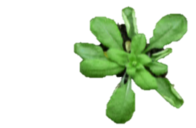
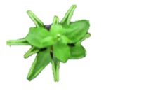
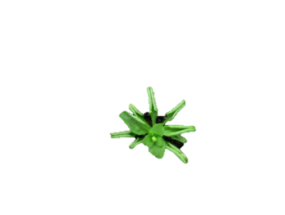
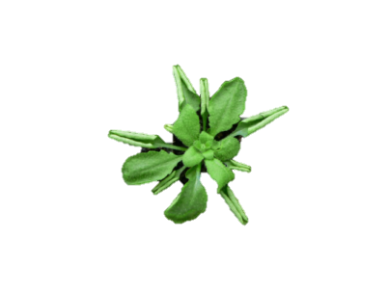

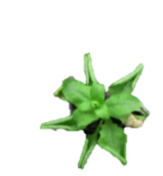
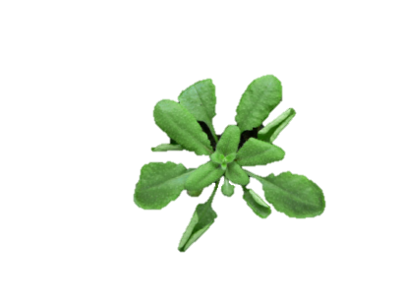
A
MYB33/MYB33
(+/+)
MYB33/myb33
(+/-)
myb33/myb33
(-/-)
(+/+)
MYB65/MYB65
(+/-)
MYB65/myb65
Line 21
Line 10
Line 14
(-/-)
myb65/myb65
Line 4
Line 6
Line 19
Line 16
Line 15
1cm
All genotypes are under mir159ab background
B
MYB33 | +/+ |  |  | +/- |  |  | -/-
MYB65 | +/+ | +/- | -/- | +/+ | +/- | -/- | +/+ | +/-
Relative mRNA levels
Notes:
Figure 3.1 CP1 transcript level tightly correlates with MYB33/65 expression. (A) Representative rosette phenotypes of five-week-old mir159ab plants carrying different combinations of heterozygous or homozygous T-DNA insertion myb33/myb65 alleles. The F3 progenies were numbered in order as the genotyping was performed, and one numbered plant of every confirmed genotype was selected to represent the rosette phenotype. (B) qRT-PCR analysis of CP1 and BXL2 mRNAs in five-week-old rosettes of different genotypes. The numbers along the x-axis correspond to the numbered plants shown in A. Coloured arrows indicate the impact of MYB33/65 expression on CP1 and BXL2 mRNA levels. (C) 3D-column presentation of CP1 mRNA levels, for comparison between the molecular and phenotypic impacts (i.e. phenotypes shown in A). (D) and (E) Phenotypic and molecular impacts of single wild-type MYB65 allele expression. Analysis was done on five-week-old mir159ab.myb33.MYB65/myb65 [myb65 (het)] mutants and mir159ab.myb33.myb65/myb65 (quad) mutants. All mRNA levels were normalized to that of housekeeping gene CYCLOPHILIN (At2g29960). Error bars represent the SD of three technical replicates of this assay.

