Slide 1
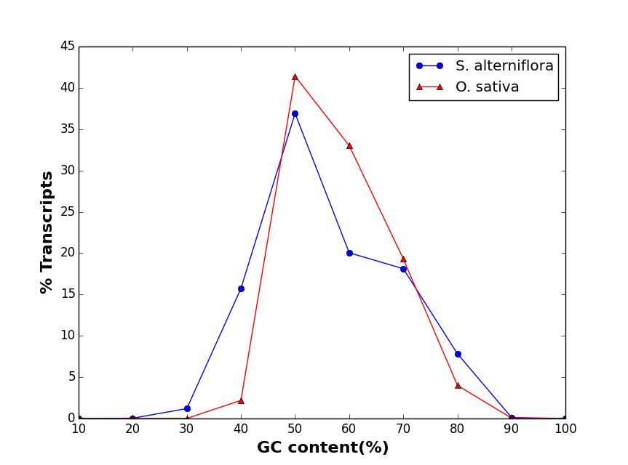
Figure S1 Percentage distribution of GC content between Spartina alterniflora and rice genes

Slide 2
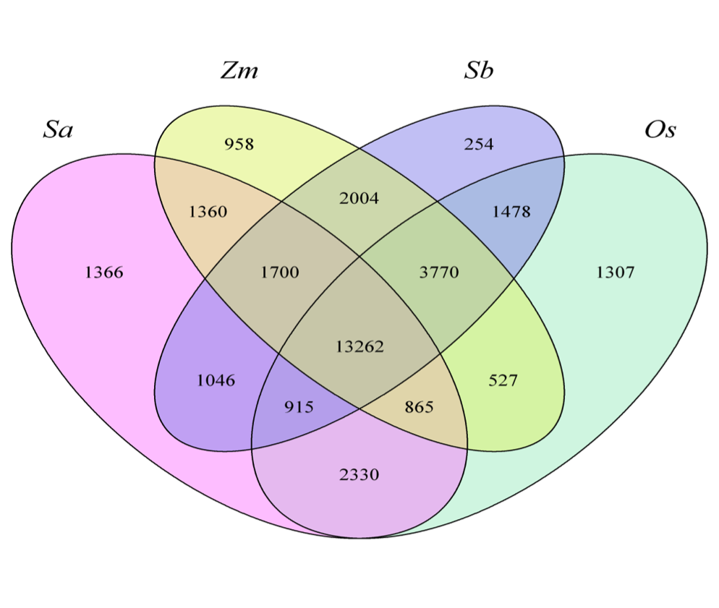
Figure S2 Gene family distribution among the four monocots, Spartina alterniflora (Sa), Oryza sativa (Os), Sorghum bicolor (Sb) and Zea mays (Zm). The homologous genes from each monocot species were clustered to represent gene family. The number of homologous genes shared by different species is represented by gene families at intersection.

Slide 3
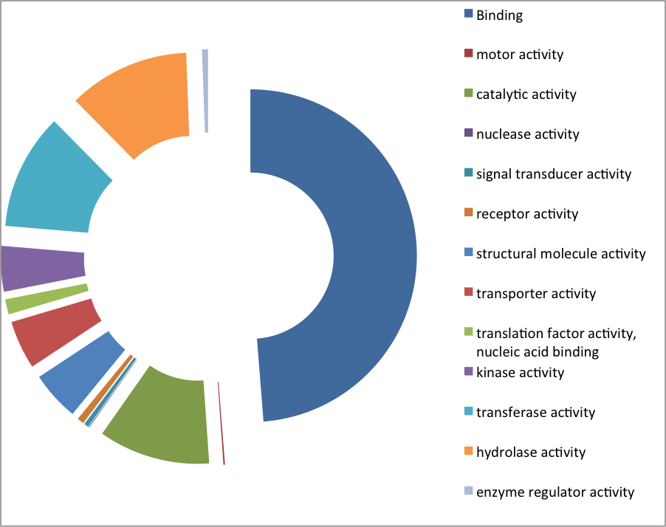
Figure S3 Functional GO terms for gene families specific to Spartina alterniflora indicating coverage of
different functional category genes specific to S. alterniflora

Slide 4
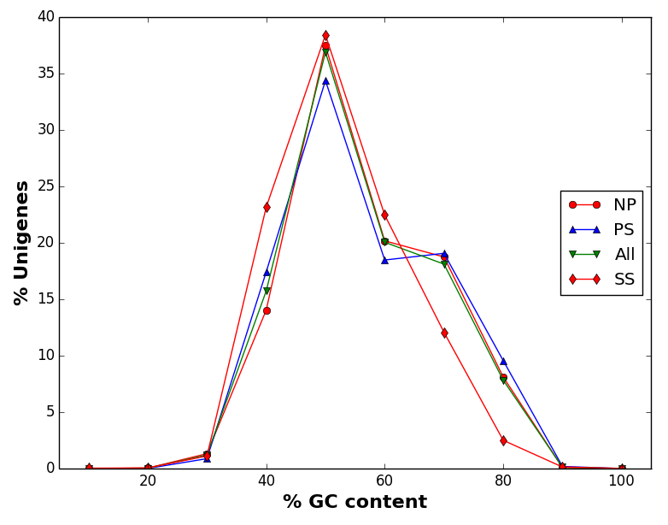
Figure S4 A histogram showing the GC content distribution in different sets of genes of Spartina alterniflora.
NP, set of genes having similarity outside of poaceae; PS, poaceae specific genes; All, whole S. alterniflora
transcriptome; and SS, S. alterniflora-specific genes.

Slide 5
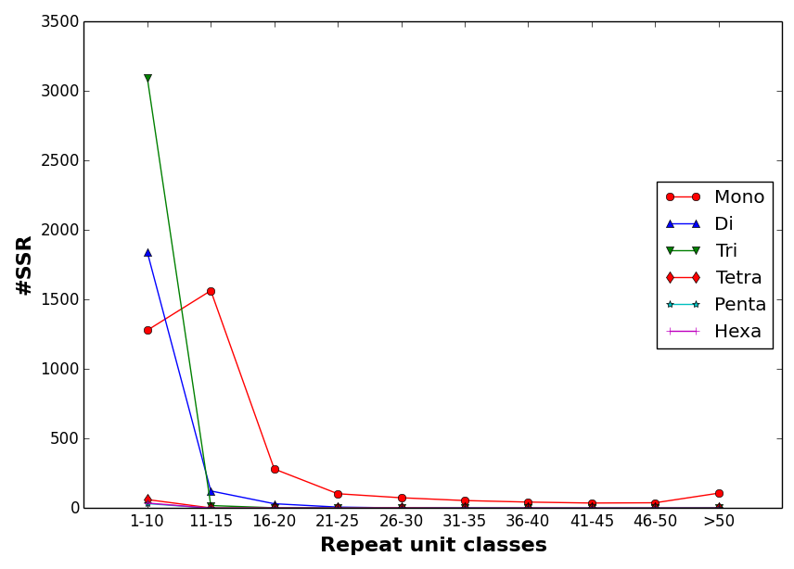
Figure S5 Distribution of different repeat unit size of the SSRs identified in Spartina alterniflora
transcriptome

Slide 6
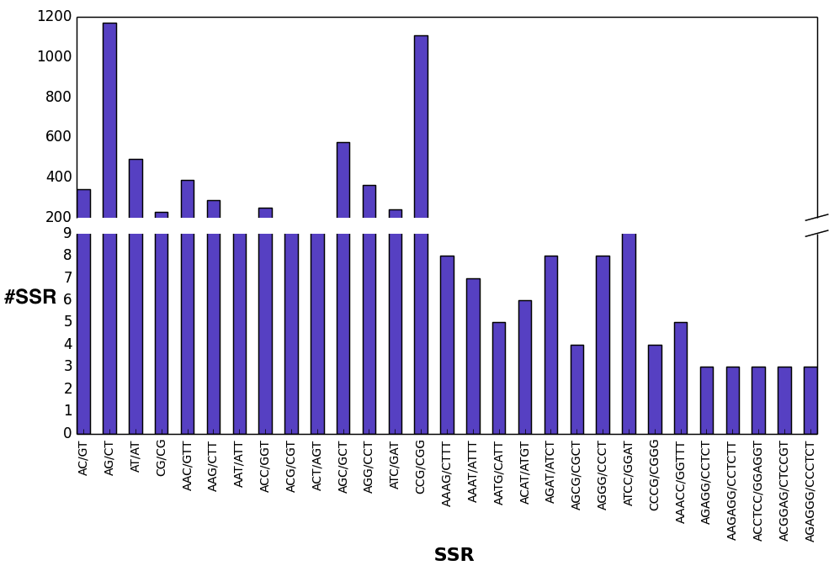
Figure S6 Distribution of different types of SSR motifs in Spartina alterniflora unigenes

Slide 7
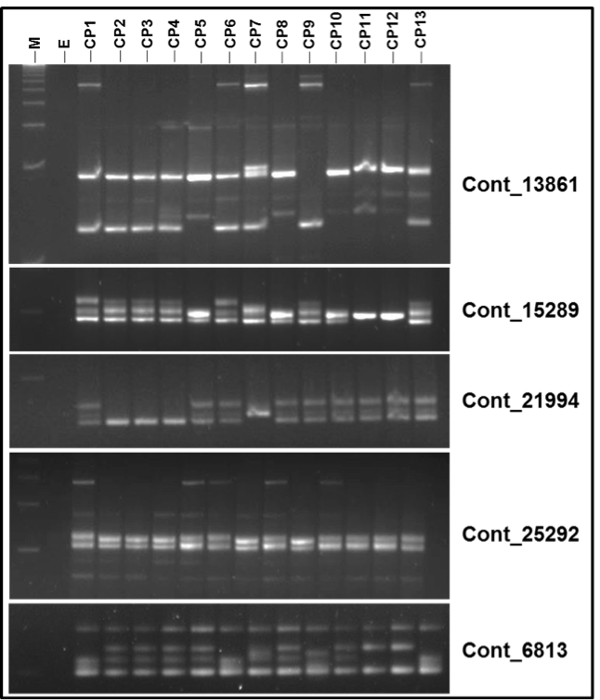
Figure S7 Representative gel showing DNA profile of 13 (CP1 through CP13) Spartina alterniflora accessions
produced by five SSR primers derived from the contigs

