Slide 1
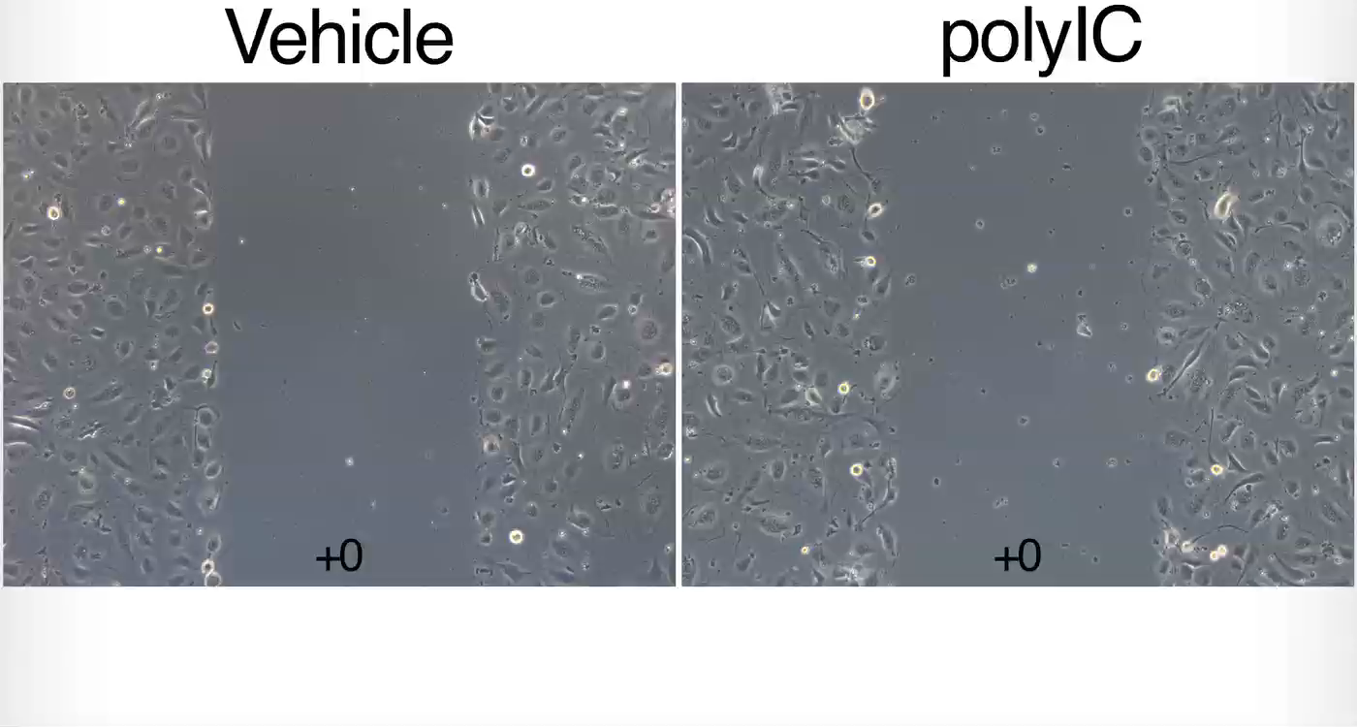
Video S1: Representative video of endothelial cell migration scratch assay
Notes:
Video S1: Representative video of endothelial cell migration scratch assay. The video is a composition of sequential photographs taken every 3 minutes after physically scratching a cell-free strip. Vehicle (left) and polyIC (right) stimulated cells.

