Slide 1
Additional file 7 - RIPcal analysis of transposable element families on the core and the supernumerary genome. A comprehensive RIPcal analysis was performed on the core and the supernumerary genome separately. On the core genome, there are 13 families that show RIPcal patterns that are typical for RIP (dominance of CpA → TpA mutations; red trace). On the supernumerary genome, there are no such instances.

Slide 2
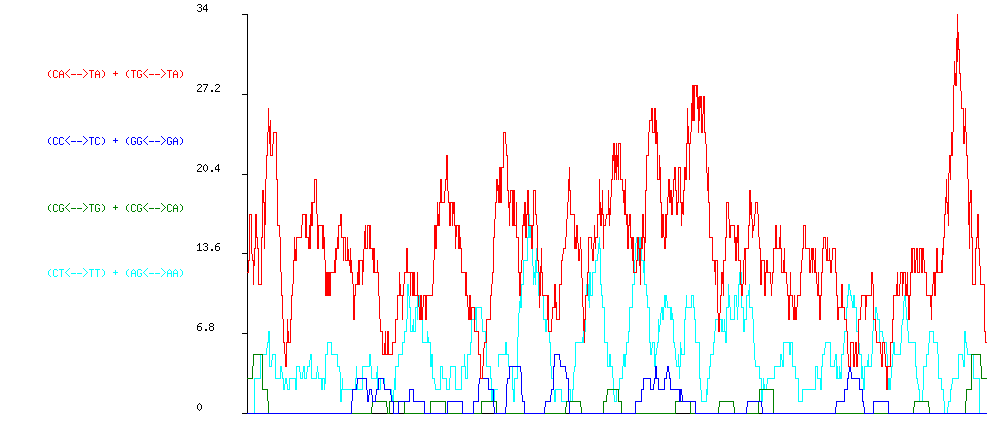
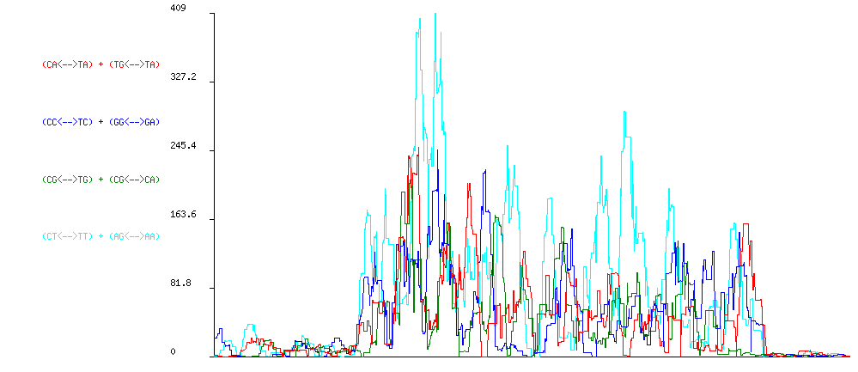
CORE
SUPERNUMERARY
DTF_Fot2.

Slide 3
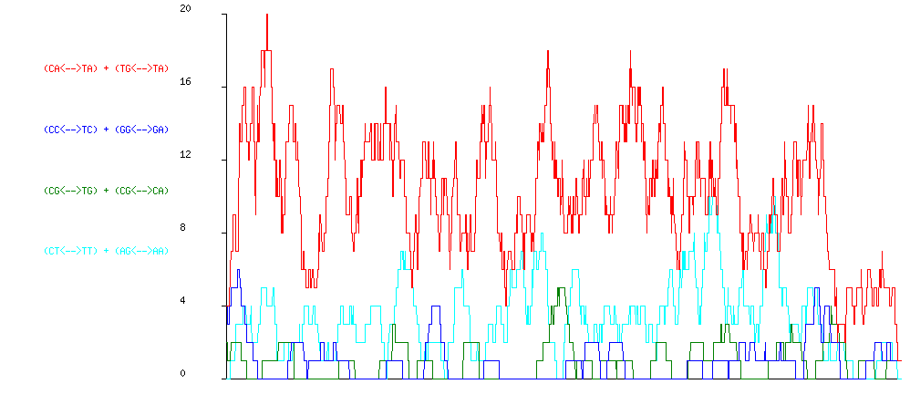
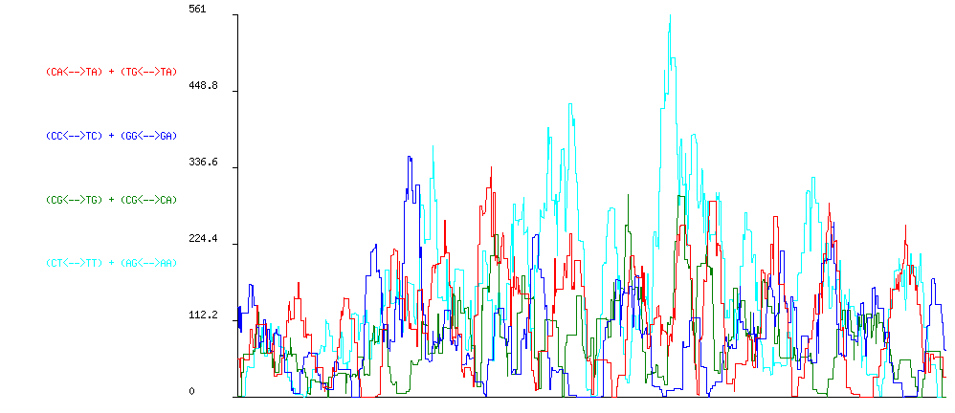
CORE
SUPERNUMERARY
DTF_Fot3-A.

Slide 4
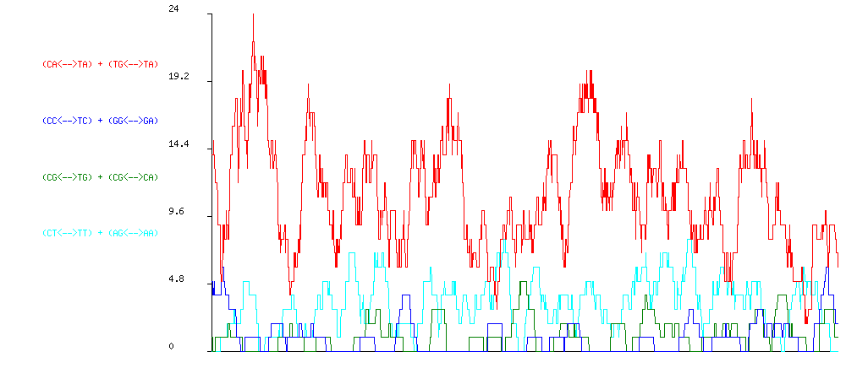
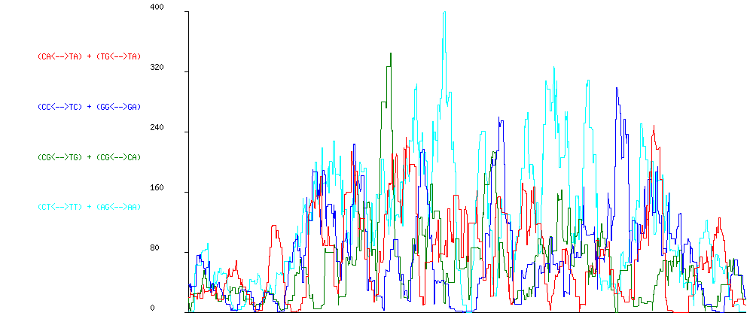
CORE
SUPERNUMERARY
DTF_Fot3-B.

Slide 5
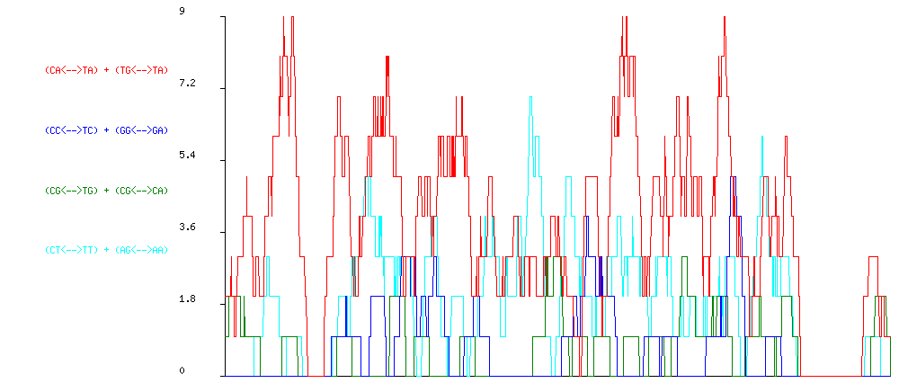
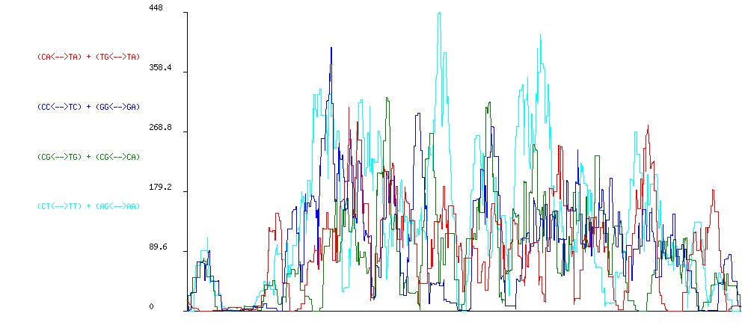
CORE
SUPERNUMERARY
DTF_Fot3-C.

Slide 6
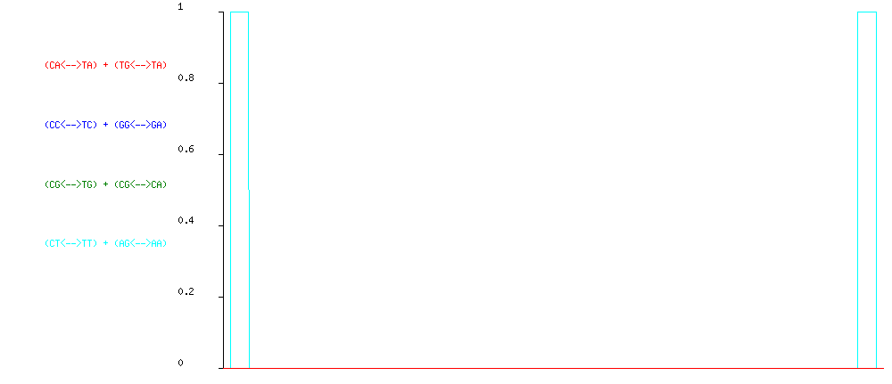
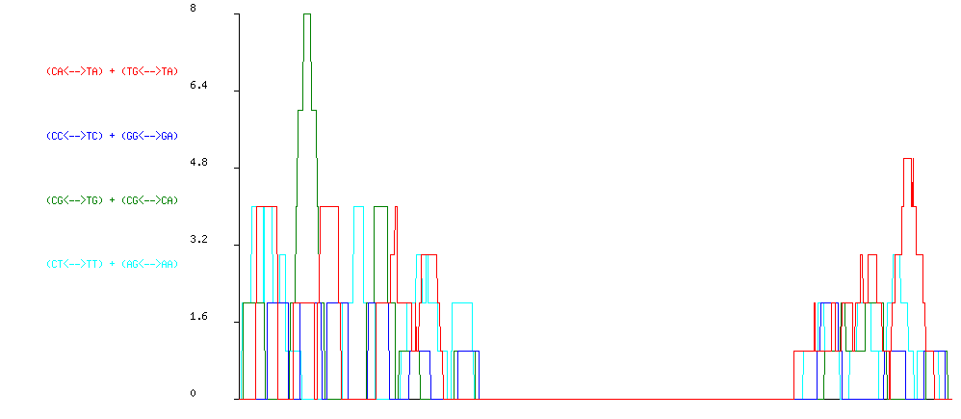
CORE
SUPERNUMERARY
DTF_Fot4.

Slide 7
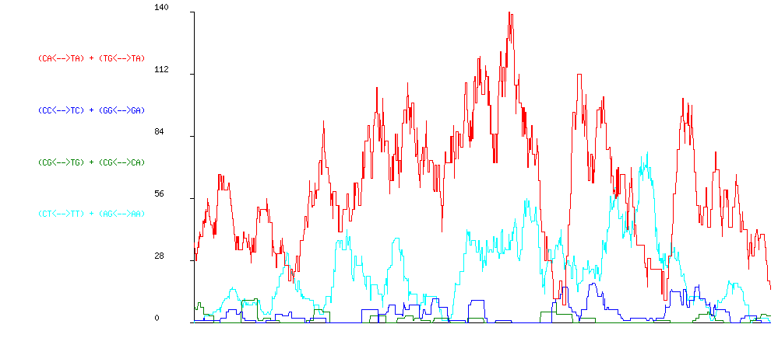
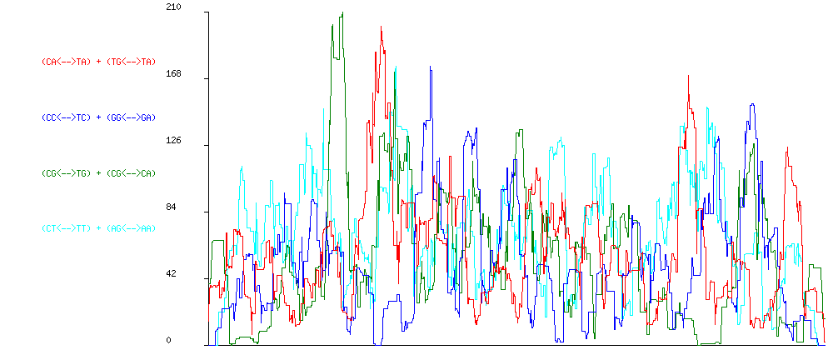
CORE
SUPERNUMERARY
DTF_Fot5-A.

Slide 8
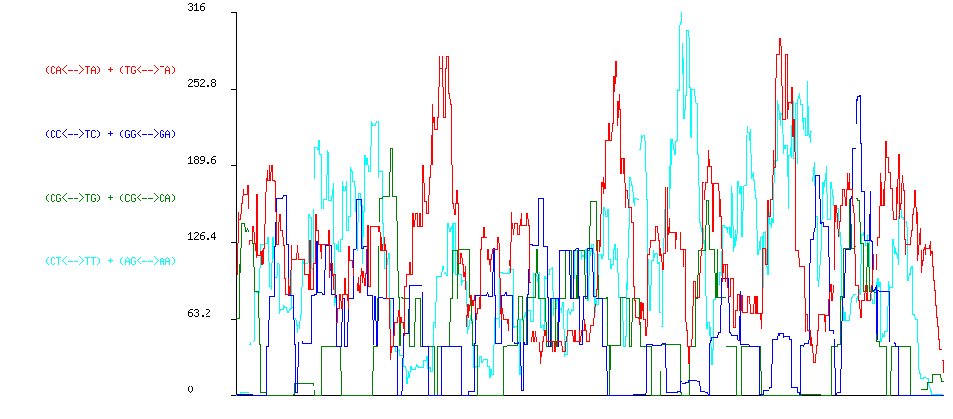
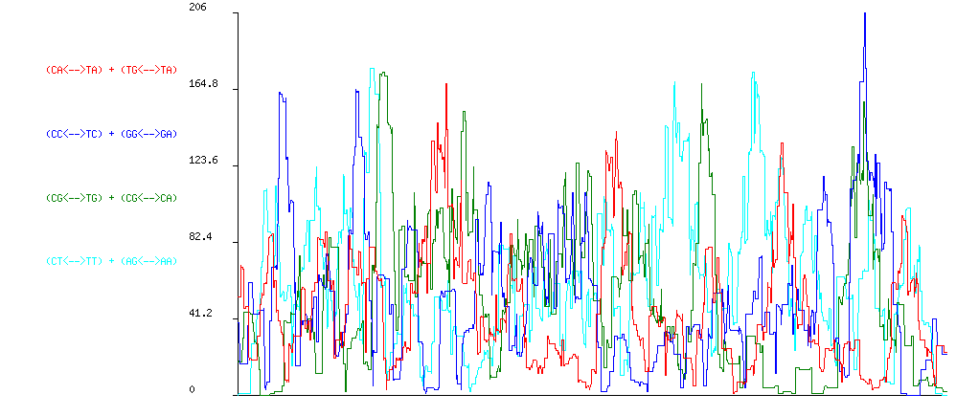
CORE
SUPERNUMERARY
DTF_Fot5-C.

Slide 9
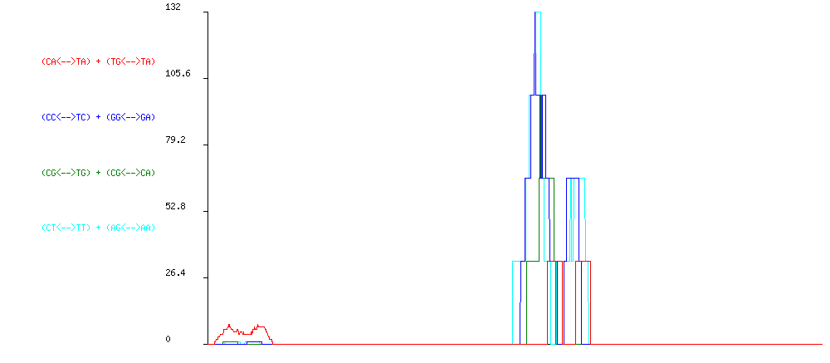
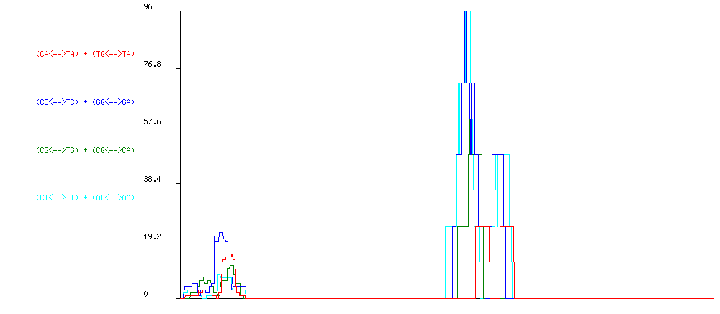
CORE
SUPERNUMERARY
DTF_Fot8.

Slide 10
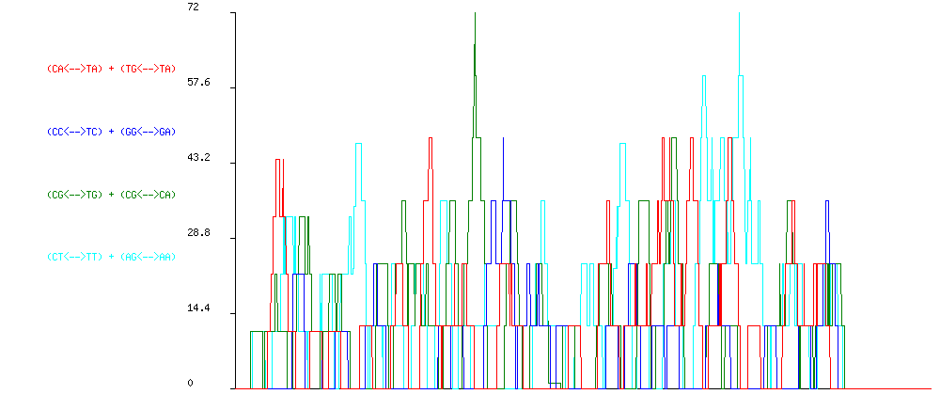
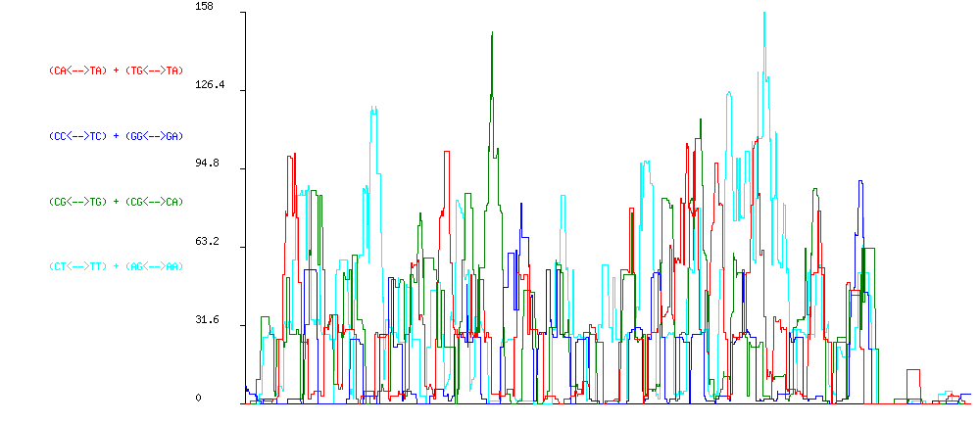
CORE
SUPERNUMERARY
DTF_ESP4-A.

Slide 11
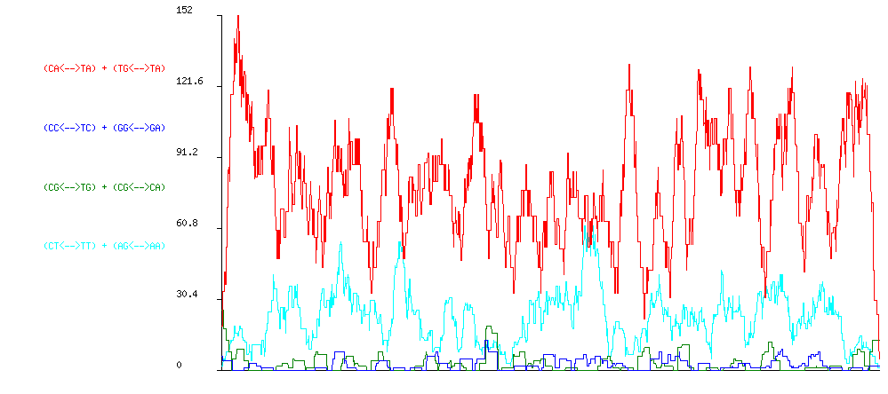
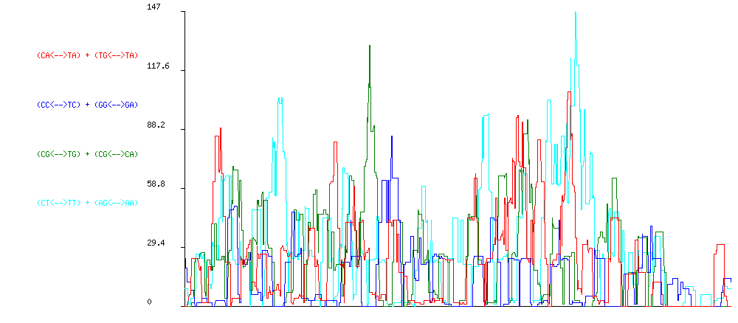
CORE
SUPERNUMERARY
DTF_ESP4-B.

Slide 12
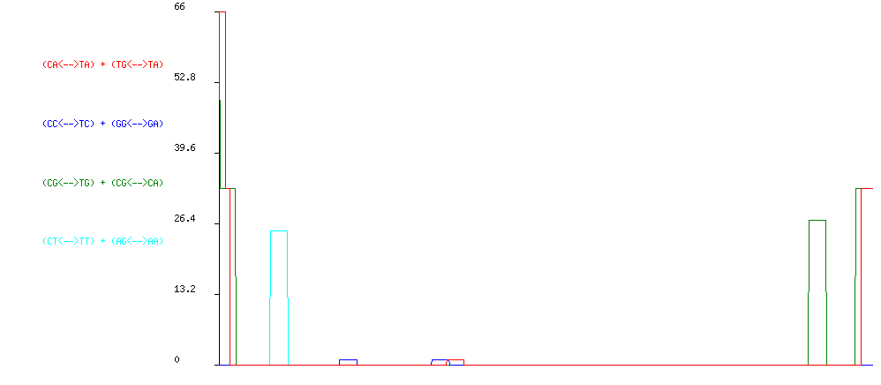
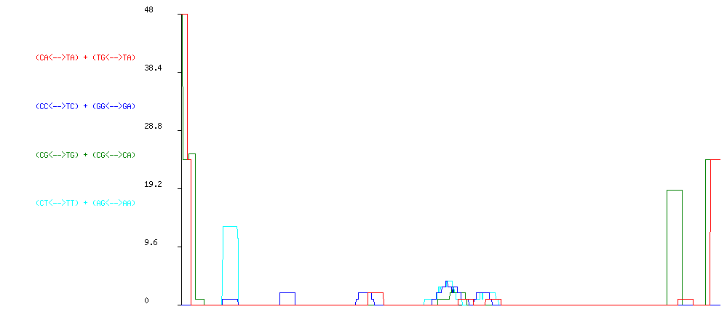
CORE
SUPERNUMERARY
DTF_Drogon.

Slide 13
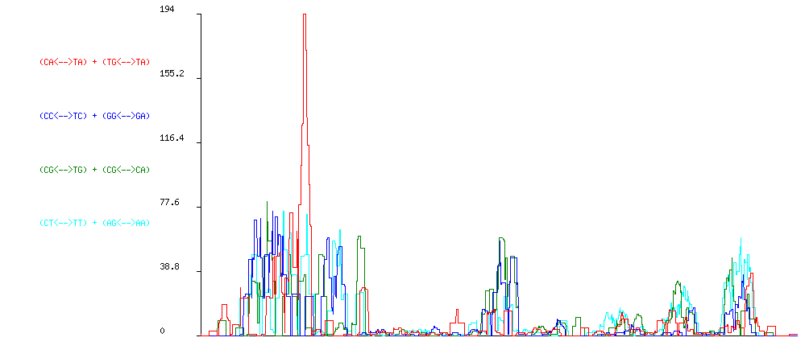
CORE
no alignment can be made on the core genome
SUPERNUMERARY
DTF_Obara.

Slide 14
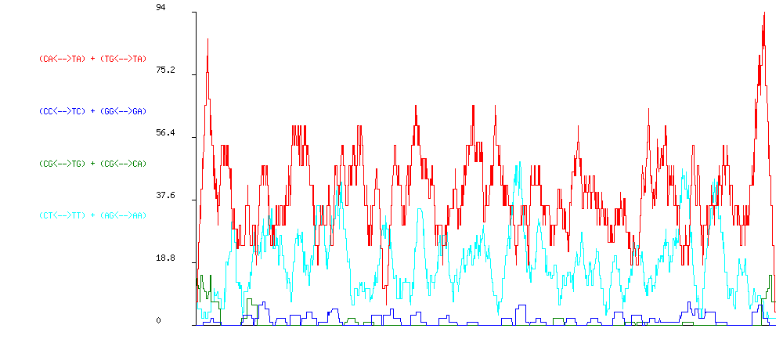
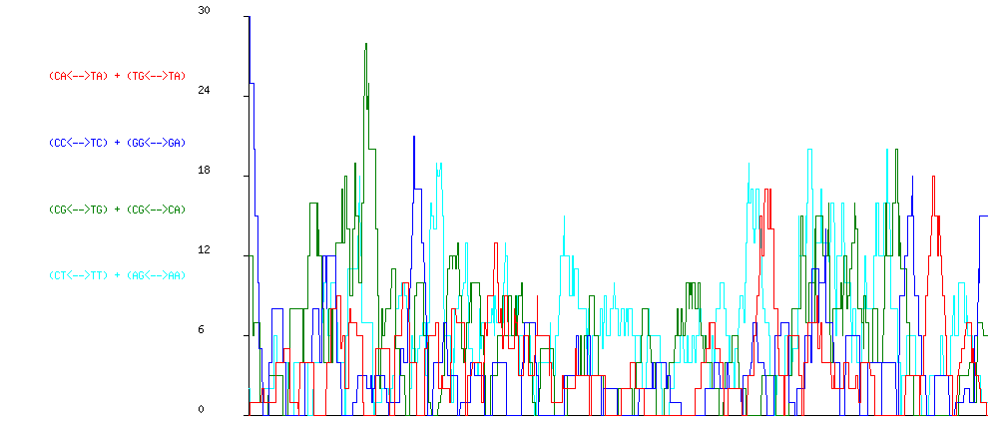
CORE
SUPERNUMERARY
DTF_Viserion.

Slide 15
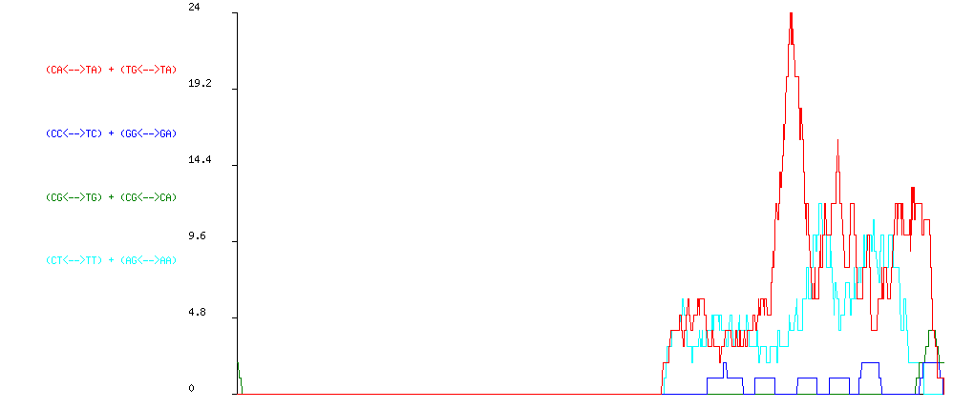
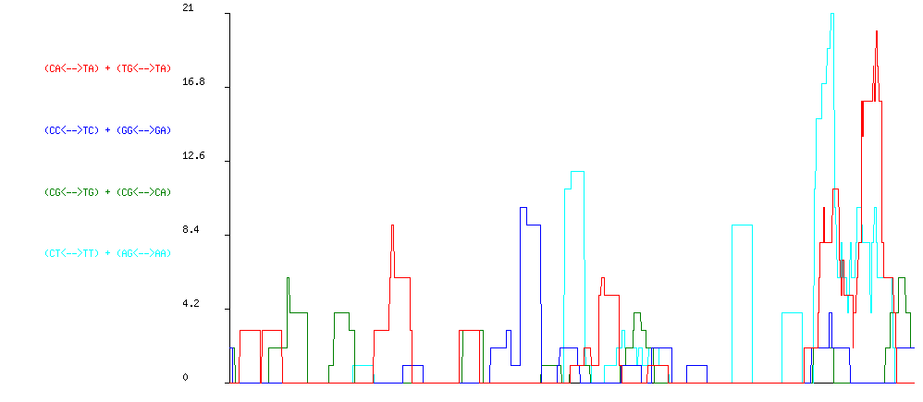
CORE
SUPERNUMERARY
DTF_Rhaegal.

Slide 16
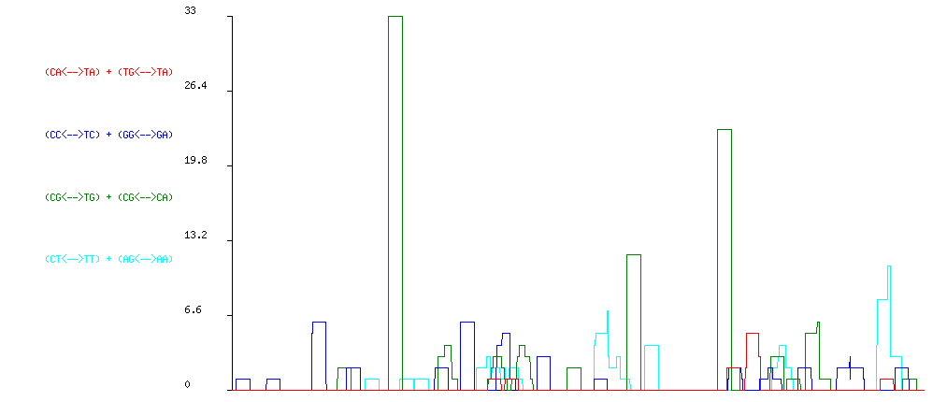
CORE
no alignment can be made on the core genome
SUPERNUMERARY
DTA_Nymeria.

Slide 17
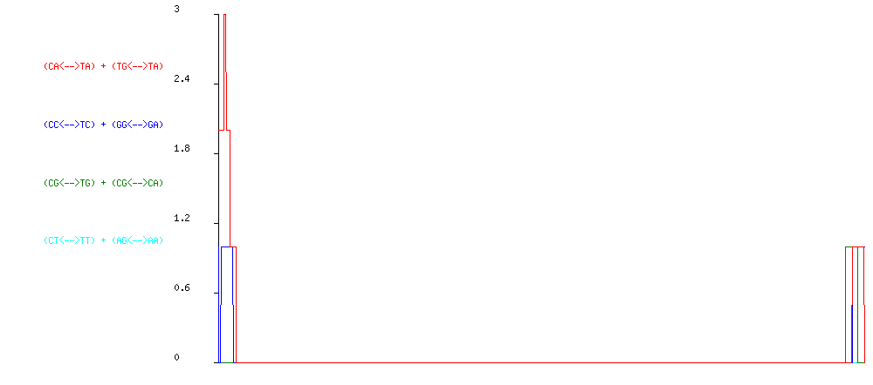
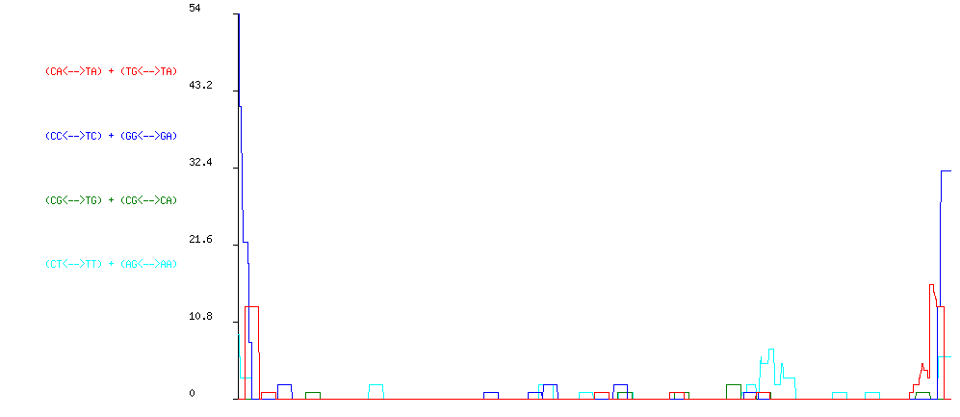
CORE
SUPERNUMERARY
DTF_Balerion.

Slide 18
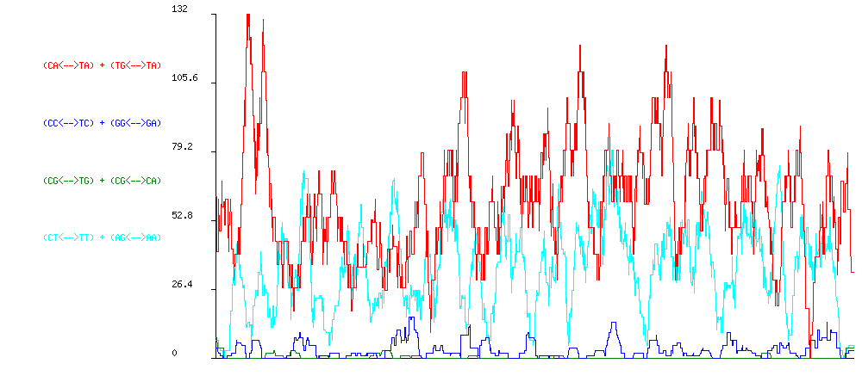
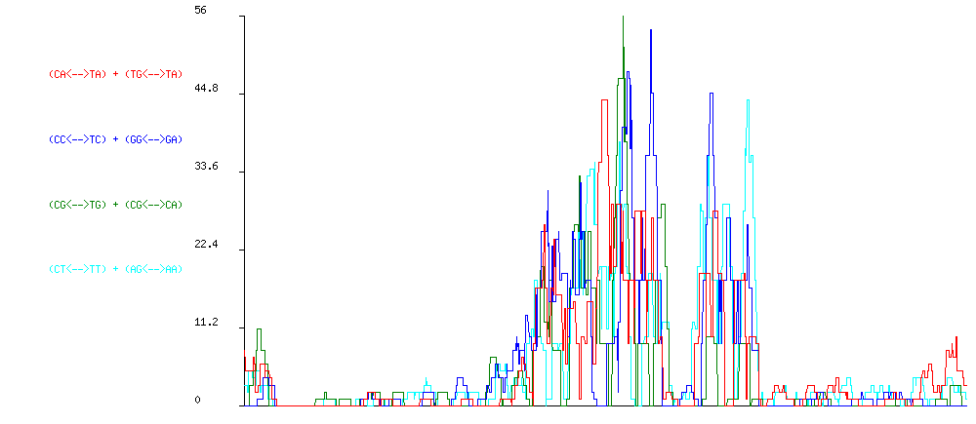
CORE
SUPERNUMERARY
DTM_Hop7.

Slide 19
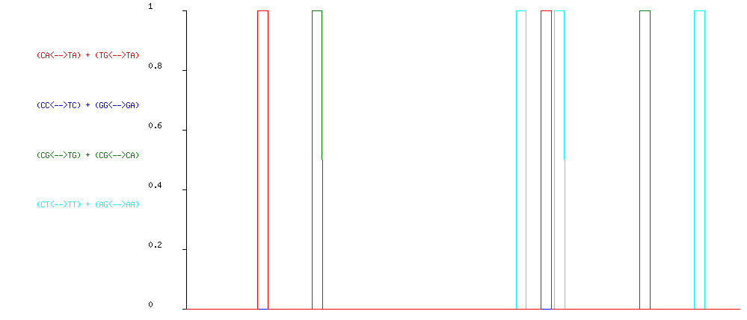
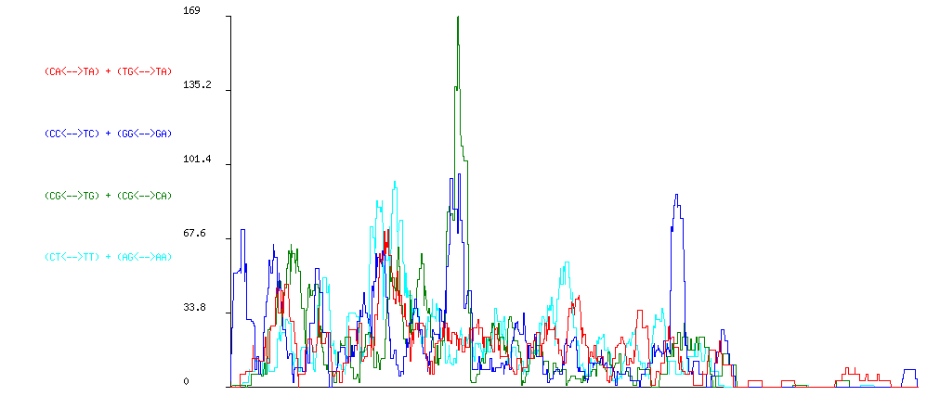
CORE
SUPERNUMERARY
DTM_Hop4.

Slide 20
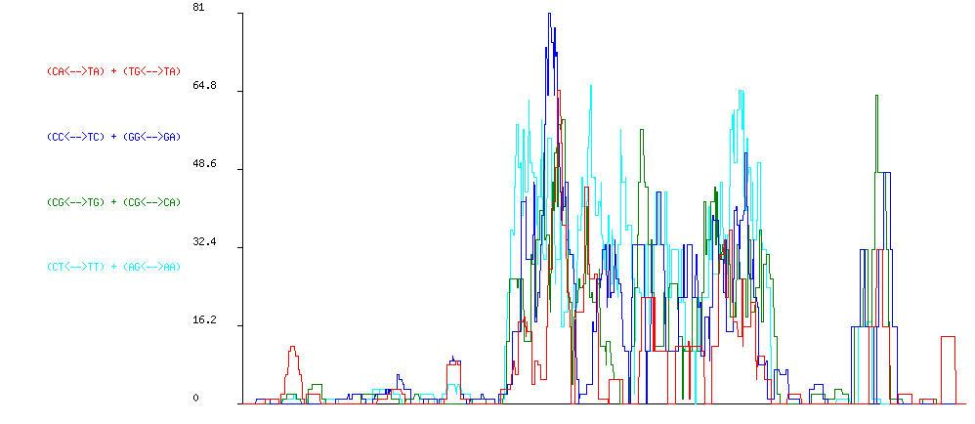
CORE
no alignment can be made on the core genome
SUPERNUMERARY
DTA_RLT1.

Slide 21
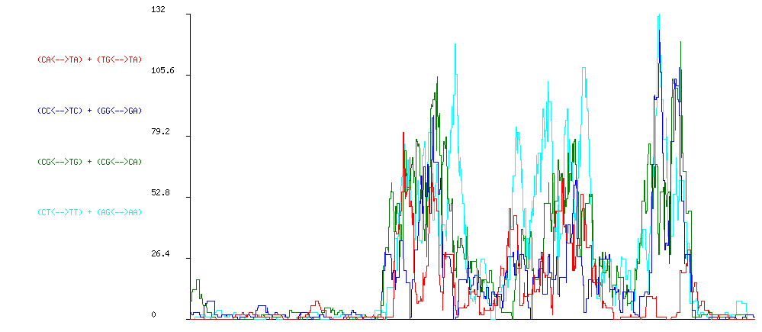
CORE
no alignment can be made on the core genome
SUPERNUMERARY
DTA_RLT2.

Slide 22
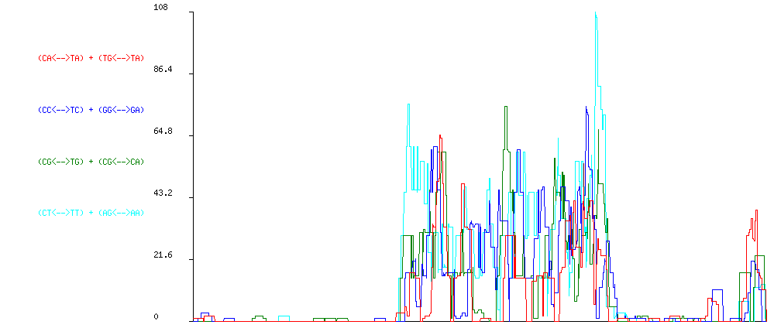
CORE
no alignment can be made on the core genome
SUPERNUMERARY
DTA_RLT3.

Slide 23
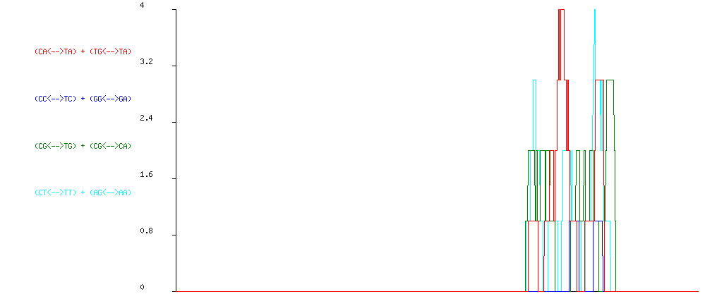
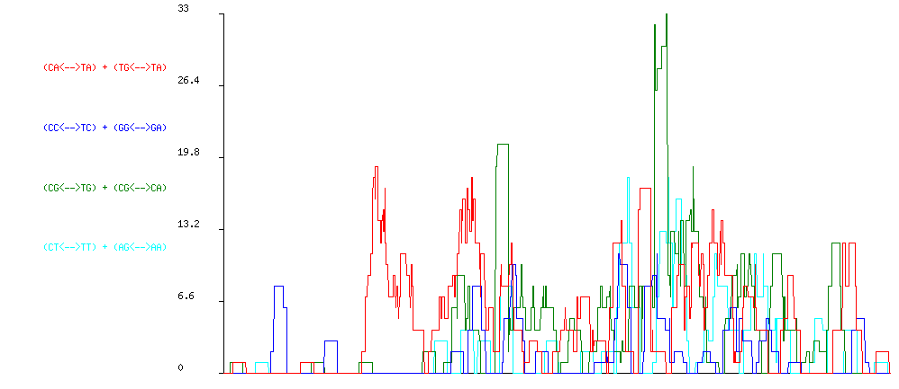
CORE
SUPERNUMERARY
DTA_Tfo1.

Slide 24
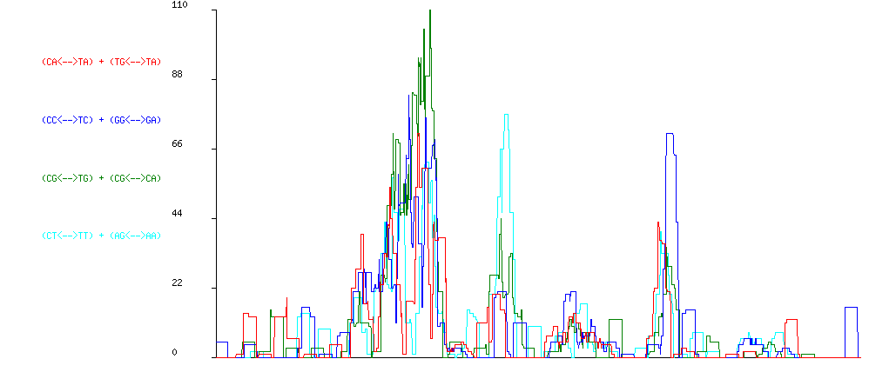
CORE
no alignment can be made on the core genome
SUPERNUMERARY
DTA_Tfo2.

Slide 25
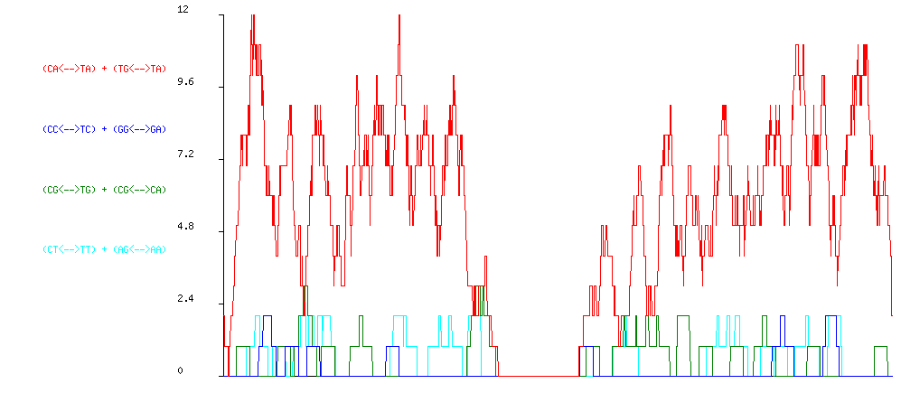
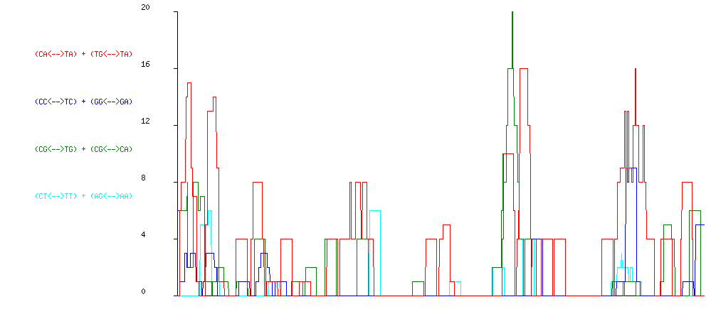
CORE
SUPERNUMERARY
DTA_Hornet1.

Slide 26
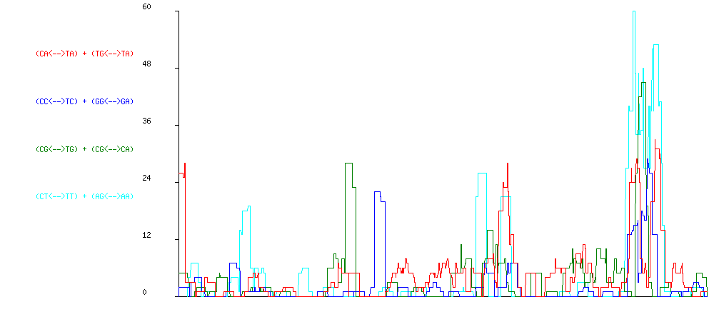
CORE
no alignment can be made on the core genome
SUPERNUMERARY
DTA_Hornet2.

Slide 27
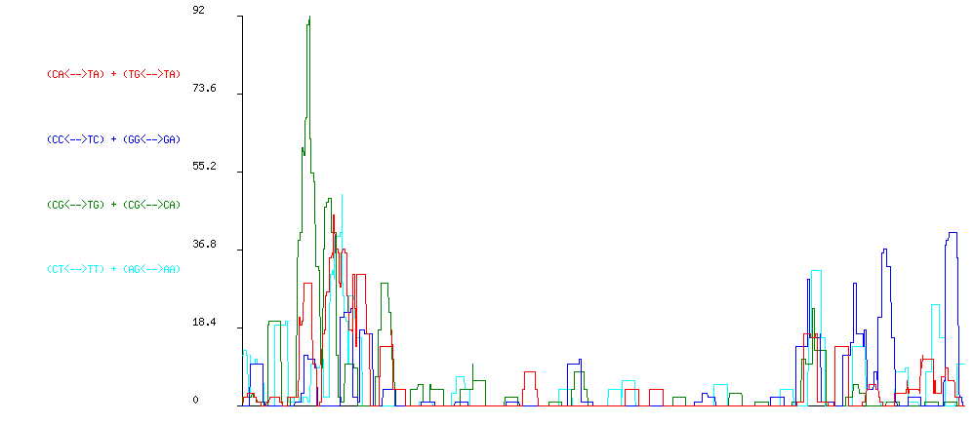
CORE
no alignment can be made on the core genome
SUPERNUMERARY
DTA_Hornet3.

Slide 28
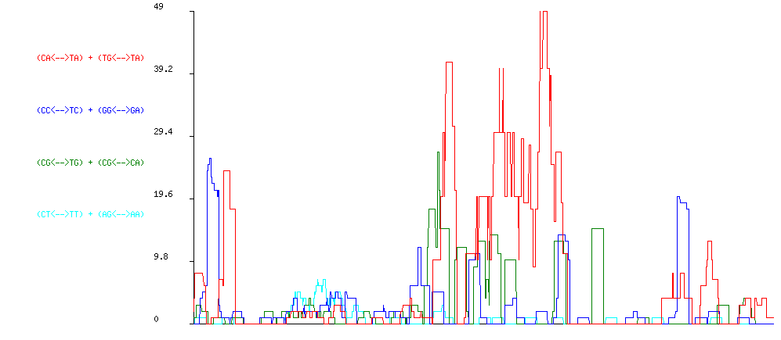
CORE
no alignment can be made on the core genome
SUPERNUMERARY
DTA_Drifter.

Slide 29
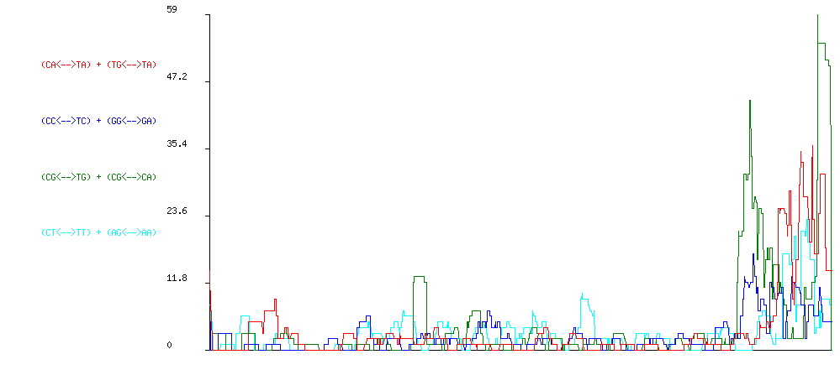
CORE
no alignment can be made on the core genome
SUPERNUMERARY
DTA_Obella.

Slide 30
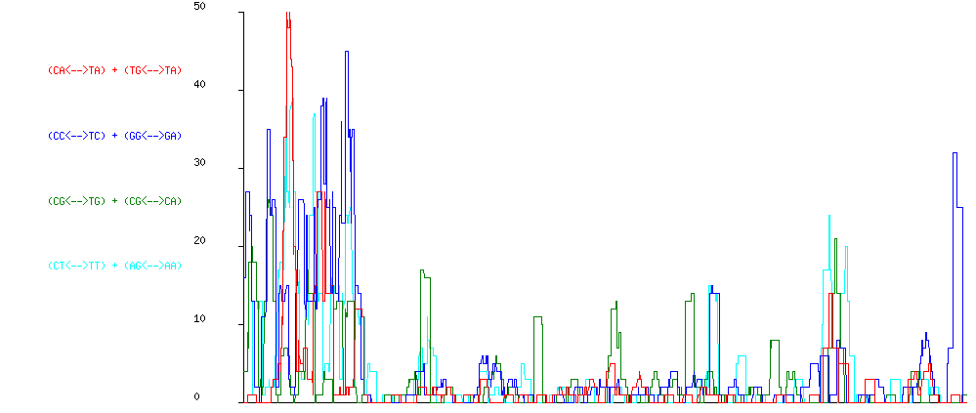
CORE
no alignment can be made on the core genome
SUPERNUMERARY
DTA_Sarella.

Slide 31
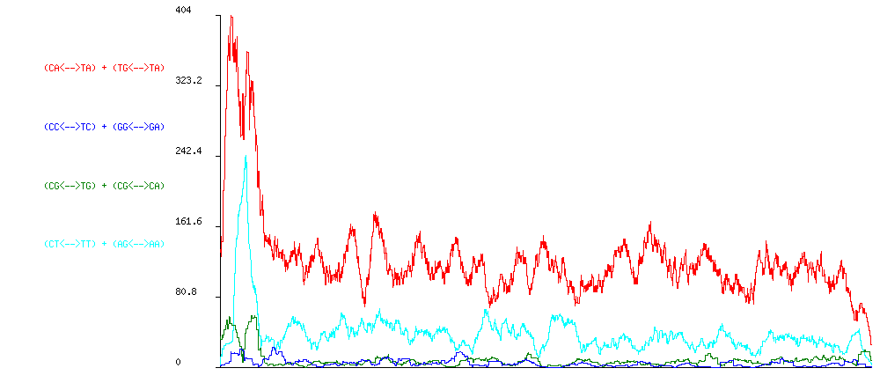
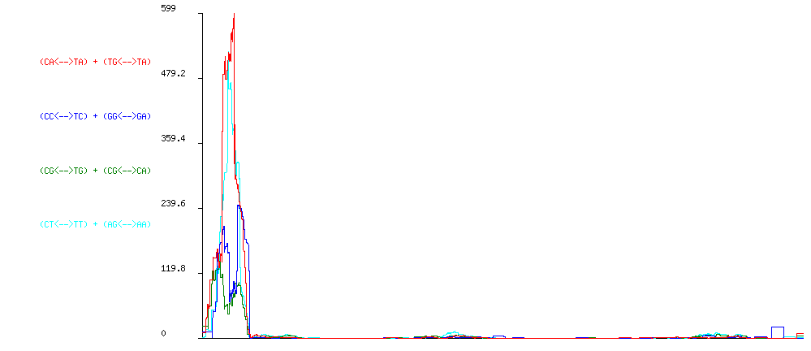
CORE
SUPERNUMERARY
RLG_Skippy.

Slide 32
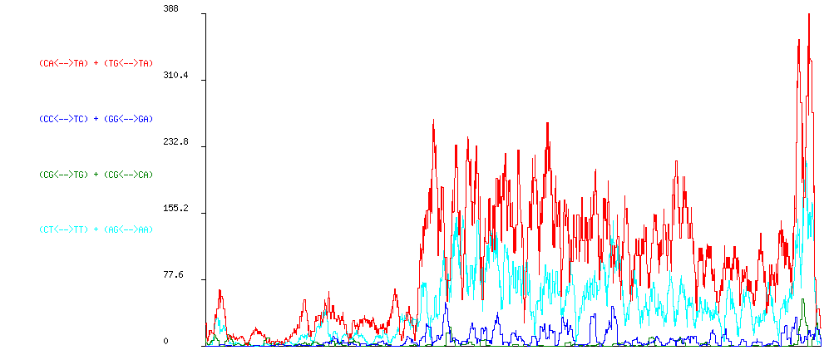

CORE
SUPERNUMERARY
RLG_Maggy.

Slide 33


CORE
SUPERNUMERARY
RLC_Ghost.

Slide 34

CORE
no alignment can be made on the core genome
SUPERNUMERARY
Rxx_Marsu.

