Slide 1
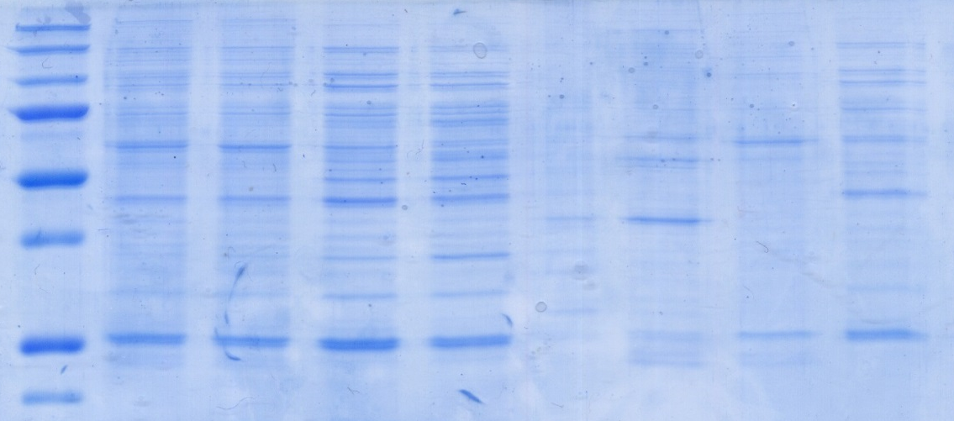
A
Supernatants
Pellets
kDa
M
0%
20%
40%
60%
0%
20%
40%
60%
250
150
100
75
50
37
25
B
Supernatants
Pellets
OD/μg Total Protein
C
nmol/min/μg
Figueroa-Teran et al., Supplementary Figure 1

