Slide 1
Figure S1. Expression patterns of CD169, CD8 and CD68 proteins in tumor-draining LNs of CRC patients.
Immunofluorescence microscopy of LN sections from tumor-draining LNs of human CRC stained with anti-CD169 (green), anti-CD8 (red) and anti-CD68 (cyan) monoclonal antibodies and DAPI (blue). Split joint of the micrographs at higher magniﬁcation to show the expression patterns of CD169, CD8 and CD68 signals with a general image of the location of CD169⁺CD8⁺ T cells. Bar, 500 µm.
500 μm
CD169 CD8 CD68 DAPI

Slide 2
40um
10um
CD169 CD8 CD3 DAPI
Figure S2. Detection of CD169⁺ staining on CD8⁺CD3⁺ T lymphocytes.
Immunofluorescence microscopy of LN sections stained with anti-CD169 (green), anti-CD8 (red) and anti-CD3 (blue) monoclonal antibodies and DAPI (cyan). Data are representative of at least three experiments.

Slide 3
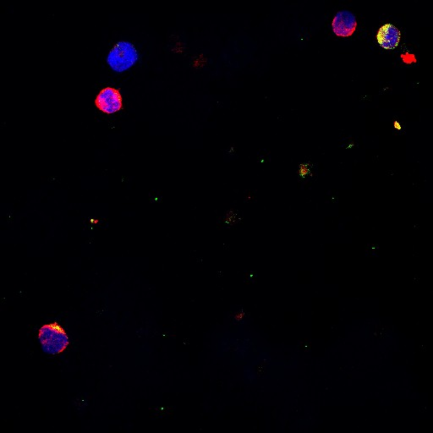
A
Tissue
Tonsil
LN
Blood
CD169
0.31
0.07
0.03
11.36
CD169
CD8
DAPI
CD8
B
Hepatocellular carcinoma
Bile duct
carcinoma
Gastric cancer
Cervical cancer
20.03
20.62
11.36
12.83
CD169
Hemangioma
Congenital Megacolon
Colorectal cancer
12.09
8.56
10.3
CD8
Figure S3. Detection of CD169⁺CD8⁺ T cells.
(A) FACS analysis of CD169⁺CD8⁺ T cells in fresh leukocytes isolated from blood, tonsil and tumor-draining LN tissues. CD169⁺CD8⁺ T cells were then sorted from digested LN suspensions using MoFlow XDP and stained with a human CD169 antibody after cytospin. (B) Samples collected from untreated fresh tumor-draining LN tissues of patients with CRC (n = 25), hepatocellular carcinoma (n = 2), bile duct carcinoma (n = 2), gastric cancer (n = 3), cervical cancer (n = 3), hemangioma (n = 2) and congenital megacolon (n = 2) were analyzed by FACS for the ratios of CD169⁺CD8⁺ T cells.

Slide 4
Figure S4. Phenotypic and functional features of CD169⁺CD8⁺ T cells in the tumor-draining LN of CRC patients.
The phenotypic characteristics of CD169⁺CD8⁺ T (CD169⁺ T_{C}) cells were determined by flow cytometry. Leukocytes from fresh LN tissues were isolated for FACS analysis. The phenotypic characteristics of CD169⁻ T_{C} cells (left) and CD169⁺ T_{C} cells (right) were determined by flow cytometry. The illustrated data are representative of at least four separate experiments.

Slide 5
A
B
Figure S5. Phenotype of CD169⁺CD8⁺ T cells.
(A) Positive correlations between levels of CD69⁺CD8⁺ and CD169⁺CD8⁺ T leucocytes (n = 15). (B) Positive correlations between levels of HLA-DR⁺CD8⁺ and CD169⁺CD8⁺ T leucocytes. Samples used in A and B were tumor-draining LN from CRC patients (n = 11).

Slide 6
Figure S6. Memory CD169⁺CD8⁺ T cells showed higher expression of CD127.
CD169⁺ (red bars) and CD169⁻ (blue bars) CD8⁺ T cells gated on CD45RA⁻ T cells in tumor-draining LNs compiled from 25 donors. Cervical carcinoma (CC), n = 13; colorectal cancer (CRC), n = 8; gastric carcinoma (GC), n = 4. CD169⁺CD8⁺ memory T cells expressed a higher CD127 level than CD169⁻CD8⁺ memory T cells in LNs.

Slide 7
A
CRC
B
GC
C
CC
Figure S7. Phenotypic and functional features of CD169⁺CD8⁺ T cells in the tumor-draining LN of CRC, GC and CC.
Phenotypic characteristics of CD169⁺CD8⁺ T cells in the tumor-draining LN of CRC, GC and CC were determined by flow cytometry. Results are presented as the mean ± SEM of four separate experiments.

Slide 8
A
PLN
DLN
Combined regions
CD169^{Hi}
CD169^{Hi}
CD169^{HiHi}
CD169^{Lo}
⇒   
⇒   
CD169^{Het}
⇒   
CD169^{Lo}
CD169^{LoLo}
CD169^{Hi}
CD169^{Hi}
CD169^{HiHi}
⇒  
⇒   
CD169^{Het}
⇒  
CD169^{Lo}
CD169^{Lo}
CD169^{LoLo}
B
PLN
DLN
Combined regions
CD8^{Hi}
CD8^{Hi}
CD8^{HiHi}
⇒   
⇒   
CD8^{Het}
⇒   
CD8^{Lo}
CD8^{Lo}
CD8^{LoLo}
CD8^{Hi}
CD8^{Hi}
CD8^{HiHi}
⇒
CD8^{Lo}
CD8^{Het}
CD8^{Lo}
CD8^{LoLo}
Figure S8. Prognostic significance of CD169⁺ cells and CD8⁺ T cells in CRC patients.
Cumulative OS and DFS times were calculated by the Kaplan-Meier method and analyzed by the log-rank test. The patients were divided into two groups according to the median value of CD169⁺ cells or CD8⁺ T cells in PLN, DLN or combined regions.

