Slide 1
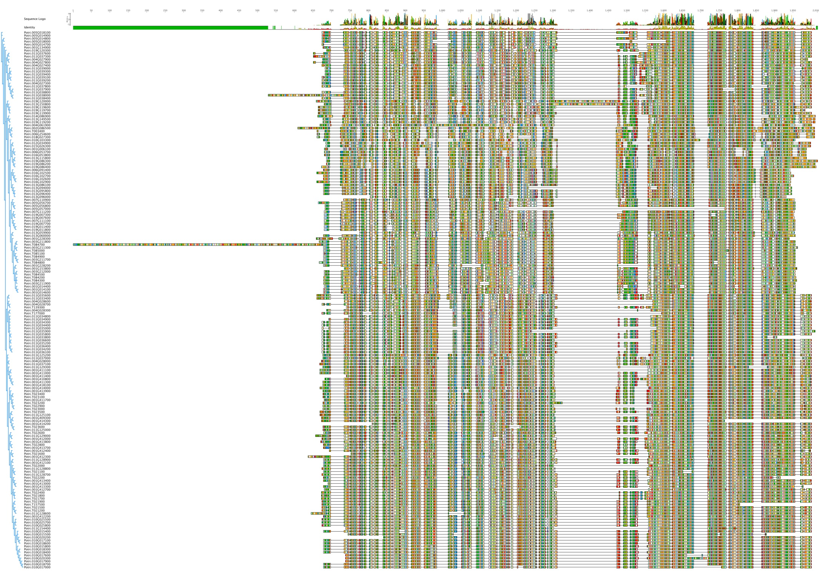
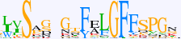

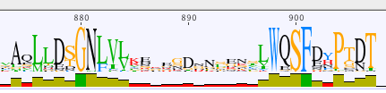
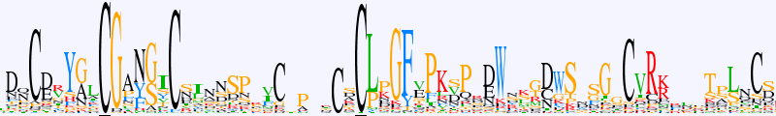
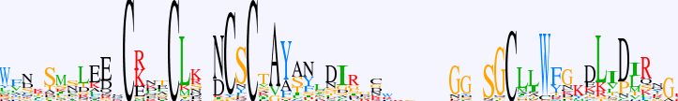
A
a
b
c
C rich
PK
d
e
Bulb lectin
S-locus
glycoprotein
EGF
PAN
TM
Protein kinase
DUF3403
B
a
4
Bits
b
0
4
Bits
c
0
4
Bits
d
0
4
Bits
C-rich I
0
e
4
Bits
C-rich II
0

