Slide 1
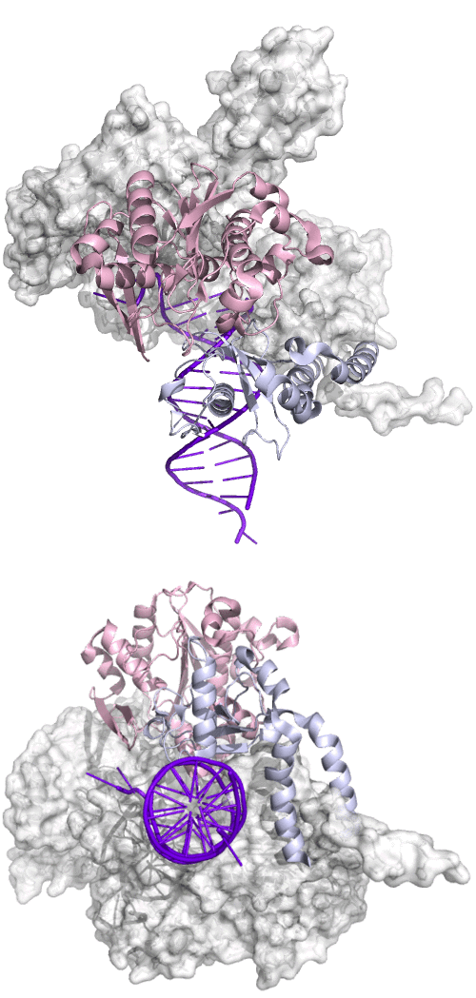

Movie S1. Near-far concerted motions of the exo and thumb domains. The DNA duplex is in purple. The exo and thumb domains are in pink and light blue ribbons, respectively. The rest of the protein is in white surface. This movie is produced from back-calculated structures from near to far conformation in Fig. 2d. Viewed from the axis of the DNA duplex (lower panel), the exo and thumb turn clockwise and thread towards the 5’ end of the template. From an orthogonal view (upper panel), these motions are perpendicular to the minor grove at the point where Lys800 of the thumb is inserted into the minor grove. DNA motion is omitted in this movie. See also Fig. 6m for the rotation and Movie S2 for translocation of DNA.

