Slide 1
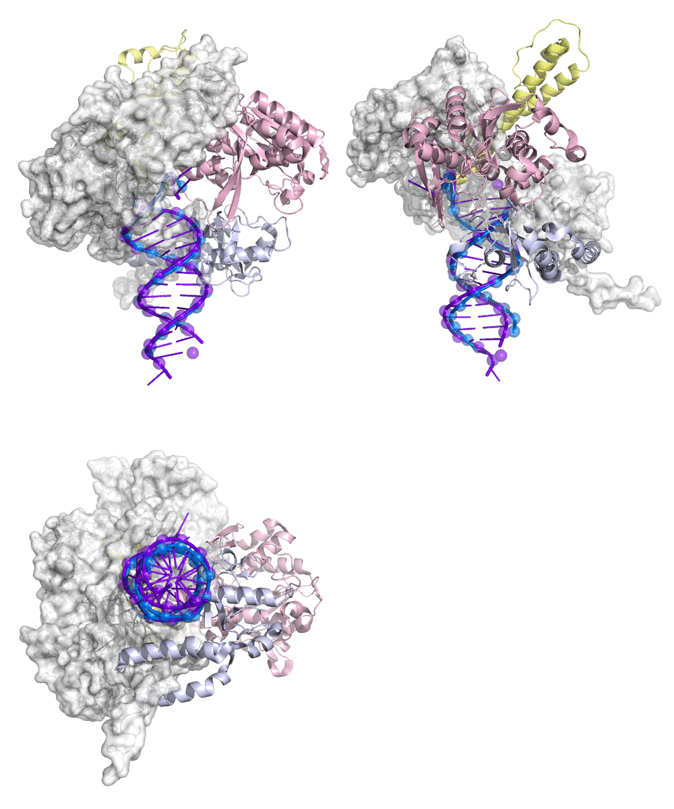

Movie S3. Switching of active sites. Three orthogonal views are shown. A reference DNA duplex is in purple. The DNA duplex in transit is in blue. P atoms are shown as spheres. The exo, thumb, and fingers domains are in pink, light blue, and yellow ribbons, respectively. The rest of the protein is in white surface. This movie is produced from the back-calculated structures along the spline curve in Fig. 7.

